Slide 1


WGNE Blue Book - status and proposed changes
Elena Astakhova
with contributions from
Michael Tsyrulnikov and Hideaki Kawai
Roshydromet

Slide 2


Motivation
Good memories
Work with the Blue Book in 2015
Suggestion from my colleagues to introduce some changes

Slide 3
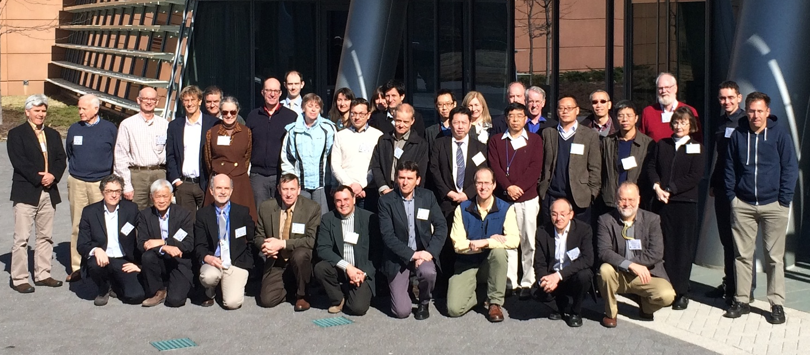
The history - how it all began
Selected Landmarks in the History of WGNE and Related Programs
1967 WGNE (Working Group on Numerical Experimentation) established by JOC for GARP
1985 First Session of WGNE, re-established for WCRP JSC and CAS, Boulder
W. Lawrence Gates
“Comments on the History of the Working Group on Numerical Experimentation “
WGNE30

Slide 4
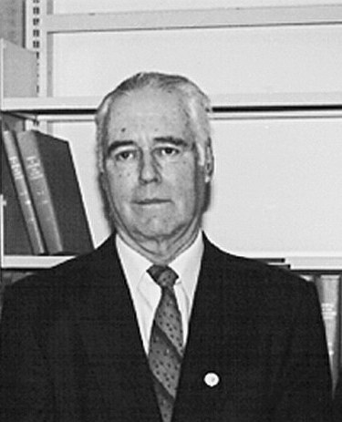
The history - how it all began
André Robert
The first Canadian scientist to successfully perform a simulation of the atmosphere’s general circulation using a computer model.
He was a founding member and one of the first chairs of the Working Group on Numerical Experimentation (WGNE) a very influential group of researchers established in the early 1970s that oversaw the development of modern day climate science and meteorology.
1970-1976 Member, Working Group on Numerical Experimentation, World Meteorological Organisation (WMO)
1971-1973 Chair, Working Group on Numerical Experimentation, WMO
1972-1973 President, Canadian Meteorological and Oceanographic Society
1972-1977 Editor, Research Activities in Atmospheric and Oceanic Modelling, WMO
Notes:
Professional appointments

Slide 5
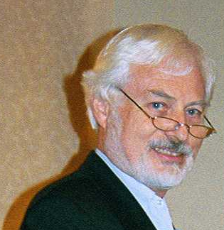
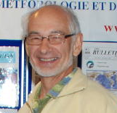
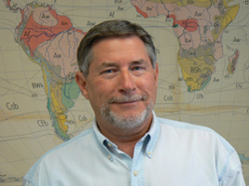

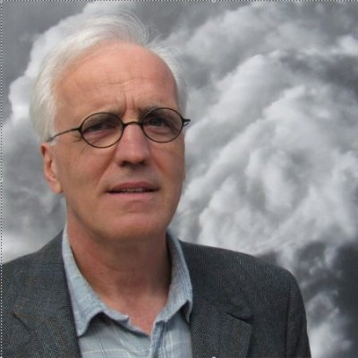
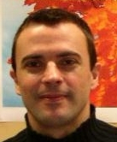

The history - how it all progressed
Who took care of the book
1977-1978 Richard Asselin
1979-1984 Ian D. Rutherford
1984-1995 George Boer
1996-1998 Andrew Staniforth
1999-2002 Harold Ritchie
Initiated the electronic version
Still ~ 200 copies were printed and mailed from Montreal
2003-2010 Jean Côté
No paper version since 2006
2011-2014 Ayrton Zadra

Slide 6
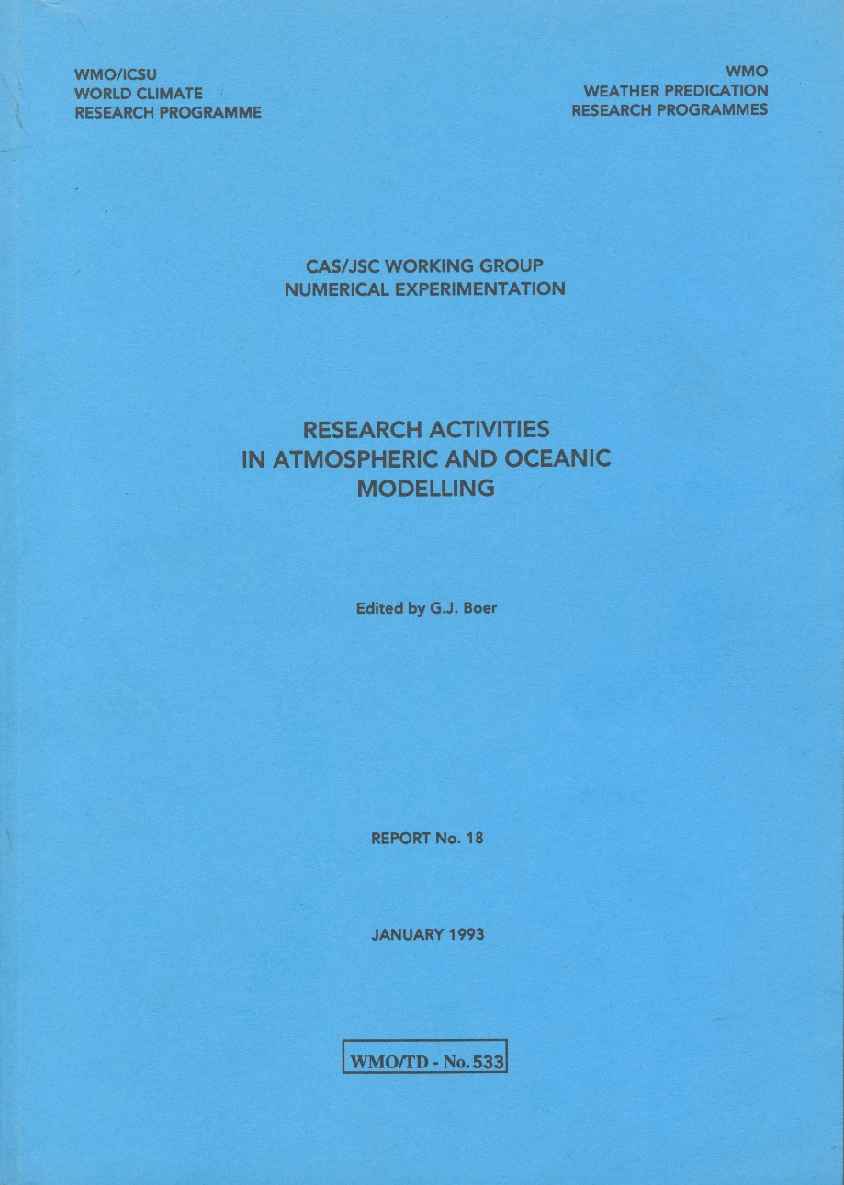
The history - how it all progressed
In 1992 the "call for contributions" was sent to approximately 750 scientists worldwide
In 2002, to 650 scientists
Now, to
wgnemembers@wcrp-climate.org
wgneexofficios@wcrp-climate.org
Mailing list ~100 scientists

Slide 7
The history - how it all progressed
 | 1992 | 2015
USA | 58 | 26
Germany | 27 | 1
USSR/Russia | 22 | 17
Japan | 17 | 26
Canada | 15
UK | 16
France | 10 | 5
Australia | 9
ECMWF | 6
Total:
1992 : 203
2015 : 77
1992: Romania (4), Netherlands (4), Denmark (3) , Finland (3), Yugoslavia (3),China (2),Czechoslovakia (2),New Zealand (1),Austria(1)
2015: Italy (3),China (1),Greece (1),Poland (1),Switzerland (1), Brazil(1)
Several “multi-country” papers

Slide 8
The history - how it all progressed
Total:
2002 : 158
2010: 59
2015 : 77
Distribution of papers over sections
1- assimilation
2- datasets, reanalysis
3-computing, resolution effects
4-parameterizations
5-regional models
6-global models
7-climate
8-ocean,waves
9-coupled models

Slide 9
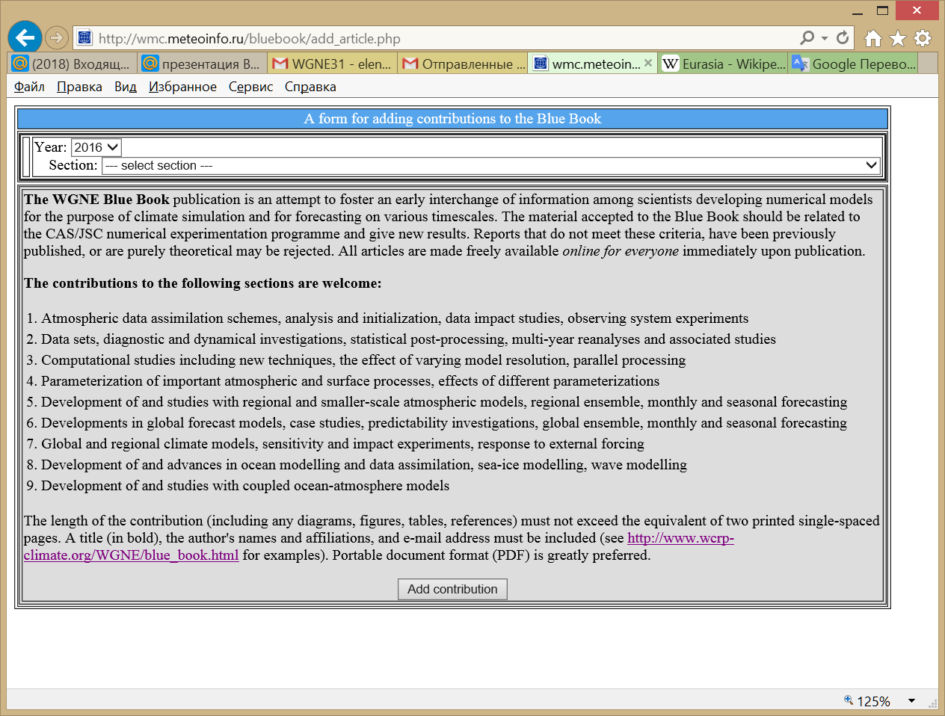
Nowadays –current status
Since 2015 the Hydrometcentre of Russia takes care of the Blue Book
Since 2016 the contributions are submitted via the Web-page
http://wmc.meteoinfo.ru/bluebook/add_article.php
User name:
science
Password:
science

Slide 10
Nowadays –current status
It’s possible to examine the downloaded files (a preliminary BB version) at http://wmc.meteoinfo.ru/bluebook
The final version will be prepared and posted in June
at http://www.wcrp-climate.org/WGNE/BlueBook.
WGNE page at the Web site of the Hydrometcenter of Russia
http://wmc.meteoinfo.ru/working-group-on-numerical-experimentation
On April 2016 there were 44 contributions.
The new contribution submission deadline is 1 May 2016.
Notes:
(the short name is given instead of full title as it’s a preliminary BB version).

Slide 11
The structure – how was it filled
The contributions are collected into subject groupings as appropriate. The range of subjects is expected to vary with time and depends on submissions received.
George J. Boer
From the Editor
Research Activities in atmospheric and oceanic modelling
Report No. 17, 1992

Slide 12
The Blue Book sections (since 2002)
Atmospheric data assimilation schemes, analysis and initialization, data impact studies, observing system experiments
Data sets, diagnostic and dynamical investigations, statistical post-processing, multi-year reanalyses and associated studies
Computational studies including new techniques, the effect of varying model resolution, parallel processing
Parameterization of important atmospheric and surface processes, effects of different parameterizations
Development of and studies with regional and smaller-scale atmospheric models, regional ensemble, monthly and seasonal forecasting
Developments in global forecast models, case studies, predictability investigations, global ensemble, monthly and seasonal forecasting
Global and regional climate models, sensitivity and impact experiments, response to external forcing
Development of and advances in ocean modelling and data assimilation, sea-ice modelling, wave modelling
Development of and studies with coupled ocean-atmosphere models
Notes:
At least since 2002 - In all electronic versions
The only change was made in 2007, in 5 (marked red)

Slide 13
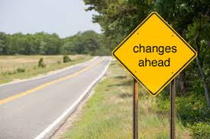
Everything changes but the Blue Book

Slide 14


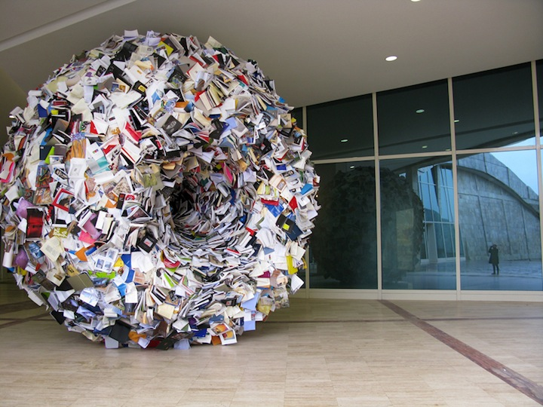
Motivation for changes – at first glance
No special sections for
Ensembles and predictability (PDEF)
Verification (JWGFVR)
Earlier there were reviews of the WGNE activities
Reports of WGNE meetings
Short description of projects and contact persons
It’s nice to continue this practice.
First step – include WGNE30 final report to BB2016
It’s easy now!
No paper version!

Slide 15
Suggested BB sections
Atmospheric and oceanic observations (in situ, satellite, radar…)
Atmospheric data assimilation (methodology,global, regional, convective-scale, diagnostic tools, reanalysis, impact studies, OSSEs)
Global and limited-area forecast models (numerics, parameterizations, effects of resolution)
Computational issues (parallel processing, GPUs,…)
Studies with numerical weather prediction models
Subseasonal and seasonal predictions
Climate and decadal modeling
Ensemble prediction (ensemble generation techniques, stochastic parameterizations, surface perturbations, calibration…)
Forecast verification (deterministic, ensemble, spatial, new approaches)
Empirical and statistical techniques (post-processing, nowcasting…)
Land surface studies (modeling, data assimilation, soil moisture)
Ocean modeling and data assimilation
Atmospheric constituents (observations, models, data assimilation, aerosols, greenhouse gases)
Coupled modeling and data assimilation (atmosphere/land/ocean/sea-ice/waves,carbon cycle)

Slide 16
Suggested changes in BB sections
Suggestions from JMA (Hideaki Kawai)
Give (recover) sequential numbers to issues
Give DOI to each report (if it is possible and easy)
Relax the page limit of 2 pages

Slide 17
Conclusions
The WGNE Blue Book publication should be considered as an attempt to foster an early interchange of information among scientists developing numerical models for the purpose of climate simulation and for forecasting on various timescales
Some changes should be introduced to BB
new sections
WGNE reports as part of BB
short information about WGNE-related projects (title, focal point, www)
doi ?
contribution size ?
3. The mailing list should be extended (advices of WGNE members are welcome)

Slide 18
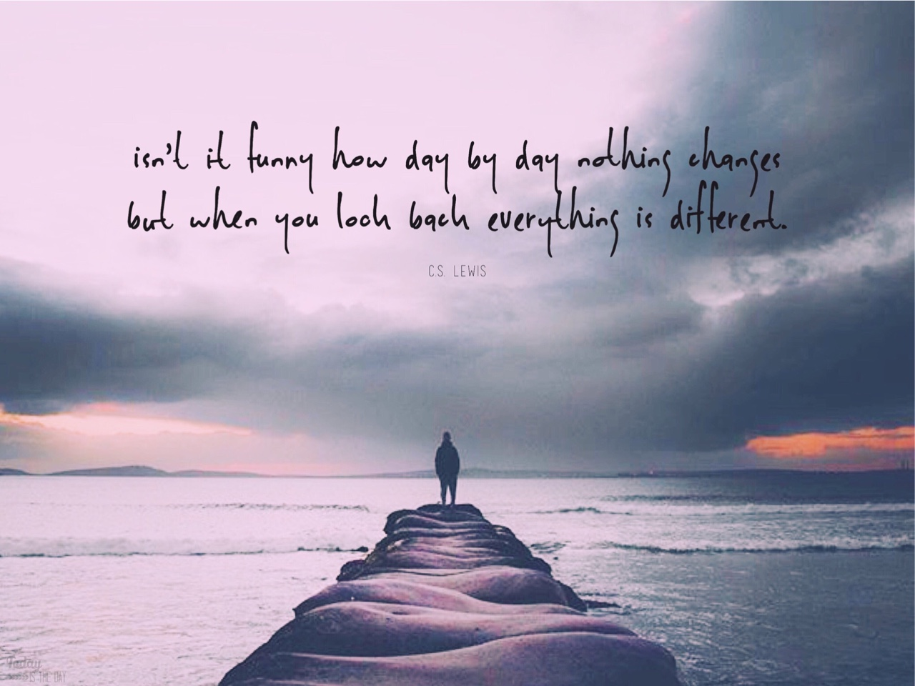
Thank you for
your attention !

