Slide 1
Recent activities related to EPS
(operational aspects)
Junichi Ishida and Carolyn Reynolds
With contributions from WGNE members
31th WGNE
Pretoria, South Africa, 26-29 April 2016

Slide 2
global

Slide 3
Operational global (weather) EPS
Center | Resolutions | FC Range | Members | Initial perturbation, DA | Model Uncertainty | B.C. | Note
ECMWF (Europe) | TCo639L91 TCo319L91 18/32km | 15d 46d | 51 | SV(Total energy norm) + EnDA | SKEB and Stochastic physics update of backscatter scheme | coupling to ocean model, EDA-based land-surface pert. in ENS ICs | Hindcast dataset increased
Met Office (UK) | 33kmL70 21km | 7d | 11+1 44 for DA 18/24, 100+ for DA | ETKF En-4D-EnVar | Random Parameters (RP2) and SKEB2. | N Coupling to ocean
Meteo France (France) | T798(C2.4) L90 | 4d | 35 | SV (Total Energy Norm)+ EnDA | A new set of 10 physical packages, new model pert. | N SURFEX and pert.
HMC (Russia) | T169L31 25-30km | 10d | 12+1+1 | Breeding Hybrid (3D-Var with ensamble based “B” | N SPPT | ?
NCEP (USA) | TL574L64 TL382L64 | 8d +8d 35d | 41 | Ensemble Kalman Filter + Tropical storm relocation | stochastic pert. to account for random model errors SKEB, SPPT, SHUM | N Stochastic pert. of land, couple with ocean | Dynamical core: Euler to Semi-Lgrangian
NRL/FNMOC (USA) | T159L42 T359L60 | 16d | 20 | local ET Hybrid 4D-Var | SKEB-mc | N SST initial pert. ocean, ice, wave coupling
CMC (Canada) | 0.6° L40 | 16d | 20 | Ensemble KF | stochastic pert. of physical tendencies and SKEB, further pert. to the physics | new method to evolve SST and sea-ice
DWD (German) | 40km | 180h | 40 | LETKF | ? | SST random pert. | Pre-operational
Black: current, Red: recent upgrade, green: planned or research

Slide 4
Operational global (weather) EPS
Center | Resolutions | FC Range | Members | Initial perturbation, DA | Model Uncertainty | B.C. | Note
CPTEC/INPE (Brazil) | T126 L28 | 15d | 15 | EOF-based perturbation EnKF | N | N | Couple with earth system model
BoM (Australia) | ~60kmL70 | 10d | 24 | ETKF | Random Parameters (RP2) and SKEB2. | N
JMA (Japan) | TL479 L60 TL479L100 TL319L100 | 11d 18d 1month | 27 | SV(Total energy norm) SV+LETKF Reduce tropical initial pert. | Stochastic perturbation of physics tendency | N Rev, SST and sea ice
CMA (China) | T213 L31 | 10d | 15 | SV | SPPT | N
KMA (Korea) | ~40kmL70 32km (p) | 12d | 24 44 | ETKF Hybrid Ensemble 4D-Var | Random Parameters (RP2) and SKEB2. | N
Black: current, Red: recent upgrade, green: planned or research

Slide 5
Model resolution upgraded / plan
Upgraded
  ECMWF
    use cubic-octahedral instead of linear grid
      Ensemble of data assimilations 50 km → 18 km (TL399 → TCo639)
      Medium-range ensemble 32 km → 18 km (TL639 → TCo639) with resolution change moved from Day 10 to Day 15
      Extended-range 64 km → 32 km (TL319 → TCo319)
      Analysis and High-resolution forecast: (TL1279 → TCo1279)
  NCEP
    Resolution 0-192h; T254L42 → TL574L64
    Resolution 192-384h; T190L42 → TL382L64
Plan
  Met Office
    Upgrade horizontal resolution 33km -> 21km
  JMA
    Resolution 11-18days; TL319 to TL479

Slide 6
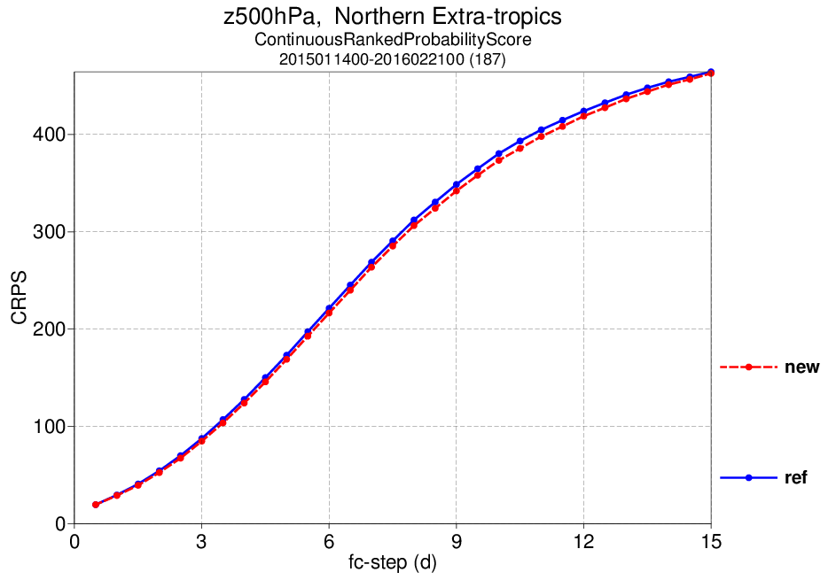
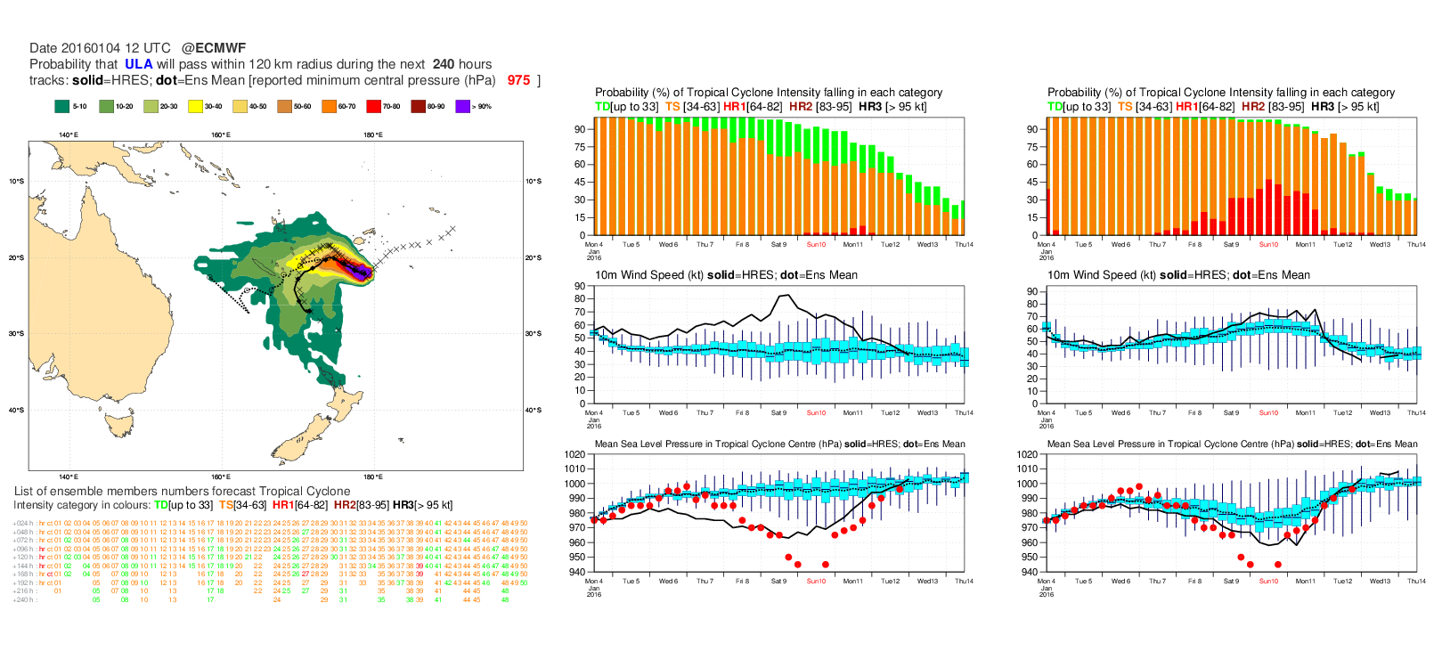
Benefit of higher resolution
Black line : HRES
Whisker Plot : ENS
Red dots : observations
Old - TL639
New - TCo639
10m
Wind
speed
MSLP
Figures from ECMWF

Slide 7
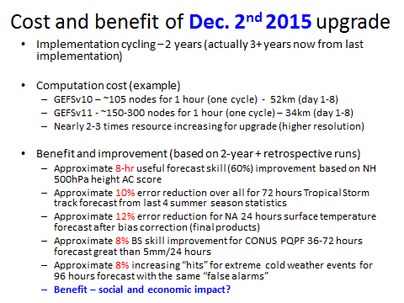
Slide from NCEP

Slide 8
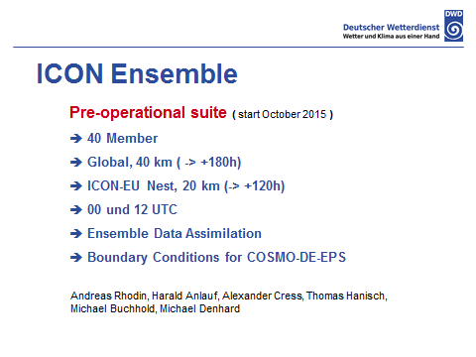
Planned new global EPS in DWD
Slide from DWD

Slide 9
Other topics
Hindcast (reforecast)
  ECMWF
    5 members once weekly to 11 members twice weekly for past 20 years
  Met Office Seasonal EPS (GloSea)
    4 start dates per month, 3 members per start date, each run to 7 months from 1993 to 2015
  Met Office Decadal ensemble (DePreSys)
    10 members out to 5 years, from 1960 to present days
  NCEP
    From ESRL offline with 25 years to EMC offline with 20 years
Verification
  DWD
    Experiment Verification against Analysis (EVA)
  CPTEC
    Assessing improved CPTEC probabilistic forecast on medium-range timescale
  JMA
    Reports to the Lead Centre on Verification of EPS under WMO/CBS

Slide 10
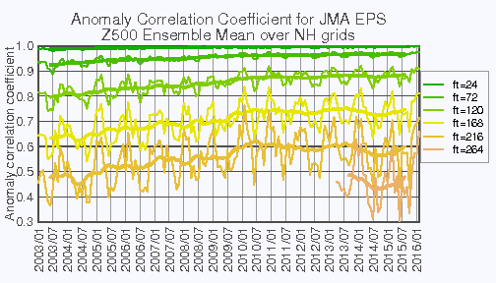
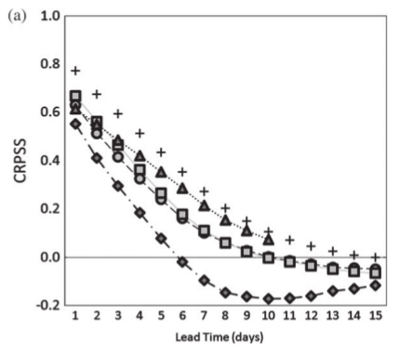
Verification
CPTEC EPS
as of 2009
(circles)
Original source : WMO/CBS Lead Centre on Verification of EPS
CPTEC EPS
as of 2001
(diamonds)
Figures from CPTEC and JMA

Slide 11
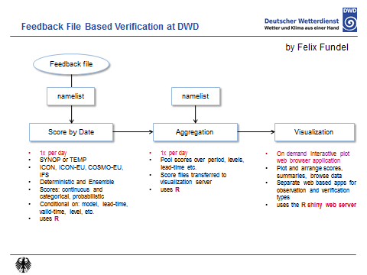
Verification
Slide from DWD

Slide 12
regional

Slide 13
Operational regional EPS
Center | Resolutions | FC Range | Members | Initial perturbation, DA | Model Uncertainty | B.C. | Note
Met Office (UK) | 2.2kmL70 1.5kmL70-120 | 36h 54h | 11+1 18/24 | High Resolution Analysis + global EPS Convective ensemble DA | Stochastic physics using random parameter | Perturbing parameters in JULES | UM Hourly operation
Meteo France (France) | 2.5km | 42h | 11+1 | Rescaled and centered from global EPS EDA or B-based random noise | SPPT | perturbations of surface | AROME Pre-operation
DWD (German) | 2.8km | 27h 45h | 20 40 | IFS, GMS, GME, GSM Ensemble DA based on LETKF | Pert. Parameters SPPT | IFS, GMS, GME, GSM Add COSMO-LEPS Global ICON EPS | COSMO For renewable energy
HMC (Russia) | 2.2km | 48h | 10 | COSMO-S14-EPS | N SPPT | COSMO-S14-EPS | COSMO
JMA (Japan) | 5kmL48 | 39h | 10+1 20+1 | SV(Total energy norm) Hybrid DA | N Pert. tendency | JMA global EPS Perturbed SST | JMA-NHM Test-operation
NRL/FNMOC (US) | 27/9/3km | 120h | 10+1 | Perturbed synoptic scales Perturbed Rankine Vortex | N | GEFS/NAVGEM with synoptic perturbations | COAMPS-TC
NRL/FNMOC (US) | 45/15/5km | 72h | 20+1 | ETKF | Parameter variations | NAVGEM ensembles | COAMPS
CMC (Canada) | 15km | 72h | 20+1 | Interpolated from global EPS Improved by global EPS | Stochastic pert. of physics | Global EPS Improved by global EPS | GEM
CMA (China) |  |  |  | Multi Scale Blending (GEPS and LETKF) | RP | Global EPS | UM
KMA (Korea) | 3kmL70 | 45h | 23+1 | Downscale from Global EPS LETKF | RP | Global EPS | UM
Black: current, Red: recent upgrade, green: planned or research

Slide 14
Extension of system configuration
Upgraded
  DWD
    Extension of Lead time from 27h to 45h
Plan
  Met Office
    Extended horizontal domain, following UKV model
    Extended forecast range (to T+54h)
    Hourly UK ensemble; combine several runs to make larger lagged ensemble
    Higher resolution (vertical 70L to ~120L and perhaps horizontal 2.2km to 1.5km)
  JMA
    Number of members; from 11 to 21

Slide 15
Other topics
Various objectives
  DWD
    Weather warnings and renewable energy applications
  Meteo France
    help human forecasters, (later) automated weather forecast products, flood prediction, air quality, customers (energy, wind farms...)
  JMA
    Disaster prevention
  NRL
    Tropical cyclone forecast using COAMPC-TC and HWRF multi model ensemble
  CMA
    1-hour EPS products for landfall typhoon forecast

