Slide 1
GASS update
By Jon Petch

Slide 2
Background
GEWEX has struggled to find leadership succession to follow on from Steve Klein and Jon Petch
This has prompted some questions about the relevance and motivation for something like GASS
On April 18th GASS held a telecon to discuss where it is at and it’s future

Slide 3
Summary of 18th meeting
GASS remains active through a range of projects – although there is evidence that new projects are coming along less frequently
GASS or something like GASS should continue but would benefit from a reinvigoration
GASS has failed in recent years to entrain younger scientists into the “family”.
  This family was seen as a strength of both GASS and GCSS before it and has provided support in developing some great scientists
  This was possibly in part an unseen consequence of the removal of the WGs
  … but also a failing of Jon Petch (sorry – should have seen this earlier)

Slide 4
Next steps
GASS SSC is keen to see it reinvigorated and evolved to provide a family for the next generation of model developer
Christian Jakob (an SSC member) has provisionally offered to host a Pan-GASS science conference in 2018 with a strong theme related to developing the next generation of scientists in model development
The SSC will continue to look to kick start other activities to address the young scientist issues
Further discussion of GASS’s future activities may take place at the Trieste meeting of Clouds Grand Challenge/CFMIP in July 2016.

Slide 5
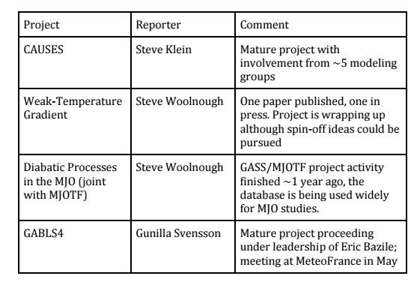
Projects

Slide 6
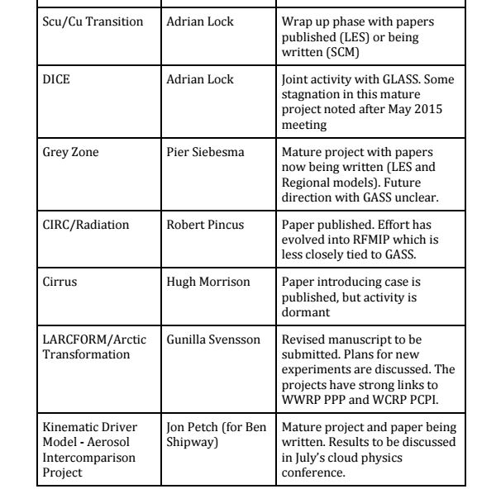

Slide 7
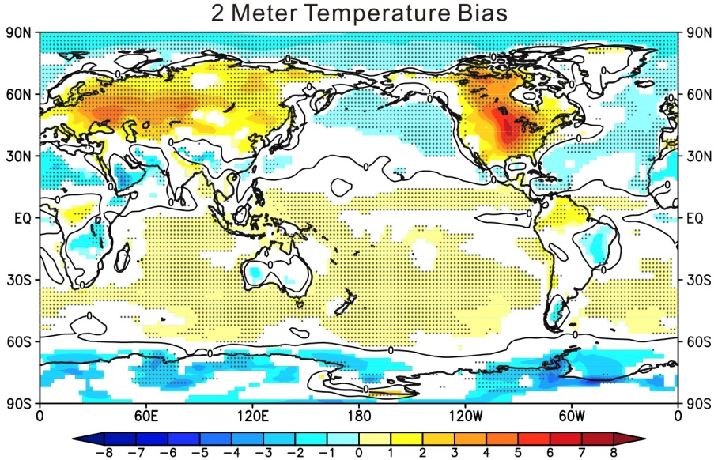





CAUSES
The warm bias over the US in summer is common to many GCMs.
It is seen in several climate models’ long-term climate mean and it also shows up as a bias within a few days when running climate models from analysis in NWP mode.
Aims:
A joint GASS/ASR comparison project aiming to evaluate clouds, radiation and precipitation in several weather and climate models using ground-based observations to better understand the reasons for the surface temperature error.
Full details of the experimental set-up and the diagnostics required is available from CAUSES website:
http://portal.nersc.gov/project/capt/CAUSES/
RGCM
Please get in touch if
you wish to participate

Slide 8
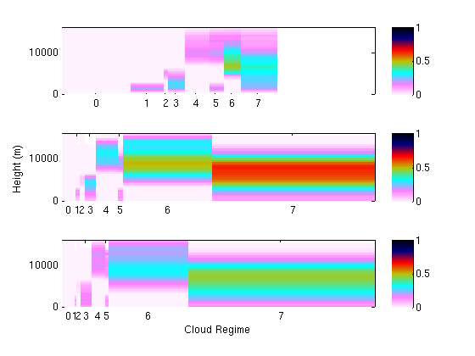
Comparison with ground-based (CloudNet/ARM) sites
(Chilbolton, Lindenberg, Darwin, SGP and Murgtal)
c/o Cyril Morcrette and Kwinten Van Weverberg
Excess high cloud in GA6 improved in GA7
Low cloud too infrequent (not seen in satellite comparisons)
Obs
GA6
0 clear sky
1 low cloud
2 mid-level
3 low and mid
4 high
5 high and low
6 high and mid
7 low and mid and high
Width = frequency of occurrence
Shading = cloud cover profile
GA7
CAUSES - http://portal.nersc.gov/project/capt/CAUSES/

