Slide 1
CAS – WWRP work and implications for WGNE:
Science for Service
Øystein Hov
Norwegian Meteorological Institute; President of CAS
WGNE Pretoria 26-29 April 2016
WMO: Research Dept.

Slide 2
WGNE (CAS-WCRP)
fostering the development of atmospheric circulation models for weather, climate, water and environmental prediction on all time scales and diagnosing and resolving shortcomings
co-ordinate numerical experimentation for validating model results, observed atmospheric properties, exploring the natural and forced variability and predictability of the atmosphere,
refining numerical techniques, and the formulation of atmospheric physics processes.
monitors the advances in data assimilation and analysis methods, review reanalysis projects to provide a multi-year homogenous data set for atmospheric and climate diagnostic studies.

Slide 3
CAS Societal challenges a 10y vision
High Impact Weather and its socio-economic effects in the context of global change
Water: Modelling and predicting the water cycle for improved DRR and resource management
Integrated GHG Information System: Serving society and supporting policy
Aerosols: Impacts on air quality, weather and climate
Urbanization: Research and services for megacities and large urban complexes
Evolving Technologies: Their impact on science and its use
Seamless across time and space scales, earth system components

Slide 4
Science for service – Quality, relevance and impact
Input
information
Core
information
Model calculations
integrating basic data
and process knowledge
User customized
information
(user products)
Production chain
The public
Basic data from:
Observations
Experiments
Process
description
Core
Services
Downstream
Services
specialized
operational
users
Other
branches of
research
or innovation
Output from
other
science
disciplines
or services
IA, socio-economics
data policy
Academia
R&D
publications
services

Slide 5
NWP and Climate Services’ Production chain driven by R&D and users - Merging of R&D and forecasters’ cultures
Research topics
Postprocessing for
General public
Aviation
Energy sector
Flooding, land slides, avalanches
Air Quality
Shipping
Road weather, train weather
Offshore
Marine resources
Wave forecasting
Agriculture
Tourism
Emergency preparedness
HiW incl PL
Process description
Dynamics
Physics, snow, ice,
Chemistry
Predictability
Earth System Model formulation
Observations
Dataassi-milation
Verification
EPS
Backend
Frontend
Human interface
Users
Observations,
Emisson fluxes,
Other boundary conditions
Research Councils,
Hirlam B, base grant, H2020, with industry and academia nationally and internationally
Hirlam B, WMO,
All specialised users
Hirlam B
MetCoOp, Research Council, national and international
Hirlam B, Research Council, national and international
Government, societal sectors and large industries, businesses
Network projects
Thematic orientation
R&D, IT geoscience focus, user competence, communication skills, data policy
Distributed metadata governed data management NRT-flow and storage

Slide 6
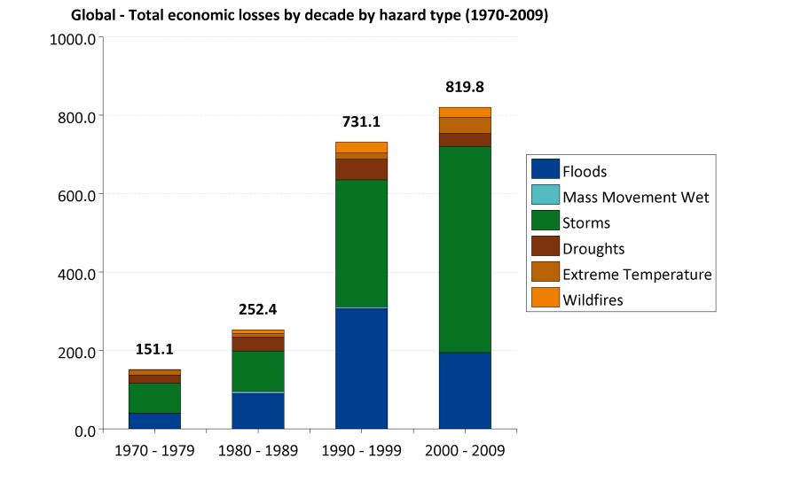
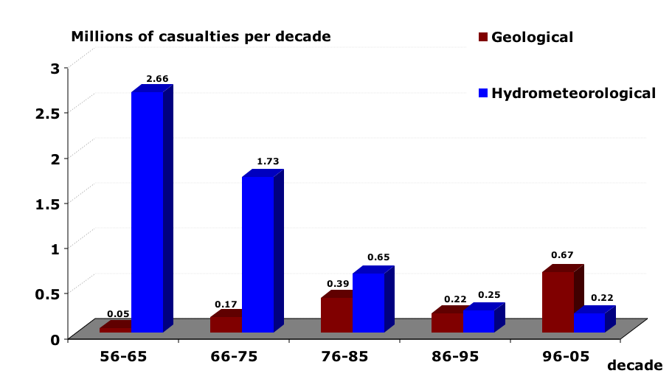
Global number of casualties by decade for 1956-2005 (left) and total economic losses (right) by decade and by hazard type in USD billions adjusted to 2011 for 1970-2009
(EM-DAT: The OFDA/CRED International Disaster Database)
(Source: WMO and CRED, 2013)

Slide 7
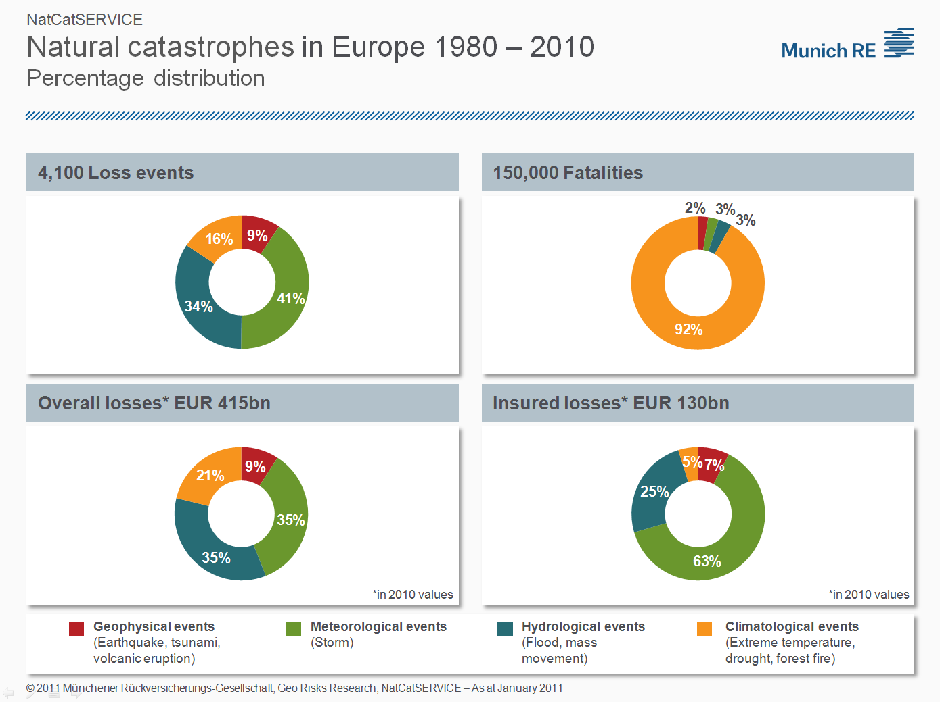
Distribution of number of extreme events, fatalities, total and insured losses in respect to the different groups of natural perils
Temperature extremes an easy early target for action (building codes, good emergency procedures)
Prepared by Professor Peter Höppe, Member of the WG, MunicRe/The German Academy of Sciences Leopoldina

Slide 8
Urbanization prospects in 2050
7 million premature deaths/a linked to air pollution (WHO 2014)
3,2 million from outdoor pollution
Percentage of urban population
Half of world’s population already lives in urban areas
Between 2011 and 2050 population to increase from 7 to over 9 billion
Urban population to increase from 3.6 to 6.2 billion, 66% of total population
Most urban population growth to occur in the less developed regions
The number of megacities (≥10 million) is currently 23 and is expected to reach 37 in 2025.
Adapted from United Nations 2012
Notes:
Source: United Nations, World Urbanization Prospects, the 2011 Revision (2012)
More than half of the 7-billion world population lives in urban areas. Cities and urban areas currently use 75% of the world’s energy and are responsible for 75% of greenhouse emissions.
Not all regions of the world have reached this level of urbanization. For example, it is expected that half of the population of Asia will live in urban areas by 2020, while Africa is likely to reach a 50 per cent urbanization rate only in 2035.
Between 2011 and 2050, the world population is expected to increase by 2.3 billion, passing from 7.0 billion to 9.3 billion.
At the same time, the population living in urban areas is projected to gain 2.6 billion, passing from 3.6 billion in 2011 to 6.2 billion 2050, thus accounting for 68% of total population. The urban areas of the world are expected to absorb all the population growth expected over the next four decades while at the same time drawing in some of the rural population.

Slide 9
WWRP overarching goals
Towards Environmental Prediction, integrating modeling components (hydrology, sea-ice, ocean, atmospheric composition, etc.) to improve and develop new services.
Towards a seamless predictive capability, developing a unified modeling approach on the weekly to monthly time scale.
Towards impacts forecasting, building community resilience in the face of increasing vulnerability to extreme weather events.

Slide 10




WWRP at a glance
WG
Nowcasting and Mesoscale
Tropical Meteor-ology
WG
Predictability, dynamics and ensemble forecasting
WG
WG
WG
Data assimilation and observing systems
Verification
WG
Social and economic research
WWRP a seamless programme
High Impact Weather
Urbanization
Predicting Water Cycle
Emerging Technologies
Polar Prediction
Sub-seasonal 2 seasonal
High Impact Weather
Challenges Projects Working Groups
10
Technical Commission for Atmospheric Science
2
Notes:
Here a brief overview of the new WWRP structure. The four challenges, the three legacy projects, Sub-seasonal to Seasonal, a joint WCRP WWRP initiative, Polar Prediction in collaboration with WCRP and High Impact Weather.
Finally the working groups and their main topics.

Slide 11
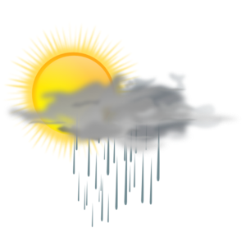



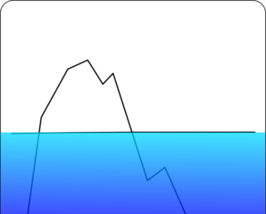

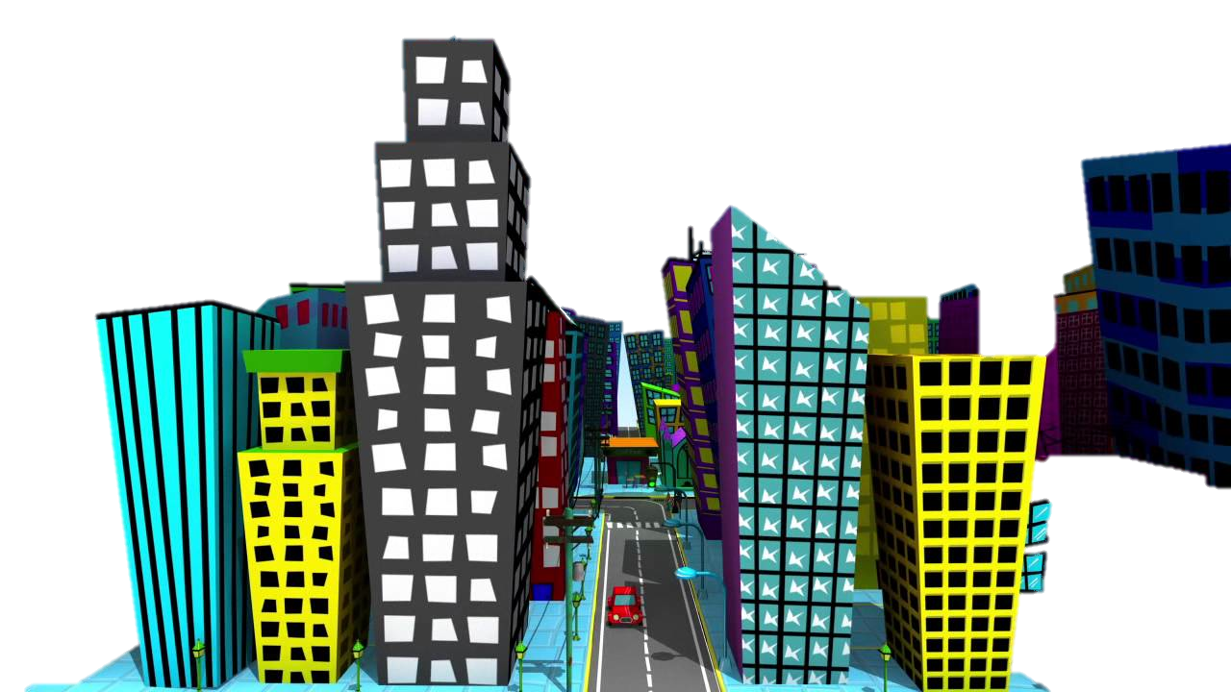


WWRP - A seamless approach for services
Nowcasting
Short to Medium Range
Monthly
HIGH IMPACT WEATHER
POLAR PREDICTION
SUB-SEASONAL TO SEASONAL
DISASTER RISK REDUCTION – CLIMATE SERVICES

Slide 12
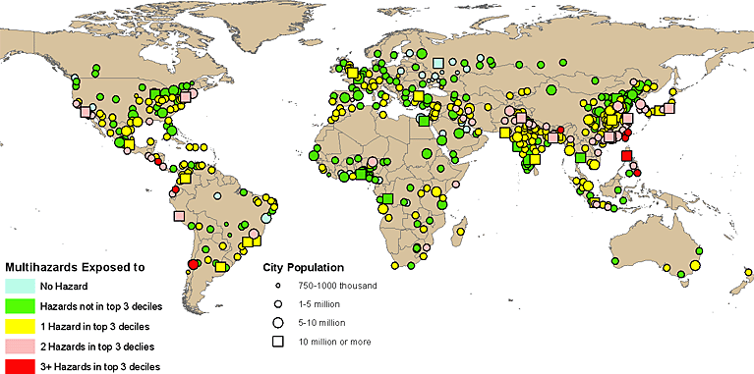
High Impact Weather Project
Increasing resilience to Urban Flood, Wildfire, Urban Heat and Air Pollution in Large cities, Localised extreme wind, Disruptive winter weather
Links to WCRP through quantifying vulnerability and risk assessment, and for response to High Impact Weather in a changing climate.
Exposure of Urban Areas to Hazards

Slide 13
HiW Steering Group
Co-chair: Brian Golding, Met Office, UK
Co-chair: David Johnston, University of New Zealand
George Craig, LMU, Germany, lead of the Predictability and Processes Theme
Beth Ebert, BoM, Australia, lead of the Evaluation Theme
Brian Mills, Environment Canada, lead of the Vulnerability and Risk Theme
Jenny Sun, USA, lead of the Multiscale Forecasting Theme
Kick-off meeting UKMO Exeter 27-29 April 2016

Slide 14
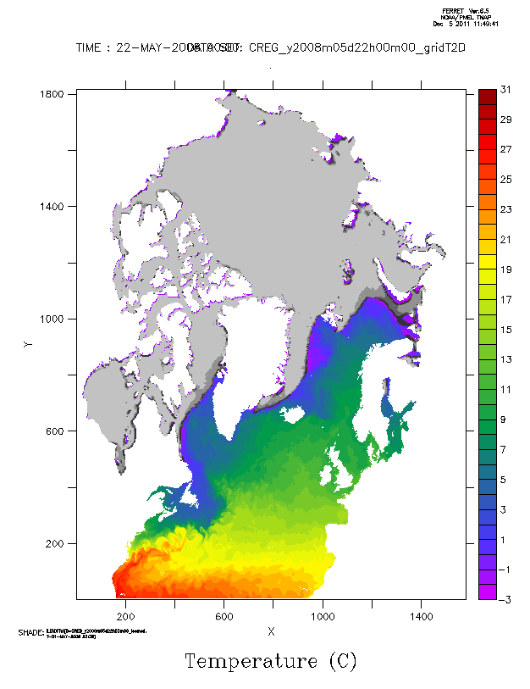

Polar Prediction Project
Improving environmental prediction services for the polar regions, on time scales from hourly to seasonal
The Year of Polar Prediction from mid-2017 to mid-2019 YOPP
Project Office: Alfred Wegener Institute, Germany

Slide 15
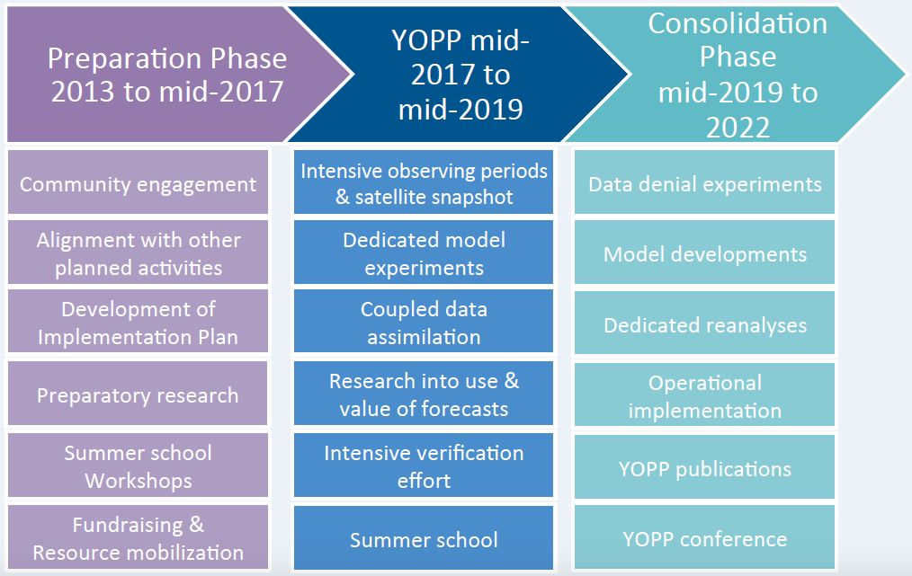
The Year of Polar Prediction
Technical Commission for Atmospheric Science
2

Slide 16
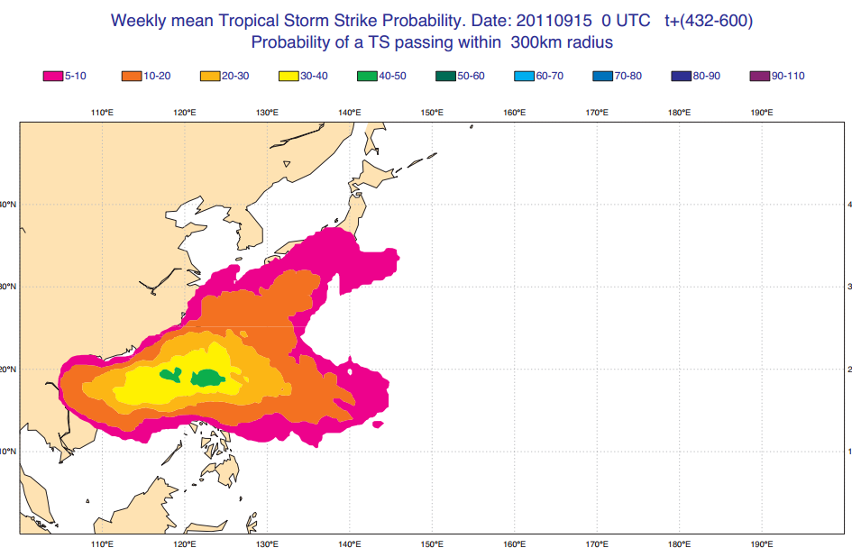
Sub-Seasonal to Seasonal Prediction Project
Evaluate potential predictability of sub-seasonal events through a multi-model approach.
Focus on specific extreme event case studies increasing resilience and improving adapting capacity.
Joint activity with WCRP
Tropical Storm Strike
Probability Days 19-25
Project Office: KMA, Republic of Korea

Slide 17

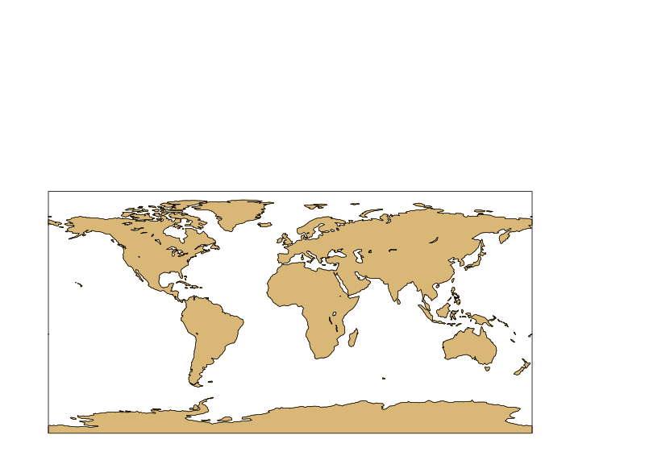
S2S – TIGGE data base
THORPEX Interactive Grand Global Ensemble
11 Data providers
2 Archiving centres
ECMWF
EC
UKMO
HMCR
Météo
France
KMA
NCEP
CNR
CMA
JMA
CAWCR
2

Slide 18
S2S – TIGGE data base
A fantastic research resource …………
Daily real-time forecasts + re-forecasts, Available 3 weeks behind real-time; Common grid (1.5x1.5 degree)
~ 80 variables archived including ocean variables, stratospheric levels and soil moisture/temperature
Archived in GRIB2; NETCDF conversion available
All partners provided S2S test data; CAWCR, ECMWF, NCEP, JMA, CMA, HMCR, Météo-France ready for data exchange.
Re-forecasts from JMA, CAWCR, NCEP and ECMWF archived in S2S database
Real-time forecasts from ECMWF, NCEP, JMA and CAWCR routinely archived in S2S database
CMA & Meteo-France re-forecasts acquisition in progress
Technical Commission for Atmospheric Science
Notes:
11 data providers and 2 archiving centres

Slide 19
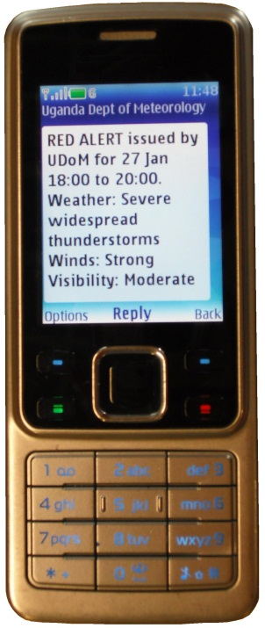
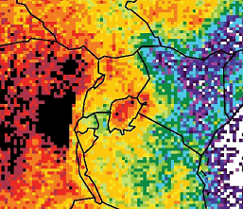
Lake Victoria – Understanding the Lake Dynamics and Severe Weather
“WMO Executive Council (EC) recommended that a World Weather Research Programme (WWRP) project be considered for the Lake Victoria Watershed that would include a test-bed for field campaigns to collect data for research to understand the dynamics over the lake in order to reduce disaster from water spouts, waves, and wind gusts that affect both lake transport and fishermen who rely on the lake for their livelihoods. The EC further noted the potential linkages with the SWFDP for Eastern Africa."
Goodman/Butcher

Slide 20
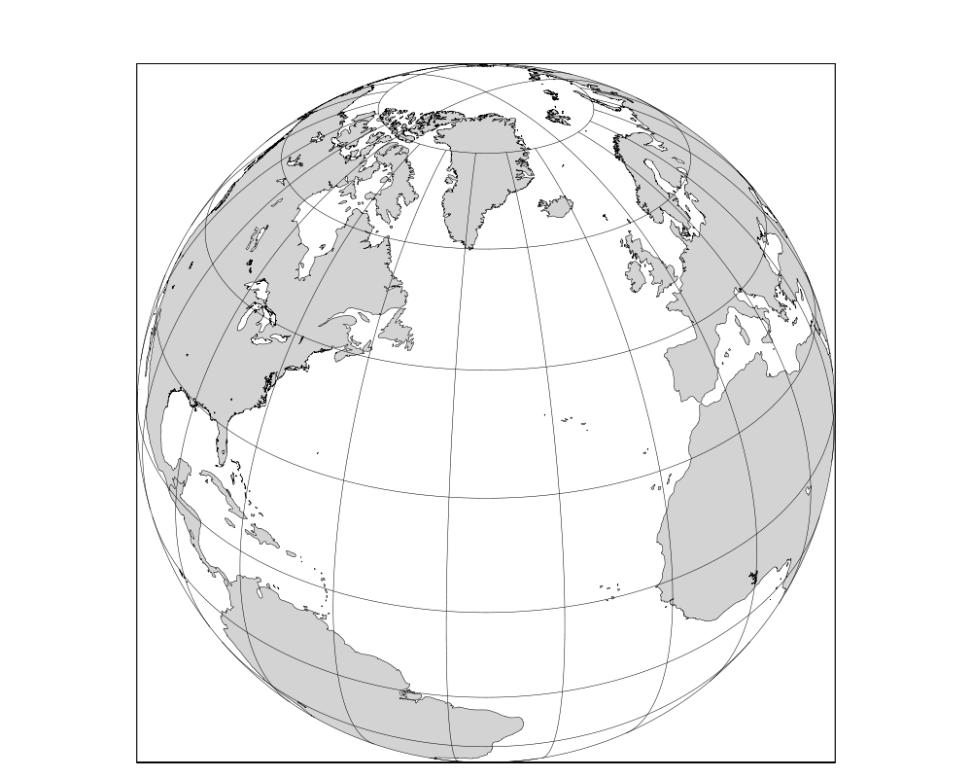
NAWDEX/DOWNSTREAM 2016
Factors modifying waveguide disturbances
Downstream impact of diabatically modified
PV anomalies
L
L
L
L
Evolution of Rossby waves along the waveguide

Slide 21



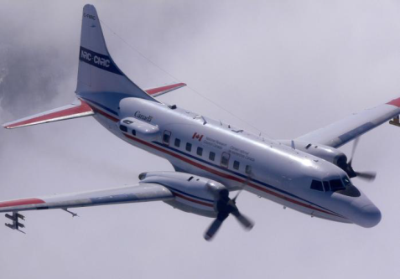
Ideal operation period in Sep/Oct 2016:
strongest storm activity
Tropical Cyclones
Polar Vortices
GV: HALO
US: GV
UK: BAE 146
L
L
L
L
CAN: NRC Convair 580
Partners
Germany: DLR IPA, FX, KIT Karlsruhe, Univ. Mainz
ETH Zürich
US: NPS, NCAR, OU, Princeton, MIT, NOAA
French, UK, CAN contributions envisaged
Links to national weather services: DWD, ECMWF

Slide 22
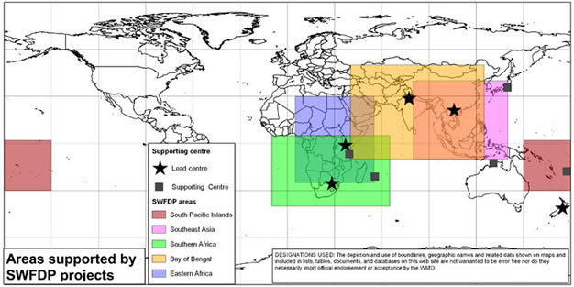
WMO / CBS Severe Weather Forecast Demonstration Projects

Slide 23
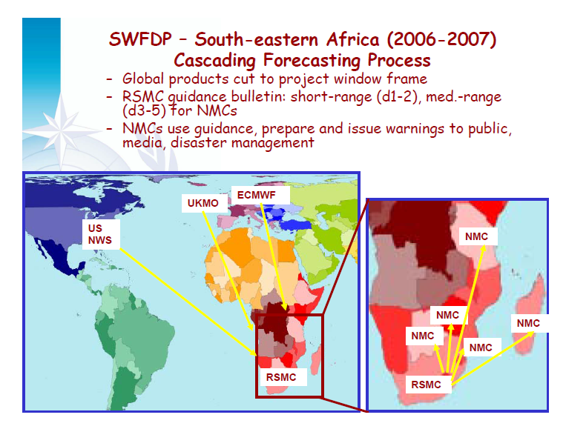

Slide 24
Some developments influencing WMO and WGNE’s agenda
Services are becoming more and more specialized, Internet based and without a clear institutional brand
WIGOS
Regional AQ and deposition forecasting in a global framework
Sustainable data management
WMO and NMHSs’ role in the global weather enterprise
«Big data» vs the traditional WMO controlled observational data flows

Slide 25
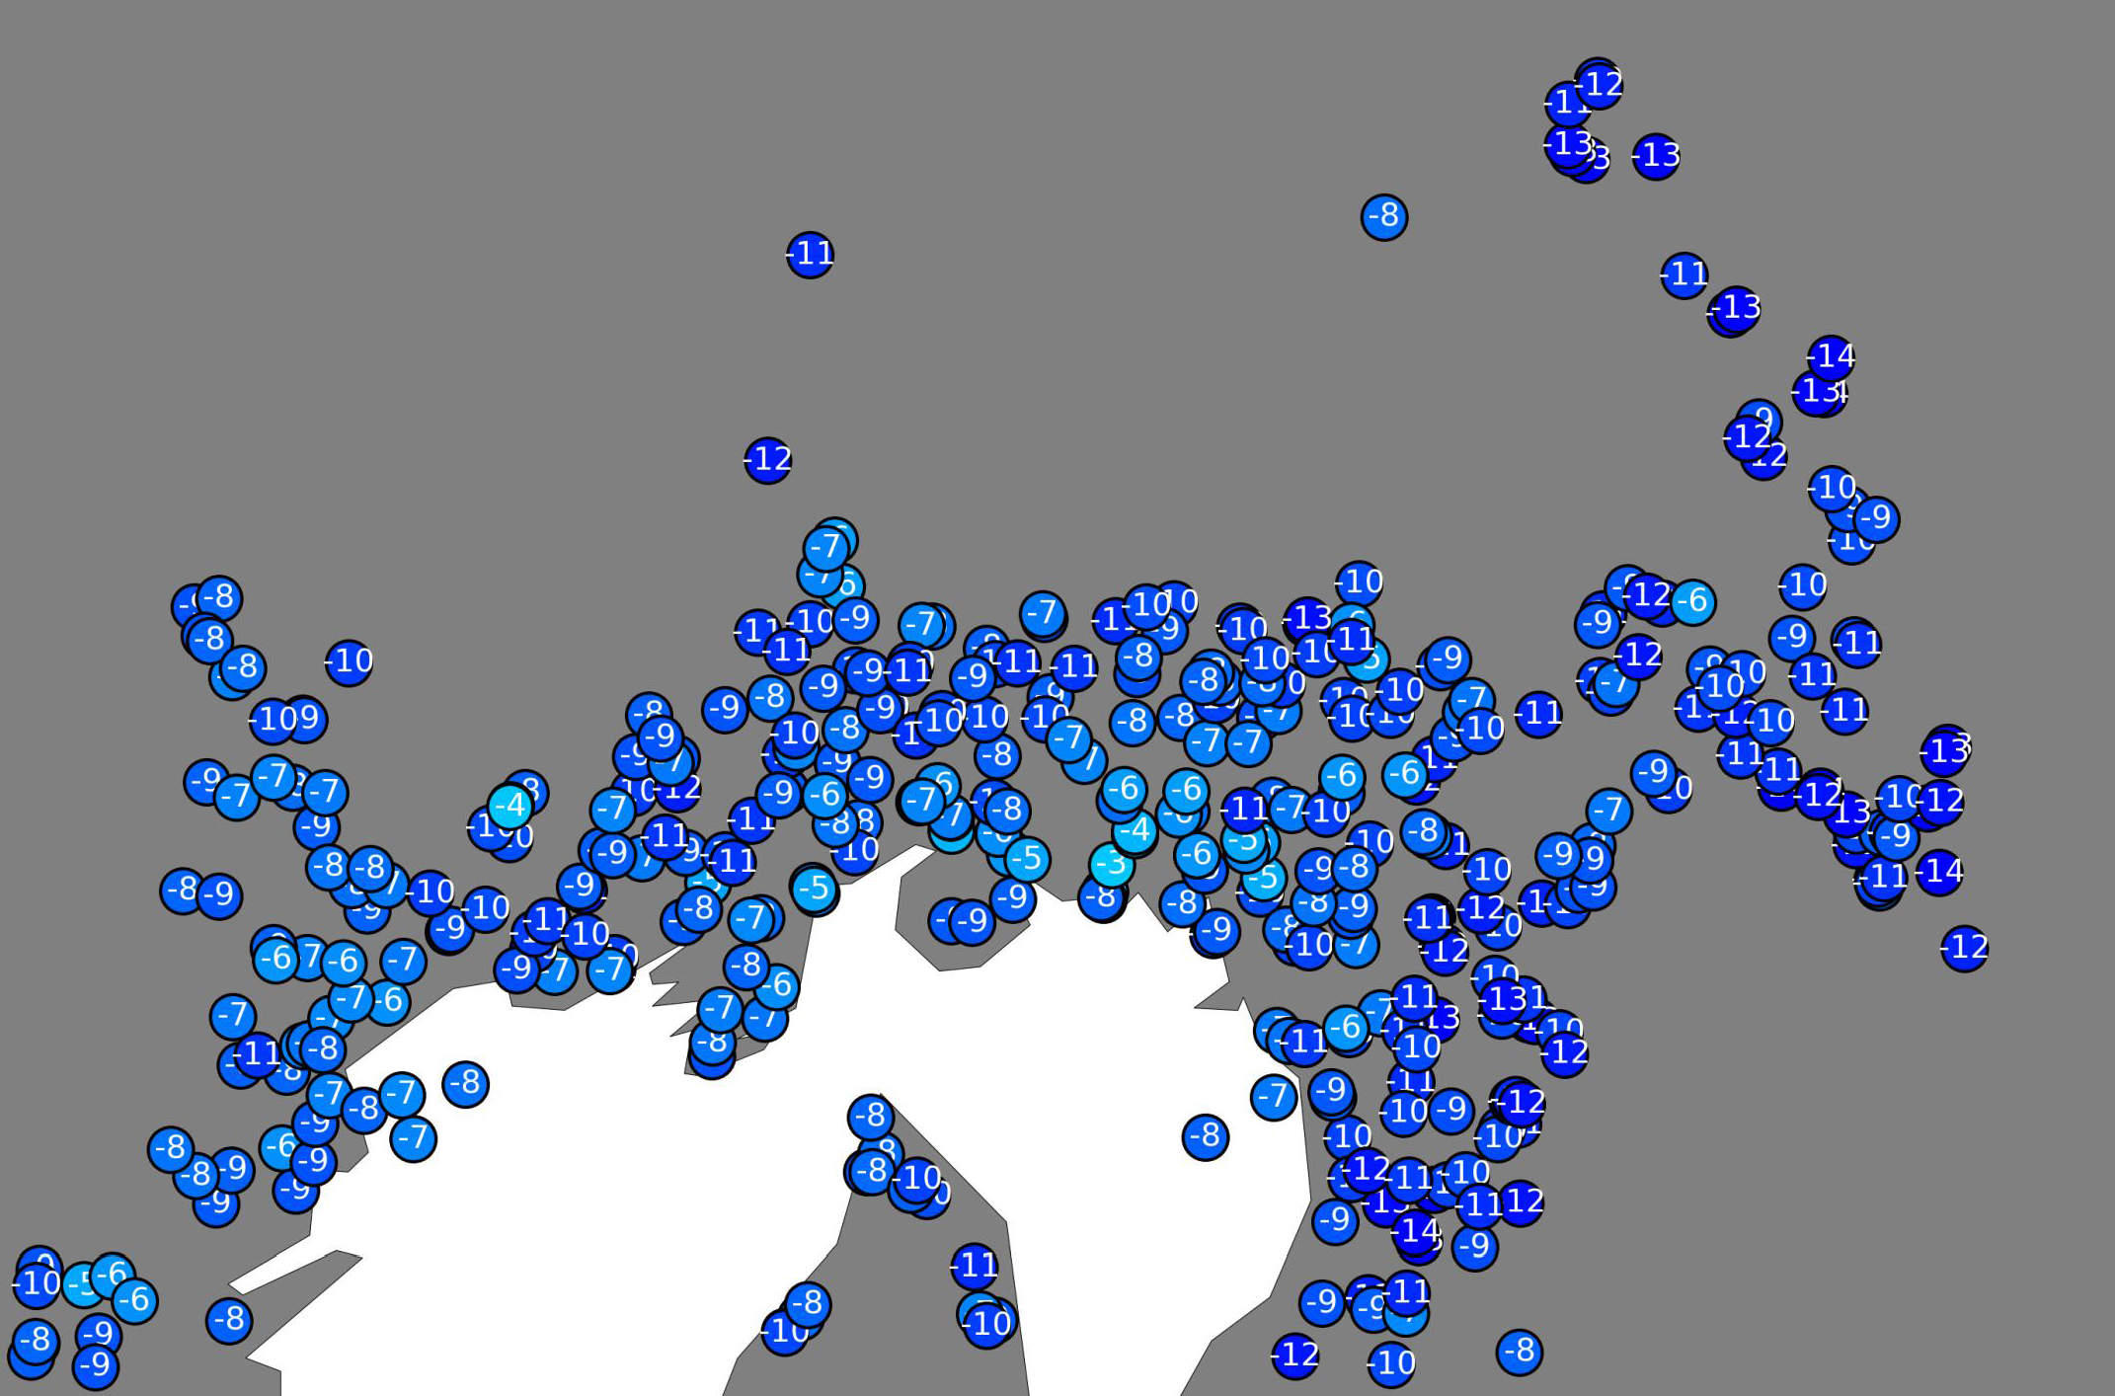
Oslo 50 km across, temperature recordings from private stations, NRT 5 min resolution
Verification. Post-processing
Netatmo data site

Slide 26
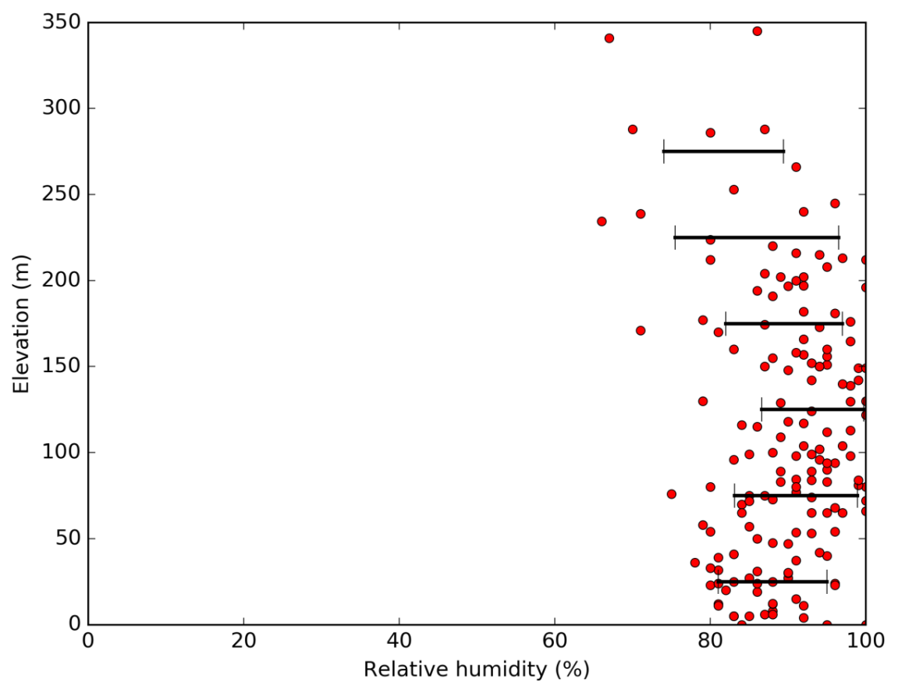
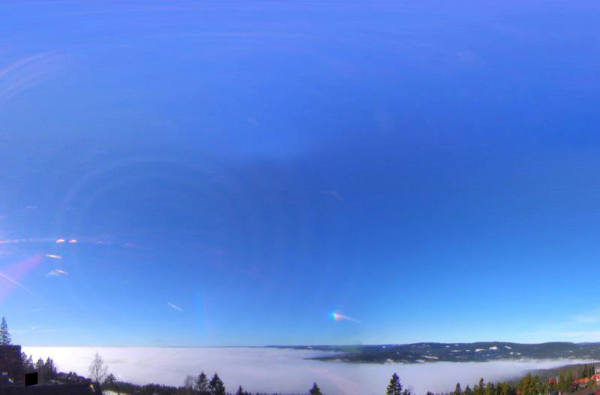
Diagnose and resolve shortcomings in models:
Cloud layer Oslo 170316 1100h at 100m a.s.l.
Netatmo data site

Slide 27
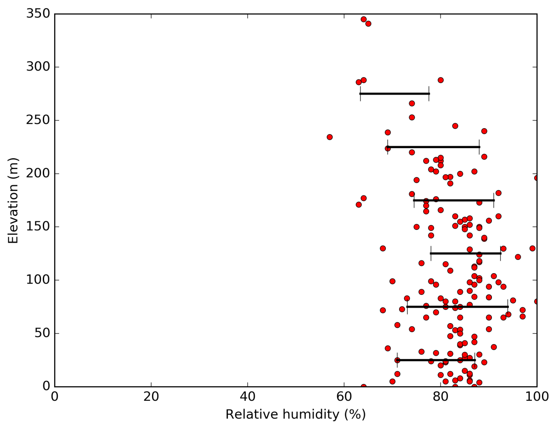
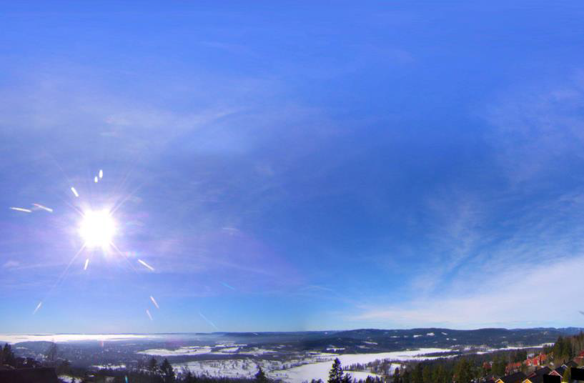
Oslo 170316 1400h at 100m a.s.l.
Netatmo data site

Slide 28
End

Slide 29
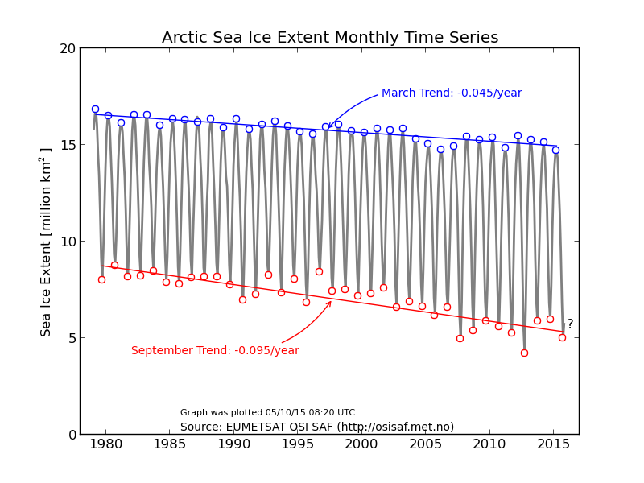
AN EXAMPLE OF CHEMISTRY – CLIMATE COUPLING
SEA ICE ANALYSIS based on satellite remote sensing observations
Analysis of remote sensing and in situ observations for variability and trends

Slide 30
Climate forcing vs climate response:
Amplification of Arctic warming by past air pollution reductions in Europe
Are there any climate impacts of the abated European acid-rain problem?
JC. Acosta Navarro, V. Varma, I. Riipinen, Ø. Seland, A. Kirkevåg,
H. Struthers,T. Iversen, H-C. Hansson, A. Ekman
Nature Geosciences, March 15th 2016.
NorESM- simulations are paired, 9-member ensembles.
Each ensemble member starts from different climate realizations
of the same external forcing.
Ensemble 1: Full historical SO2-emissions in Europe and elsewhere
Ensemble 2: European SO2-emissions kept as in 1980,
elsewhere as for the historical emissions

Slide 31
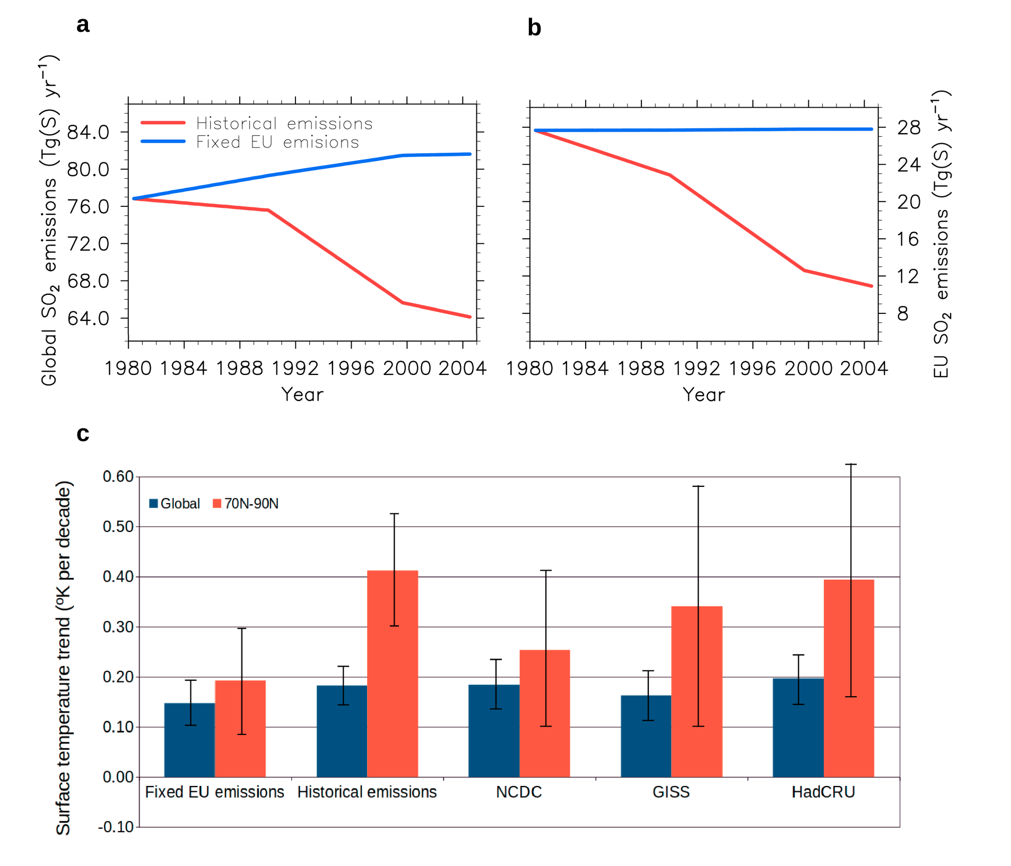
Impacts of reduced European SO2-emissions are seen in the Arctic
Actual emissions
Europe-emissions fixed at 1980
Global SO₂ emissions
European SO₂ emissions
Mean surface temperature trends (1980-2005) 95% confidence interval
Global and Arctic
K/decade
The increased T-trend
is 63% larger in the Arctic
and 17% larger globally
due to reduced
European SO2-emissions
Deduced from observations
NorESM-fixed European
NorESM-full historical

Slide 32
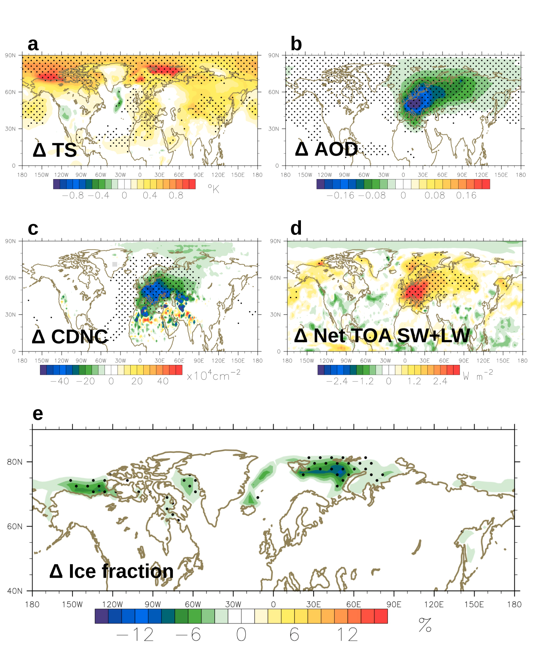
Effects of reduced European sulfate (SO₂+SO₄) emissions on climate variables.
surface temperature
all-sky AOD (visible)
Annual mean (1996-2005) differences
=
Historical emission simulation
minus
Fixed European emission simulation
(dots: change with 95% confidence)
column integrated CDNC
net (in – out) SW and LW TOA flux
Reduced European SO2-emissions
cause:
Reduced aerosol optical depth (AOD)
Reduced cloud droplet numbers
Increased net radiative forcing
In or close to Europe
and
Increased Arctic surface temperature
Reduced Arctic sea-ice cover
ice cover fraction
An aerosol-reduction causing a positive forcing strictly confined to the mid-latitude Europe,
mainly influences the climate of the Arctic

Slide 33
Mechanisms
Reduced sulfate aerosols in Europe, summer
Increased solar heating of the ground in Europe, summer :+2.55 Wm⁻²
Increased atmospheric (+0.25 Wm⁻² ) and oceanic (+0.43 Wm⁻²)
summer input of heat by winds and currents to the Arctic
Reduced summer ice fraction (-1.24%) and
delayed Arctic freeze-up in autumn (-1.65%)
Increased surface heat flux to the Arctic atmosphere
in autumn (+1.61 Wm⁻²) and winter (+1.51 Wm⁻²)
Increased SST in autumn (+0.90 ºC) and winter (+0.62 ºC)
triggering further positive feedbacks (lapse-rate and surface albedo)
Reduced pole-to-midlatitude atmospheric T-difference
- and atmospheric heat transport -
all seasons, except summer.

Slide 34
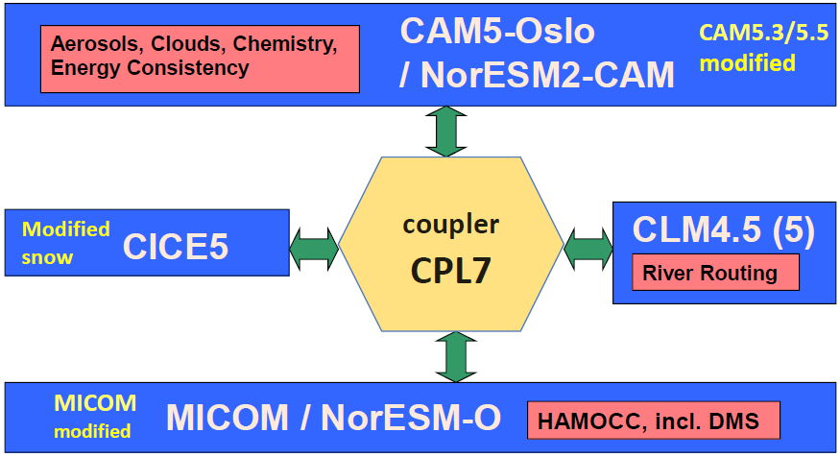
Atmospheric chemistry – climate couplings based on
NorESM in the “family” of models in the (NCAR) Community ESMs,
The ocean model is replaced with an iso-pycnic co-ordinate version developed from MICOM (Miami Isopycnic Community Ocean Model;
Ocean bio-geochemistry is based on HAMOCC (HAMburg Ocean Carbon Cycle Model);
Own modules for aerosol life-cycling, physics, and interactions with cloud microphysics (CAM-Oslo);
Adjusted processing of sea-ice and snow on sea-ice.

Slide 35
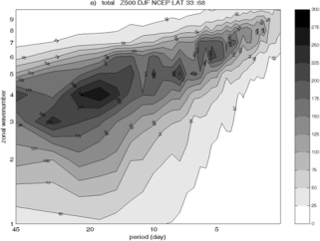
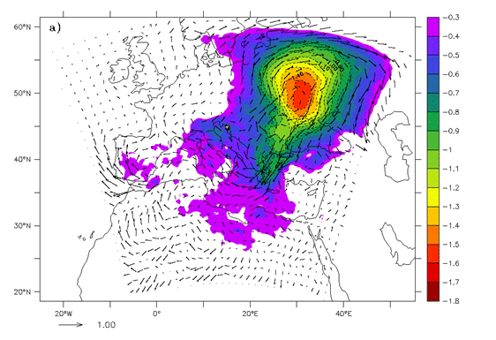
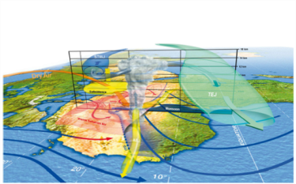
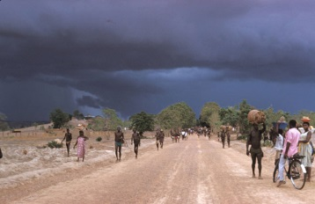
WWRP Vision
WWRP advances society's resilience to high impact weather through research focused on improving the accuracy, lead time and utilization of weather prediction, and through engaging users & stakeholders to define research priorities and facilitate transition to applications
WWRP promotes cooperative international & interdisciplinary research in the operational and academic communities and supports the development of early career scientists
WWRP aims at Seamless Prediction of the Earth System from minutes to months using coupled systems – thus applying expertise in weather science to promote convergence between weather, climate and environmental communities
Technical Commission for Atmospheric Science
35
2

Slide 36
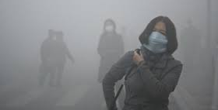
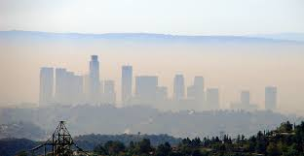

CAS-16 priority: Urbanization: Research and services for urban complexes
WMO
Integrated Urban Weather, Water, Environment and Climate Services
Poor air quality; extreme heat/cold waves; flooding; sea-level rise; energy/water sustainability; public health.
GURME (WWRP+GAW): integral part of urban research and services
Focus on impact based forecast and risk based warnings
Weather in urban planning. Green cities
Urban activities should be a specific cross-cutting element within WMO
Doc. 9.8
Notes:
Risks in the urban environment: flooding; poor air quality; sea-level rise; extreme heat/cold and human thermal stress; energy and water sustainability; public health problems caused by the previous.
GAW Urban Research Meteorology and Environment Project (GURME) : integral part of urban research and services
To enhance the capabilities of NMHSs in providing the weather and environment service for cities to deal with weather, climate and environmental problems
Scientific issues: Requirements for observations; Near-real-time data assimilation; Coupling of air quality, meteorological, surface, hydrological processes; Seamless approach: scale interaction; High-resolution modelling: ‘grey zone’.
Focus on impact based forecast and risk based warnings
From science to integrated urban services
Toward Integrated and user-tailored Urban Weather, Water, Environment and Climate Services
Urban activities shall be a specific cross-cutting element within WMO and in collaboration with WHO, UNEP, HABITAT-III, etc.

Slide 37

The need for an Integrated, Global, Greenhouse Gas Information System (IG³IS)
Over the next few years, governments will likely become more involved in efforts to limit atmospheric concentrations of greenhouse gases.
  Changes in emissions will vary by location and type
  Strategies will vary by nation, region, and economic sector
  Many nations are already pursuing such activities and some are coordinating efforts.
Any large-scale emission reduction effort requires independent information to succeed.
A suitable information system would include
  ground-based and space-based observations,
  improvements in transport and carbon-cycle modeling,
  fossil fuel-use, terrestrial trends, and oceanic processes,
  information about sources and sinks of greenhouse gases at sub-continental, policy-relevant scales.
Despite some efforts to reduce emissions, greenhouse gases in the atmosphere continue to rise.
Notes:
Focus on two main bullets here

Slide 38
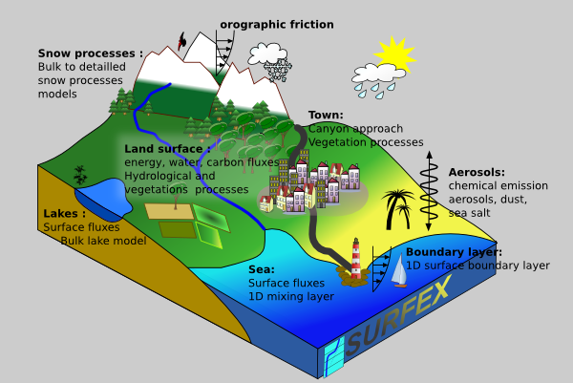
Coupled land surface-atmosphere modelling AROME+SURFEX+CROCUS
http://www.cnrm.meteo.fr/surfex/
SURFEX – land surface model for natural land surface, urban areas, lakes and oceans. Can be used for assimilation of surface and near surface variables. 1d formulation. Runoff calculated by summing over all land surface columns. SURFEX+CROCUS model for avalanche forecasting, hydrology/run off

Slide 39

Surface temperature response to forcings by natural factors, anthropogenic GHGs and anthropogenic aerosol
global
Arctic
All forcings
Anthropogenic GHG
Natural (Solar + volcanoes)
Anthropogenic Aerosols
Notes:
39

Slide 40
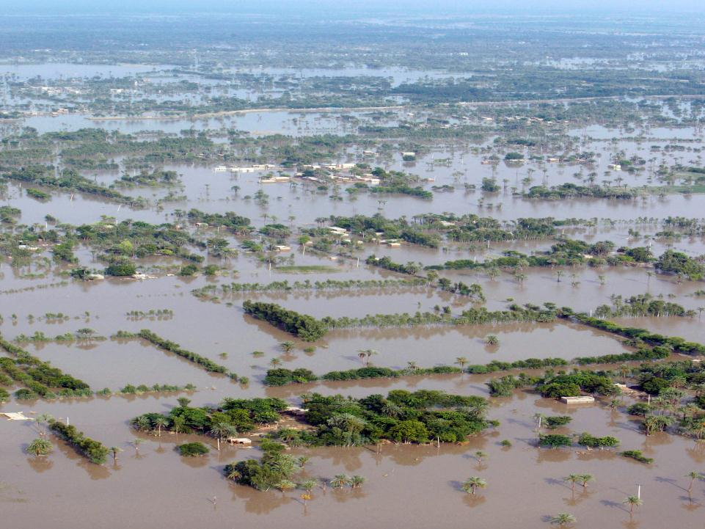


The Sub-seasonal to Seasonal (S2S) Prediction Project
“Bridging the gap between weather and climate”
Co-chairs:
Frédéric Vitart (ECMWF), Andrew Robertson (IRI)
Project Office: KMA/NIMR

Slide 41
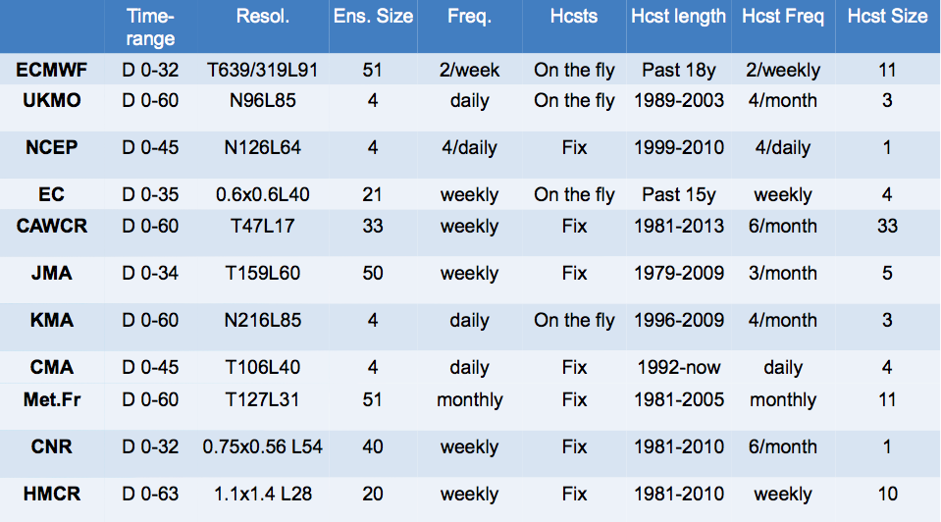
S2S – TIGGE data base
Technical Commission for Atmospheric Science
Notes:
11 data providers and 2 archiving centres

Slide 42
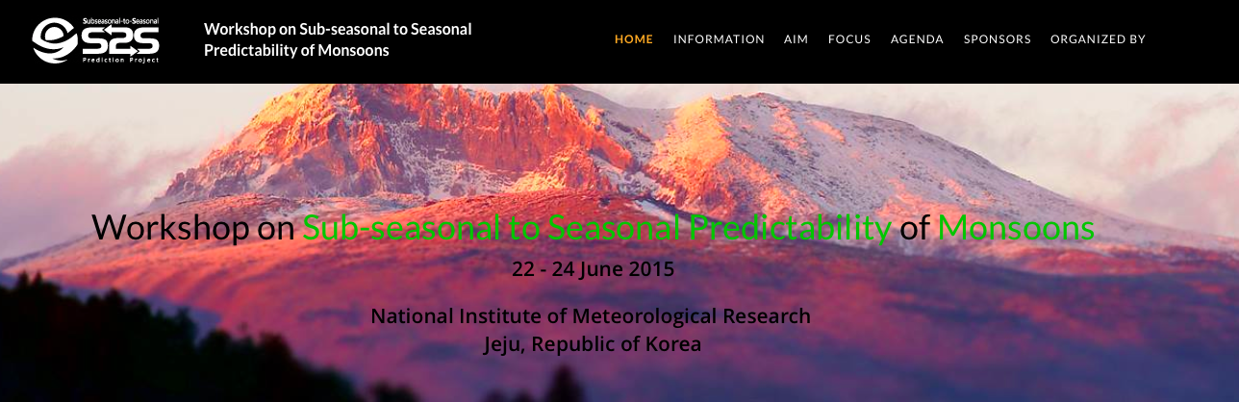
Sub-seasonal to seasonal
http://s2sprediction.net
Technical Commission for Atmospheric Science
2

Slide 43
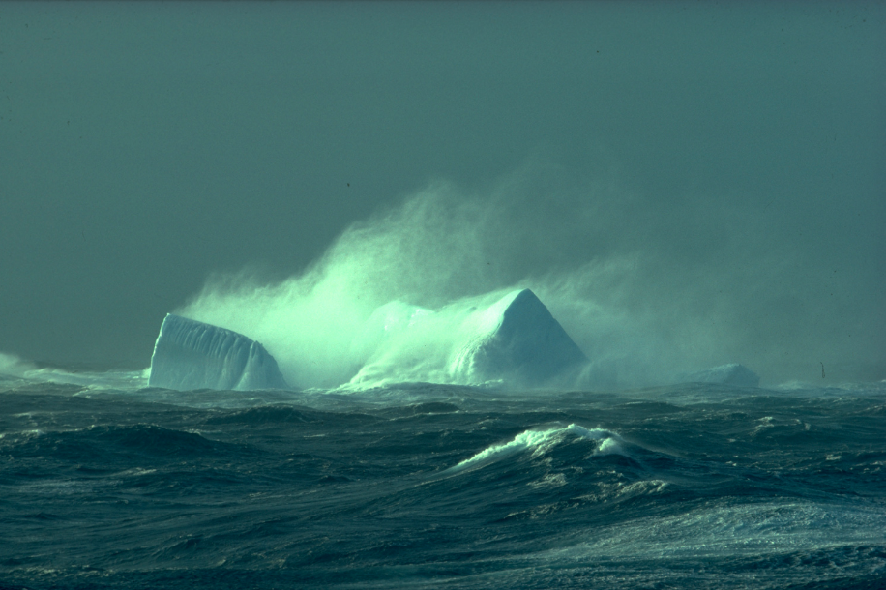
The WWRP Polar Prediction Project
(2013-2022)
Chair: Thomas Jung, AWI
Project Office: Alfred Wegener Institute, Germany
Promote cooperative international research enabling development of improved weather and environmental prediction services for the polar regions,
on time scales from hourly to seasonal
Notes:
The text above represent PPP‘s mission statemement the following aspects are central
Coordination of research activities (research and operational communities + weather and climate community)
Weather and environmental -> we go beyond traditional NWP by using coupled models
Prediction services for the polar regions (stakeholder needs!)
Time scales from hourly to seasonal (i.e. WWRP pushes the prediction boundaries out to a season)

Slide 44
PPP – selected activities
New mailing list for polar prediction (jointly with WCRP)
YOPP Implementation Plan 1.0
Workshop on polar-lower latitude linkages and their role in weather and climate prediction, Barcelona, 10-12 December 2014
WWRP/WCRP/Bolin Centre Polar Prediction School 5-16 April 2016
YOPP briefing of the Interagency Arctic Research Policy Committee (IARPC)
Strong engagement with funding agencies
44
Technical Commission for Atmospheric Science
2

Slide 45
YOPP Summit
When: 13-15 July 2015
Where: WMO, Geneva, Switzerland
Attendance: ≈ 180 people
Purpose:
  give an overview of the present level of planning,
  identify stakeholder expectations and requirements,
  develop priorities,
  define intensive observing periods,
  agree on the YOPP data legacy,
  coordinate planned activities, and
  gather formal commitments from parties interested in YOPP
45
Technical Commission for Atmospheric Science
2

Slide 46
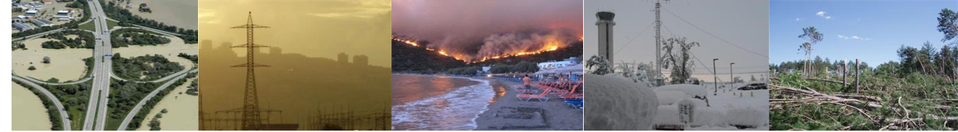
High Impact Weather Project
Increasing resilience to Urban Flood, Wildfire, Urban Heat Waves and Air Pollution, Localised extreme wind, Disruptive Winter Weather through improving forecasts for timescales of minutes to two weeks and enhancing their communication and utility in social, economic and environmental applications
Implementation Plan (2015-2024) approved by WWRP SSC
Links to WCRP through quantifying vulnerability and risk assessment, and for response to High Impact Weather in a changing climate.
Chair: Brian Golding, MetOffice
Christof Stache/AFP/Getty Images; Marina Shemesh /publicdomainpictures.net; Alexandros Vlachos/EPA; NOAA NWS; NOAA NWS
46
Technical Commission for Atmospheric Science
2
Notes:
“Promote cooperative international research to achieve a dramatic increase in resilience to high impact weather, worldwide, through improving forecasts for timescales of minutes to two weeks and enhancing their communication and utility in social, economic and environmental applications”

Slide 47

Societal challenges: a 10y vision
High Impact Weather and its socio-economic effects in the context of global change
Water: Modelling and predicting the water cycle for improved Disaster Risk Reduction and resource management
Urbanization: Research and services for megacities and large urban complexes
Evolving Technologies: Their impact on science and its use
Technical Commission for Atmospheric Science
47
2
Notes:
Priorities defined by CAS ………these four should be addressed in WWRP.
1. All projects consider High Impact Weather, this is a particular focus for the HIWeather project …..
Moving towards 1-km scale forecasting should result in a more accurate rainfall forecast down to small catchments ….
3. 75% percent of the population is projected to live in urban regions by 2050 … what is our vision of weather services and what are the main research gaps…
4. …. Are we able to envisage the observational network in a seamless perspective; CAS has responsibility to keep EC and Congress informed on developments in Climate Engineering – need to work with WCRP here.

Slide 48
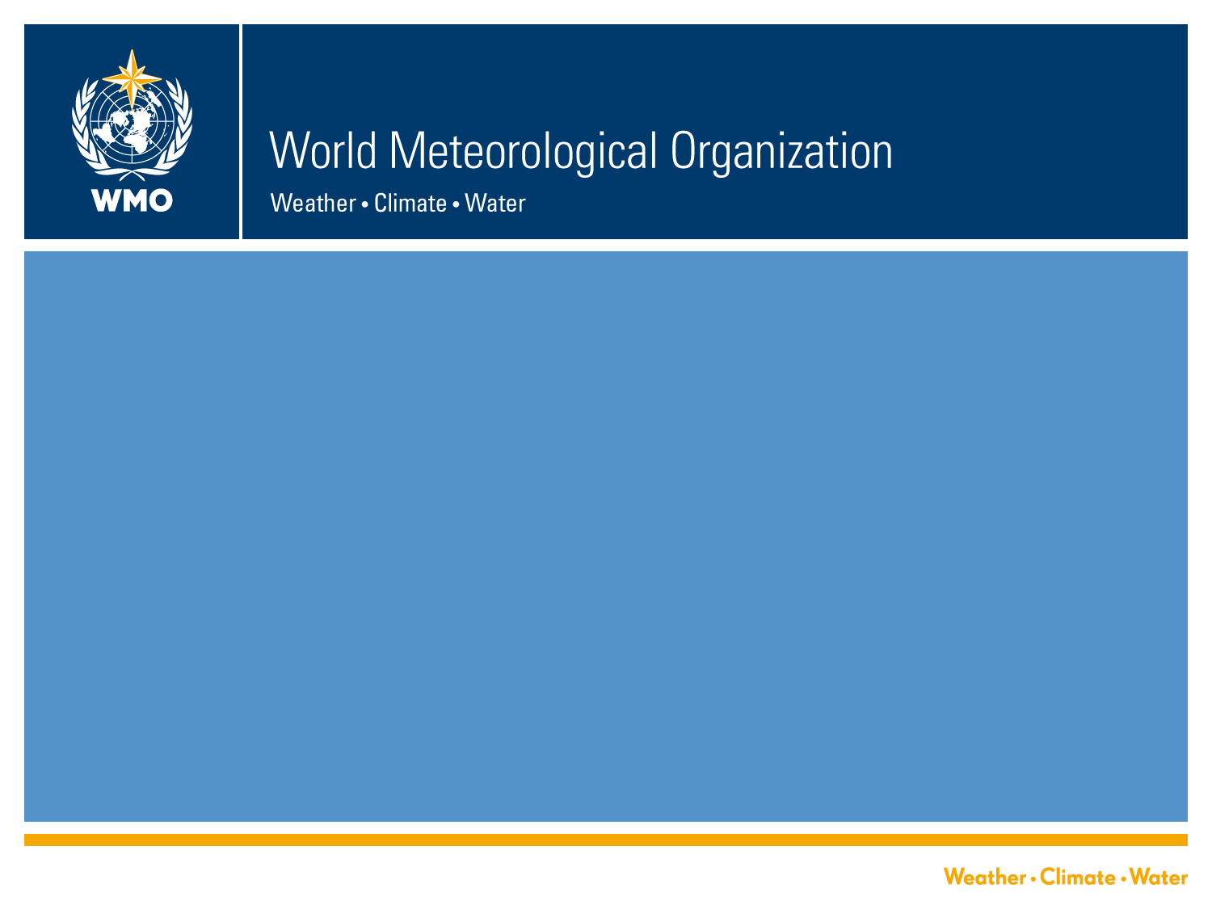

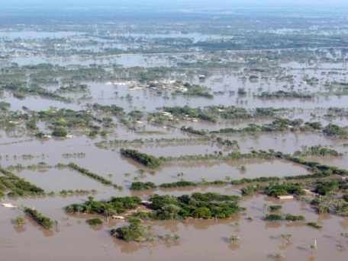
Technical Commission for Atmospheric Science
World Weather Research Programme
Sarah Jones, Chair WWRP SSC
Paolo M Ruti, Chief WWRD,WMO
Christof Stache/AFP/Getty Images; Marina Shemesh /publicdomainpictures.net; Alexandros Vlachos/EPA; NOAA NWS; NOAA NWS

Slide 49

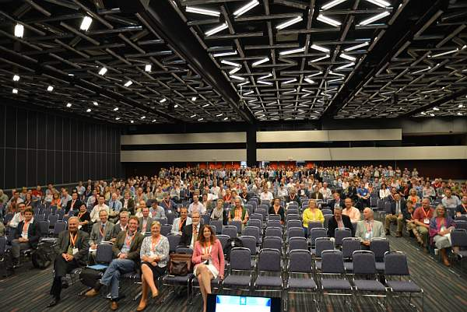
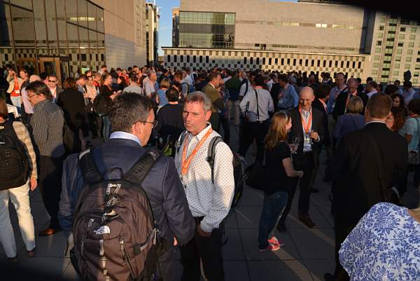
WWOSC: World Weather
Open Science Conference
Seamless Prediction of the Earth System: from minutes to months.
16 –21 August 2014, Montréal, Canada
Science Program
User, Application & Social Science Program
Early Career Scientist Program
Panels on Future of the Weather Enterprise
Book will be published this year providing a reference of current state and future challenges of World Weather Science
49
Technical Commission for Atmospheric Science
2

Slide 50
WWOSC: some highlights
Over 1000 participants: experts from over 50 countries in meteorology, application developments, social science as well as users.
An A-list of heads and scientists from National Meteorological and Hydrological Services and academia:
Secretariat and members of World Weather Research Program Committees + representatives from other WMO programs
Early Career Scientists with support from WMO and National Science Foundation (US)
Largest international gathering of social and interdisciplinary scientists and application specialists focused on weather-related research
50
Technical Commission for Atmospheric Science
2

Slide 51
WWRP & WCRP
S2S Joint Project
Established links for Polar Prediction Project
Links to HIWeather need defining
Potential links to Working Groups e.g. on ensembles /quantifying uncertainty, Data Assimilation for reanalyis
Potential for collaboration on WCRP Grand Challenges: “Climate Extremes”, “Clouds, Climate, Circulation”, “Regional Climate Information”
Joint activities for Early Career Scientists
Potential joint future challenges: Urbanisation, Scalability, Providing underpinning research for developing services, …….………
51
Technical Commission for Atmospheric Science
2

Slide 52
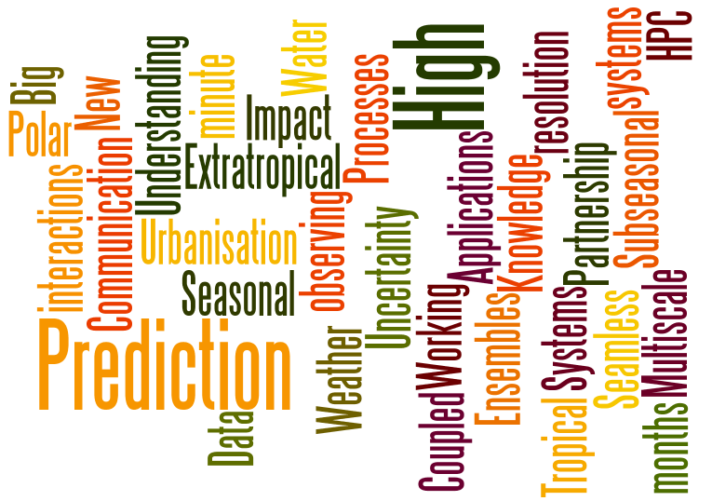
52
Technical Commission for Atmospheric Science
2

Slide 53
WWRP
WWRP
53
Technical Commission for Atmospheric Science
2
Notes:
WWRP mission … Towards forecasting the impacts of weather-related hazards: improving prediction, evaluation and communication

Slide 54
New technology
Underpinning Science
Research Infrastructure
Quantify impacts
Communication
Validation
Science to Applications
Education and Mentoring
International
Interdisciplinary
Partnerships: Operational – Academic
Developed and Developing Countries
User and Research Communities

Slide 55
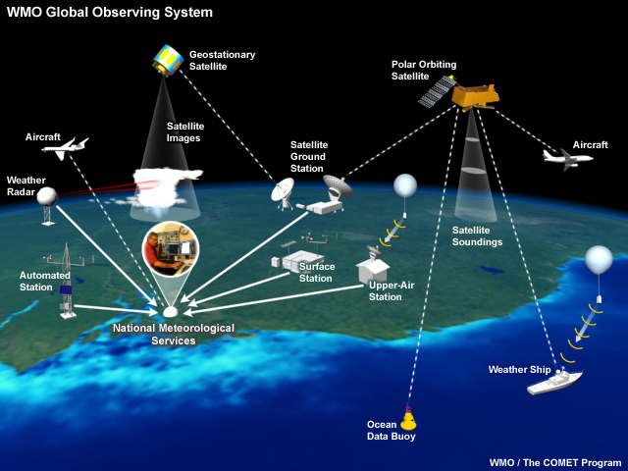
Implementation of an Integrated, Global, Greenhouse Gas Information System (IG³IS))
IG³IS combines:
  ground-based and space-based observations of concentrations and fluxes,
  improvements in atmospheric transport and carbon-cycle modeling,
  inverse modeling and anthropogenic GHG flux attribution on sub-continental, policy-relevant scales.
LIDAR
Ozone
sondes
&
Research Institutions
Research vessel

Slide 56
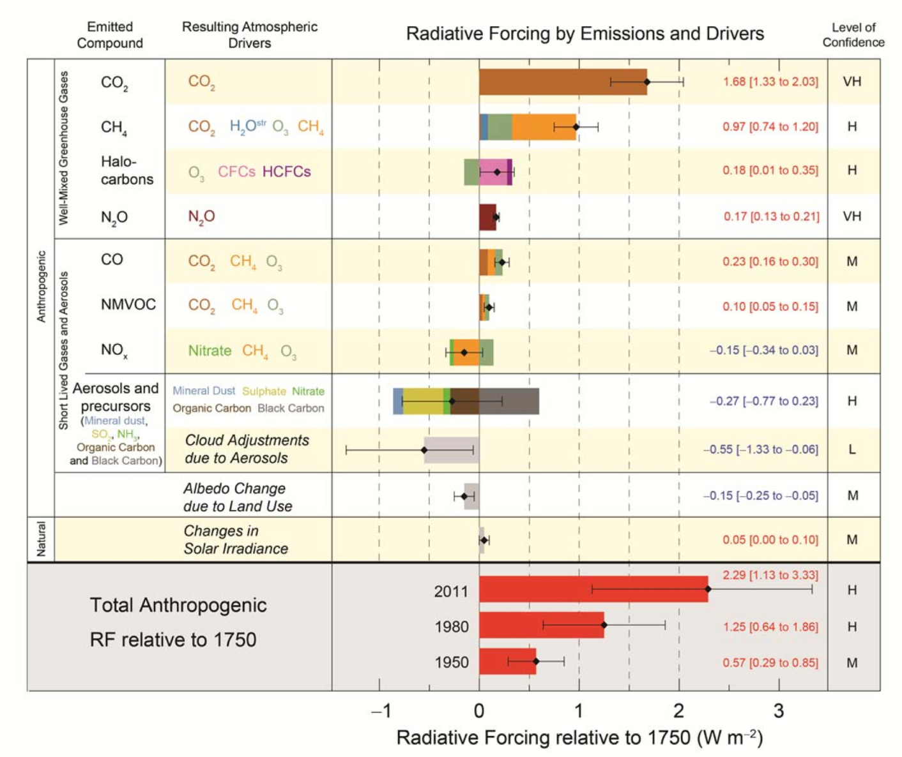

Atmospheric composition and climate
GAW coordinates global observations of these essential climate variables
Climate engineering debate to be informed by science
Notes:
Greenhouse gases are the drivers of climate change according to IPCC AR5
Greenhouse gases and aerosols are accepted by GCOS as Essential Climate Variables
GHG are needed to support GFCS
Actions on GHG will be different between countries and need an independent verification – the Integrated Global Greenhouse Gas information System will help to identify the effects of those actions – through scientific understanding of carbon cycle (both sources and sinks)
We need improved knowledge of the GHG behavior in the atmosphere, we need to improve atmospheric transport models and data assimilation schemas to deliver user relevant information on the local and regional scale
(paras 11 and 12)

Slide 57
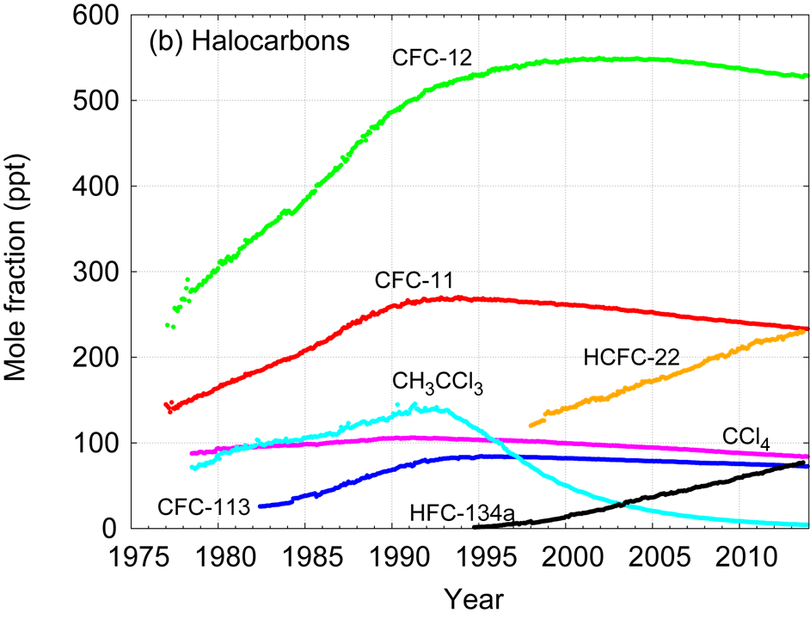
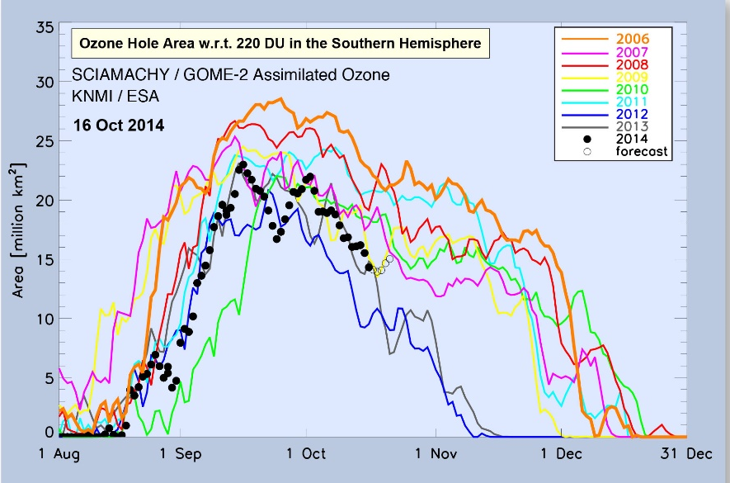
Support of Conventions
Ozone research are carried out in collaboration with UNEP
The actions taken through Montreal Protocol and Vienna Conventions are seen in long-term data sets of CFC-11 and CFC-12.
Continues ozone observations are required to confirm the expected recovery
WMO; Research
8
Notes:
Effects of control of ozone depleting species requires long-term observations to document the effects of the ozone layer and on climate forcing
WMO played an important role in initiating and originally supporting ozone network (now most of funding is coming from UNEP)
57

Slide 58
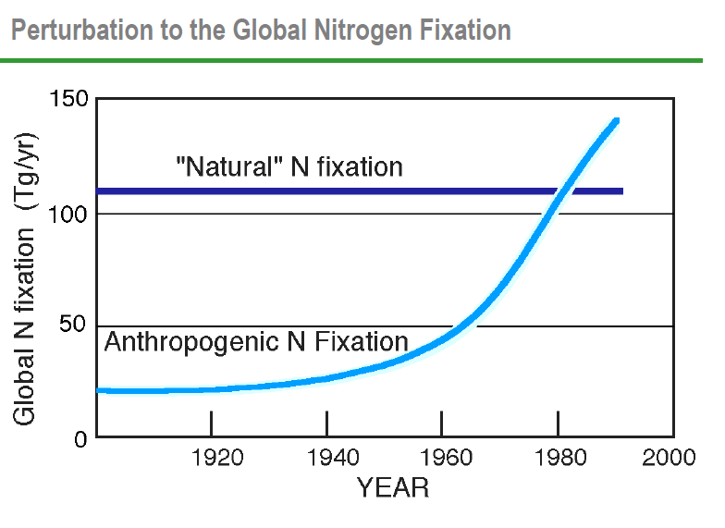
Atmospheric composition, health and ecosystems
WHO passed a resolution on air pollution and health
3.7 millions premature deaths per year are associated with outdoor air pollution
Deposition of oxidised and reduced nitrogen causes eutrophication, acidification, impacts water and soil quality, airborne Nr affects air quality, oxidation efficiency, visibility, climate, crop yield
Notes:
Atmospheric composition has numerous impact on health and ecosystems.
Short-lived climate pollutants (including aerosol and tropospheric ozone) in addition to their impact on regional climate have adverse effects on human health and food security (both through crop loss due to ozone exposure and impact of deposition on fresh water and oceans)
In Europe the wheat loss in 2000 caused by tropospheric ozone 3.2 billion Euro. Due to actions taken on emission to control peak ozone level the loss is forecasted to be 2 billion Euro in 2020.
The forecasting of future losses is associated with projected climate change, that impacts projected air quality (tropospheric ozone level). Climate change will be essential for future deposition patters as it impacts precipitation and vertical velocity critical for deposition.
There is a substantial impact of short-lived climate pollutants on human health. Some clinics in USA (based on EPA data) have an increase in admission (emergency due to respiratory diseases) proportional to the ozone exposure the previous day.
Better collaboration should be established with a commission on agricultural meteorology to better quantify global effects of air pollution on agricultural production.

Slide 59
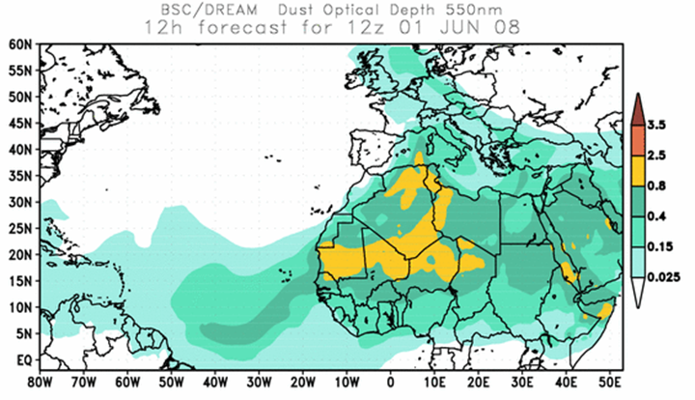
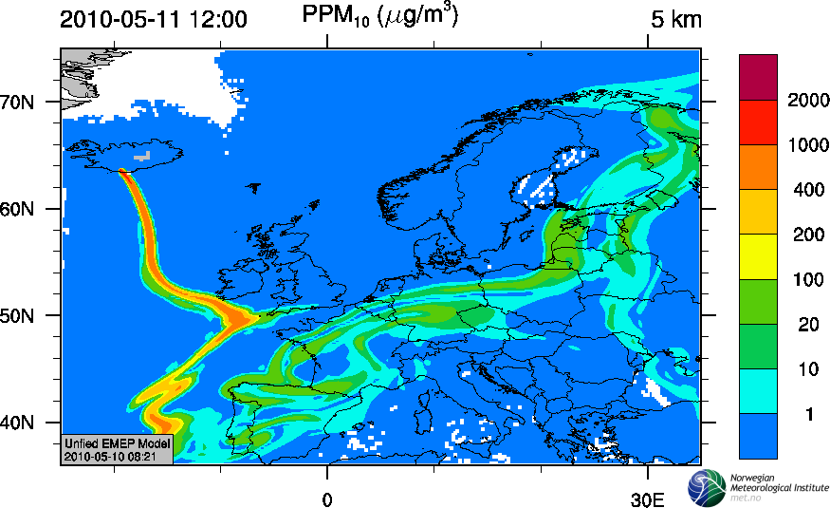
Atmospheric composition and security
Sand and Dust storm forecasting system
Volcanic ash plume forecasting (CAMS)
Notes:
These are two other applications of atmospheric composition:
In collaboration with WWRP on DSD warning. Better coordination is needed with GAW in particular relative to observations required for verification
Work on volcanic ash is done in collaboration with aeronautical meteorology, so far the coordination is rather weak. Special cross-cutting group was created to address this issue

Slide 60
A seamless approach for services
Nowcasting
Short to Medium Range
Monthly

Slide 61
WWRP at a glance
WG
Nowcasting and Mesoscale
Tropical Meteorology
WG
Predictability, dynamics and ensemble forecasting
WG
WG
WG
Data assimilation and observing systems
Verification
WG
Social and economic research
WWRP a seamless programme
High Impact Weather
Urbanization
Predicting Water Cycle
Emerging Technologies
Polar Prediction
Sub-seasonal 2 seasonal
High Impact Weather
Challenges Projects Working Groups
61
Technical Commission for Atmospheric Science
2
Notes:
Here a brief overview of the new WWRP structure. The four challenges, the three legacy projects, Sub-seasonal to Seasonal, a joint WCRP WWRP initiative, Polar Prediction in collaboration with WCRP and High Impact Weather.
Finally the working groups and their main topics.

Slide 62

A changing environment pushes science for integrated approaches (a seamless framework for weather, climate and earth system analysis and prediction)
WMO

Slide 63

WWRP – WCRP – GFCS partnerships
GFCS: seasonal to decadal forecasts; downscaling

Slide 64
Forsknings- og brukerdrevet produksjonskjede ROMS /CMEMS /WAM/ismodeller En instituttkultur med flere dialekter
Postprosessering for
Shipping
Offshore
Marine ressurser
Bølgevarsler
stormflo
Turisme
Beredskap
HiW inkl PL
Prosessbeskrivelse
Dynamikk
Fysikk, snø, is,
Kjemi
Prediktabilitet
Jordsystem
Modellformulering
Dataassi-milasjon
Verifikasjon
EPS
Backend
Frontend
Human interface
Bruk
Observasjoner
Post 50, FFI,
BW, Beredskapsetater,
NRS,….
Alle spesialiserte brukere
Forskningsrådet
CMEMS, post50
EU-prosjekter
Nettverk med NERSC, HI, EUMETSAT, U&H
internasjonalt
NRS
Forskningsrådet
U&H nasjonalt og internasjonalt
R&D, IT med geofaginnretning, brukskompetanse, formidlingskompetanse

Slide 65
Forsknings- og brukerdrevet produksjonskjede NorESM
En instituttkultur med flere dialekter
Postprosessering for tilpasning
RCM
ESD
Allmennheten
Energisektor
Flom/NVE
Bedre byluft
Shipping
Veivær, togvær
Offshore
Marine ressurser
Bølgevarsler
stormflo
Landbruk
Turisme
Beredskap
HiW inkl PL
Prosessbeskrivelse
Dynamikk
Fysikk, snø, is,
Kjemi
Jordsystem
Modellformulering
Dataassi-milasjon S2S, dekadisk
Verifikasjon
EPS
Backend
Frontend
Human interface
Bruk
Observasjoner
Post 50, KSS,
Statkraft, Statnett, Beredskapsetater, CORDEX, CMIP6, IPCC
NCAR,
Hirlam B, WMO,
Alle spesialiserte brukere
Forskningsrådet
post50
EU-prosjekter
Nettverk med UiB,
U&H, WMO, WCRP, NCAR, AMAP
internasjonalt
Forskningsrådet, SFF?
U&H nasjonalt og internasjonalt
Forskningsrådet, SFF?
U&H nasjonalt og internasjonalt
R&D, IT med geofaginnretning, brukskompetanse, formidlingskompetanse

Slide 66
Forsknings- og brukerdrevet produksjonskjede EMEP
En instituttkultur med flere dialekter
Postprosessering for
CLRTAP
GAINS
Mitigation
Energisektor
Bedre byluft
Shipping
sektorforurensning
Offshore
Landbruk
Beredskap
Prosessbeskrivelse
Dynamikk
Fysikk,
Kjemi
Jordsystem
Modellformulering
Dataassi-milasjon
Verifikasjon
EPS
Backend
Frontend
Human interface
Bruk
Observasjoner
Post 50, SVV, Beredskapsetater, EU-prosjekter
Nettverk med NILU, IIASA, EMEP -
internasjonalt
WMO,
Alle spesialiserte brukere
EMEP, CAMS, Forskningsrådet
post50
EU-prosjekter
Nettverk med NILU, IIASA, EMEP -
internasjonalt
CAMS,
NRS
Forskningsrådet
CLRTAP
R&D, IT med geofaginnretning, brukskompetanse, formidlingskompetanse

Slide 67
Forsknings- og brukerdrevet produksjonskjede beredskapsmodeller
En instituttkultur med flere dialekter
Dataassi-milasjon
Postprosessering
Verifikasjon
EPS
Backend
Frontend
Human interface
Bruk
Observasjoner
Post 50, SSV, Beredskapsetater, EU-prosjekter, SFF CERAD
EMEP, SSV, Luftfartstilsynet/
Avinor,
Kystverket, Hovedrednings-sentralen, SFF CERAD
R&D, IT med geofaginnretning, brukskompetanse, formidlingskompetanse

Slide 68



Loss in life expectancy attributable to anthropogenic PM2.5 [months] (IIASA)
MILJØANALYSER
2000 2010 2020
Loss in average statistical life expectancy due to identified anthropogenic PM2.5, average of calculations for 1997, 1999, 2000 & 2003 meteorologies

Slide 69

Production chain in a weather service
Input
information
Core
information
Model calculations
integrating basic data
and process knowledge
User customized
information
(user products)
The public
Basic data from:
Observations
Experiments
Process
description
specialized
operational
users
Other
branches of
research
or innovation
Core
Services
Downstream
Services
Output from
other
science
disciplines
or services
IA, socio-economics
National weather,
marine
climate
emerg-encies,
pollution
data policy

Slide 70
Production chain in a weather service
Distributed, metadata governed data managament, NRT and legacy-orientert
Input
information
Core
information
Model calculations
integrating basic data
and process knowledge
User customized
information
(user products)
The public
Basic data from:
Observations
Experiments
Process
description
specialized
operational
users
Other
branches of
research
or innovation
Core
Services
Downstream
Services
Output from
other
science
disciplines
or services
IA, socio-economics
National weather,
marine
climate
emerg-encies,
pollution
data policy

Slide 71
A changing environment pushes science for integrated approaches (a seamless framework for weather, climate and earth system analysis and prediction)
WMO

Slide 72
Trajectory-Based Operation (TBO)
Transition from nowcasting scale -> mesoscale -> global scale -> mesoscale -> nowcasting scale
Mesoscale / Global modelling
Nowcasting
Nowcasting
Terminal Control Area:
Location specific
En Route Phase: Mainly supported by global/regional Multi-model Aviation Weather Forecast Centre (AWFC)
Terminal Control Area:
Location specific

Slide 73


Meteorological Service for the Terminal Area (MSTA)
airport
This is the area needs 0-6 hr nowcast
The closer to the airport, the high resolution meteorological information will be required.
Different airports will have different requirements
* Nowcast or nowcasting hereafter refers to all techniques/systems including observation-based, expert system-based, human-machine interfaced and meso/microscale NWP or any combination thereof which can generate high resolution, rapidly updated forecasts for the next 0-6hr ahead

Slide 74

Ensemble systems at MET
Three time horizons covering smaller domains and higher resolutions :
IFS ENS
--> 15 d or 32 d
32 km resolution
Made by ECMWF
20 years in Dec 2012
52 members
GLAMEPS
--> 54h
8 km resolution
Multi-model
Operational within HIRLAM/ALADIN
HarmonEPS
--> ~1.5-2d
2.5 km resolution
Multiphysics (Arome and Alaro)
HarmonEPS will by end of 2015 replace the current deterministic forecast from MET (2.5km resolution) (in the HIRLAM-project). Will be implemented in MetCoOp
HarmonEPS under further development with new perturbation types in the HIRLAM project
Kilde: Inger Lise Frogner
Notes:
Tre tidshorisonter, mindre og mindre
område dekkes, men høyere oppløsning:
IFS ENS
Lange prognoser ( → 15 eller 32 dager)
32 km gridoppløsning
Produseres av ECMWF, Reading, UK
GLAMEPS
For varsler over Europa opp til 54h
8 km gridoppløsning
Multi-modell system
Operasjonelt samarbeid – HIRLAM/ALADIN
HarmonEPS
For korttidsvarsel -> ~1.5 - 2 døgn
2.5 km gridoppløsning
Multi-fysikk (Arome og Alaro)
HarmonEPS vil i slutten av 2015 erstatte dagens
deterministiske prognose fra MET på 2.5 km
HarmonEPS utvikles videre med nye typer
perturbasjoner i HIRLAM-samarbeidet.

Slide 75


    Mobile X-band radar:
    30-50 km range, 250m horizontal resolution. 1-2min time resolution (1-2 min). Co-location field experiment?
Haukeliseter Test field
Wind correction of precipitation and WMO Solid Prec Intercomparison Experiment

Slide 76

Use of radar data in forecasting and analysis – wind and precipitation
S E Norway not well covered by C-band radars

Slide 77

Warming in permafrost
Data from Romansky, Fairbanks; Jerry Brown, U Oslo and Ketil Isaksen, met.no. In ”Melting snow and ice. A call for action”

Slide 78


Planlagt HF Radar dekning 2015
3 HF Radar installeres på Finnmarkskysten i 2015 med støtte fra Eni Norge, Statoil og Norske Shell.
HF Radar måler overflatestrøm – radiellkomponent. Rekkevidden er 150-250 km.
Dataene assimileres i METs havmodell for å forbedre strømvarsler.
HF Radar kan også brukes til skips-deteksjon
Notes:
Langtidsplanen er å bygge nettverket av radarer videre langs kysten, både østover og sydover.

Slide 79


Discovery Access and Retrieval Services in WIS
Forvaltning av alle slags data. Ikke bare håndtering av NRT datastrøm.
Global Information System Centres (GISCs)
ISO compliant Meta Data format and contents
GCW, NORDMAP, NMDC, NorDataNet, SIOS, AeN, GeoAccess,
Data Collection or Production Centres (DCPCs)
Notes:
79

Slide 80


