Slide 1

Global Atmosphere Watch (GAW) – oppertunities for WGNE
31st WGNE meeting, 26-29 April 2016, CSIR, Pretoria,
South Africa

Slide 2

The Next GAW Decade
The vision for the next decade of GAW is to grow the international network of high-quality atmospheric observations across the global to local scale to drive high quality and impact science while co-producing a new generation of research enabled products and services.
We also realise that: A future where GAW-lead activities play’s an enhanced role in supporting society will require a greater integration of enhanced observation and modeling capabilities

Slide 3
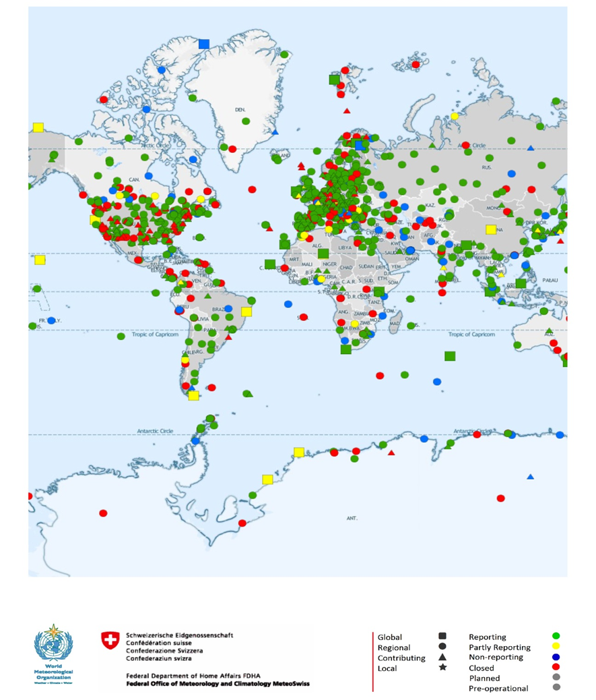
Key to GAW's success
Shared Vision
Global Collaboration (across disciplines)
High quality products (data as well as the QC and QA thereof)

Slide 4
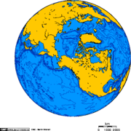
Challenge: How best to incorporate or integrate Composition, Weather and Climate Services
Moderating
Influences
Coupled Environmental Models
Impacts
Extreme Weather
Climate induced …Health impacts
Toxic, Nuclear & …Disease Transport
Flooding/Drought ...Alerts
Water Availability
Air Pollution
Habitat changes
Biodiversity loss
Atmospheric
(Weather)
Coupled
Computer
Modelling
Monitoring
Natural &
Human-Induced
Environmental
Change
Models
Air-borne Transport
Water Cycle
Atmospheric Chemistry
Land change processes
Ecosystems
Research
Adaptation
Measures
Across Relevant Temporal and Spatial Scales
4

Slide 5
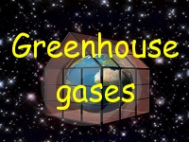
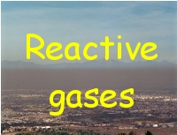
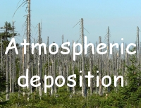
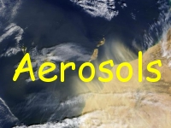

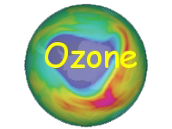
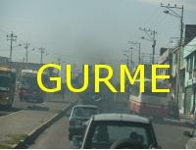

Operational SAG's
Apps

Slide 6
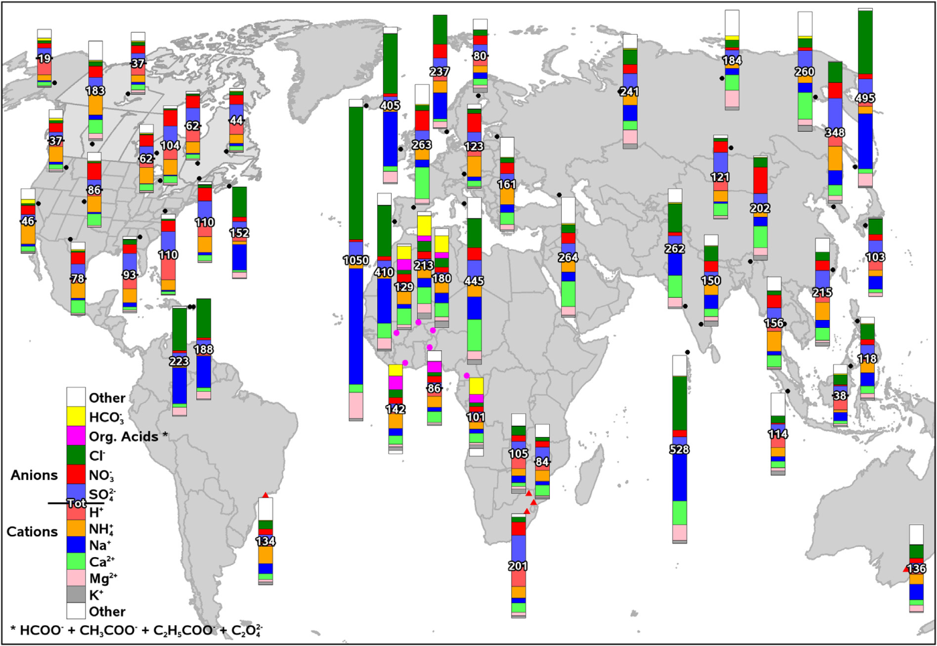
Products of SAG's
3-year average ion composition of rain water (2005 - 2007)
(Data can be obtained from the GAW World Data Centre for Precipitation Chemistry)
http://dx.doi.org/10.1016/j.atmosenv.2013.10.060

Slide 7
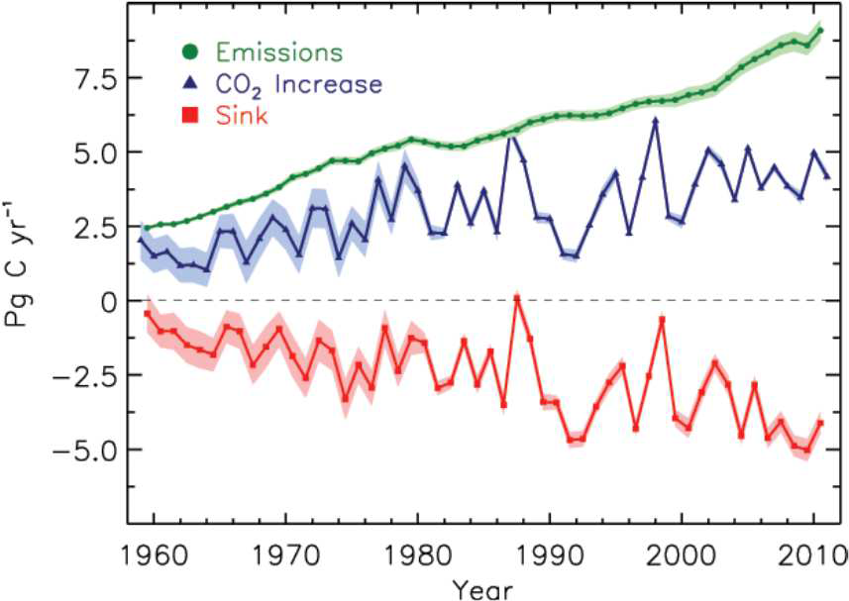
Products of SAG's (IG3IS – Greenhouse Gas information system)
Complexity of carbon cycle
# Identification of sinks needs dedicated measurements
# CO₂ uptake by oceans lead to ocean acidification
# Knowledge of terrestrial and ocean sinks is essential for definition of anthropo-genic contributions

Slide 8
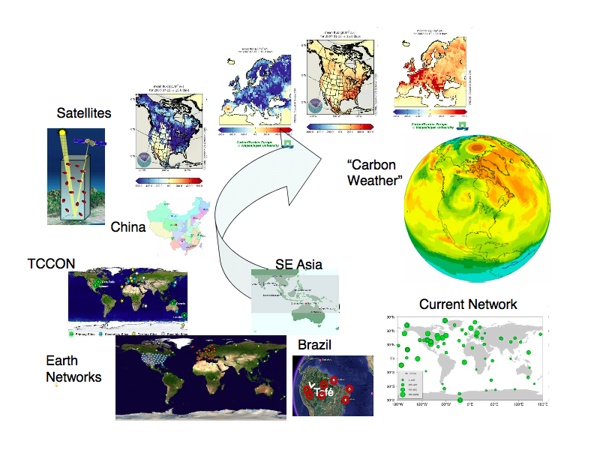
IG3IS – Greenhouse Gas information system
Everything we learn about state of the greenhouse gases in the global atmosphere is based on the high quality long-term globally harmonized observation
The Earth System captures 50% of emissions (terrestrial biosphere and ocean uptake) – for how long?

Slide 9
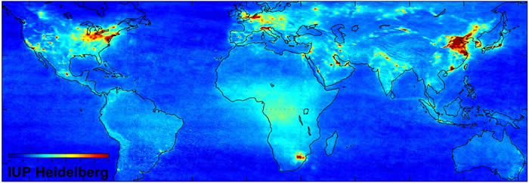
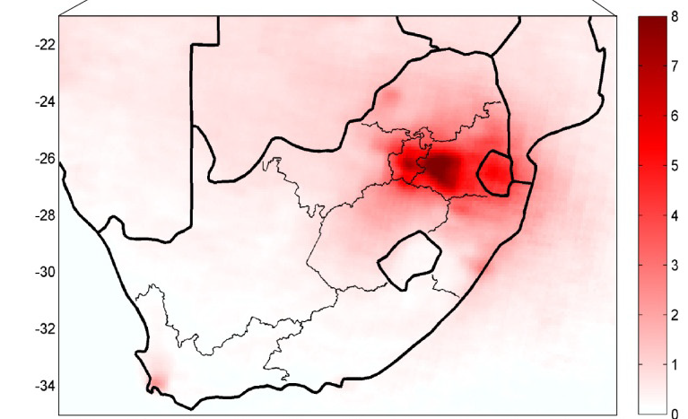
Products of SAG's
Lourens et. al. “Re-evaluating the NO₂ hotspot over the South African Highveld.” S Afr J Sci, 2012;108(11/12)

Slide 10


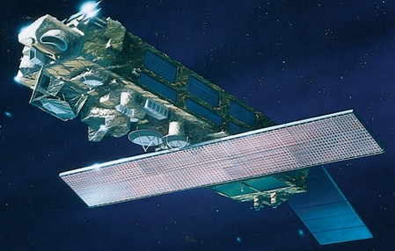
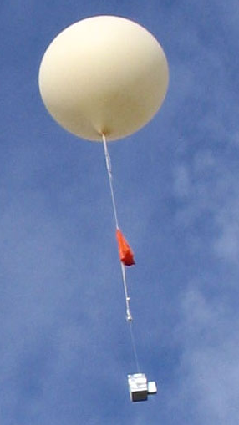
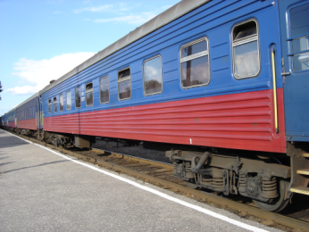

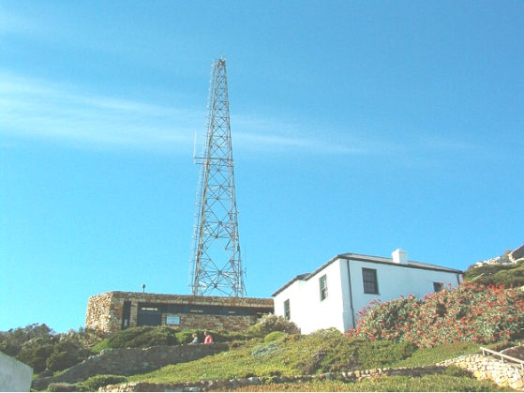
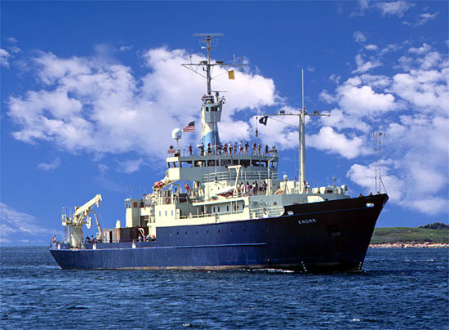
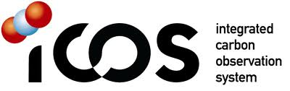




Good News: The global observing system for atmospheric composition is growing
Airplanes
Satellites
Balloons
Trains
Ground-based stations
Ships
…

Slide 11
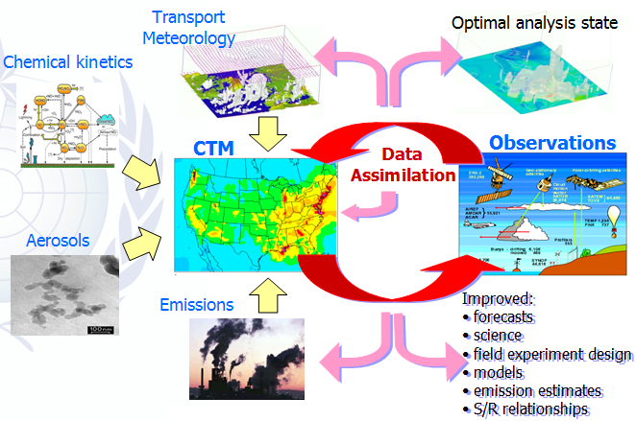
Improving Air Quality Predictions/Services and the role of Atmospheric Composition in Weather and Climate applications offer great opportunities
Evolving
Obs Systems
Improved Forward Models & Assm. Sys.
Improved Predictions
Requires
Continuous Research
Enhanced
Data Manag. & Discovery
Systems
Improved
Emissions

Slide 12
GAW – what’s next?
Continue to improve observational systems and data using RRR and WIGOS/WIS (WMO Integrated Global Observing System and WMO Information System) to evolve the observing system for atmospheric composition to support the growing services to:
☑ allow near real-time provision of GAW data,
☑ support integration of surface, vertical profile and column datasets from different platforms to provide a unified understanding of aerosol and gas distributions,
☑ minimize gaps in the measurement networks in data-poor regions,
☑ support the expanding service needs related to cities, high impact weather, and climate

Slide 13
GAW – what’s next?
Expand GAW’s role in enhancing predictive capabilities (wrt atmospheric composition and its uses)
☑ through further developing urban air quality forecasting capabilities through (GURME) ,
☑ establishing a new SAG (“Apps” – usefulness exchanging chemical observational data in NRT))
☑ expanding collaborations with WWRP/WCRP/WGNE and others

Slide 14
Ideas for Increased Collaboration
model expertise exchange and joint model development;
model-observation integration among the SAGs;
integrating observation with model development, including, but not only, model evaluation, data assimilation and source attribution;
stimulating the atmospheric chemistry community worldwide to engage on model development going further than models use only;
identifying local/regional needs in terms of operational products and services;

Slide 15
Ideas for Increased Collaboration
guiding design and implementation of local/regional atmospheric chemistry operational forecasting systems;
performing global/regional model reanalysis in order to build up a multi-model database resources for model applications;
carrying on global/regional assessments via observation-modeling integration;
developing common reference on skill standards for chemical composition models and products for evaluation purposes.

Slide 16
Creating a better world requires working together as the complexity of challenges facing us requires more than parallel computing power!

Slide 17
