Slide 1

JWGFVR highlights
Marion Mittermaier
Laurie Wilson

Slide 2
Current membership
Barb Brown (NCAR)
Barbara Casati (Canada)
Jing Chen (China)
Caio Coelho (Brazil)
Manfred Dorninger (Austria)
Thomas Haiden (ECMWF)
Stephanie Landman (SA)
Chiara Marsigli (Italy)
Yuejian Zhu (NCEP)
one vacancy
Co-chairs:
Marion Mittermaier (UK)
Laurie Wilson (Canada)

Slide 3
Outline
Outreach, training and meetings
Strategic direction/challenges
WWRP activities
  HIW
  S2S
  PPP
Selected research highlights of interest to WGNE
Discussion items

Slide 4
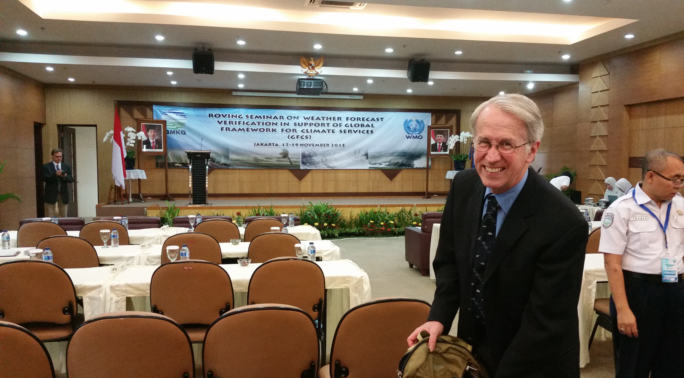
Recent outreach
Jakarta roving tutorial 17-19 Nov 2015 @ BMKG
~20 students with four lecturers (Pertti, Barb, Laurie, Marion)
SWFDP training in Africa
Mausam special issue released with 6IMVW papers

Slide 5
Meetings
EMS-ECAM (Sofia) - September 2015 - verification session (biggest parallel session with strong FROST14 contribution, BAMS paper now published), MesoVICT session, annual WG meeting
M-Clix workshop (WCRP grand challenge) (Oslo) - October 2015
IICWF DA and PPP ice verification workshop (Frascati) - April 2016
HIW evaluation Task Team meeting (Exeter) - April 2016
IMSC (Canmore) - June 2016 - International Meeting on Statistical Climatology verification session
RMetS NCAS conference workshops (Manchester) - July 2016
EMS-ECAC (Trieste) - September 2016 - verification and MesoVICT sessions
MesoVICT workshop (Bologna) - September 2016 + annual WG meeting
7th verification methods workshop and tutorial (Berlin) - May 2017

Slide 6

Extremes / warnings
Impact of observations uncertainty /
lack of observations/
under-utilisation /
new
Increasing resolution / ensembles
Identified JWGFVR future challenges
Methods for seamless / coupled
Environmental Prediction / propagation of errors
Model v user
WWRP SSC Update 2015

Slide 7
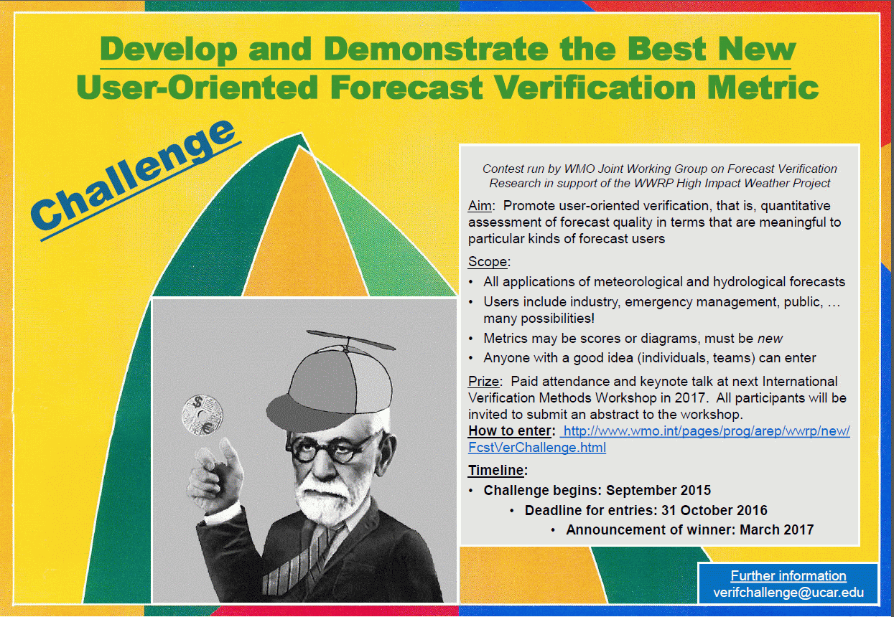

Slide 8
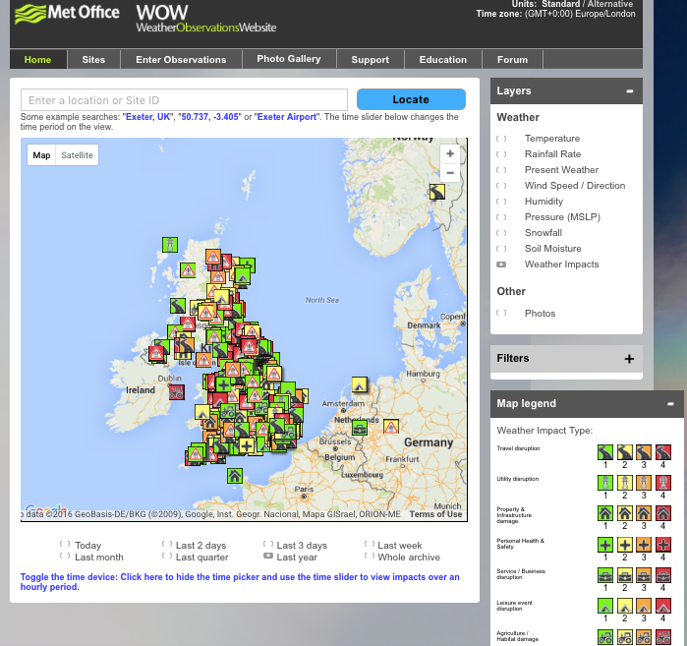
HIW contributions
H2020 bids, one successful (I-REACT), one not (Meteo-INFORMED)
Met Office specific work with WOW and collaboration with Exeter University

Slide 9
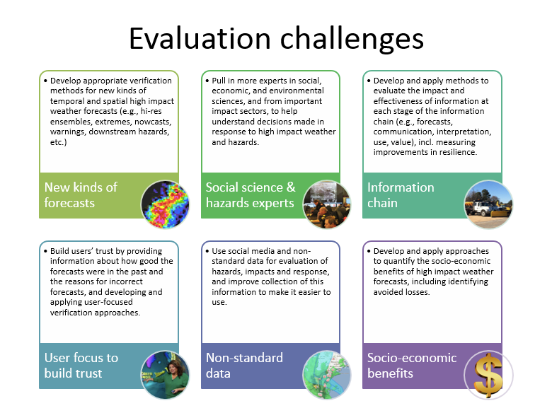
HIW
Notes:
Key Challenges
Recent work has demonstrated the value of using diagnostic and spatial verification methods to evaluate precipitation forecasts. We need to develop appropriate verification methods for new kinds of temporal and spatial high impact weather forecasts (e.g., high resolution ensembles, extremes, nowcasts, warnings, downstream hazards, etc.)
There are currently a very small number of scientists working in the area of user-focused evaluation. We need to pull in more people with expertise in the area of social, economic, and environmental sciences to assist with appropriate methods of evaluation, and from important impact sectors to help understand the decisions made in response to high impact weather and associated hazards.
Analysis of information content typically shows that information is apparently lost at each stage of the information chain (e.g., forecasts, communication, interpretation, use, value). We need to develop and apply methods to evaluate the impact and effectiveness of information at each stage, including measuring improvements in resilience.
Effective use of forecasts and warnings has been associated with trust in the product and its source. We need to build users’ trust by providing information about how good the forecasts were in the past and the reasons for incorrect forecasts, and developing and applying user-focused verification approaches.
Evaluation of hazards, impacts and response are limited by access to data. We need to use social media and non-standard data for evaluation and to improve collection of this information to make it easier to use.
Governments require assessments of the value of forecasting and warning services to national economies. Very few comprehensive studies have been undertaken. We need to develop and apply approaches to quantify the socio-economic benefits of high impact weather forecasts, including identifying avoided losses.

Slide 10
Contributions of JWGFVR to S2S
Subseasonal to seasonal prediction research implementation plan (Verification section led by Barb Brown, Initially appointed as liaison between JWGFVR and S2S)
S2S Sub-project on verification science plan (Led by Caio Coelho, Current liaison between JWGFVR and S2S)
WMO Publication, 2015: Seamless Prediction of the Earth System: from minutes to months. Two chapters:
Chapter 20. Sub-seasonal to seasonal prediction: Linking weather and climate (by S2S Steering and Liaison groups including JWGFVR)
Chapter 21. Numerical prediction of the Earth system: Crosscutting research on verification techniques
(by JWGFVR members)

Slide 11
S2S sub-project on verification (and products)
Objectives:
Recommend verification metrics and datasets for assessing forecast quality of S2S forecasts
Provide guidance for a potential centralized effort for comparing forecast quality of different S2S forecast systems, including the comparison of multi-model and individual forecast systems and consider linkages with users and applications
Issues to be addressed:
Identification of current practices in sub-seasonal to seasonal forecasts
Identification of user-relevant variables and quantities to be verified
Provision of guidance on minimum hindcast standards (hindcast length and ensemble size)
Promotion of subseasonal forecasting intercomparison efforts and evaluation of benefit of multi-model approach
Links with WMO Joint Working Group on Forecast Verification Research (JWGFVR), WMO CBS/CCl ET-OPSLS, WMO LC-LRFMME and other S2S sub-projects
Sub-project members: Caio Coelho, Andy Robertson,
Yuhei Takaya, Richard Graham, Debra Hudson and Joanne Robbins

Slide 12
S2S sub-project on verification (and products)
Website: http://www.s2sprediction.net/xwiki/bin/view/Main/Verification
Science plan developed with inputs from JWGFVR, SERA and S2S: http://www.s2sprediction.net/resources/documents/sub-projects/Verification.pdf
Current activities and plans:
Questionnaire on subseasonal verification practices in operational centers prepared and sent to Global Operational Centers, with the purpose sharing current practices used to verify subseasonal forecasts (both for operations and research) and also help identify gaps and guide novel developments. Results discussed with WMO CBS/CCl ET-OPSLS
Literature survey on S2S verification posted to the sub-project webpage
S2S is now included in the JWGFVR user-oriented verification challenge
https://www.wmo.int/pages/prog/arep/wwrp/new/FcstVerChallenge.html
Plans for establishing verification of sub-seasonal and longer range forecasts as a theme for the 7th International Verification Methods Workshop (IVMW) organized by the JWGFVR, Berlin in May 2017, and promote a S2S verification and climate metrics session in this workshop
Science plan: Guidance document
to stimulate scientific community
to address S2S verification problems

Slide 13
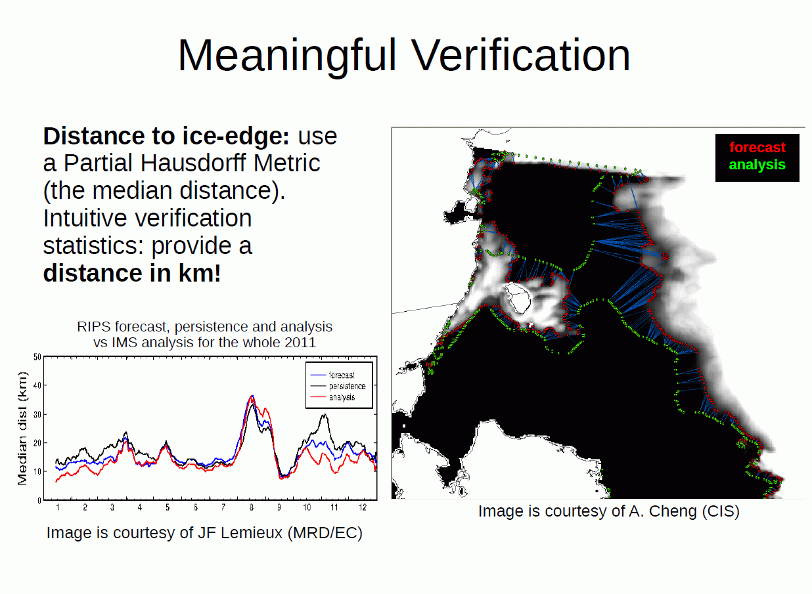
PPP – example of user-relevant metric

Slide 14
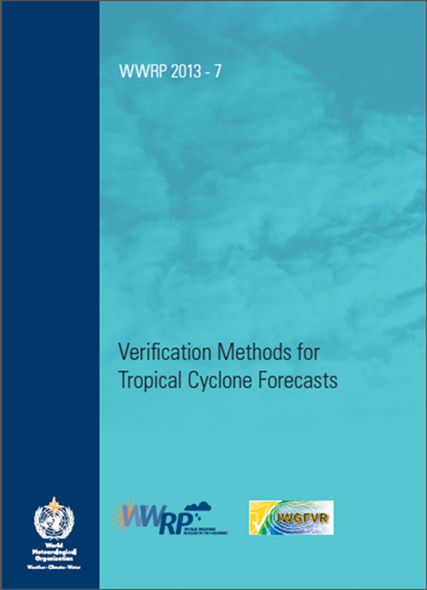
TC verification
“Commissioned” by World Weather Research Program (WWRP) and Working Group for Numerical Experimentation (WGNE)
IWTC8 outcome for WG to develop a set of required/recommended metrics for operational evaluation (requires coordination with CBS and tropical committees)
https://www.wmo.int/pages/prog/arep/wwrp/new/Forecast_Verification.html
IWTC VIII, December 2014, Jeju, South Korea

Slide 15
Science highlights and issues
Observation uncertainty
Application of “weather” methods in climate applications
MesoVICT
Precipitation verification
Verification of km-scale forecasts

Slide 16
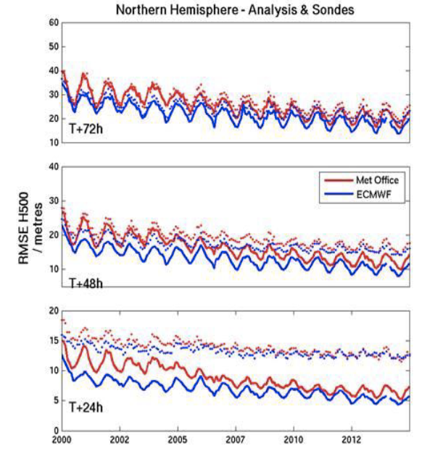
Observation
error
No longer able to detect improvements at t+24h (and t+48h) because reached observation error limit
Errors against analyses still appear to be able to decrease. Is this real?
Marion Mittermaier and Bill Bell.

Slide 17
Synoptic observations and model equivalents
Model time steps:
UKV (1.5 km) = 50s
MOGREPS-UK (2.2 km) = 75s
GM (17 km) = 10 min
Variable | SYNOP (in UK) | Model
Temperature | Instantaneous at HH-10 | Instantaneous time step closest to HH
Wind speed + direction | 10-min average between HH-20 and HH-10
Cloud base height | Instantaneous (manual) at HH-10 or exponential aggregate over 40 min (auto) at HH-10
Cloud amount
Visibility | 1-min sample reported HH-10
Precipitation | Accumulation (for hourly HH-70 to HH-10) | Accumulation between time steps nearest HH and HH-60

Slide 18
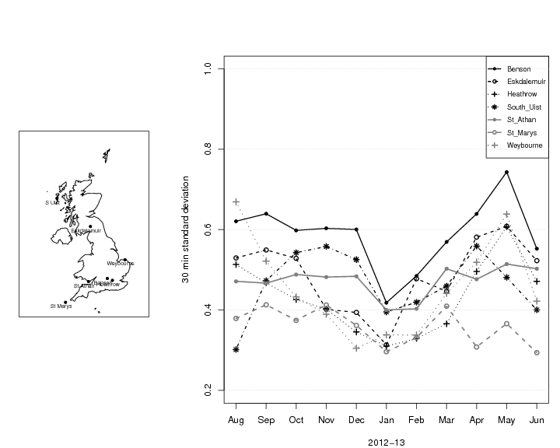
Observations sub-hourly variability - Temperature
m = 30 min past the hour standard deviations
Values vary between 0.3-0.75K
SW-facing coastal locations show little annual variation
Other locations have more pronounced annual cycle with distinct minima in January

Slide 19
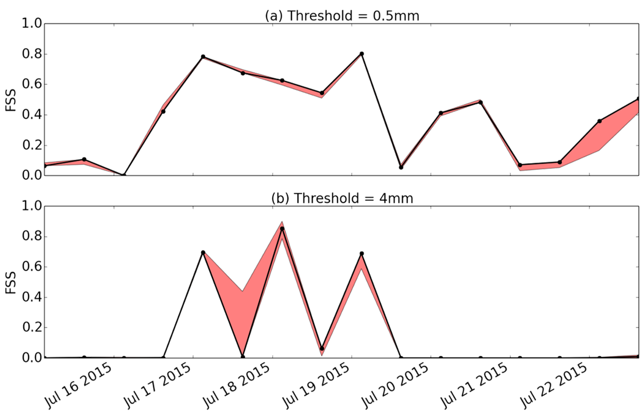
Radar-rainfall estimates are far from perfect. Using a radar ensemble of analyses to verify shows that the scores can vary considerably, and the effect is non-linear with intensity

Slide 20
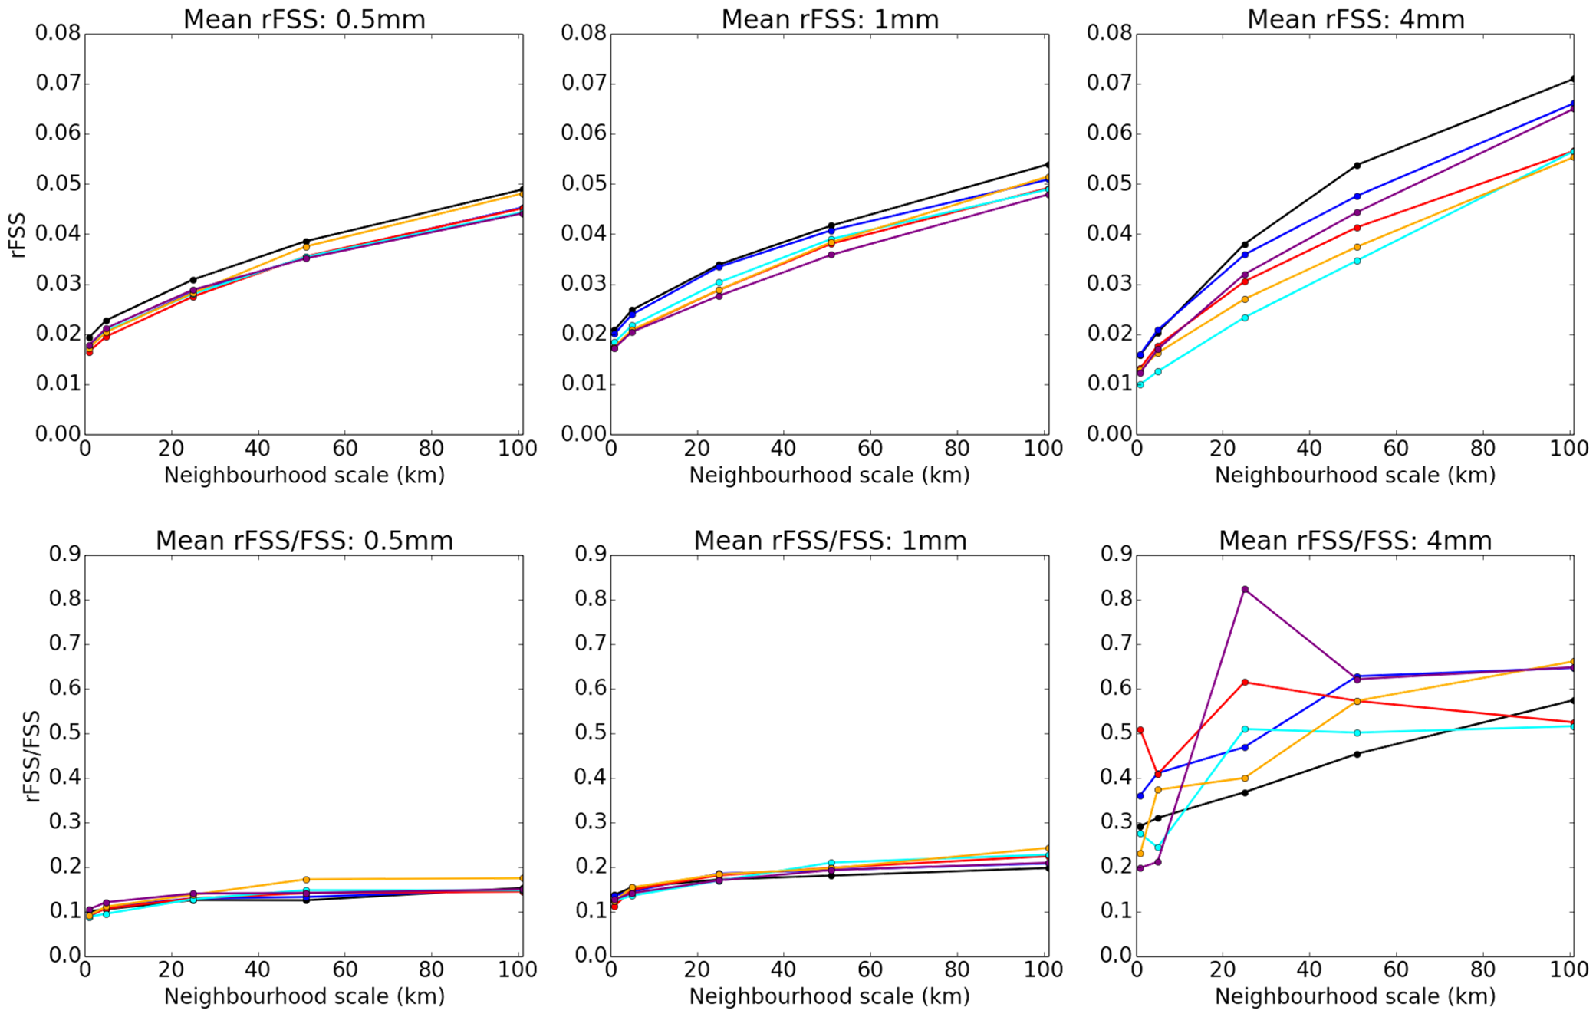
From Allison et al 2015, AMS radar conference, colours indicate different lead times,
rFSS = range of FSS scores for UKV assessed against the radar ensemble
10%
10-20%
30+%

Slide 21
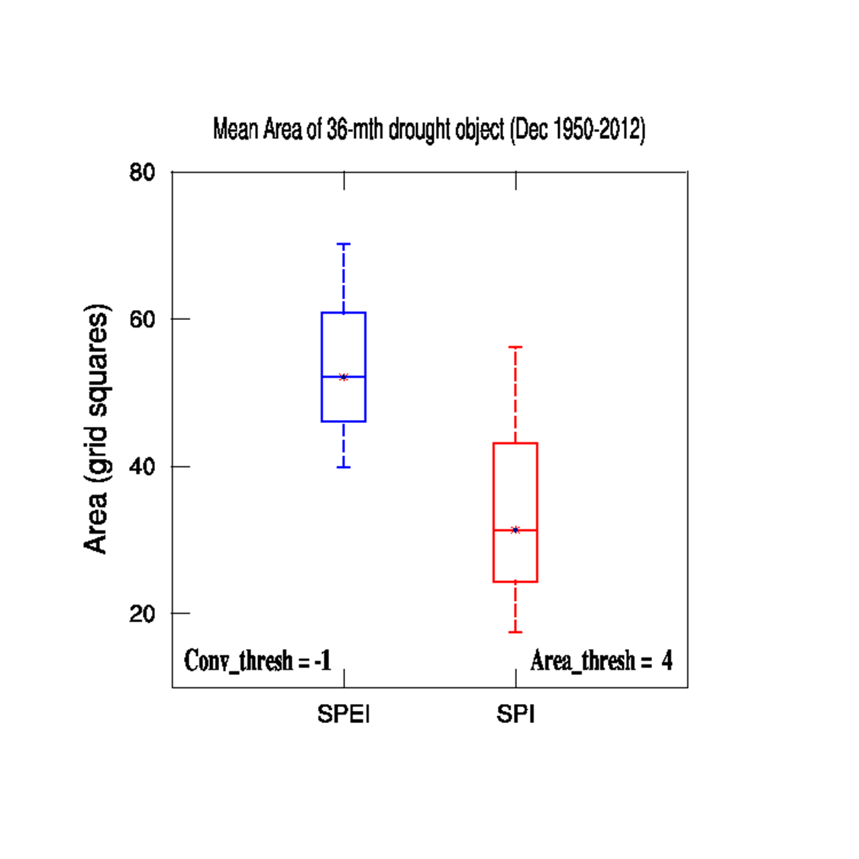
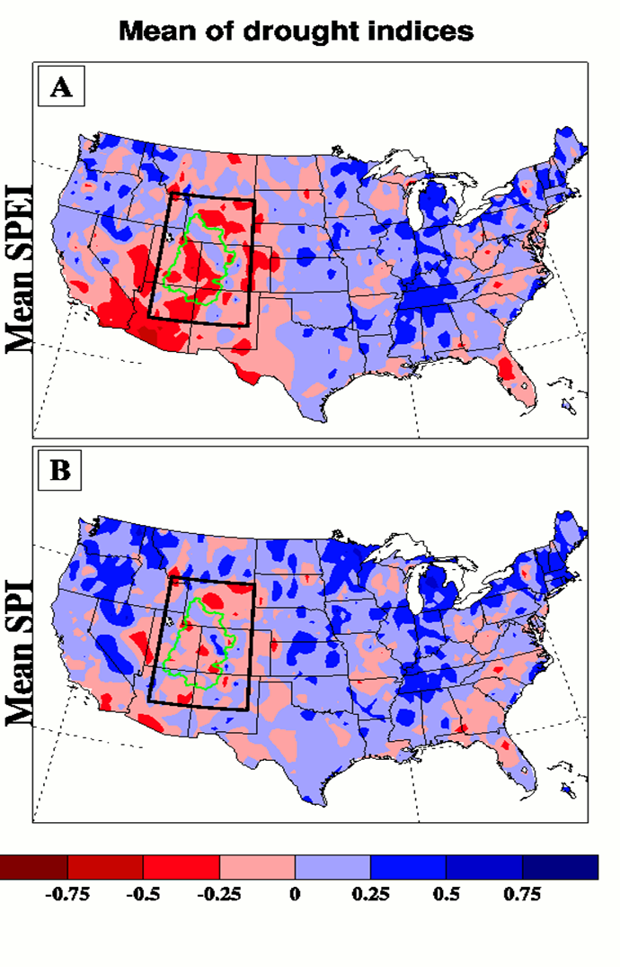
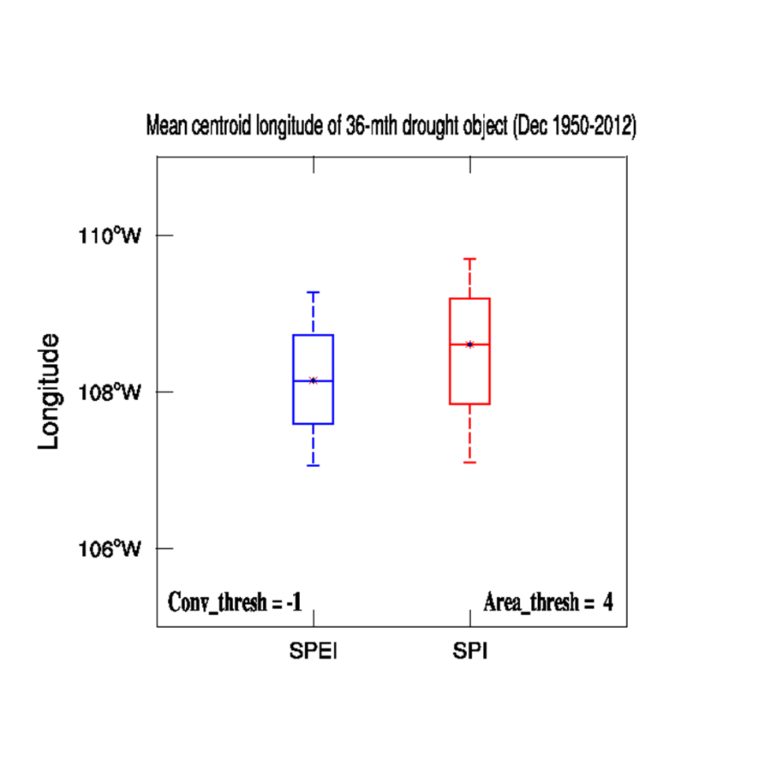
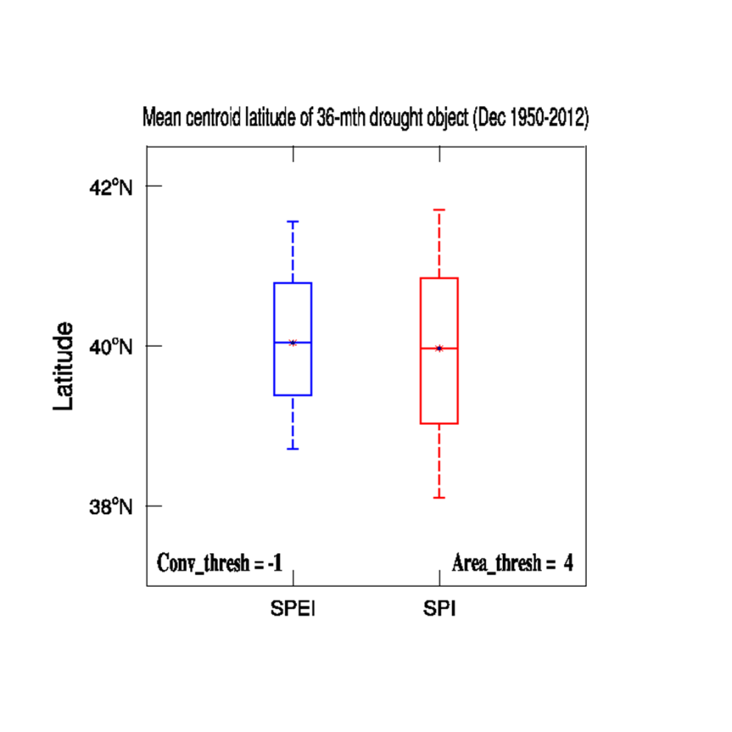
Use of MODE to compare 2 drought indices (SPI and SPEI) (36-mo averages, 1950-2012)
Object Area
SPEI
SPI
Longitude
Latitude
Credit: A. Abatan

Slide 22

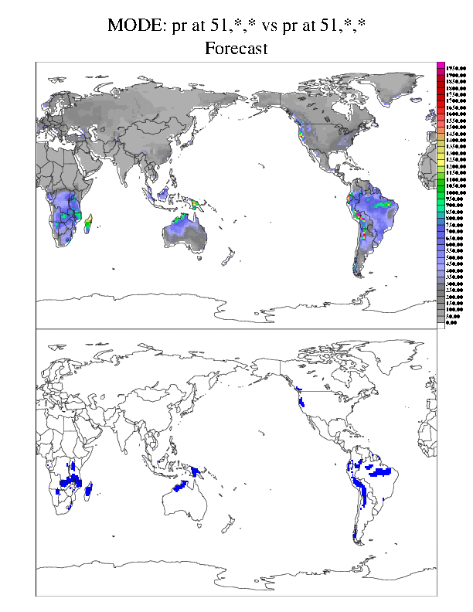
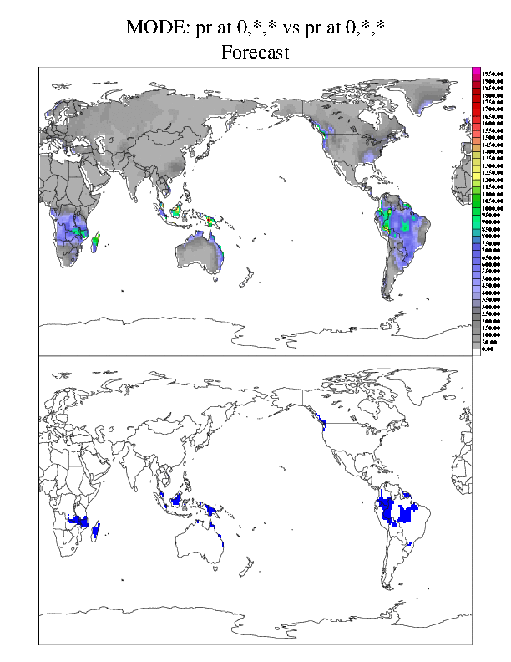
Comparison of forecast and observed precipitation objects
DJF precipitation, object threshold: 700 mm
CESM
CRU

Slide 23
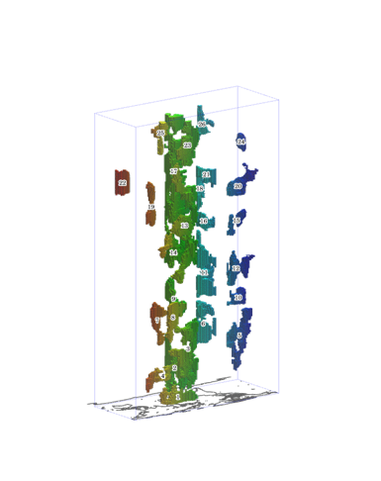
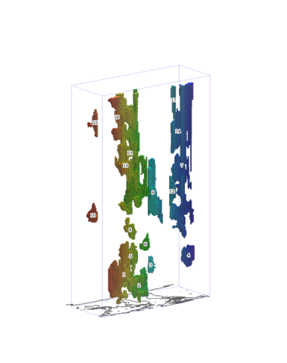
MODE: Time Domain (MODE-TD)
Pred
Obs
Characterize phenomena in space and time
Evaluate: time-integrated “volume”, velocity in space, lifetime, growth/decay rates, spatial complexity, …
September 2015 MET5.1 released
MODE-TD applied to
drought index

Slide 24
Aims of MesoVICT
How do/can spatial methods:
Transfer to other regions with complex terrain, and other parameters: wind (speed and direction) and rain?
Work with ensembles?
Incorporate observations uncertainty?
7
Notes:
Phase 1 (precipitation) completed
Methods applied by researchers to same datasets (precipitation; perturbed cases; idealized cases)
Subjective forecast evaluations
Weather and Forecasting special collection 2009-2010
I will show one or two examples of each type of method

Slide 25
  Progress to date
Very successful MesoVICT session at EMS-ECAM.
Good response from COSMO consortium - companion project called INSPECT
Continued development of SpatialVx R package
Good response from community in rerunning cases with latest model configurations: e.g. CMC, ISPRA, MeteoSwiss, Met Office etc
Less clear on response in terms of developing new methods etc

Slide 26
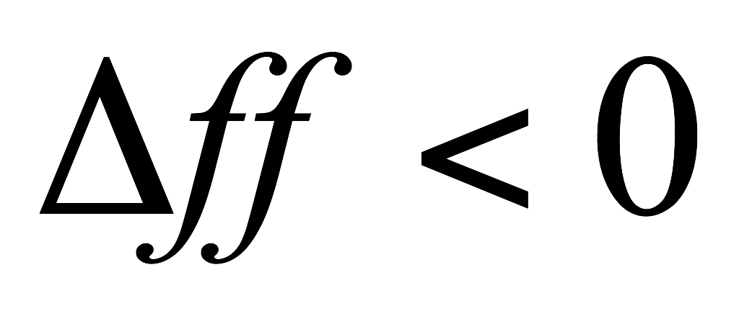
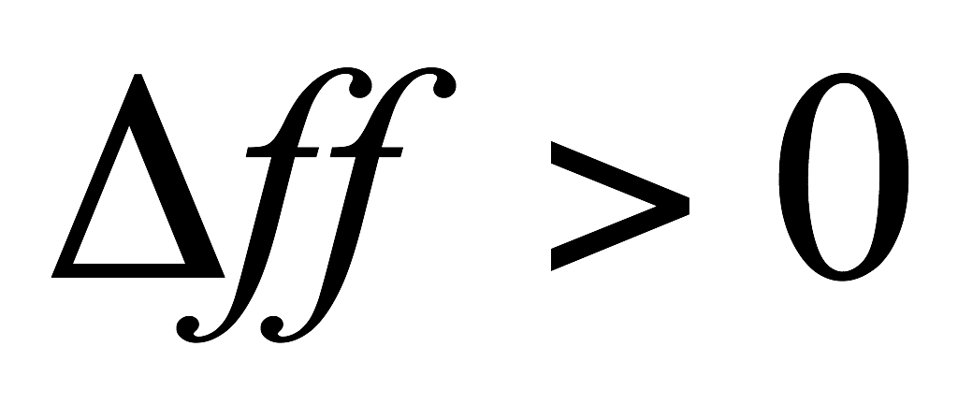
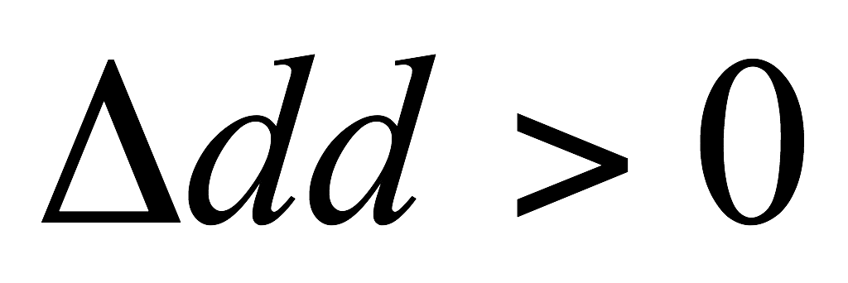
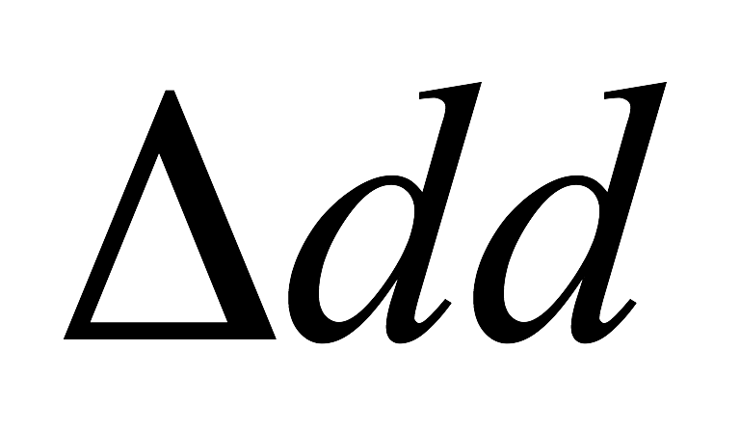
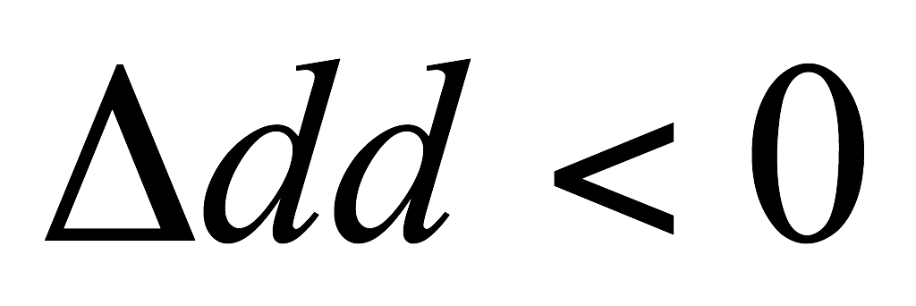
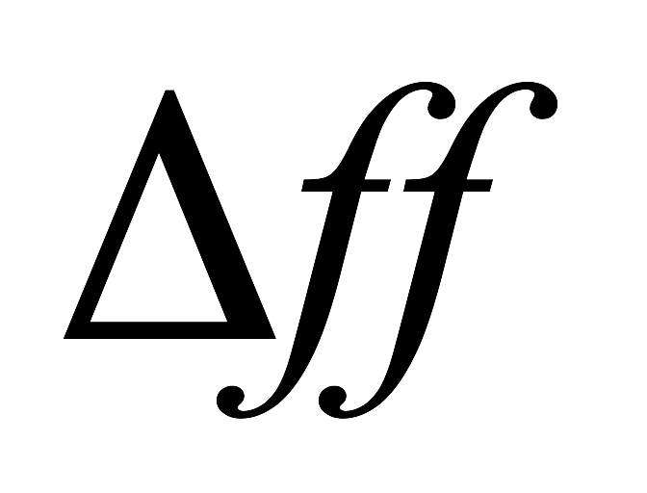
Simple verification scheme for wind direction
Verification of wind (2D, 10m) in complex terrain is one of MesoVICT goals
Possible Interpretation
+180 deg
II
I
FC of ff too low
FC of dd too anti-cyclonic
FC of ff too high
FC of dd too anti-cyclonic
FC of ff too low
FC of dd too cyclonic
FC of ff too high
FC of dd too cyclonic
III
IV
-180 deg
EMS/ECAM, Sofia
11 Sep, 2015

Slide 27
Recommendations from precipitation document
Recommendations document will need to be revisited to incorporate recent and current work e.g. CBS and MesoVICT outcomes etc
CBS TT-SV outcomes -> SEEPS was initially accepted but then reluctantly rejected because logistically the station lists and climatologies could not be reconciled between global centres participating in the initial tests (MetO, ECMWF, CMC and JMA). See http://www.wmo.int/pages/prog/www/DPFS/Meetings/TT-SV_Geneva2014/DocPlan_TT-SV.html

Slide 28
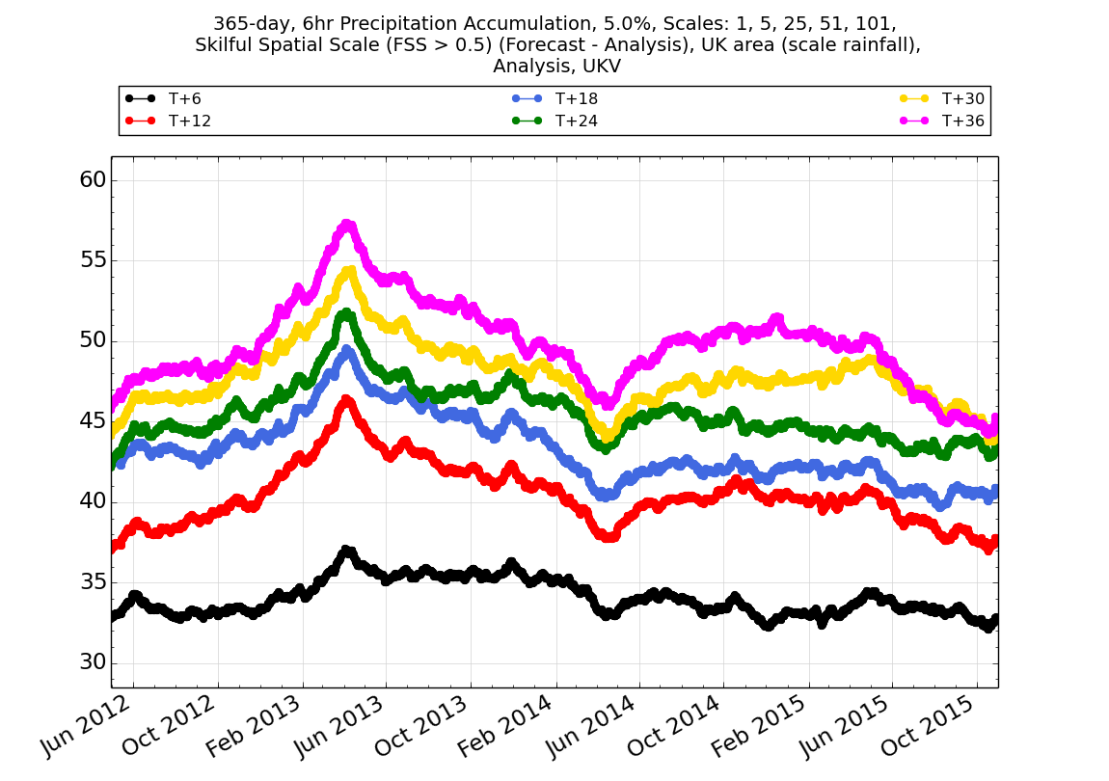
Monitoring of km-scale precipitation forecasts against 1km radar data over the UK
Continuation/follow-on from Mittermaier et al. 2013)
Running mean anomaly
Tracking results long-term is tricky!

Slide 29
CBS exchange of global surface verification 1
Mandatory
2-m temperature
10-m wind speed
10-m wind direction (for speeds greater or equal 3 m/s)
24-h precipitation
Additional recommended
Total cloud cover
6-h precipitation
2-m relative humidity
2-m dew point
Mandatory: forecast steps 6h, 12h, 18h, 24h, .., 240h or end of the forecast
for 24-h precipitation: steps 24h, 48h, .., 240h or end of the forecast
Additional recommended: 3-hourly (for improved representation of diurnal cycle)
for 6-h precipitation: steps 6h, 12h, 18h, 24h, .., 240h or end of the forecast
For any given 1-month period, error scores and contingency tables are computed for each station individually. It forms the basis for aggregation by users of the exchanged verification data, both in time and space.
Spatial aggregation is not part of the exchange, and is left to user discretion.
Outcomes of the CBS DPFS TT-SV

Slide 30
CBS exchange of global surface verification 2
Verification is carried out for a set of surface stations (SYNOP, METAR, fixed marine observing stations) which should be chosen based on high availability and reliability, in order to reduce the effect of observation errors and ensure consistency over time. Each participating centre can decide which stations they want to include in the verification. This is made possible by the fact that scores for individual stations will be exchanged.
Scores are computed for each station individually. A station for which scores are computed should have at least 90% data availability during the verification period.
For 2-m temperature, 2-m relative humidity, 2-m dewpoint, 10-m wind speed, 10-m wind direction, and total cloud cover the following error scores are computed:
Mean error (ME)
Mean absolute error (MAE)
Root mean square error (RMSE)
For 10-m wind direction, the equivalence of 360 and 0 degrees needs to be taken into account (cyclic continuation).
For 10-m wind speed, precipitation, and total cloud cover, contingency-tables for the following thresholds are provided:
10-m wind speed: 5, 10, and 15 m/s
24-h precipitation: 1, 10, and 50 mm
6-h precipitation: 1, 5, and 25 mm
Total cloud cover: ≤ 2 okta, ≥ 6 okta
For total cloud cover, the model output should be rounded to the nearest okta prior to verification (for the contingency tables only).
Outcomes of the CBS DPFS TT-SV

Slide 31
The km-scale dilemma
The forecasts are getting better, but the detail is often wrong – and there are good scientific reasons why this problem will remain.
We are must deliver frequently updated useful and accurate automated local forecasts.
We also need to deliver accurate timely local warnings of severe weather.
How do we achieve this?
We must not interpret the raw forecasts on the grid scale.
We must use probabilities.
© Crown copyright Met Office

Slide 32
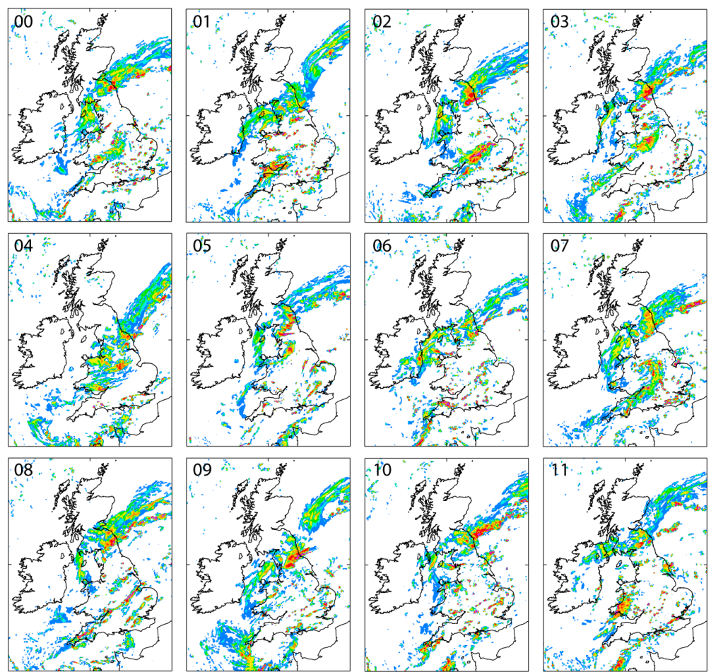
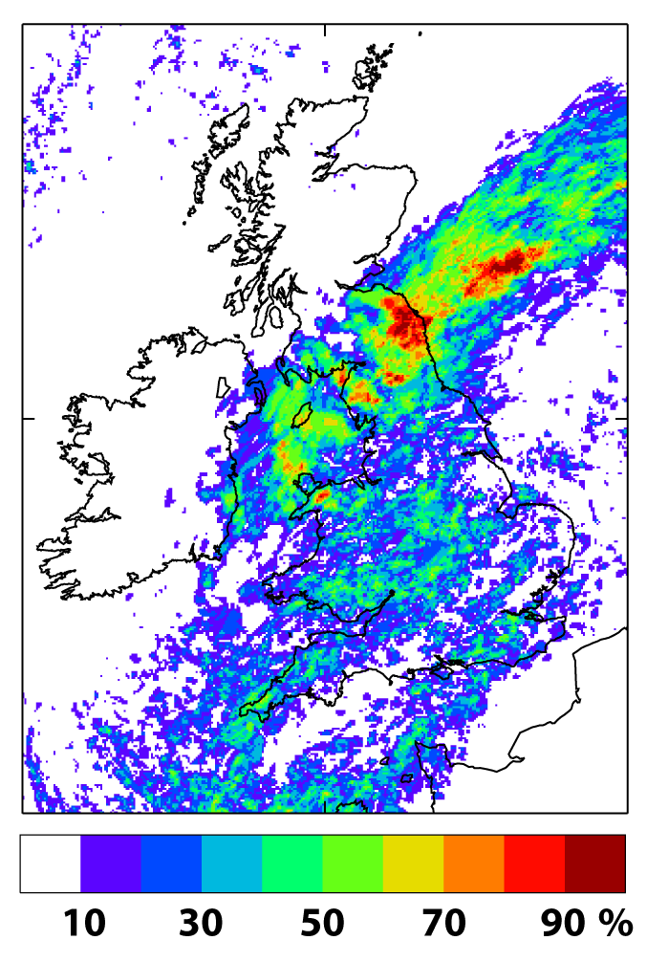
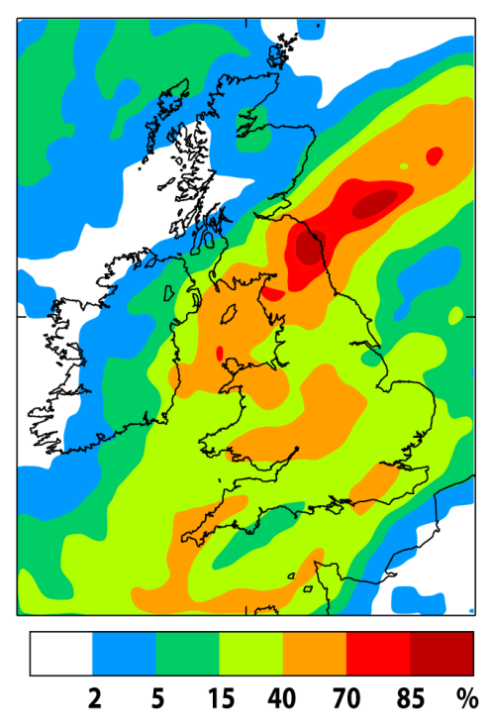
Link between verification and post-processing
X
Smooth probabilities with additional neighbourhood processing
MOGREPS-UK
Gaps because of under-sampling
Spatial post processing (neighbourhood) essential
R&D neighbourhood size, adaptive methods, topography, blending probabilities

Slide 33
Traditional verification method – “pointwise” comparing
Ob

Slide 34
Single-observation-neighbourhood-forecast methods (SO-NF) (Ebert, 2008)
Neighbourhood sizes:
1*1, 3*3, 5*5, ...
“Pseudo” ensemble members:
Number of the gridpoints
(1, 9, 25, etc.)
Ob

Slide 35
Single-observation-neighbourhood-forecast approach (SO-NF)
Ob

Slide 36
Single-observation-neighbourhood-forecast approach (SO-NF)
Ob

Slide 37
Single-observation-neighbourhood-forecast approach (SO-NF)
Ob

Slide 38
Single-observation-neighbourhood-forecast approach (SO-NF)
for ensemble forecasts
Neighbourhood sizes:
1*1, 3*3, 5*5, ...
“Pseudo” ensemble members:
N * (number of gridpoints)
(N, 9*N, 25*N, etc.)
N members
Ob

Slide 39
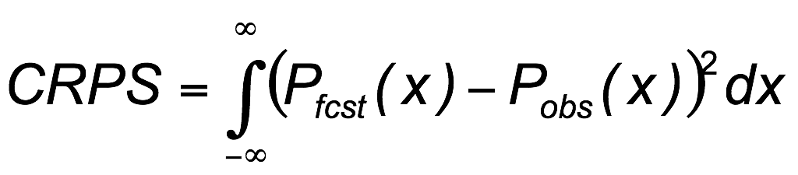
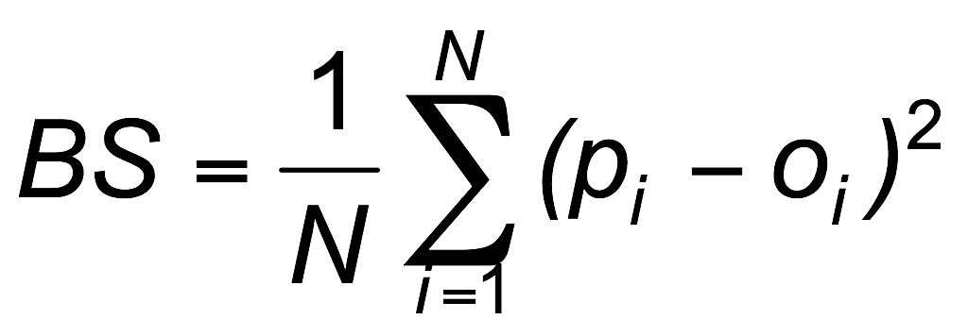
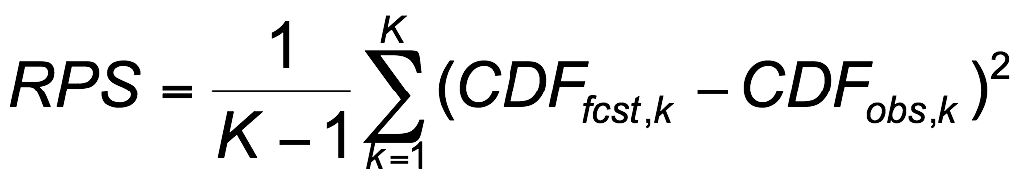
Model-specific vs. user-relevant
Probabilistic Forecast / Binary Observation
Modeller interested overall
performance or pdf
Users interested in
specific thresholds:
e.g. defining a
decision point or hazard
1
obs
1
obs
CDF
CDF
fcst
0
k
0
x
1
CDF_{obs}-CDF_{fcst}
0
Perfect score = 0
k
p_{i} = forecast probability
o_{i} = observed occurrence (0 or 1)
K = discrete threshold categories
Perfect score = 0
Perfect score = 0

Slide 40
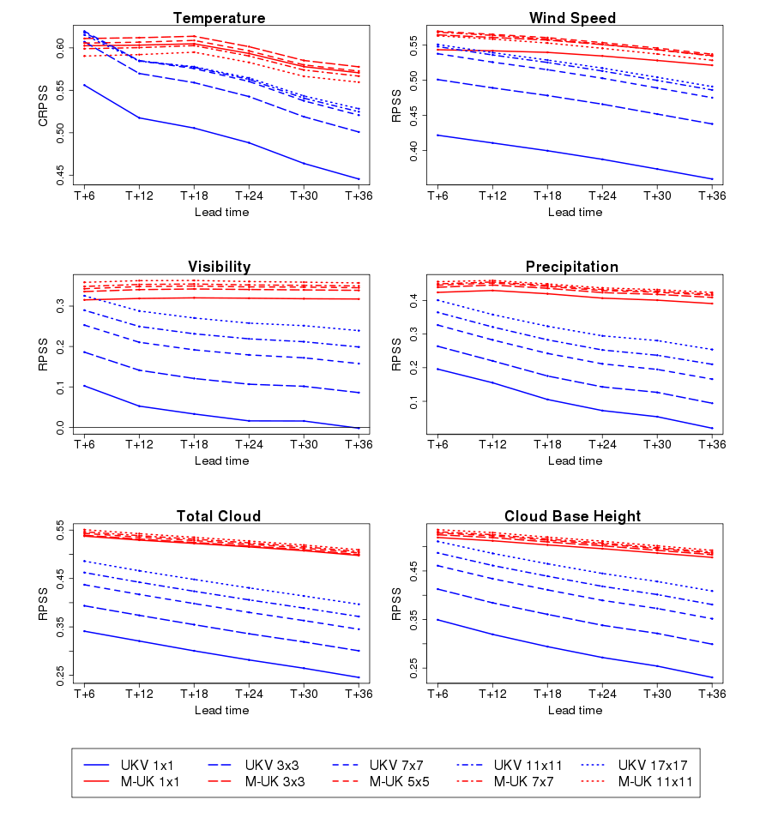
Influence of neighbourhood size for the UKV and MOGREPS-UK
BLUE: UKV
RED: MOGREPS-UK
Scores: RPSS / CRPSS
(model-oriented approach)
First sight:
MOGREPS-UK better than UKV (except some T+6)
Impact:
- at both models
- much bigger at UKV
Mittermaier (2014, WAF)
Mittermaier and Csima, in prep.

Slide 41
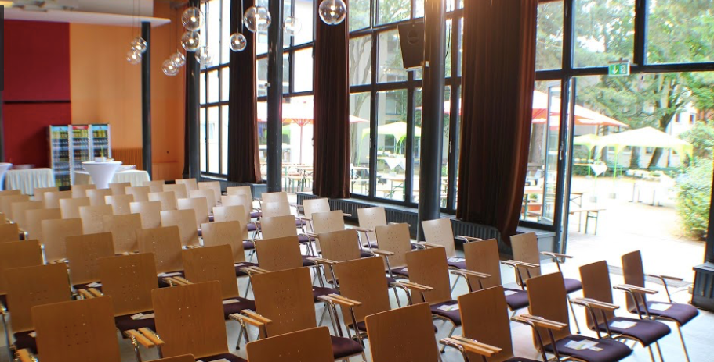
7th Int’l verification methods workshop
Berlin 15-18 May workshop (prov. Festsaal Berliner Stadtmission) and tutorial 10-13 May (prov. Max Planck Institute)
Plan to extend by 1 day to include sessions covering Climate Metrics panel and climate applications more generally

Slide 42
Discussion items
Linkage with climate metrics panel (under WGCM)
How can the role of JWGFVR within WGNE be enhanced/better integrated? (Within WWRP we are very well integrated with other WGs as well as with RDPs, S2S, PPP and HIW)
Is the “commissioning” process adequate?

