Slide 1

Progress in seasonal forecasting in South Africa
Willem A. Landman
(Willem.Landman@up.ac.za)

Slide 2
The evolution of seasonal forecasting in South Africa
Model/system development started in early 1990s – SAWS, UCT, UP, Wits (statistical forecast systems)
South African Long-Lead Forecast Forum
SARCOF started in 1997 – consensus through discussions
Late 1990s – started to use AGCMs and post-processing
  At SAWS (COLA T30, then ECHAM4.5)
  At UCT (HadAM3P)
  At UP/CSIR (CSIRO-II/III, then CCAM)
Global Forecasting Centre for Southern Africa – 2003
Objective multi-model forecast systems – 2008
Coupled model considerations – 2010 onwards

Slide 3
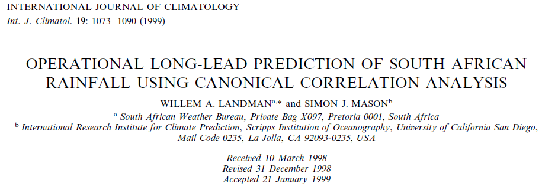
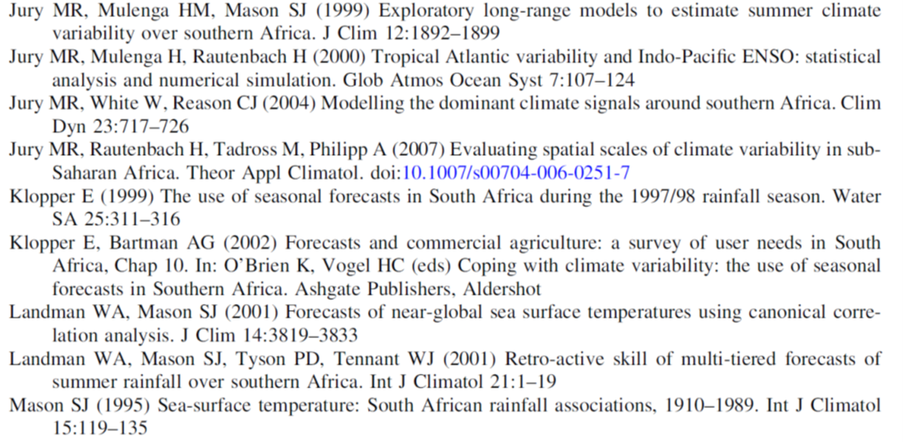
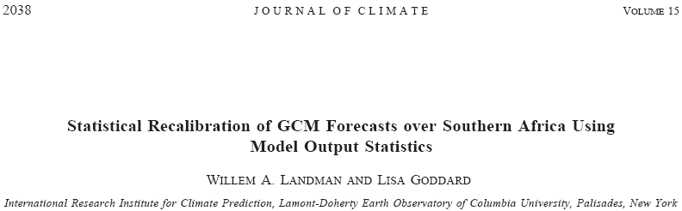
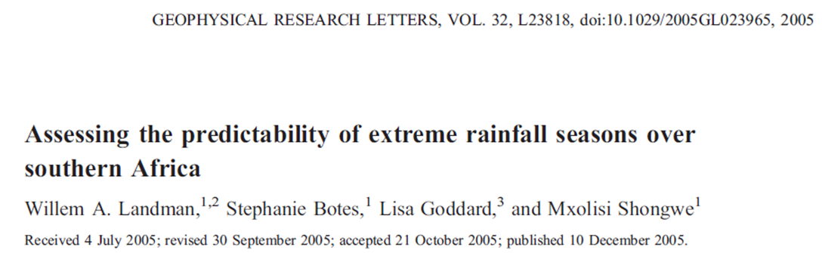
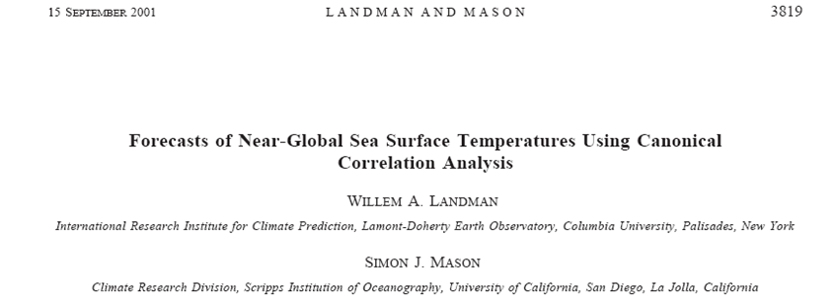
Statistical modelling

Slide 4
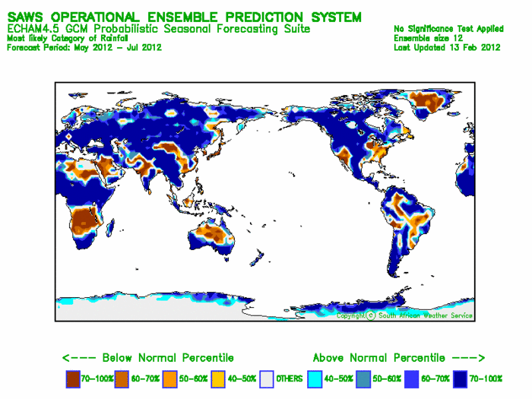
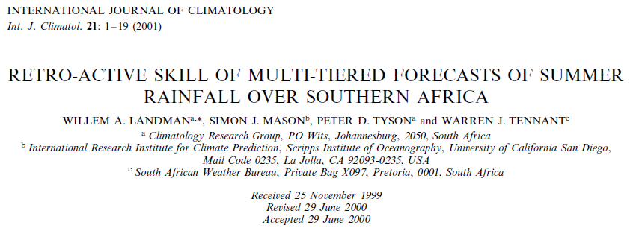
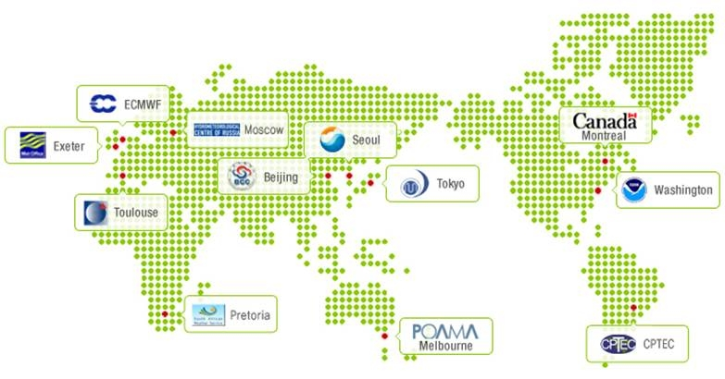
AGCMs at SAWS
ECHAM4.5
COLA T30

Slide 5
DJF rainfall forecasts using RCM
Operational regional climate model forecast for southern Africa
ECHAM4.5-RegCM3

Slide 6
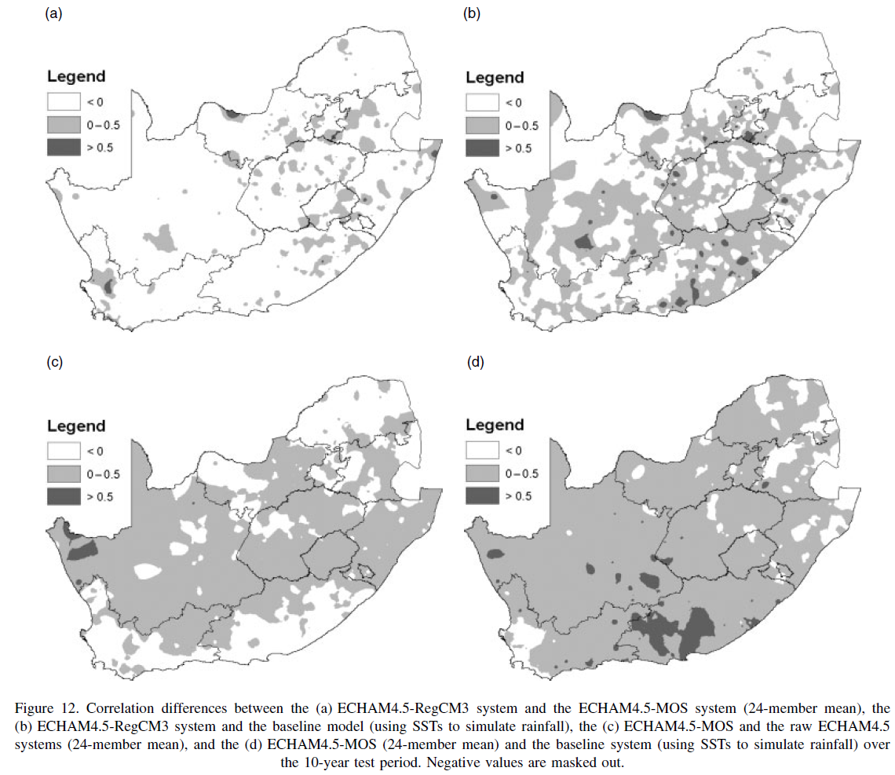
RCM - MOS
RCM - SST
MOS - GCM
MOS - SST

Slide 7
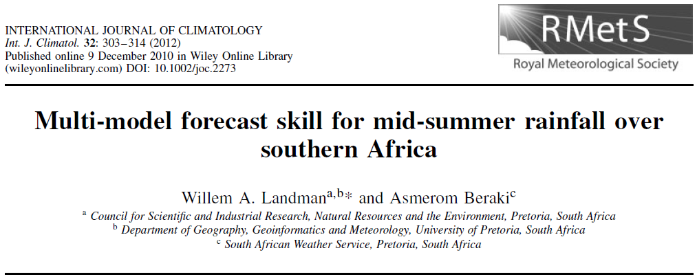
3x

Slide 8
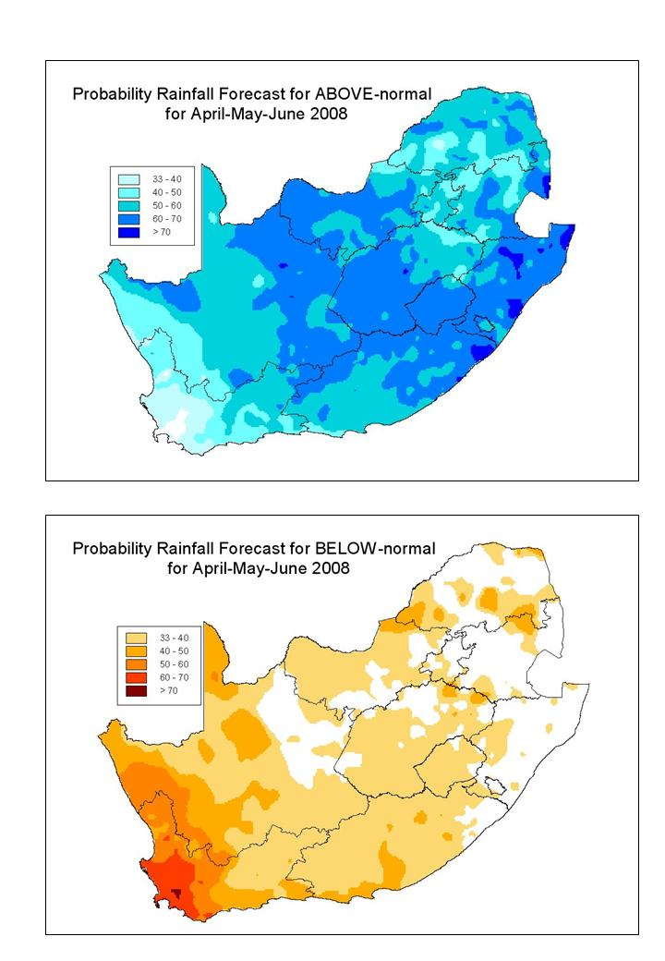
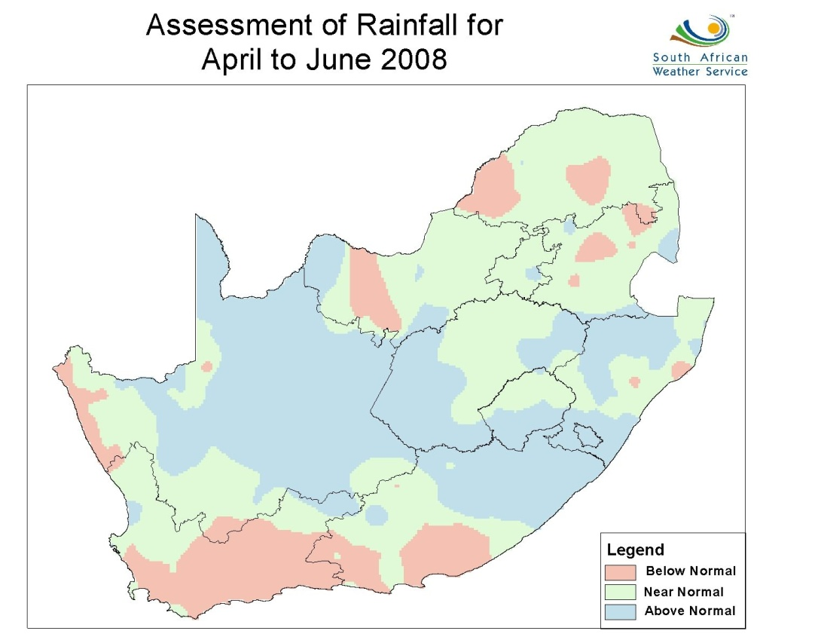
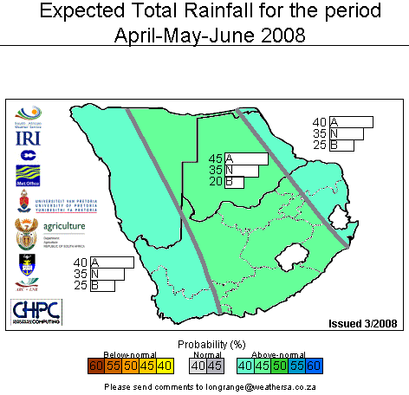
New objective multi-model forecast
ECHAM4.5 (IRI) + CCAM (UP)
Old subjective consensus forecast

Slide 9
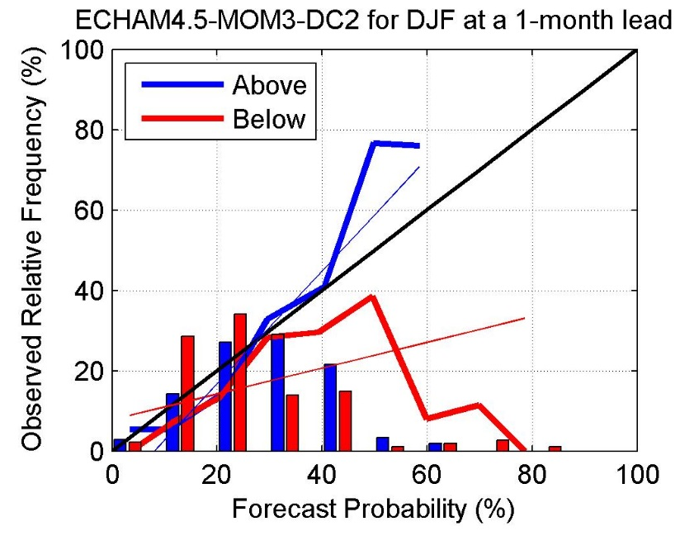
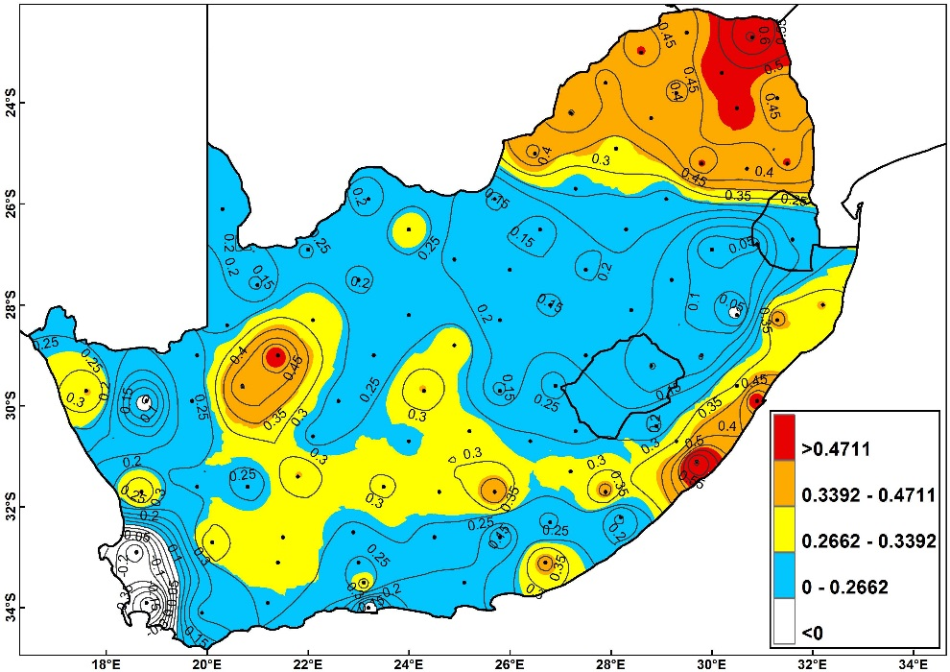

Slide 10

Coupled model work:
ECHAM-MOM @ SAWS
Notes:
10

Slide 11
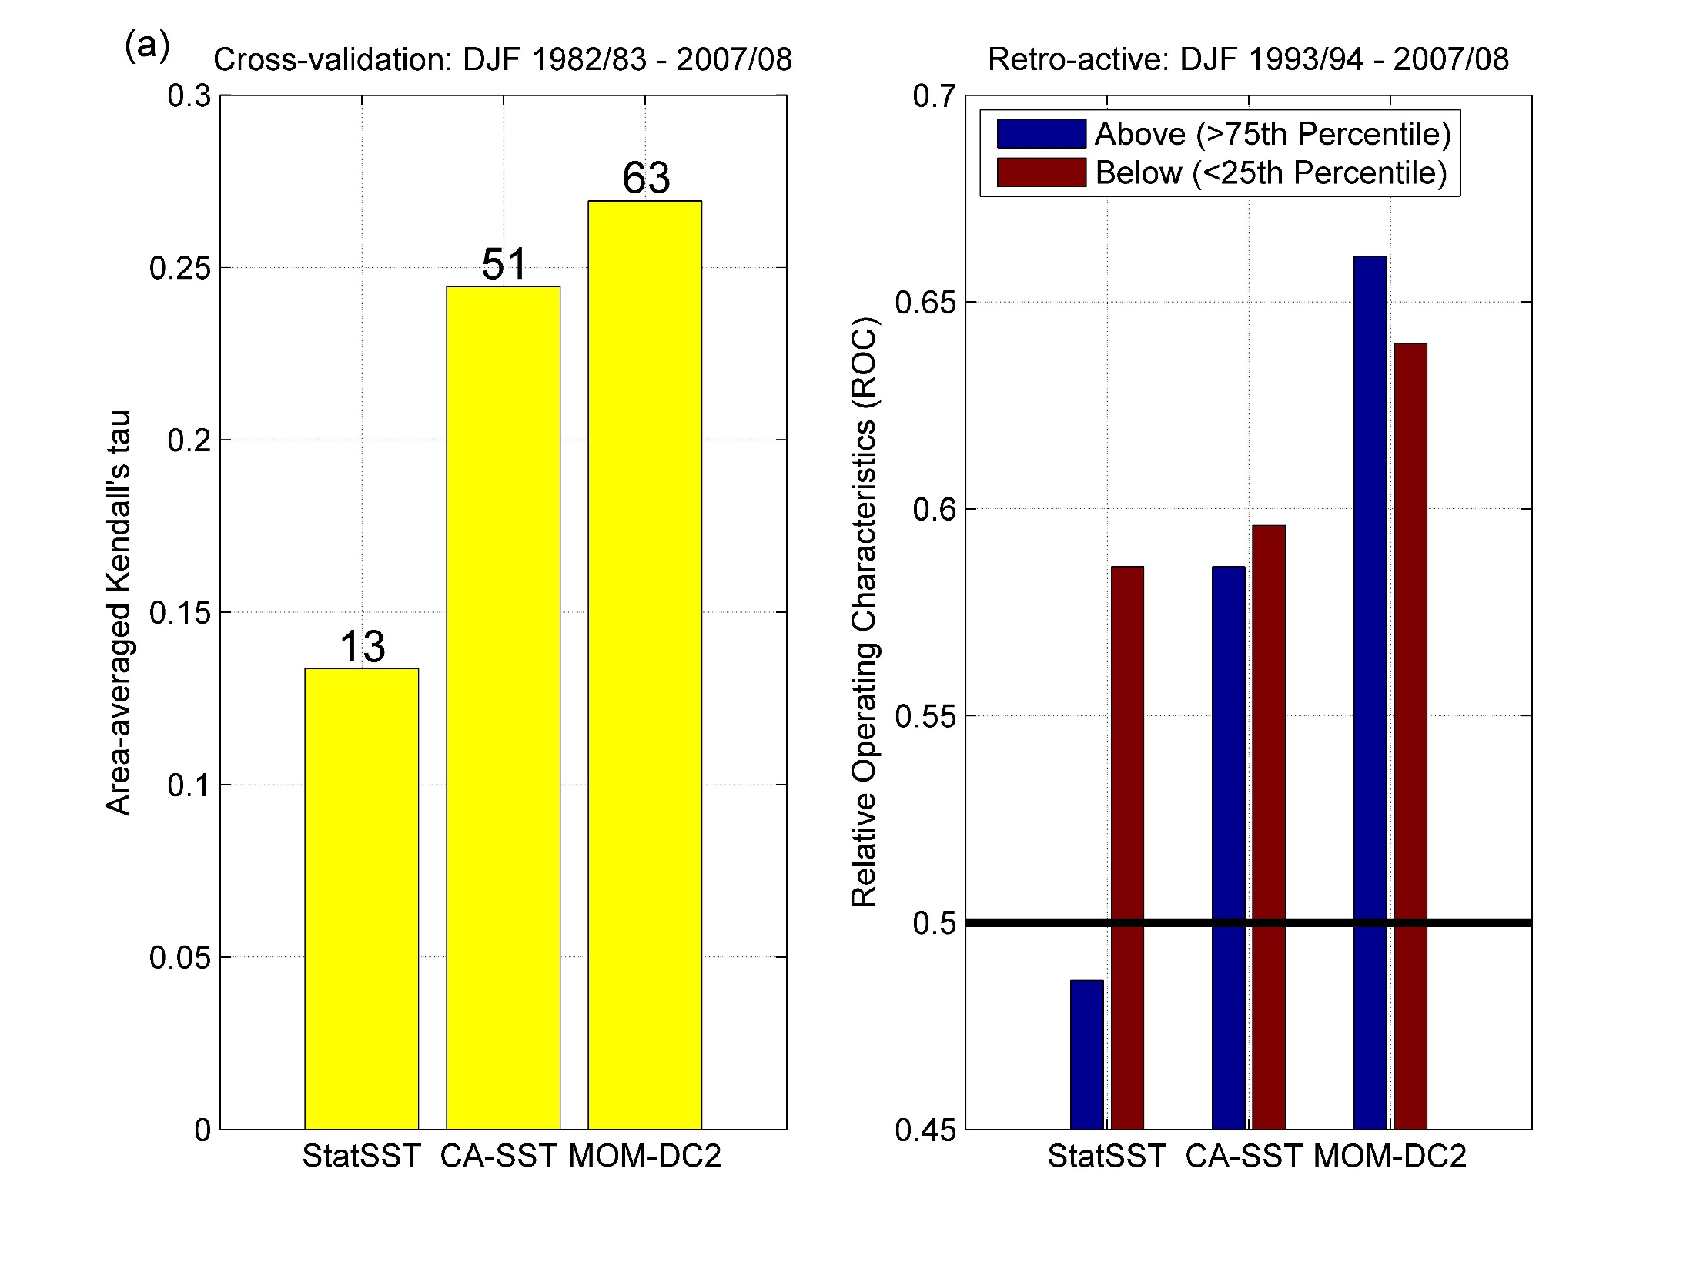

Slide 12
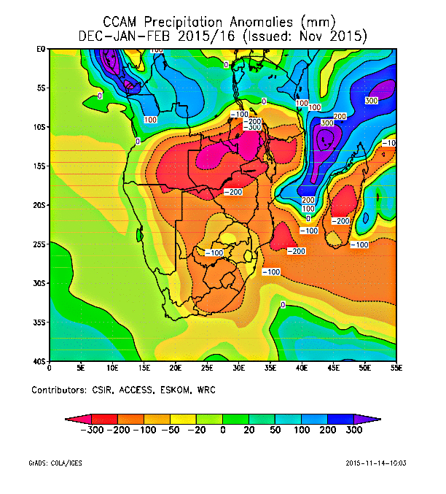
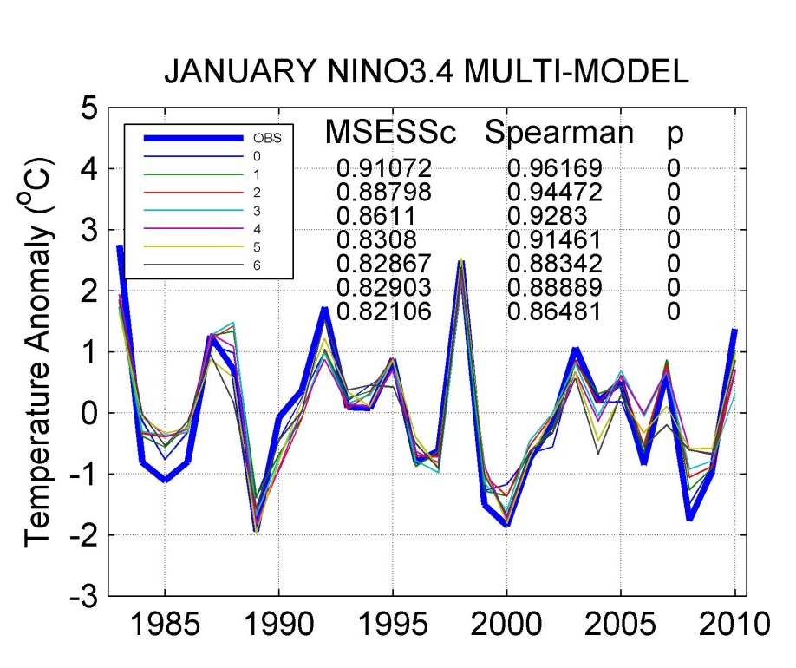
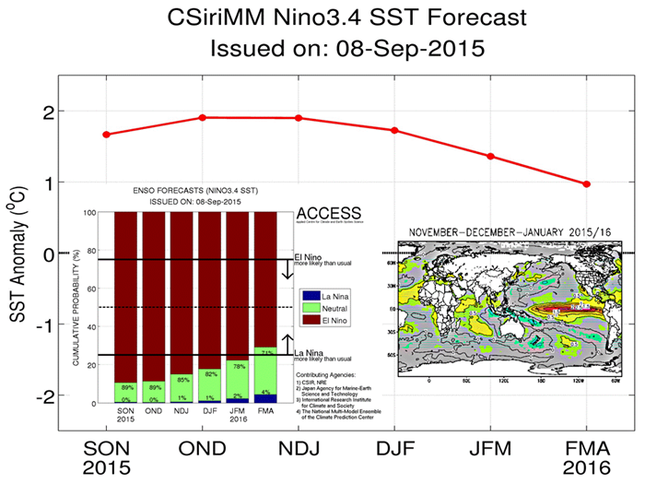
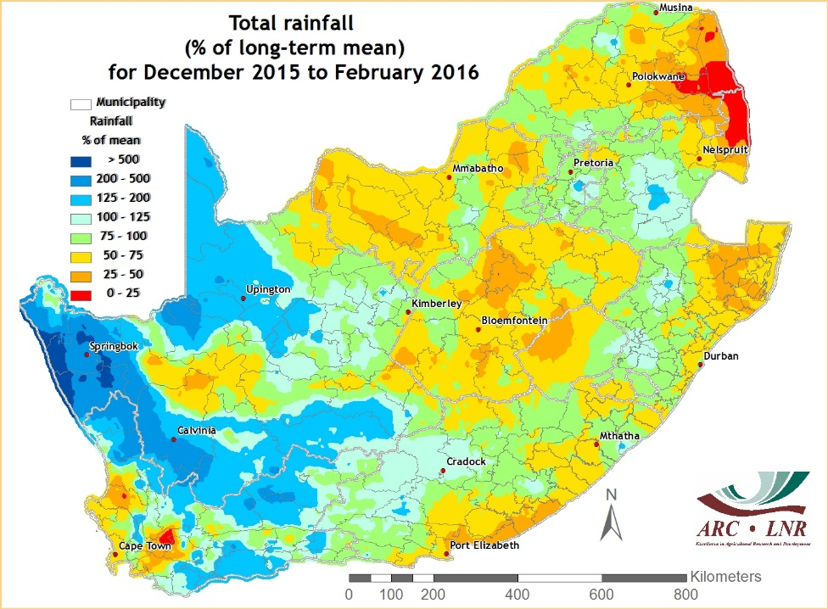

Slide 13
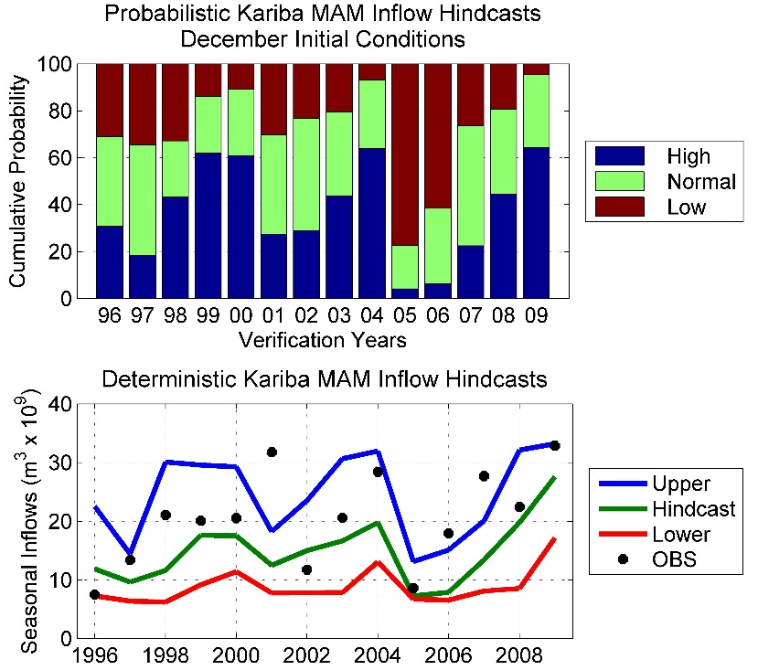
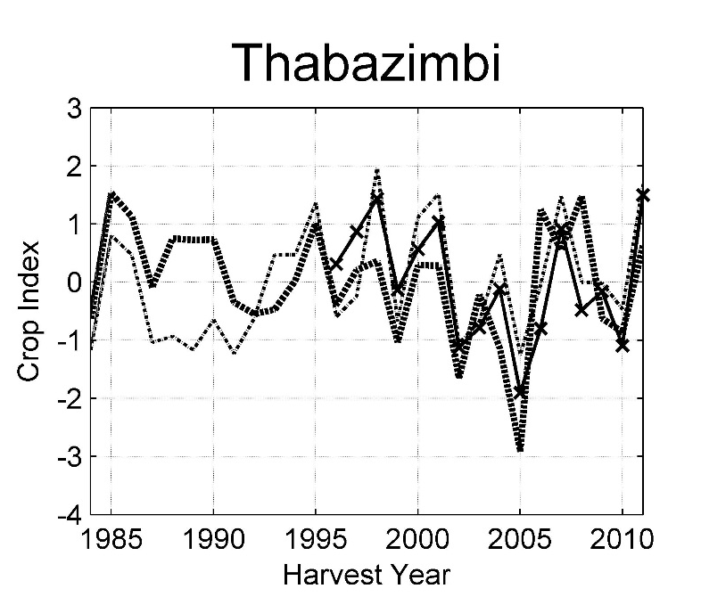
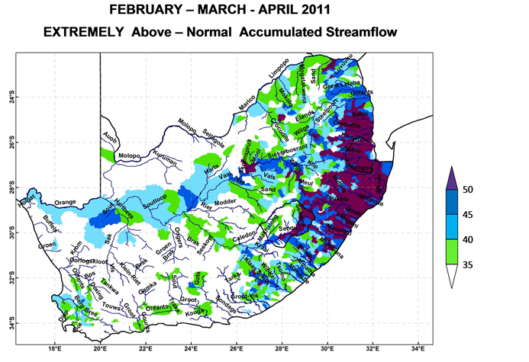

Crop and streamflow predictions

Slide 14
To summarize
Seasonal forecasting in South Africa since early 1990s
Model/system development (mostly focussed on operational forecast production)
  MOS
  RCMs
  Multi-models
  Coupled models
  Model skill has improved incrementally
  Simple applications models
International and national collaboration significant

