Slide 1
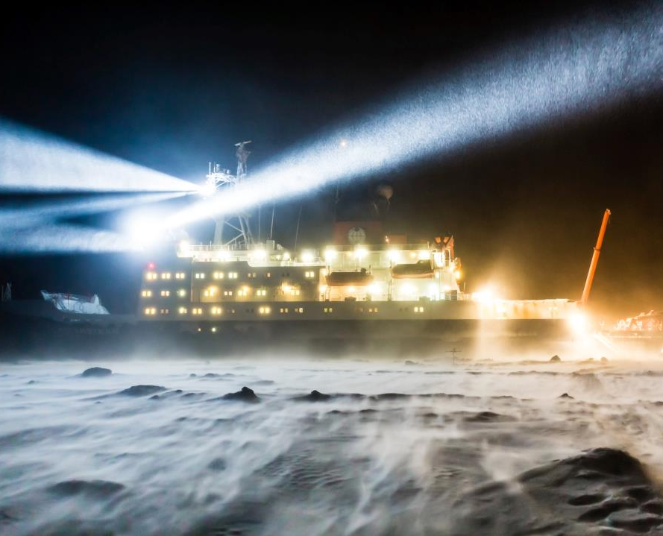
The WWRP Polar Prediction Project (2013-2022)
Photo: S. Hendricks, AWI
Thomas Jung
Chair of the PPP steering group
Alfred Wegener Institute, Germany
WGNE meeting, 26 March 2016

Slide 2
Outline
PPP and YOPP
Brief reminder
Recent activities
MOSAiC
Review of actions from last year
Areas of collaboration

Slide 3
PPP Mission Statement
Promote cooperative international research enabling development of improved weather and environmental prediction services for the polar regions, on time scales from hourly to seasonal

Slide 4
Why?
Increasing demand for reliable prediction capabilities in polar regions and beyond
Emphasis of previous international efforts on lower latitudes
Significant gaps in the polar observing systems
Need for enhanced coupled environmental prediction systems
Potential for advanced predictions in middle latitudes

Slide 5
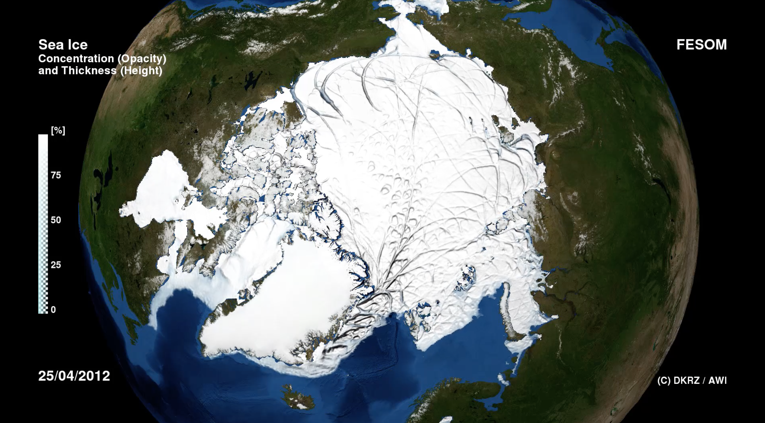
Why?
Need for enhanced coupled environmental prediction systems
Animation

Slide 6
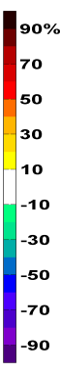

Why?
Benefits for mid-latitude prediction
Day 1-5
Day 6-10
Day 11-30
Jung et al. (2014), Geophys. Res. Lett.

Slide 7
How?
PPP Steering group for developing plans and overseeing their implementation
International Coordination Office (administrative support, outreach etc.)
Development of planning documents (e.g. implementation plans)
Endorsement process
Organisation of meetings
Development of flagship activities (e.g. YOPP)
Engagement with funding agencies
Education and outreach

Slide 8
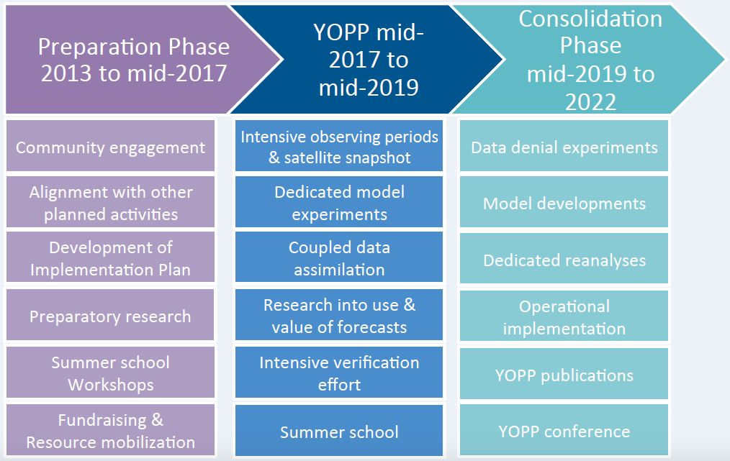
The Year of Polar Prediction—YOPP

Slide 9
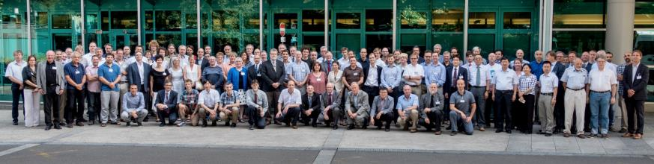
YOPP Summit
WMO, Geneva,13-15 July 2015
116 participants from 20 nations
Live streaming: Up to 750 users online at the same time
Decisions summarized in YOPP Summit report
Meeting report published in BAMS (early online)
Recommendation incorporated in YOPP Implementation Plan v2.0

Slide 10
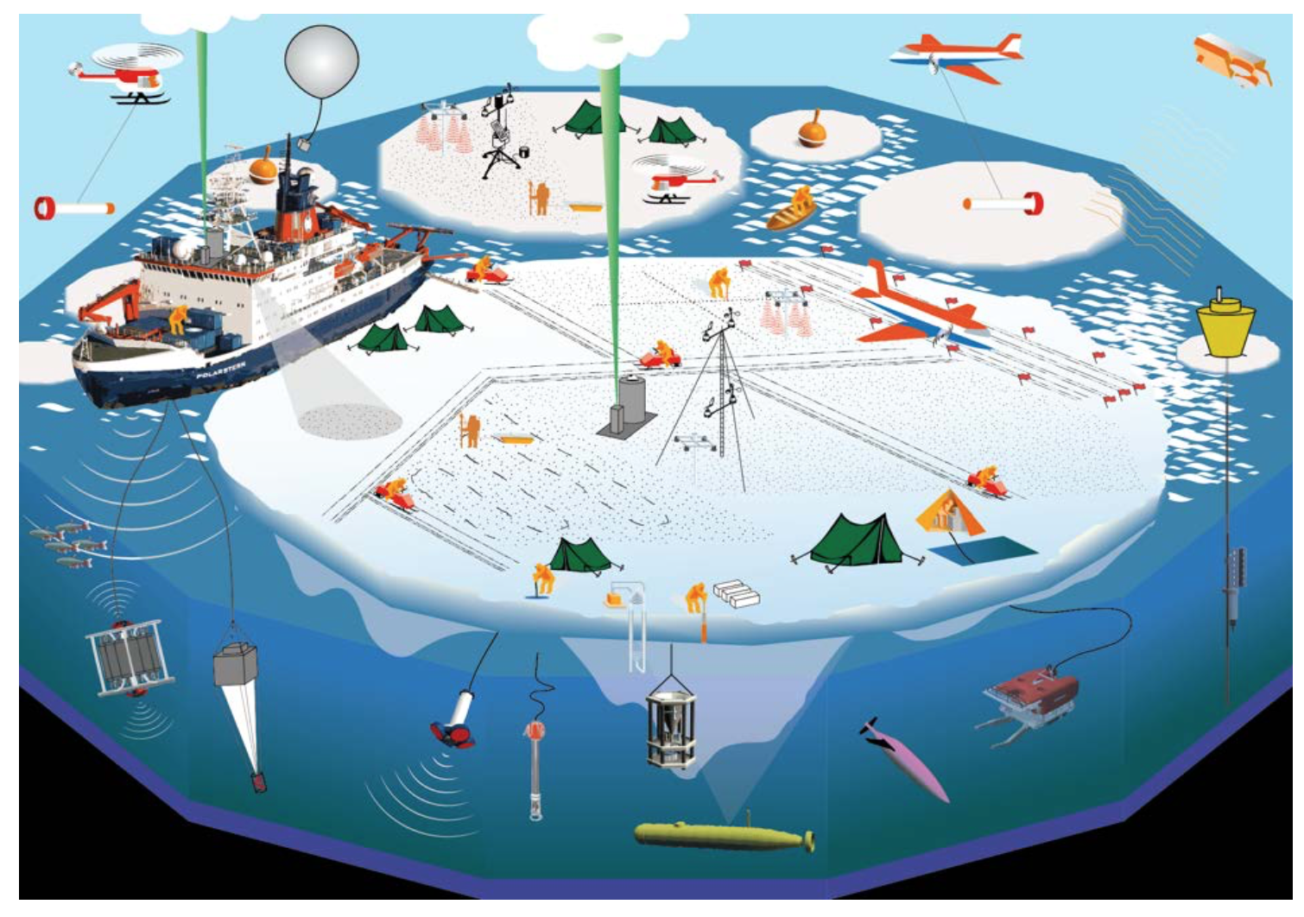
MOSAiC
Multidisciplinary drifting Observatory for the Study of the Arctic Climate

Slide 11
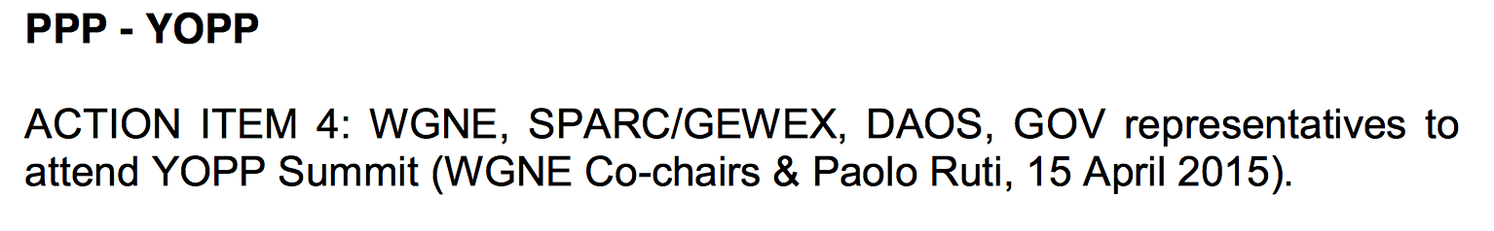
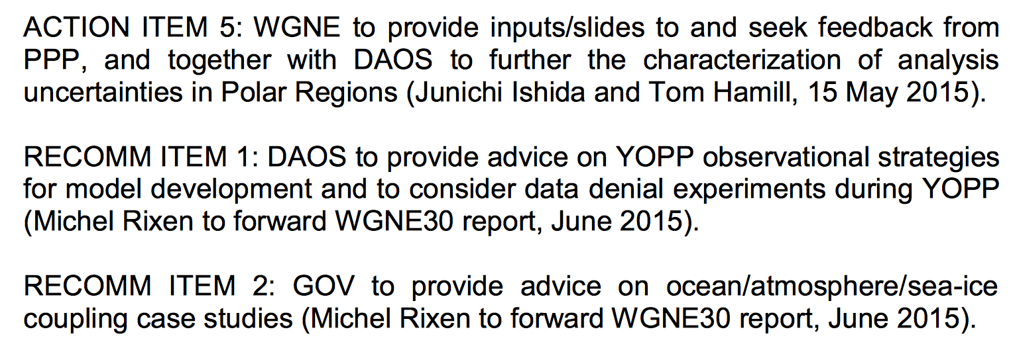
Action items from WGNE-30

Slide 12
Recent activties (selected)
Polar verification document
BAMS meeting reports (Barcelona workshop & YOPP Summit)
BAMS PPP overview paper (in press)
QJ special issue
H2020 proposals
PPP-SERA meeting
Abisko winter school

Slide 13
The way forward: YOPP modelling activities
YOPP Modelling Component will be central
Will cover the full two-year YOPP core period
Testing of an Arctic Polar Regional Climate Centre
Plans for a „virtual YOPP field campaign“ following the YOTC model (ECMWF)
Provision of high-resolution coupled forecast data (10km, Environment and Climate Change Canada)
Need for high-resolution sea ice prediction experiments
Data assimilation experiments (e.g. data denial)
YOPP reanalysis
YOPP planning meeting (ECMWF, 5-9 September 2016) ➔ WGNE representative?

