Slide 1
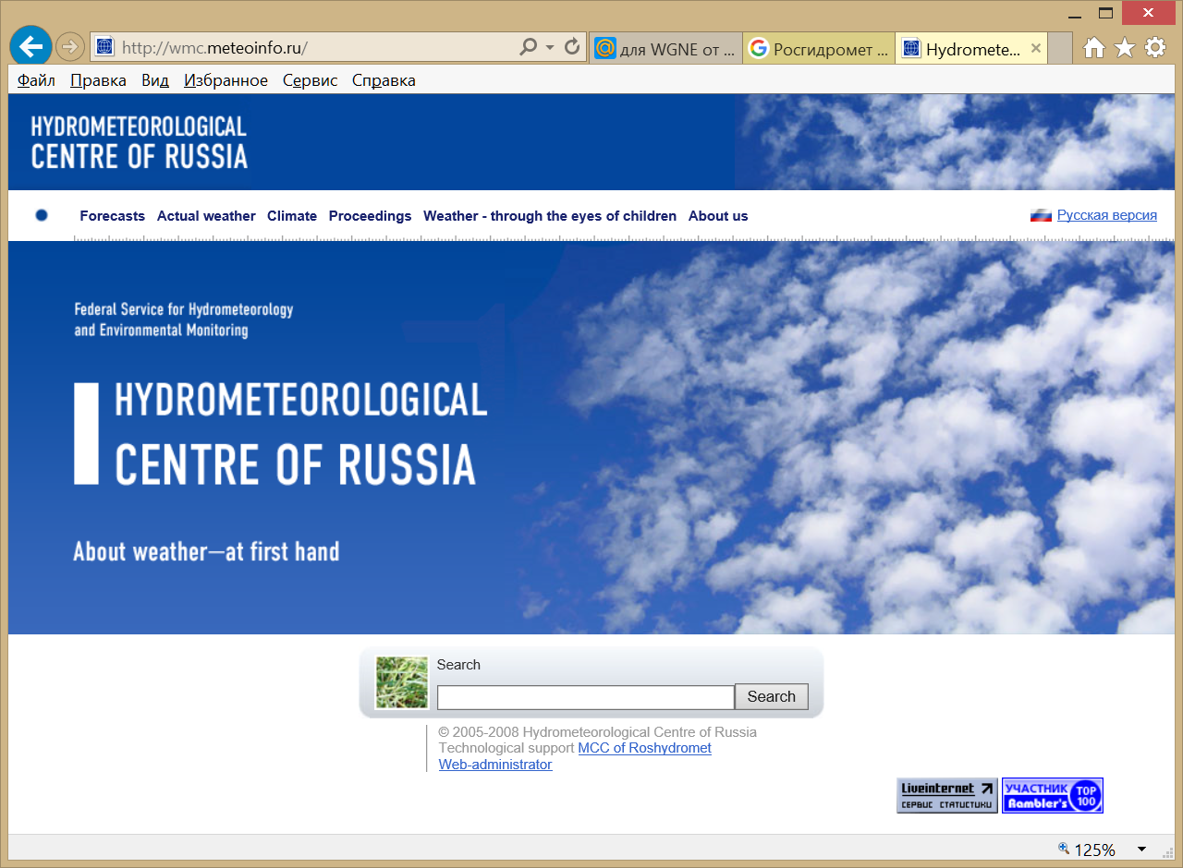


Research in atmospheric modelling in Russia
Elena Astakhova
with contributions of M.Tsyrulnikov, N.Chubarova, D.Gayfulin, A.Rakitko, A.Kirsanov, A.Poliukhov, M.Shatunova, M.Tolstykh, G.Rivin
WGNE31, Pretoria, South Africa
April 2016
Roshydromet

Slide 2
NWP at the Hydrometcenter of Russia
Forecast system | Global SLAV | Global SMA |  | Mesoscale model COSMO | 10-day EPS | Seasonal EPS
Purpose | Short- and medium-range forecasts |  |  | Short-range forecasts | Short- and medium-range forecasts | Seasonal and one-month forecasts
Forecast domain | Globe |  | Globe | Russia and surrounding areas | Globe | Globe
Grid size and/or number of grids | 0.225x(0.16-0.24) deg |  | 0.53 deg (T339) | 13.2 / 1000×500×40 7/ 700×620×40 2.2 / 420×470×50 1.1 / 190×190×50 | 1.065 deg (T169), 0.9x0.72 deg | 1.125x1.4 lat-lon
Vertical levels/Top | 51/5hPa |  | 31/ 10 hPa | 40/40/50/70 Top: 23000 m | 31, 28/ 10hPa | 28/5hPa
Forecast range | 240h (12UTC) 120h (00UTC) |  | 240h (12UTC) 84h (00UTC) | 48 h (06,18 UTC) 78 h (00,12UTC) | 10 days (12UTC) 14 members | 126 days 20 members
IC | 3D-Var |  | 3D-Var | ICON | 3D-Var | 3D-Var

Slide 3
The global SL-AV model
Semi-Lagrangian vorticity-divergence dynamical core of own development, mostly ALARO/LACE parameterizations.
Following parallel runs, the version with the resolution 0.225˚x(0.16-0.24)˚ degrees lon-lat, 51 levels replaces the version 0.9x0.72 degrees lon/lat, 28 levels
Developments since last WGNE session:
New version of longwave parameterization (RRTMG LW) (v.4.85)
Improving T2m correction on difference between model and physical orography
Simplified extended Kalman filter (SEKF) for deep soil moisture initialization
Implemented hybrid vertical coordinate instead of sigma (improvement in upper troposphere and stratosphere)
Changing computational infrastructure: Improving scalability from 1700 to 7000 cores (at 13 km grid)
Development of the LETKF-based ensemble prediction system
Coupling with the ocean model INM-IO: technically done, currently under tuning
Climate version: first results of AMIP2 runs
April 27,2016 - WGNE31, Pretoria

Slide 4
Outlines
Development of a new approach to EnKF and EnVar: Hierarchical Bayes Ensemble Filter (HBEF)
Updating aerosol for NWP models
A Limited-Area Spatio-Temporal Stochastic Pattern Generator (SPG)
April 27,2016 - WGNE31, Pretoria

Slide 5
An update on the
Hierarchical Bayes Ensemble Filter (HBEF)
M Tsyrulnikov and A Rakitko
HBEF in a nutshell
Ensemble size is small, hence ensemble covariances provide only a rough and partial information on the true background error covariance matrix B, which remains, thus, largely uncertain.
This has motivated us to explicitly admit that the B matrix is unknown and random and treat it as part of the control variable in an optimal hierarchical Bayes analysis scheme.
In this update of B, ensemble members are used as generalized observations on B.
Observations are allowed, in this update, to influence the covariances.
B is updated first (in the so-called secondary filter) and the result is then used to update the state using the traditional EnKF equations (the primary filter).
Tsyrulnikov M., Rakitko A. Hierarchical Bayes Ensemble Kalman Filtering. – ArXiv preprint, 2015, arXiv:1509.00652. Physica D, under review.
Notes:
The principal problem in EnKF and EnVar is an inevitably small affordable ensemble size, which results in a poor background error covariance matrix B. The common remedy: localization (of different kinds)+ inflation

Slide 6
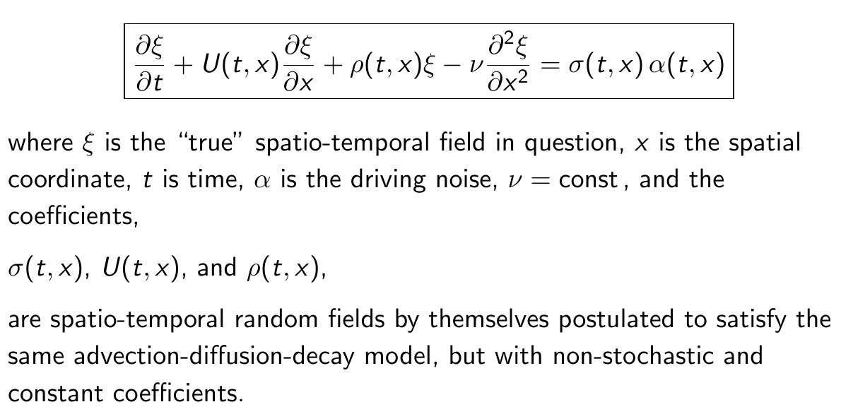
Results with a doubly stochastic advection-diffusion-decay model on the circle
Double stochasticity means that the model is, first, forced by a random noise and second, some of the coefficients of the model are random spatio-temporal fields by themselves

Slide 7
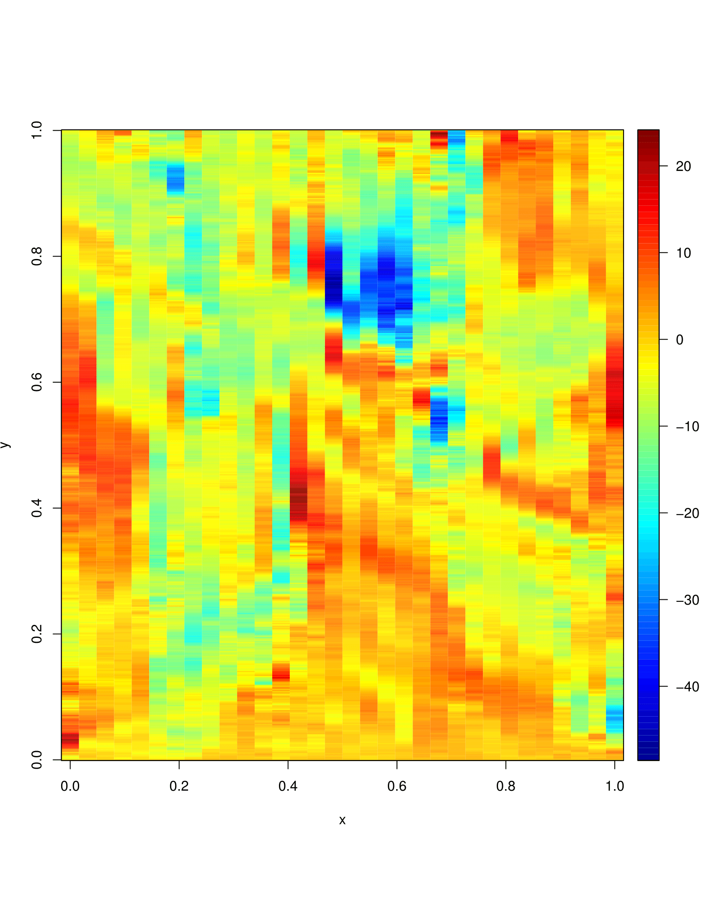
Example of the “true” field
(x is space, y is time).
The field is reasonably inhomogeneous and non-stationary.
Example of the “true” field

Slide 8
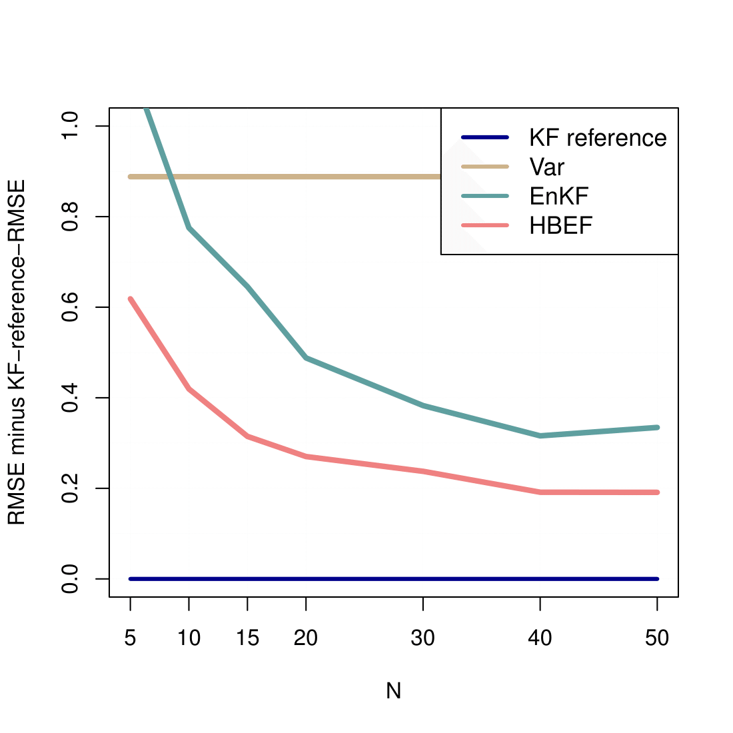
Analysis RMSEs for VARiational assimilation, EnKF, and HBEF
(RMSE of the exact non-ensemble KF is subtracted). The grid size is 32.
Abscissa N is the ensemble size.
HBEF significantly outperforms EnKF and Var.
It is planned to use HBEF in EnVar.

Slide 9
Updating aerosol for NWP models:
Updating aerosol for NWP models:
New aerosol climatology in COSMO-Ru
The Tegen (Tegen et al.,1997) aerosol climatology has previously (and currently) been used in COSMO model:
Total optical thickness for 5 aerosol types
(sea salt, SO₄, mineral dust, black carbon, organics)
resolution 4x5 deg
monthly mean values
The new climatology: MACv2 (Kinne et al., 2015):
aerosol optical thickness, single scattering albedo, asymmetry parameter
fine and coarse mode, total mode
resolution 1x1 degree
monthly mean values
Courtesy M.Shatunova
Notes:
MACv2 uses remote sensing and global aerosol-climate model results of AEROCOM to determine the four dimensional distribution of AOD, single scattering albedo and asymmetry parameter
MAC is still evolving

Slide 10
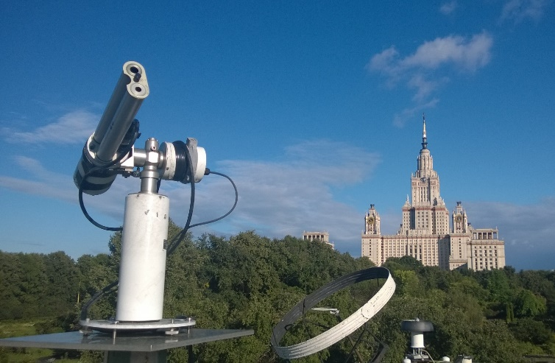
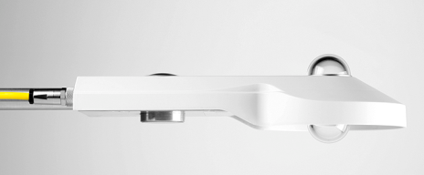
Updating aerosol for NWP models:
Aerosol climatology assessment against in situ observations
Meteorological Observatory of the Moscow State University
www.momsu.ru
sun sky photometer AERONET CIMEL
dataset from AERONET v2.0
(aerosols and atmospheric water
vapor content)
net radiometer Kipp&Zonen CNR-4
(downward shortwave and longwave radiation,
upward shortwave and longwave radiation)
Notes:
MSU MO is within AERONET network from 2001
High-precision instruments are for radiation observation
Ordinary meteorological observations are performed also – T2m, RH, wind, sky condition etc.

Slide 11
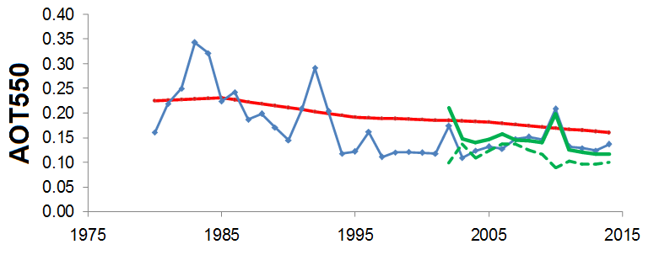
Updating aerosol for NWP models:
Aerosol climatology assessment against in situ observations
The average annual aerosol optical thickness at 550 nm (AOT550) (Moscow)
MACv2
Calculated from observed direct shortwave irradiance
Impact of
the El-Chichon
eruption
AERONET data
Impact of
the Pinatubo
eruption
Wild fire
impact
(2002, 2010)
Chubarova et al., The accuracy assessment of the COSMO-Ru radiative calculations using different aerosol climatologies and their influence on temperature forecast, COSMO/CLM/ART USER-Seminar, 2016
Notes:
AOT550 time series (average annual) according to long-term measurements of the direct shortwave irradiance at the surface at the MSU MO
(поток прямой радиации на поверхности используется для определения величины интегральной оптической толщины аэрозоля)
Note: MACv2 has the same negative trend as in observations
!!! Impact of two volcano eruptions and two cases of wild fire on the European part of Russia (2002, 2010) – выделяются последовательными кликами!!!

Slide 12
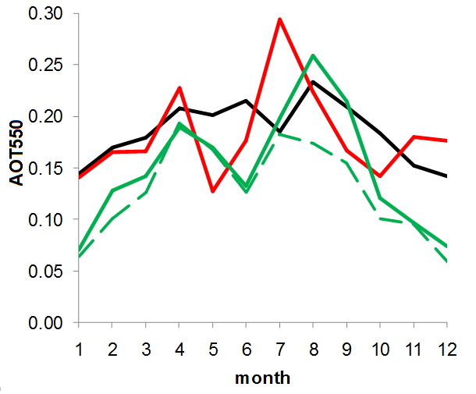
Updating aerosol for NWP models:
Aerosol climatology assessment against in situ observations
The intra annual changes of AOT550 (Moscow)
MACv2
Tegen climatology
AERONET data: monthly mean
(2001-2014 averaged)
AERONET data: median
(excluding the wild fire impact in August and September)
Chubarova et al., The accuracy assessment of the COSMO-Ru radiative calculations using different aerosol climatologies and their influence on temperature forecast, COSMO/CLM/ART USER-Seminar, 2016
Notes:
Здесь средние значения наблюденной АОТ на длине волны 0.55 микрометров (550 нанометров) по данным AERONET + значения АОТ по климатологиям Теген и Кинне для Москвы
Tegen climatology is much more smooth.
However, new MACv2 and Tegen are of the same level but variations in MACv2 are in better agreement with real climatology in Moscow though the minimum is shifted to May.
Главный вывод, что оба варианта климатологии имеют ошибки в зимние месяцы – на след. слайде – just CLICK ☺

Slide 13
Updating aerosol for NWP models:
Aerosol climatology assessment against in situ observations
The intra annual changes of AOT550
MACv2
Tegen climatology
AERONET
Aerosol optical thickness is overestimated
by both climatologies in winter
Chubarova et al., The accuracy assessment of the COSMO-Ru radiative calculations using different aerosol climatologies and their influence on temperature forecast, COSMO/CLM/ART USER-Seminar, 2016
Notes:
Возможная причина расхождений для зимних месяцев в том, что при построении климатологии аэрозоля не учитывался (или неверно учитывался?) эффект перистых облаков на результаты измерений. У Чубаровой в этом году выйдет статья на эту тему.

Slide 14
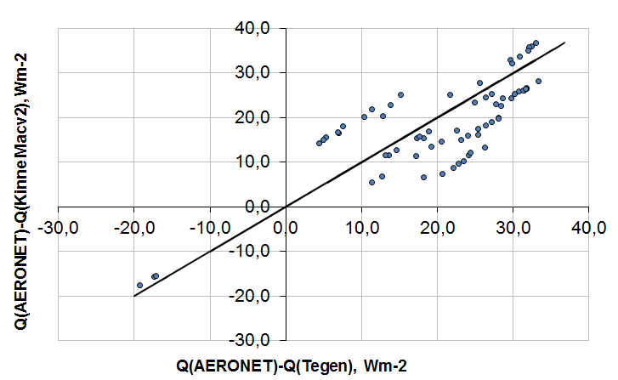
Updating aerosol for NWP models:
The role of aerosol climatology choice
Differences in global shortwave irradiance
(CLIRAD model simulations for clear sky)
MACv2 climatology
gives better results
Chubarova et al., The accuracy assessment of the COSMO-Ru radiative calculations using different aerosol climatologies and their influence on temperature forecast, COSMO/CLM/ART USER-Seminar, 2016
Notes:
Оценка «чистого» вклада двух версий аэрозольной климатологии.
CLIRAD используется в качестве модели для расчета радиационных характеристик, имеющая высокую точность., чтобы не вносить в сравнение с наблюдениями
«шум» от несовершенства рад.блока COSMO.
Профиль метеопараметров в этом случае взят, тем ни менее, из COSMO.

Slide 15
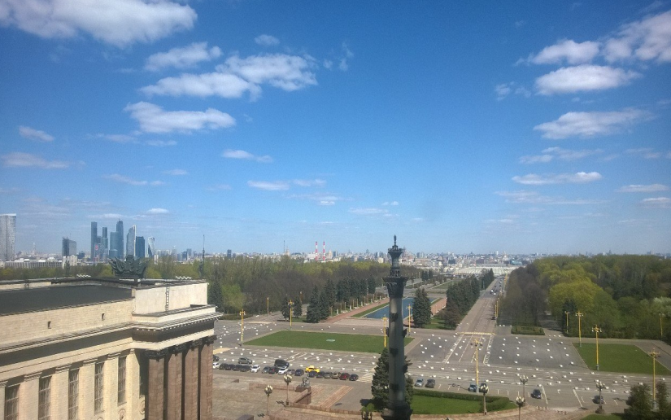
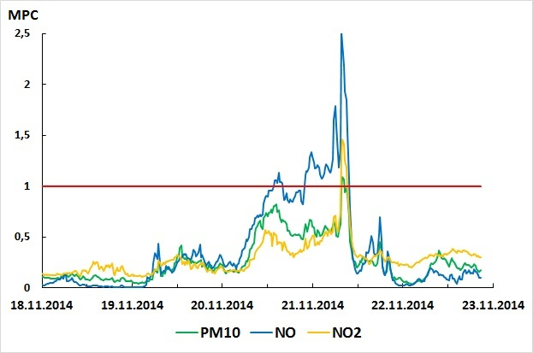
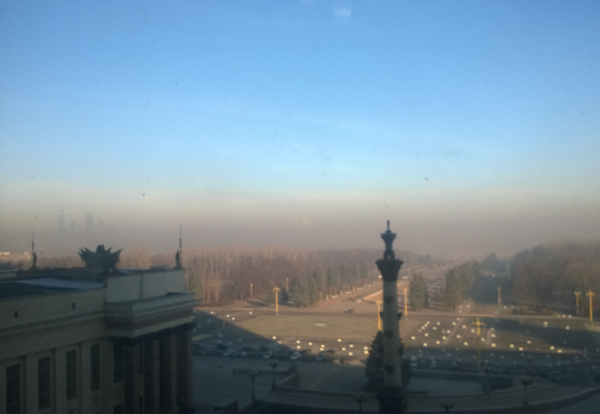
Updating aerosol for NWP models:
The role of aerosol climatology choice
Clear day view
In commonly used aerosol climatologies there is no information about NO, NO2 and PM10 content.
To what errors can it lead?
Pollution on November 21, 2014
Chubarova et al., The accuracy assessment of the COSMO-Ru radiative calculations using different aerosol climatologies and their influence on temperature forecast, COSMO/CLM/ART USER-Seminar, 2016
Notes:
Проблемный случай – нет данных о «неклиматологических» аэрозолях – NОx и PM10 (частицы с диаметром порядка 10 мкм, пассивный аэрозоль).
Источник таких аэрозолей гл.о. антропогенный.
20-21 ноября 2014 г. утечка (выброс) неизвестно чего на хим.заводе на окраине Москвы. Данные о концентрациях из МосЭкоМониторинг, в МГУ есть станция.
Расчеты сделаны для 20 ноября (ясный день), 21 была небольшая облачность.
На фото вид на центр города от здания университета.
PM₁₀ is particulate matter with a mean aerodynamic diameter of 10 μm

Slide 16
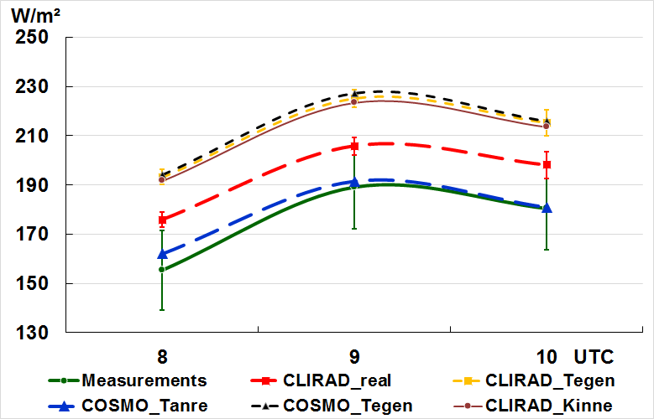
Updating aerosol for NWP models:
The role of aerosol climatology choice
Clear day view
20.11.20014
MACv2 and Tegen clim. in CLIRAD and COSMO-Ru
AERONET data in CLIRAD
Pollution on November 21, 2014
Tanre clim. in COSMO-Ru
observations
Chubarova et al., The accuracy assessment of the COSMO-Ru radiative calculations using different aerosol climatologies and their influence on temperature forecast, COSMO/CLM/ART USER-Seminar, 2016
Notes:
Сравниваются с наблюденными значениями (зеленая линия) потока КВ излучения на поверхности значения, рассчитанные:
По модели COSMO с климатологий Танре (синяя линия) и Теген
По модели CLIRAD с климатологий Теген и Кинне (метеорология из COSMO) – близкие значения между собой, а также к COSMO+Теген
По модели CLIRAD с данными по АОТ, альбедо поверхности и интегральному содержанию водяного пара из наблюдений, остальное из COSMO – красная линия
В старой климатологии Танре значения АОТ были завышены, поэтому и меньше поток излучения. В новых вариантах значения АОТ близки к наблюденным в данный конкретный день (АОТ=0.17-0.20),
НО нет ни данных о содержании NОх, ни учета учет поглощения этими соединениями, поэтому рассчитанные потоки оказались больше наблюденных.
MPC maximum permissible concentrations

Slide 17
Updating aerosol for NWP models:
New aerosol climatology can improve COSMO-Ru model performance. But some uncertainties remain due to overestimation Aerosol Optical Thickness for the winter time and inconsideration of the other aerosol types (NOx, PM10, soot and CO from wild fires, etc.).
Next step – to verify the results against observational data and to perform tests at different observation points (e.g. observatories in Israel and Germany (Lindenberg)).
The final goal is to implement new aerosol climatology MACv2 and the MACC prognostic aerosol fields to the COSMO model.
The work is within the framework of the COSMO Priority Project - T2(RC)2 -Testing & Tuning of Revised Cloud Radiation Coupling.
Scientists from DWD (Germany), IMS (Israel), RHMC (Russia) and MCH (Switzerland) participate.
Notes:
Учет аэрозоля от периодических, случайных источников возможен только в совместной модели, например, COSMO-ART.

Slide 18
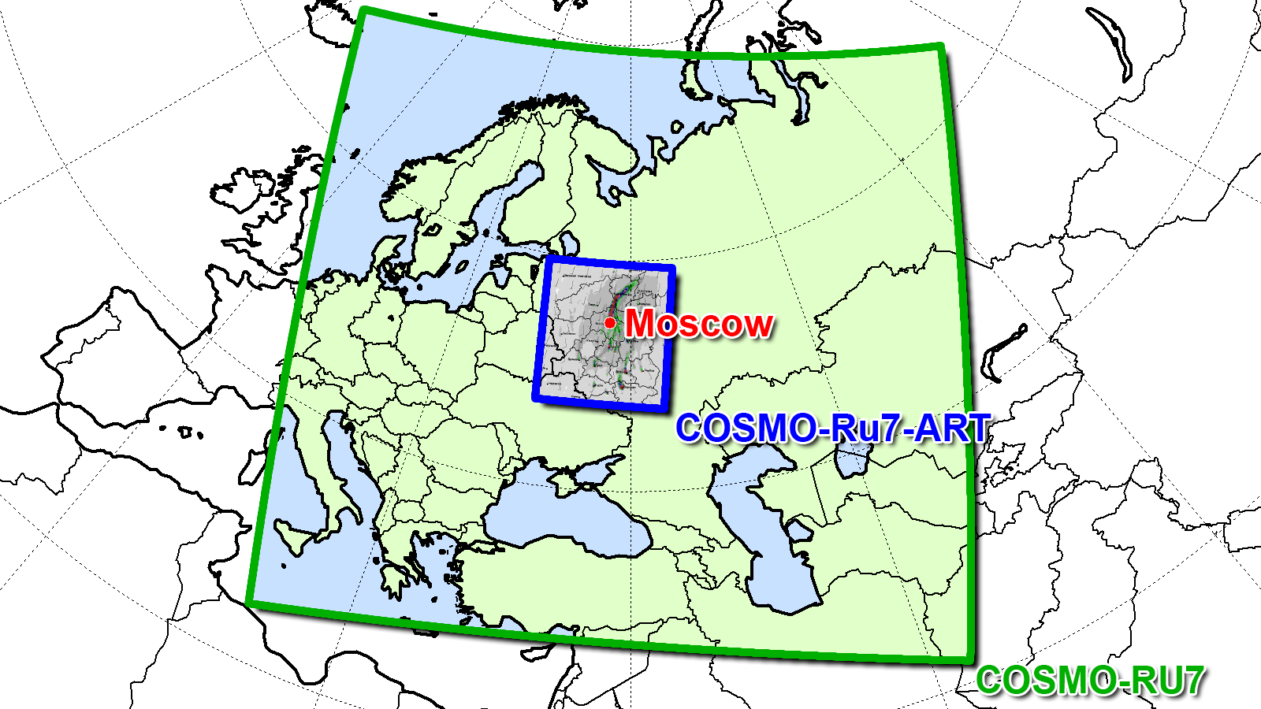
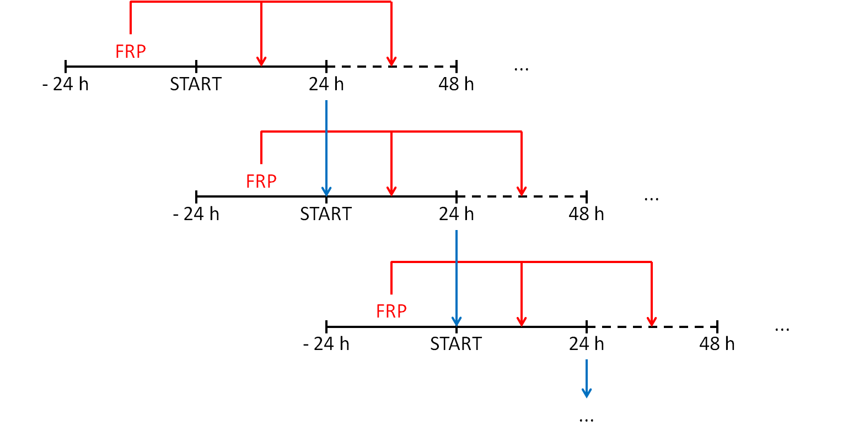

Estimating the effects of intense forest fires with COSMO-Ru7-ART (ART->Aerosols and Reactive Trace gases)
Region: ~30-45°E, 50-60°N
Δ x= 7 km, Δt = 40 s
IC&BC from COSMO-RU7
48h forecast from 00 UTC
anthropogenic emissions TNO
Landuse Data GLC 2000
CO, NO, NO2, O3, SO2, PM10
Pyrogenic emission estimated using MODIS data (Fire Radiative Power (FRP), Land Cover Type)
CO2, CO, NOx, CH4, NMVOC, PM10
Organization of operational air pollution forecast
during forest fire episodes
Courtesy A.Kirsanov
Notes:
TNO?
CO… - это то, что рассчитывается?
18

Slide 19
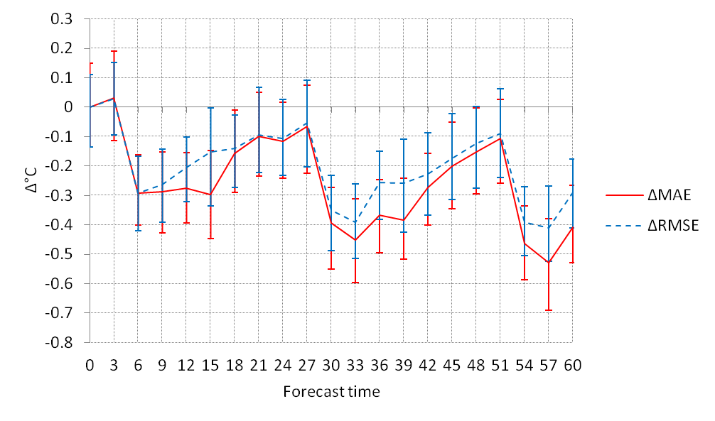
IMPACT OF AEROSOL RADIATION INTERACTION
ON AIR TEMPERATURE FORECAST
aerosol feedback decreases air temperature forecast error
by 2°C at daytime,
over highly polluted areas
control – experiment without aerosol radiation interaction
feedback – experiment with aerosol radiation interaction
Notes:
19

Slide 20
A Limited-Area Spatio-Temporal
Stochastic Pattern Generator (SPG)
Michael Tsyrulnikov and Dmitry Gayfulin
Motivation:
Existing approaches:
“Random numbers in boxes” (Buizza et al., 1999)
Spectral-space based pattern generators (Li et al. 2008; Berner et al. 2009; Bowler et al., 2009; Palmer et al. 2009; Bouttier et al. 2012)
Both do not give rise to spatio-temporal interactions (space and time are independent). Their spatio-temporal correlations are separable.
In reality, longer spatial scales “live longer” than shorter spatial scales, which “die out” quicker. This “proportionality of scales” is widespread in geophysical fields (Tsyroulnikov QJRMS 2001) and other media.
The goal is to build an SPG with realistic non-separable spatio-temporal correlations to generate model-error perturbations
Notes:
Motivation: Nature is stochastic. Therefore there are many tasks in Geophysics that require some random fields to describe the stochastic physical processes.There are several approaches to generation of such stochastic patterns.The SPPT suggested by Buizza in 1999 is an example . Another example give spectral-space based pattern generators.
However both approaches do not give rise to spatio-temporal interactions (space and time are independent). Their spatio-temporal correlations are separable.
……

Slide 21
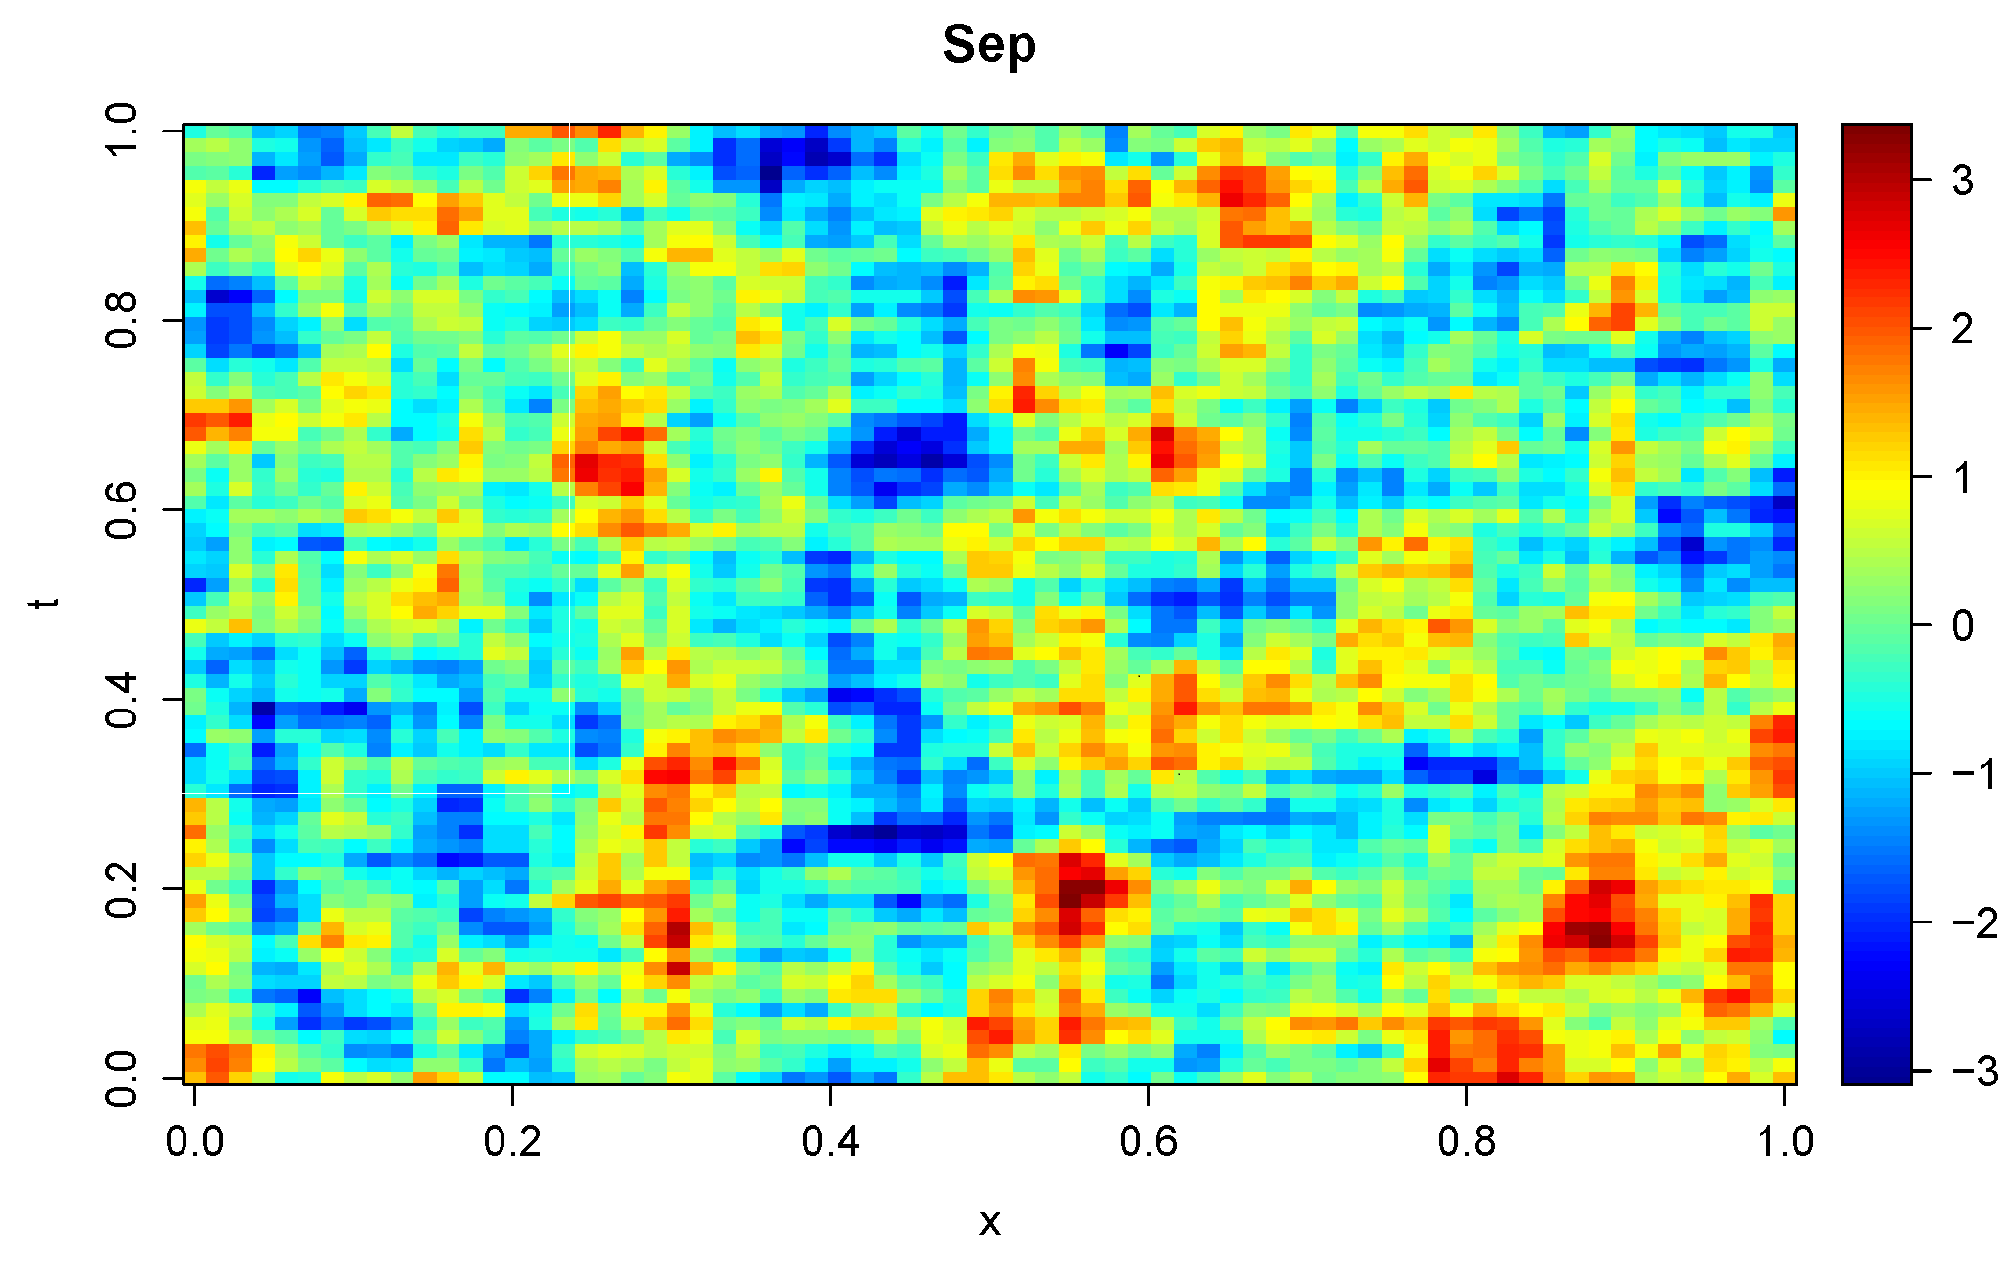
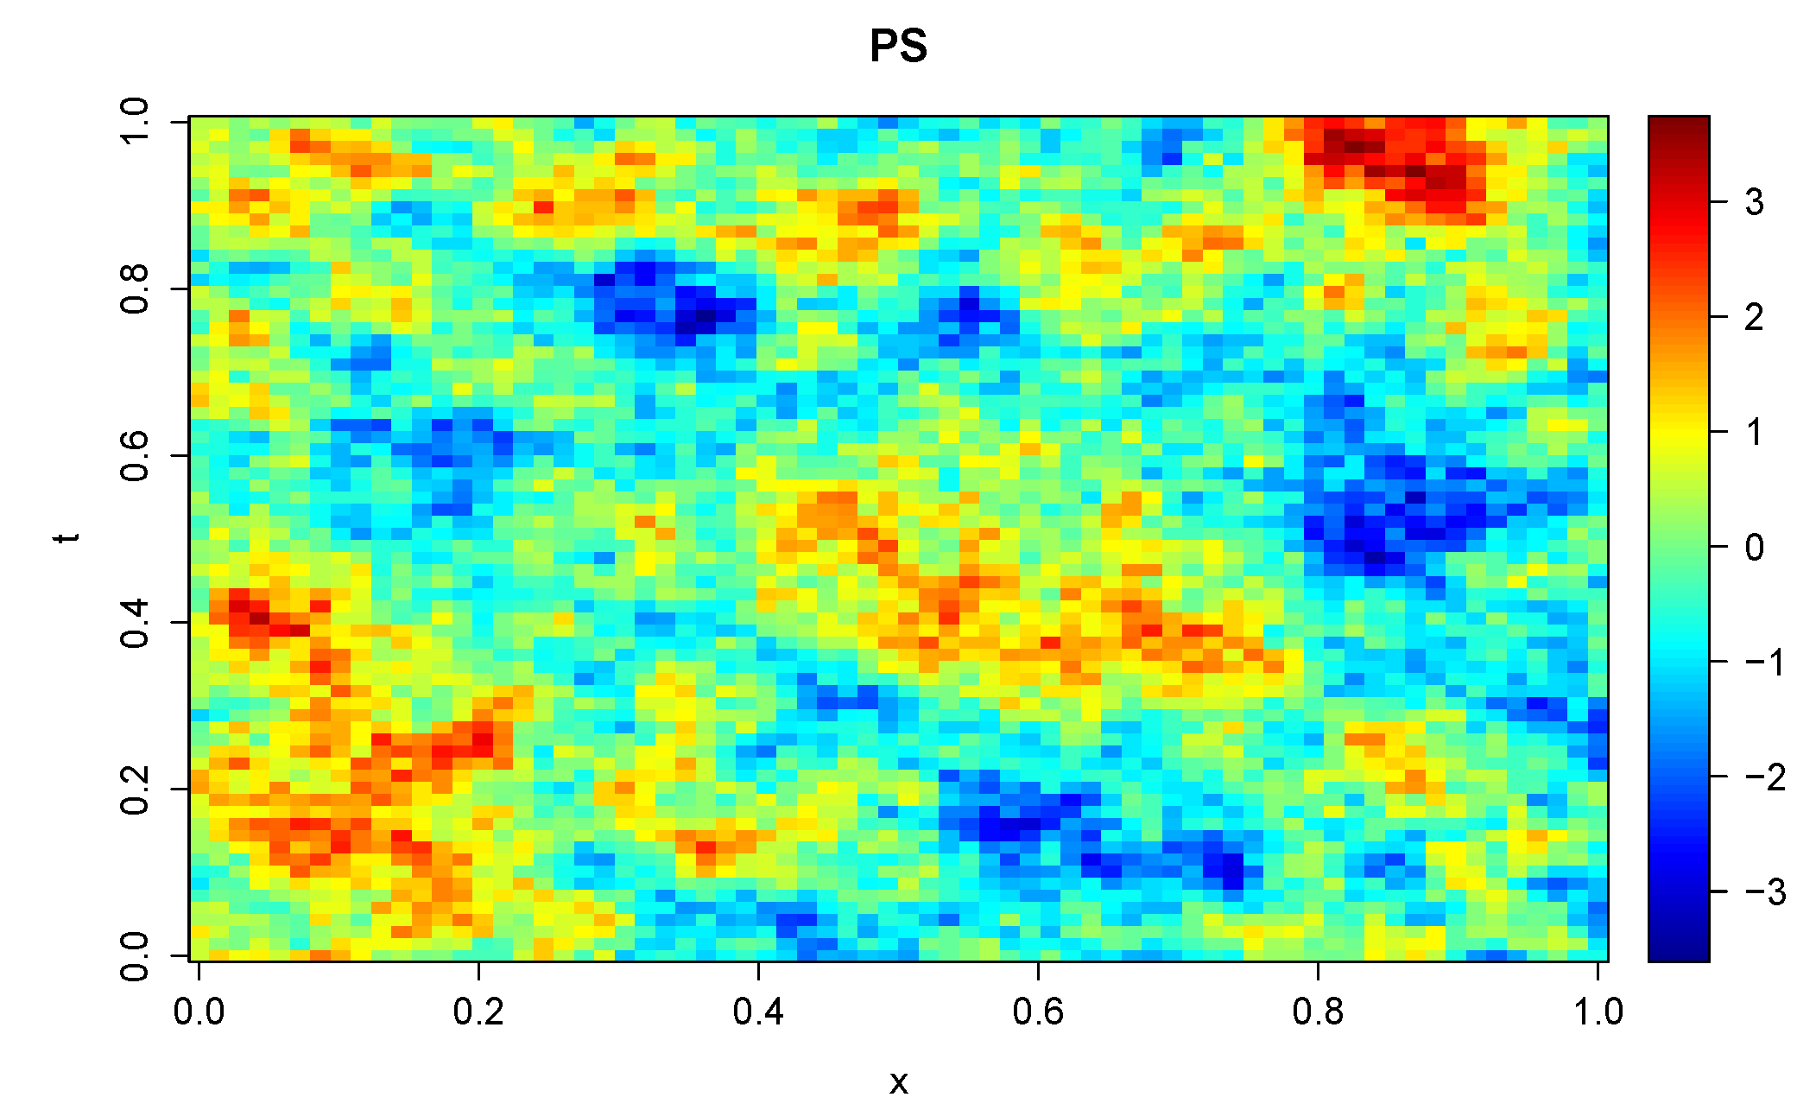
Realizations of random fields with separable and
non-separable spatio-temporal correlations
t
Separable:
“longevity” of spatial structures is independent of the their scale
x
t
Non-separable
looks “nice”, exhibits a kind of isotropy and organization
x
Notes:
This slide demonstrates how the spatio-temporal random fields with separable and
non-separable spatio-temporal correlations look like. Abscissa is the spatial coordinate x, ordinate is time.
The two simulated fields have the same exponential correlation functions both in space and time.
But they look very different: the non-separable field exhibits a more “organized” and “isotropic” field,
in which large spatial features indeed live longer than small-scale structures.
Top: C(t,x)=C(t)*С(x)=exp(t/tau) * exp(x/L)
Bottom: C(t,x)=exp(-r), where r=sqrt((x/L)^2 + (t/tau)^2) . CVF -> CVM -> random vector E x E^T=C

Slide 22
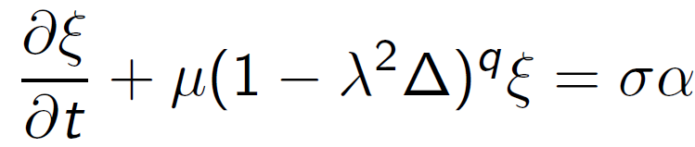
Technique: stochastic partial differential equation
In a first-order equation ∂ξ/ ∂t + A ξ = forcing, we select A to be a polynomial in the spatial Laplacian ∆ (to get isotropy in space) and forcing to be a white noise:
where ξ is the generated field, α is the white noise,
μ, λ, σ are parameters that control the temporal length scale, spatial length scale, and variance, respectively,
q is the spatial order of the model
This equation does not satisfy “the proportionality of scales “ (when spatial wavenumber k corresponds to temporal scale ~1/k)
Notes:
Stochastic differential equations are known to be a flexible and computationally fast approach to generate random processes and fields.
Если мы хотим добиться пропорциональности масштабов (имеется ввиду non-separability) для этой модели, мы получаем q=0.5 и поле дисперсии в установившемся состоянии оказывается бесконечным (что нереально)

Slide 23
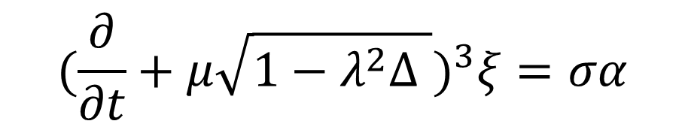
Need for a higher-order in time model
Trying to get the random fields with non-separable spatio-temporal correlations and “proportionality of scales” we have come up to the following equation
Consider ξ (t,x,y,z) where x, y, z belong to a cube with periodic boundary conditions in all 3 dimensions.
Numerical solution: Spectral method.
Spectral-space computations are very fast. FFT limits the speed.
Notes:
Да, и модель надо изменить. Вот придумали повысить порядок по времени and got the following model/
Для решения используется спектральный метод – переходим в спектральное пространство и решаем ур=ния дял спектральных коэффициентов
To facilitate a spectral-space solution, we define to be a cube with periodic boundary conditions in all 3 dimensions (
На нем Basis functions look as exp(imx+iny+ilz). Easy to use FFT
The operational random field is obtained by mapping the field from the standardized spatial domain to the domain of interest.

Slide 24
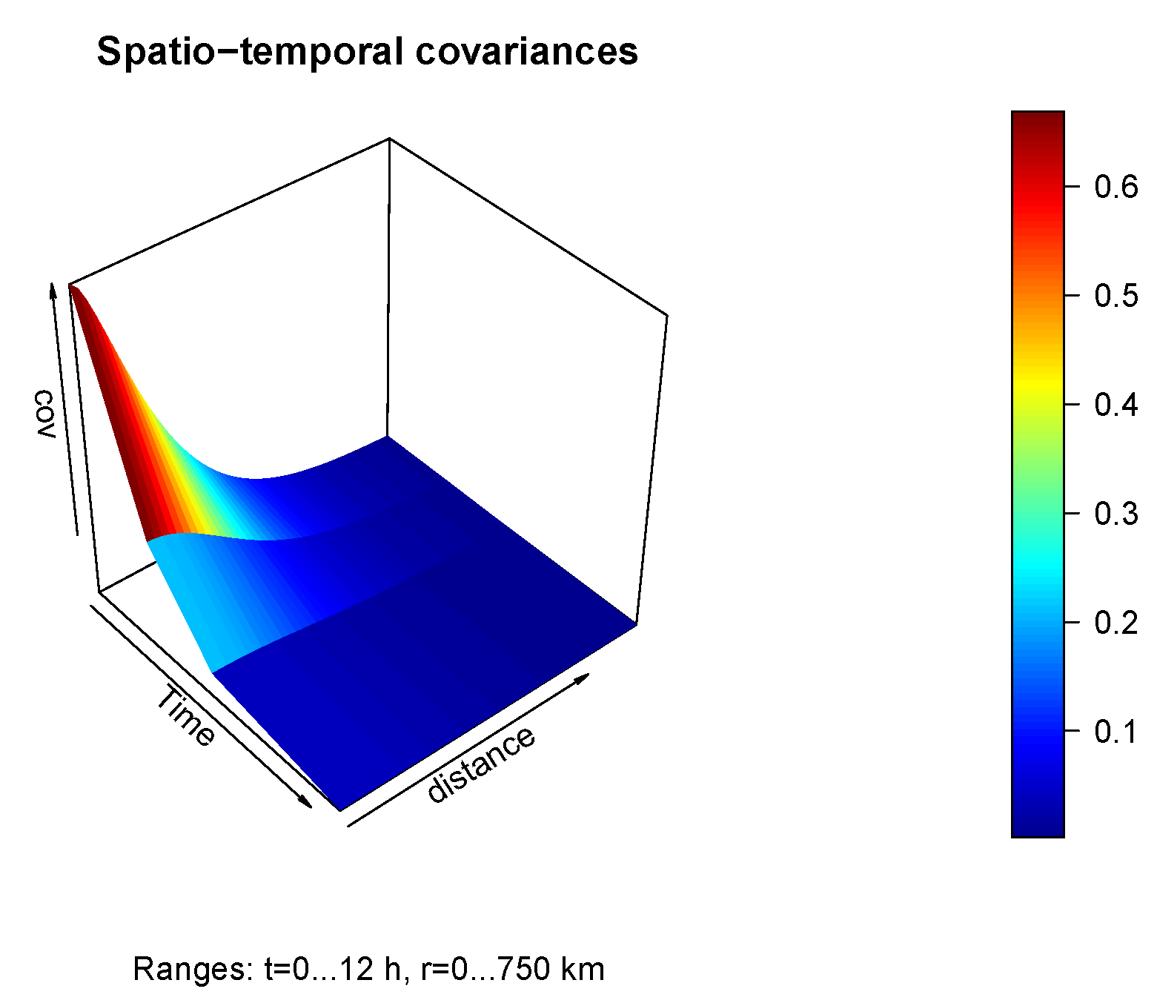
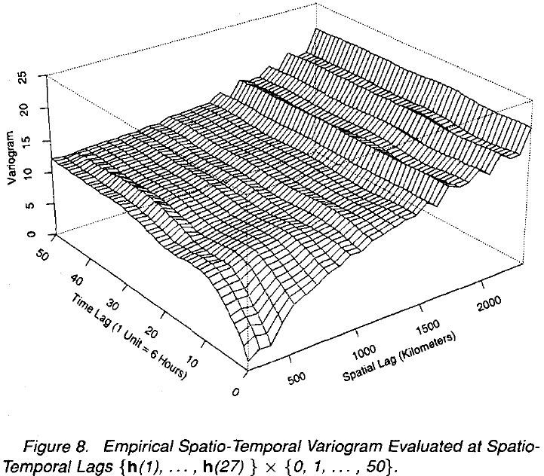
Spatio-temporal correlations of a random field generated by SPG and empirical variogram (Cressie,Huang,1999 )
SPG
Empirical
NB: the variogram is proportional to 1-C(t,x), where C is the correlation function
With higher time lags, the spatial correlations decay at a slower rate and have larger spatial length scales. This is observed for real-world wind speed data see left figure) but not modeled by separable pattern generator techniques.
Notes:
Correlation function of a random field generated by our SPG.
This is the function of two arguments: one spatial argument (x, directed to NE) and one time argument (t, directed to SE).

Slide 25
Current application
SPG has been used to generate soil moisture and temperature perturbations in COSMO EPS.
Embedded in the COSMO model code,
the SPG takes 1% of the total CPU time.
Perturbed COSMO run
Perturbing
model fields (each time step)
COSMO model
SPG

Slide 26
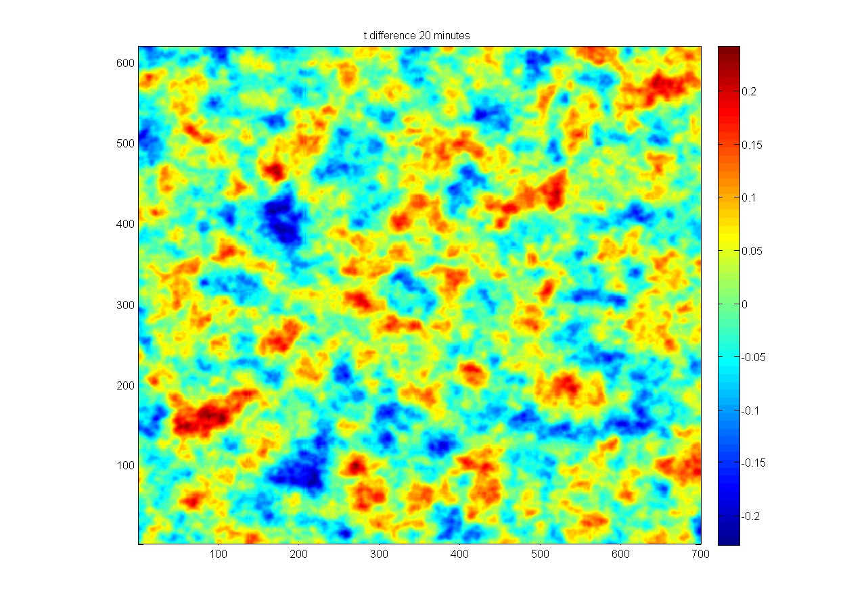
An example of temperature perturbation field generated by SPG on COSMO horizontal grid (at about 3 km above the ground)
t=0
Notes:
Сгенерировали такое поле (+ для скоростйе ветра, давления по гидростатике через темп )
Генератор работает паралл модели в реальном времепни Сгенерированно еполе добавл\ется к прогнотси каждые 20 мин
26

Slide 27
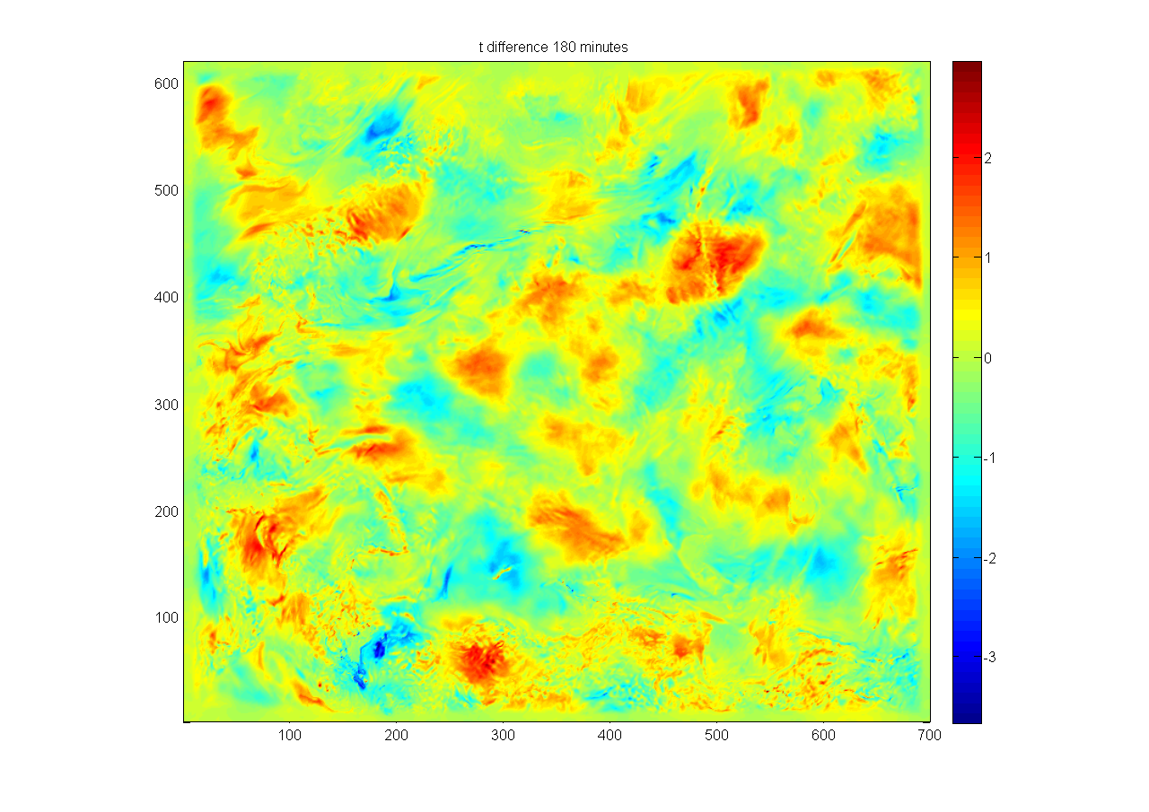
The resulting 2-D temperature forecast perturbation field after 3 h of time integration
t0+3h
Both a larger overall spatial scale and a fine structure are visible.
Notes:
Через три часа получилось это
Общая структура стала крупнее и симпатичнее
Its planned to be used in COSMO EPS
Сейчас результаты SPG просто добавлялись, можно умножать тенденции
27

Slide 28
References
1. Chubarova N., Poliukhov A., Gorlova I.
Long-term variability of aerosol optical thickness in Eastern Europe over 2001–2014 according to the measurements at the Moscow MSU MO AERONET site with additional cloud and NO2 correction. Atmospheric Measurement Techniques, Vol.9, No. 2, pp. 313-334
2. M.Tsyrulnikov and D.Gayfulin. Limited-Area Spatio-Temporal Stochastic Pattern Generator for ensemble prediction and ensemble data assimilation, Meteorol. Z. (in preparation), 2016.
3. Tsyrulnikov M., Rakitko A. Hierarchical Bayes Ensemble Kalman Filtering. – ArXiv preprint, 2015, arXiv:1509.00652. Physica D, under review.
Contacts: Michael Tsyrulnikov, mik.tsyrulnikov@gmail.com
Marina Shatunova, gbert@gmail.com

Slide 29
THANK YOU FOR YOUR ATTENTION!
СПАСИБО ЗА ВНИМАНИЕ!

Slide 30
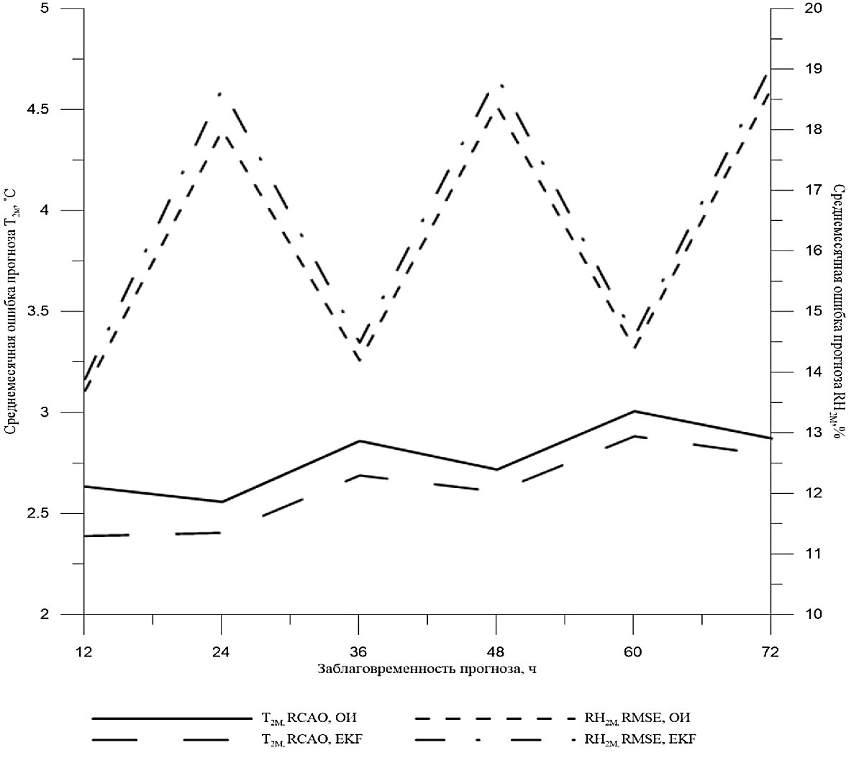
T2m abs. error, RH2M RMSE for OI and SEKF soil moisture assimilation

Slide 31
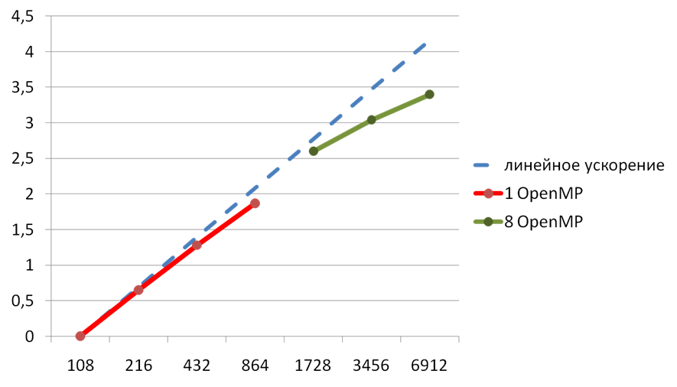
Parallel speedup of the new SLAV program complex. 2880x1730x51 grid. Preliminary results!
Log(time w.r.t. time at 108MPIx1OpenMP cores)
47% (55%)
65%
84%
81%
90%
96%
# of cores

Slide 32
First results for AMIP2 experiment with SL-AV model . Mean January 1979-1983 MSLP field. ERA (left), SLAV (right). Note different color definitions

Slide 33
Global SL-AV model: Plans for further development
Implement SEKF soil moisture initialization for multilayer INM soil model
Ozone cycle (advection + simplified photochemical cycle)
Moving upper boundary to 0.5 hPa and increase vertical resolution (waiting for new computer)
Finish tuning of climate version, AMIP2
Coupled model (SLAV + INM-IO) seasonal hindcasts
Finish new program complex development (expected scalability about 10000 cores with 13km grid)
Experimental version for Intel Xeon Phi cluster (PetaStream)
Monte-Carlo independent column assumption (MCICA) in radiation (waiting for new computer)
Version with 10 km horizontal resolution (first version in 2016, to be ready for tuning at new computer)

