Slide 1
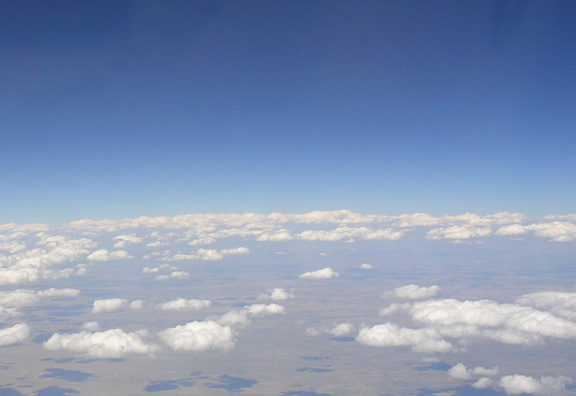
GEWEX Global Land/Atmosphere
System Study (GLASS):
Update at WGNE-31
Michael Ek (GLASS Co-chair, NCEP/EMC)
Aaron Boone (GLASS Co-chair, CNRM-GAME/Météo-France)
GLASS panel members and other GEWEX collaborators
31th session of the JSC/CAS
Working Group on Numerical Experimentation (WGNE)
CSIR, Pretoria, South Africa, 26-29 March 2016

Slide 2
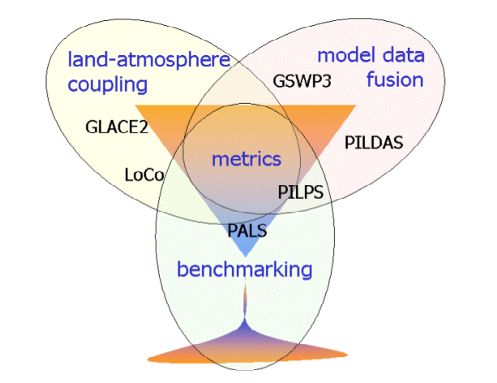
GEWEX Global Land/Atmosphere System Study (GLASS)
The aim of GLASS is to promote community activities that improve:
Our best estimates and the model representation of state variables
Our understanding of land/atmosphere feedbacks
Our understanding of the role of land surface in predictability.
To best achieve these aims, GLASS has been re-structured into three elements: (right)
DICE

Slide 3
GLASS Project Updates
GLASS Projects of most relevance to WGNE:
PALS-PLUMBER: Land model benchmarking.
PILDAS: Project for the Intercomparison of Land Data Assimilation Systems.
DICE: Land-atmosphere interaction, links to GEWEX Global Atmosphere System Studies (GASS).
LoCo: Local Coupled Land-Atmospheric Modelling.

Slide 4
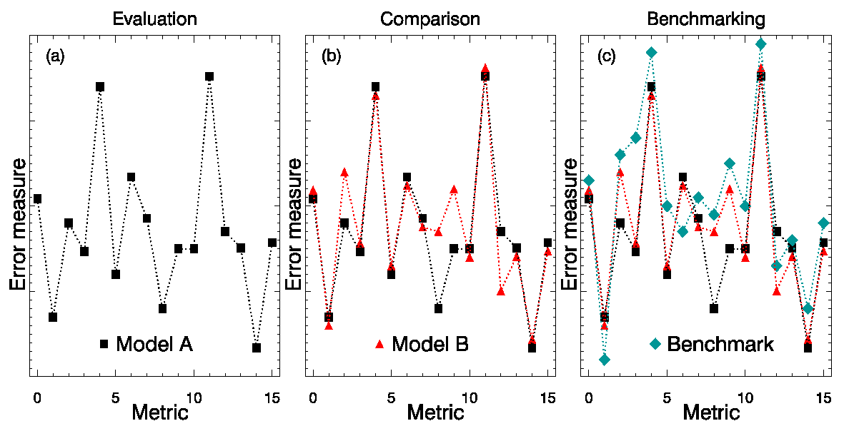
PALS-PLUMBER: Land Model Benchmarking
Reminder: Evaluation & Comparison versus Benchmarking
Evaluation & Comparision: Run model and compare output with observations or another model, & ask: How good is the model?
Benchmarking: Decide how good model needs to be, run model and ask: Does model reach the (benchmark) level required?

Slide 5
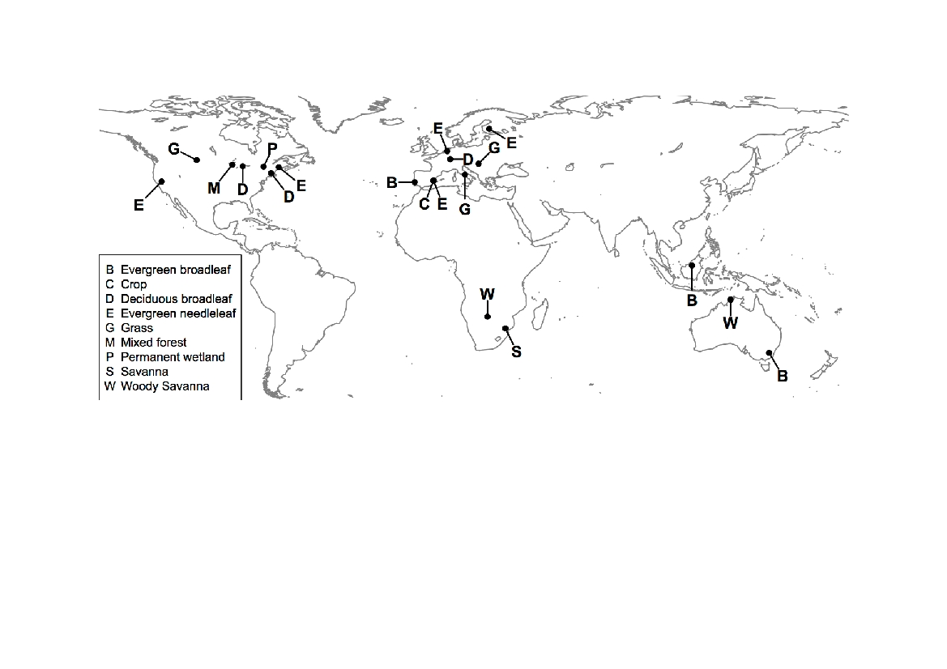
PALS-PLUMBER: PLUMBER Fluxnet Sites

Slide 6
PALS-PLUMBER: The Benchmarks
Penman-Monteith (well-watered)
Manabe bucket model
Linear regressions
  Linear 1 var: S_{W↓}
  Linear 2 var: S_{W↓}, T_{a}
  Piecewise linear 3 var: S_{W↓}, T_{a}, q_{a}

Slide 7
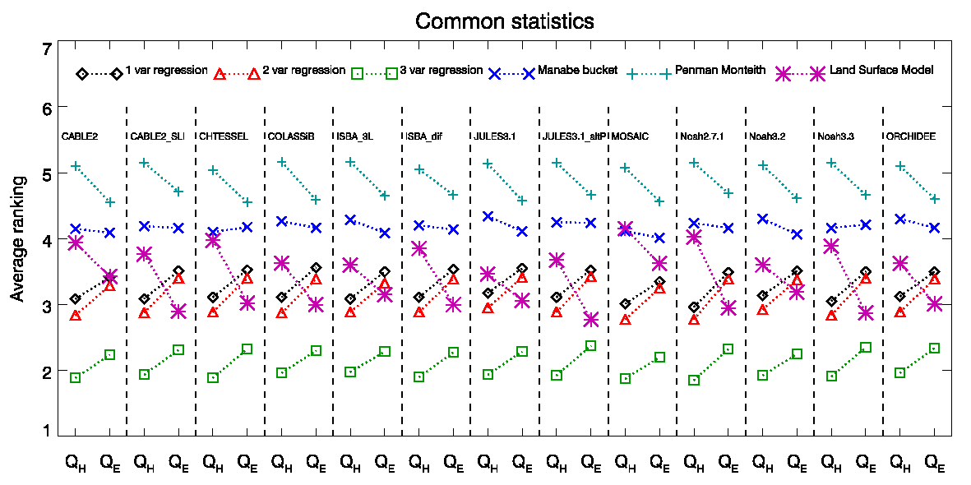
Benchmarking Against Common Statistics
Mean Bias Error | MBE
Normalised Mean Error | NME
Standard Deviation | sd
Correlation coefficient | r

Slide 8
PALS-PLUMBER: PALS Updates
The Protocol for the Analysis of Land-surface models (PALS):
Web-based database of model simulation & obs land surface datasets.
Integrated diagnostic analysis tools (Abramowitz 2012).
Standardized benchmarking in land-surface model intercomparisons.
Publications: PALS Land sUrface Model Benchmarking Evaluation pRoject (PLUMBER), Best et al 2015, Haughton et al 2015.
“Experiment” structures-internal PALS structuring allows:
Either point-based, catchment-based, regional or global experiments.
Each experiment defined by resolution, grid and evaluation variable(s).
All analysis controllable/editable by experiment owner–no coding need.
User-defined benchmarks:
Allow users to specify benchmarks other than empirical models (up to 3), e.g. previous model versions, other models internationally where they have completed experiments for which benchmarks are requested.
Report generation facility:
Create tables of scalar metrics comparing model with its nominated benchmarks for all experiments where benchmarks are available.
Useful for model development and management.

Slide 9
PALS-PLUMBER: PALS Future
So far in 0.5 degree format (for PALS/Global GSWP3 Grid):
LandFlux ET.
GLEAM ET.
MODIS ET.
MPI Jena ET, NEE.
MODIS Vis, NIR albedo.
For both Global and Australia.
Currently working on:
Including QA/QC information in plots.
Plot class that incorporates all related (e.g. ET) products at same time.
How best to incorporate runoff or streamflow constraint.
The difficulty is not producing these plots, it is doing so reliably in an automated system.
Future:
Additional variables and metrics, e.g. land state validation, surface-layer turbulence/momentum stress, land-atmosphere coupling.
“Mirror” PALS web site elsewhere, e.g. NCAR/NOAA, NASA.

Slide 10
Project for the Intercomparison of
Land Data Assimilation System (PILDAS)
Leads:
Rolf Reichle (NASA/GSFC)
Jean-François Mahfouf (CNRM/Météo-France)
Qing Liu (NASA/GSFC)
Enable better communication among developers of land data assimilation systems (LDAS).
Develop and test a framework for LDAS comparison and evaluation.
Compare land assimilation methods, e.g. EnKF, EKF, etc.
Conduct sensitivity studies of assimilation input parameters, such as model and observation errors.
Provide guidance and priorities for future land assimilation research and applications.
Ultimately, produce enhanced global datasets of land surface fields for model initialization.
10
Notes:
10

Slide 11
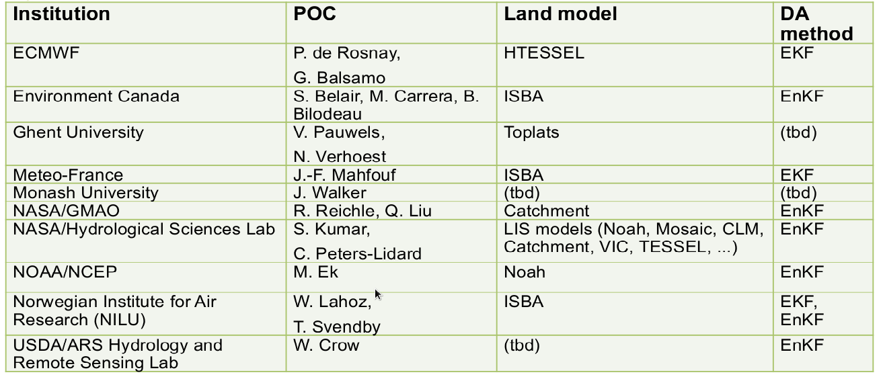
PILDAS: Participants/Institutes/Contributions
11
Notes:
11

Slide 12
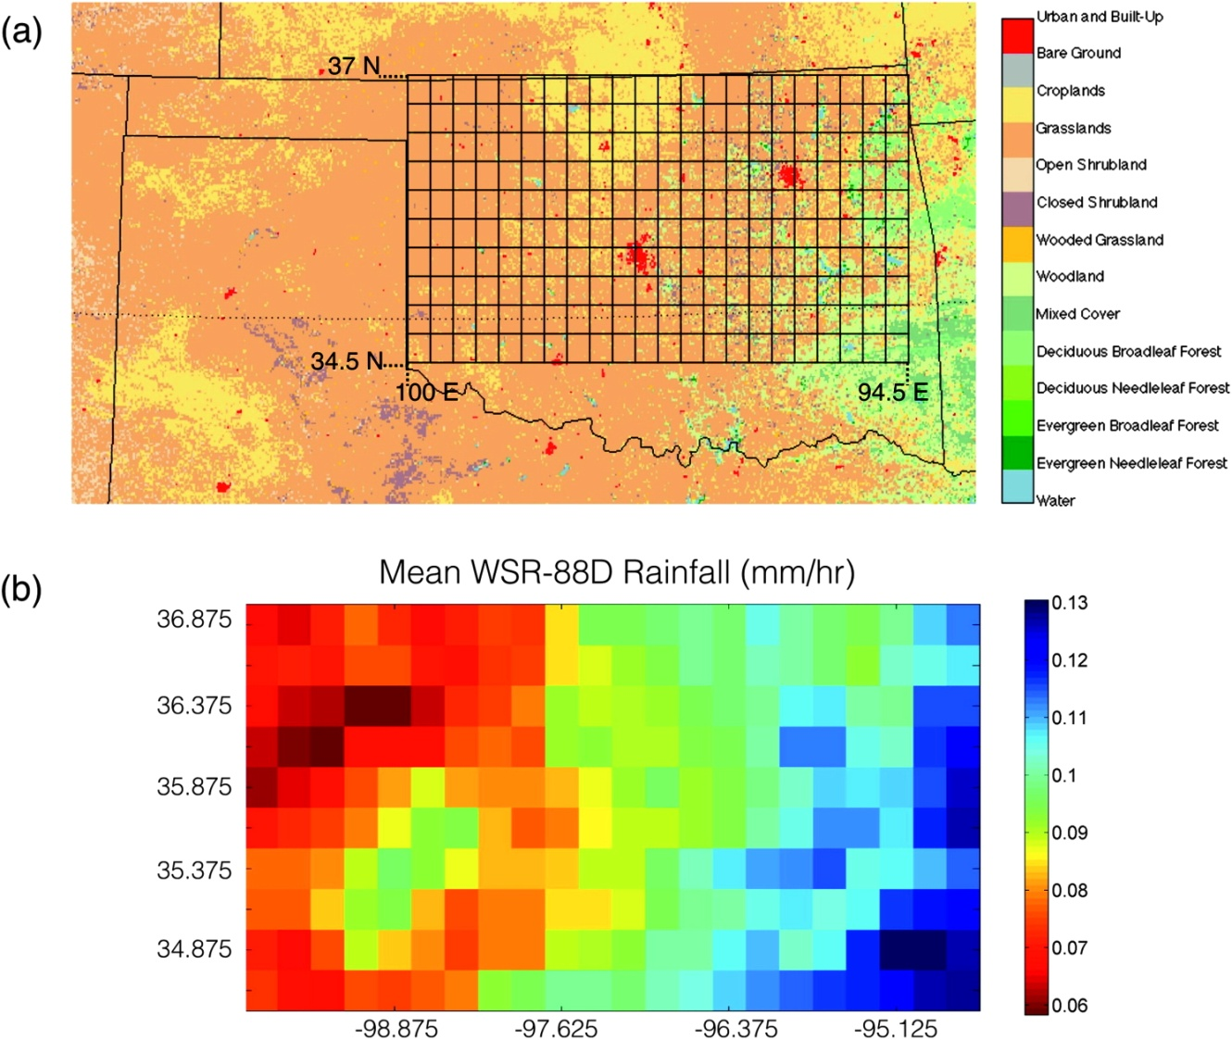

PILDAS: Experiment Domain
Tentative experiment setup:
Domain: 34.5°-37°N, 100°-94.5°W
Exchange grid: 0.125 deg lat/lon
Duration: 2001-2011
Annual mean precipitation [mm/h]
Grid shown at 0.25° resolution
Forcing data provided and LDAS output is expected on exchange grid.
Participating systems may run on their native modeling/assimil grids.
Participating systems use native model parameters (land cover, soil texture, vegetation,etc).
12
Notes:
12

Slide 13
PILDAS: Status of Current Work Plan
PILDAS launch delayed into 2015, slowly spinning up in 2016 (Lead PI is on the SMAP science team).
The experimental design essentially complete, with pilot study by project leads using two land-surface models with one DA algorithm in NASA’s Land Information System (LIS).
Delays also due to modifications to the ALMA model output convention made by GLASS panel requiring considerable software updates (still ongoing).
Recent progress at ECMWF (P. de Rosnay) and USDA (Wade Crow):
  obtained PILDAS forcing data from NASA/GMAO.
  working to set up their systems to read forcing data and generate their versions of the "truth" data set.
  expected completion time of this phase sometime in winter or spring of 2016.
13
Notes:
13

Slide 14
PILDAS: Future Work
Phase-1 still focused on operational centers (rather than specific research projects), use of synthetic obs, and different DA algorithms with different LSMs for a 1/8-degree domain over the Southern Great Plains (US).
GLASS will take the experimental plan and initial results to WGNE (which has interest in land DA) to entice other centers not currently participating, e.g. from Asia.
Later phases will focus on coupled DA systems and use of actual satellite observations from SMOS and SMAP.
NASA Pis will continue to lead the effort and make initial experiments in the next phases of PILDAS.
14
Notes:
14

Slide 15
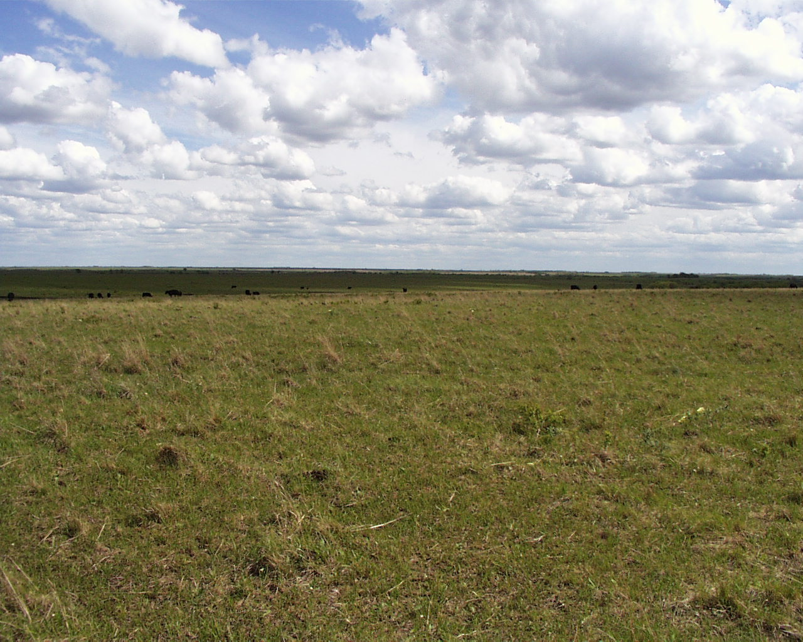


Diurnal land/atmosphere coupling experiment (DICE)
Project started April 2013 to study the interactions between the land-surface & atmospheric boundary layer.
Leads: Adrian Lock, Martin Best (UKMO).
Joint activity between GLASS (land-surface modellers) and GASS (atmospheric boundary-layer modellers).
12 models participating.
Follow-on to GABLS-2, where land-atmosphere coupling was identified as a important mechanism.
Workshops:
1st: 14-16 Oct 2013, UK Met Office.
2nd: 14-18 Jul 2014, GEWEX conf./Neth.
3rd: 20-22 May 2015, Météo-France.
Manuscript in preparation (for JHM).
CASES-99 Experiment
(Southern Great Plains, USA)
http://appconv.metoffice.com/dice/dice.html
15

Slide 16
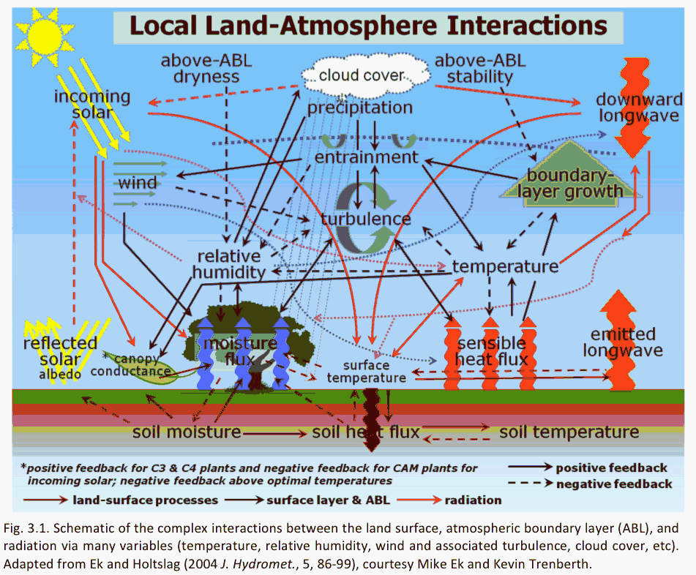
GEWEX Plans for 2013 and Beyond
http://www.gewex.org/gewex-content/uploads/2015/02/GEWEX_Imperatives_final.pdf

Slide 17
DICE-GABLS: Participants/Institutes/Contributions
Model | Contact scientist | Institute | Stages submitted | Levels | Sensitivity tests
Arome | Eric Bazille | Meteo France | All | 60/70 | resolution
Arpege | Eric Bazille | Meteo France | All | 60/70 | resolution
ECEARTH | Reinder Ronda | Wageningen | SCM only | 91 | LAI
GDPS3.0 | Ayrton Zadra | CMC | All | 79
GFDL | Sergey Malyshev | Princeton | All | 24
GISS_E2 | Ann Fridlind, Andy Ackerman | GISS | All | 40
IFS/HTESSEL | Irina Sandu, Gianpaolo Balsamo | ECMWF | All | 137 | LAI
MESO_NH | Maria Jimenez | UIB | All | 85 | Bare soil
UM/JULES | Adrian Lock, Martin Best | Met Office | All | 70 | Vegetation
WRF-NOAH | Weiguo Wang | NUIST | All | 60 | Lots!
WRF | Wayne Angevine | NOAA | ? | 119 | PBL scheme
CAM5, CLM4 | David Lawrence | NCAR | 1a, 1b | ?
PBCM | Pierre Gentine | Columbia | Not yet
17

Slide 18
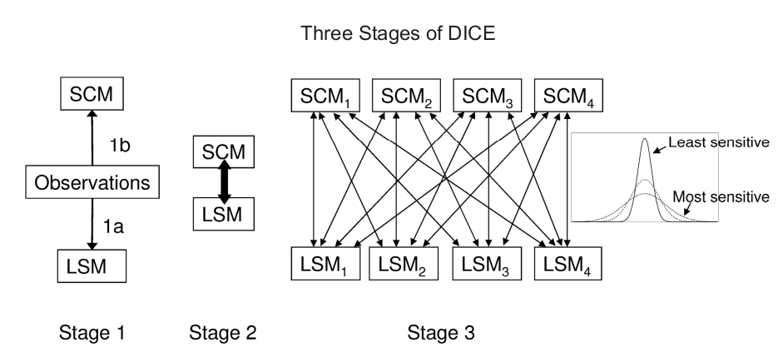
DICE Experimental Design
Objective: Assess impact of land-atmosphere feedbacks.
Stage 1: stand alone land, and single column model (SCM) alone.
Stage 2: Coupled land-Single Column Model (SCM).
Stage 3: Sensitivity of LSMs and SCMs to variations in forcing.
Data Set: CASES-99 field experiment in Kansas, 23-26 Oct 1999 using 2.5 days and 3 nights with intermittent turbulence (night one), continuous (two), radiatively-driven/no turbulence (three).
Martin Best and Adrian Lock (UKMO) et al.

Slide 19
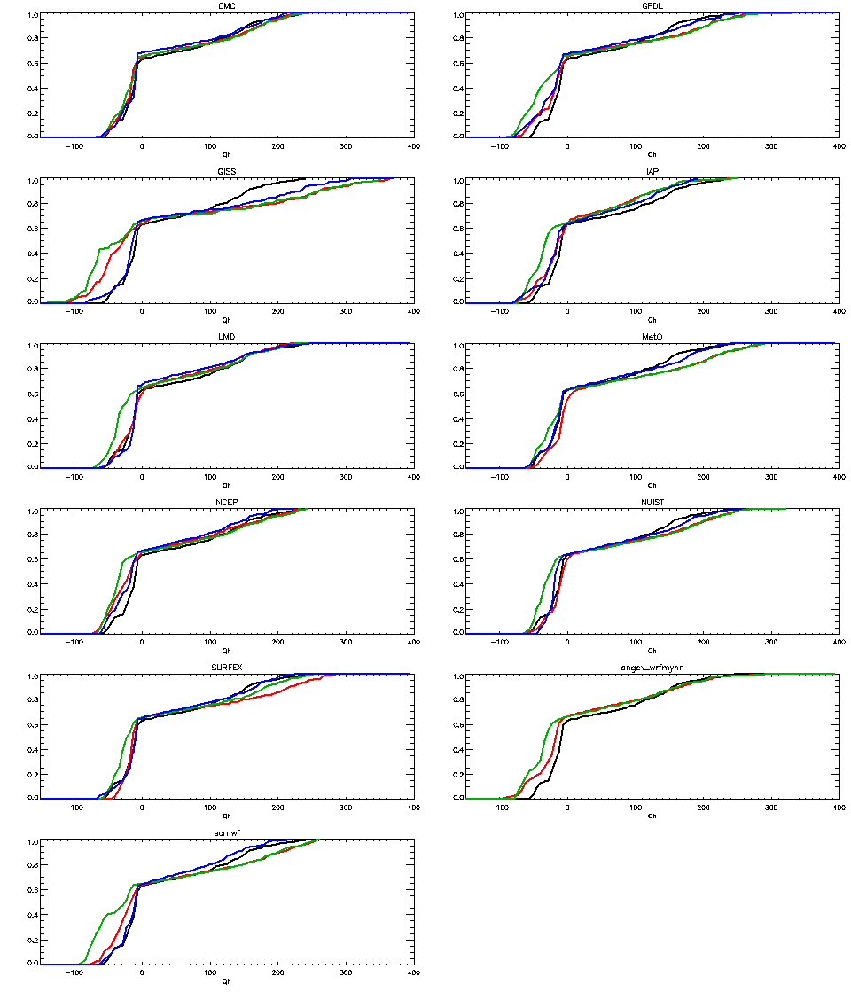
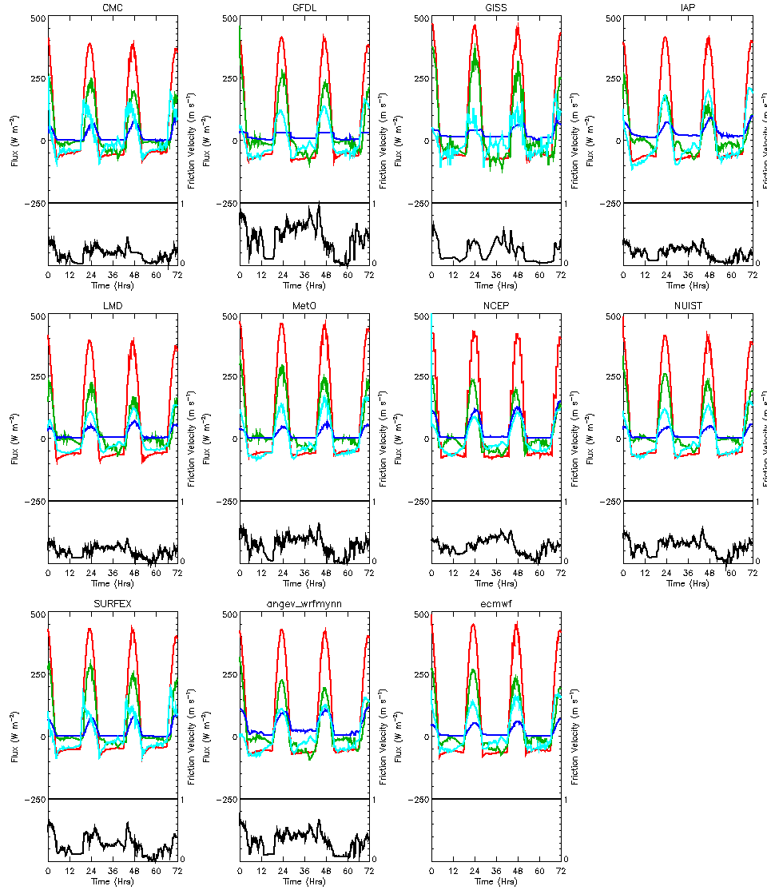
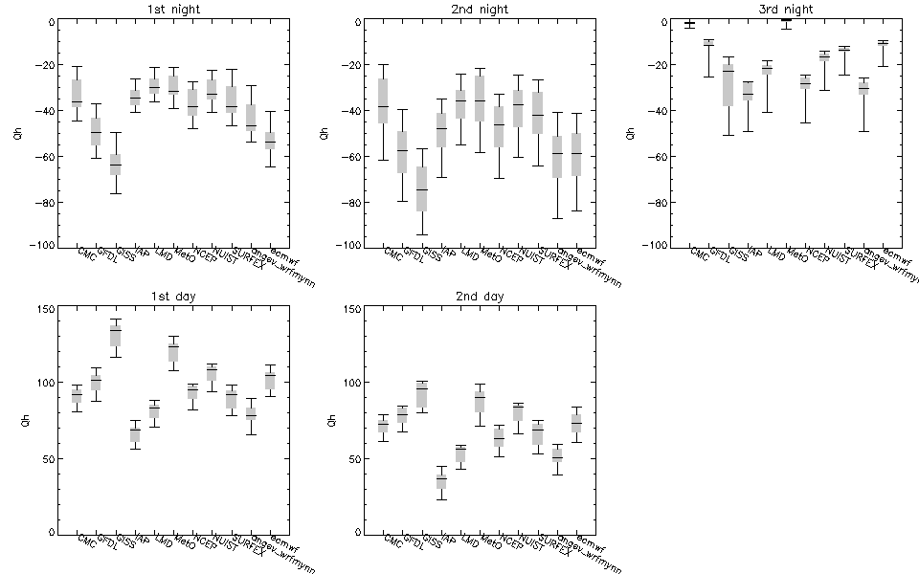
DICE Status/Summary
12 pages and 80 figures of results for stages 1, 2, 3!
9-year spin-up for LSMs.
SCM: no relaxation of time-varying geostrophic wind (uniform with height); subsidence of T,q; horizontal advection of T,q,wind; radiation switched on in all simulations.
Stage 1a (LSM): LHF generally far too large (LSMs didn’t account for dead grass, adversely affecting bowen ratio); SHF and stress too large at night; 55m forcing too high for LSMs (vs 10m) especially for stable nighttime conditions.
Stage 1b (SCM): Difficulty with wind profiles, particularly 1st night (intermittent turbulence); large differences in daytime parameterized entrainment; potential inaccuracy of (prescribed) large-scale forcing; SCM generally can be forced by observed fluxes and stresses.
19

Slide 20
DICE Status/Summary (page 2)
Stage 2 (LSM+SCM): excessive drag from LSMs generate deeper/less stratified SBLs; soil-surface coupling sensitivity at night; daytime PBL differences dominated by LSM surface fluxes, with RH dominated by SHF; more spread in PBL moisture; daytime PBL temperature evolution a “slave” to surface fluxes with PBL moisture more complicated.
Stage 3a (LSM ensemble spread due to PBL variability forcing): largest variation in SHF during day & at night for more continuous turbulence.
Stage 3b (PBL ensemble spread due to LSM variability forcing): day-time PBL: T, q dominated by sfc fluxes with variability between different SCMs similar, but sensitivity of inversion height very different.
Summary: surface momentum flux and momentum profiles should be examined by DICE community; large errors in evaporation may dominate signal and the impact of coupling; further examine nocturnal fluxes and boundary layers and soil-surface coupling sensitivity.
Repeat for many other sites (DICEs), e.g. GABLS project for Antarctica: GABLS4 or “DICE-over-ICE” (next page).
  Differences in different models’ (LSM+SCM) sensitivity to changes in forcing are likely important in GCMs; needs to be better understood.
20

Slide 21
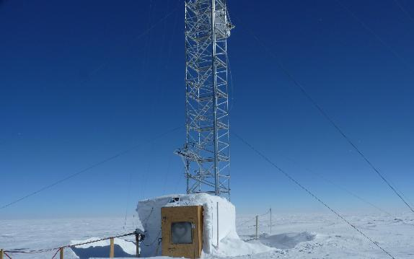
GABLS4: “DICE-over-ice”
Project started in 2015 to study the interactions between the ice/snow-surface & atmospheric boundary layer under conditions of strong stability.
Leads: E. Bazile, F. Couvreux, P. Le Moigne (Météo-France)
Joint activity between GLASS and GASS.
Several models/centers participating.
Follow-on to earlier GABLS studies with focus on very stable conditions, and a surface with low conductivity and high cooling potential over snow/glacier, and following the earlier DICE experimental design, as well as including LES studies.
Initial results presented at GABLS4-DICE Workshop, 20-22 May 2015, Météo-France.
Dome C - Antarctica
(Southern Great Plains, USA)
http://www.cnrm.meteo.fr/aladin/meshtml/GABLS4/GABLS4.html
21

Slide 22
LoCo: Project Overview/Goals
LoCo Working Group: Joe Santanello (NASA/GSFC), Paul Dirmeyer (GMU),
Kirsten Findell (NOAA/GFDL), Pierre Gentine (Columbia Univ.),
Benoit Guillod (ETH), Craig Ferguson (SUNY-Albany),
Josh Roundy (U. Kansas), Ahmed Tawfik (NCAR)
LoCo: GEWEX-GLASS core theme to understand, model, and predict the role of local land-atmosphere coupling in the evolution of land-atmosphere fluxes and state variables, including clouds.
Answer the following questions:
1. What role do land-atmosphere interactions (i.e., coupling strength) play in hydrologic extremes and abrupt shifts in regional climate?
2. What are the trends in regional coupling strength over the period of record? Where has coupling enhanced (or suppressed) the global warming signal?
3. How do we measure and benchmark coupling?
LoCo WG continues to grow & support initiatives on L-A coupling, supporting a new generation of L-A coupling leaders–“incubator”!
22

Slide 23
LoCo Coupling Metrics Toolkit
Ahmed Tawfik (NCAR): working on a land-atmosphere (L-A) coupling metrics toolkit written in modular Fortran 90.
Based on a compilation of Paul Dirmeyer.
Allow broader exposure/use of these techniques if metrics are well-documented, relatively standardized, and modular.
Release on github, after getting permission from various authors.
Metrics:
The Heated Condensation Framework (completed).
Mixing diagram variables like Entrainment Ratios (completed).
RH-Tendency from Mike Ek's work (partially completed).
Intrinsic Biophysical Factors.
Soil Moisture Memory using lagged auto-correlation (not started yet).
Terrestrial Coupling Index via Paul's 2011 GRL paper (not started yet).
CTP-HI-low Findell metrics (not started yet) + Coupled Drought Index (J. Roundy).
23

Slide 24
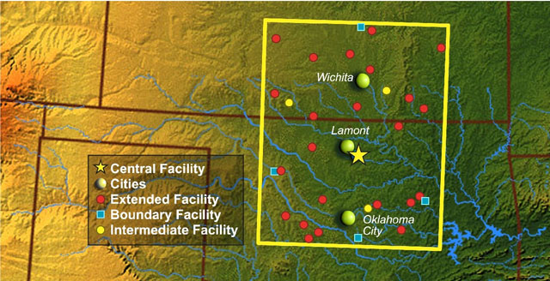
LoCo-SGP (Southern Great Plains) Testbed
“Enhanced Soundings for Local Coupling Studies”
PIs: C. Ferguson, J. Santanello, P. Gentine
15 June - 31 August 2015 at ARM-SGP Central Facility.
12+ IOP days chosen by PI’s, based on regime, soils/ET, and PECAN connection (nighttime convection) campaign.
14-sounding supplement to standard 6-hourly sonde launches, with hourly launches (daytime) and 10 minute lagged launch every 3-hours.
Data set for evaluation of models, LoCo metrics.
24

Slide 25
LoCo: Connection to GLASS Community Projects
LoCo unique as a WG instead of a MIP, that contributes across projects from different angles and informs on future observing networks.
Diagnostics can be used in current GLASS efforts:
DICE: 1st order quantification of impact of land-PBL coupling in Single Column Model (SCM) framework over SGP; currently focus on one-at-a-time site evaluation of fluxes, PBL, etc.
PALS/Benchmarking: Looking ahead to distributed (spatial) benchmarking. Extend to examining coupled benchmarks (beyond offline). Single-site first, e.g. other DICE efforts, LoCo-AMMA(?).
Observations can be used in current GLASS efforts:
SMAP: Launched February 2015. Data available this summer, 9km soil moisture product every 2-3 days, SMAP call for proposals (May)
PBL Profiling: Still a ‘gap’ in Earth Observations, COSMIC GPS-RO proposal, ESA abstract (Oct 2015), NASA WG on PBL missions.
25

Slide 26
GLASS Project Updates: Broad Summary
GLASS Projects of most relevance to WGNE:
PALS-PLUMBER: Additional flux sites, PALS website updates with new metrics/tools/data sets, hydrology.
PILDAS: Land data assimilation project likely underway this year.
DICE: Surface fluxes dominate signal of land-atmosphere interaction. Extend to “DICE-over-ice”.
LoCo: Assess land-atmosphere coupling diagnostics using summer 2015 SGP testbed data set.
“Including water management in large scale models”
A workshop co-sponsored by GEWEX/GLASS and GEWEX Hydro-climatology Panel (GHP), Gif-sur-Yvette, France, 28-30 September 2016

Slide 27
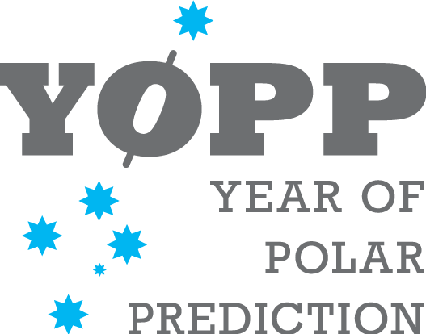

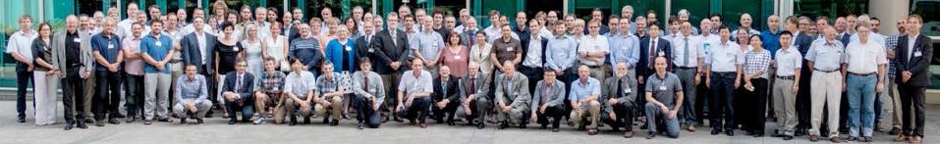
Year of Polar Prediction (YOPP)
"Extended period of coordinated intensive observational and modelling activities in order to improve polar prediction capabilities on wide range of time scales in both polar regions."
2017-2019 (preparation starting 2013, post activities through 2022).
Key activity of WWRP Polar Prediction Project (PPP).
Cooperation with WCRP Polar Climate Predictability Initiative (PCPI) and Climate and Cryosphere Project (CliC).
YOPP Summit 13–15 July 2015 at WMO headquarters in Geneva.
Mike Ek reviewed YOPP Implementation Plan, attended YOPP summit.
Key recommendations relevant to GLASS: Important topics of high-latitude land processes, hydrological cycle, land/ice-atmosphere interaction featured more prominently in revised Implementation Plan.
Relevant to a GLASS-GHP-CliC-iLEAPS Cold Season Processes Project.
YOPP Summit 13–15 July 2015, WMO, Geneva

Slide 28
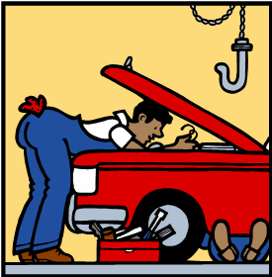
GEWEX Global Land/Atmosphere System Study (GLASS)
Uh oh! These surface fluxes don’t look so good.
..and you’re also going to need a land-atmosphere interaction alignment.
Thank you!
Ugh! Look at the hydrology in this thing!
GLASS
Land Models
GLOBAL MODELERS:
But how much will this cost to fix?!
Well… at least several more funding cycles.

