Slide 1
Unifying the NCEP Production Suite
Integrated coupled modelling approach at NCEP
Michael B. Ek
Deputy Director, Environmental Modeling Center (EMC)
National Centers for Environmental Prediction (NCEP)
NWS / NOAA
Thanks to Hendrik Tolman, EMC Director, for sharing some of these slides.

Slide 2
Emerging requirements
“Weather Ready Nation”: Products and social science, high impact events.
Weather to climate—seamless suite of guidance and products.
  Weeks 3&4.
  Systematic reforecasts need; Forecast uncertainty, and calibration of outlook products.
Range of products beyond weather (suggests more fully coupled):
  Land, ice, ocean, waves, aerosols, (ecosystems, space weather).
  Water cycle, collaboration with NWS National Water Center (NWC).
Key stakeholders to be addressed:
  NCEP Service Centers, National Weather Service Centers, Regions/Forecast Offices, NWC
  Other partners
  National Ocean Service, NOAA Fisheries, US Geological Survey, Defense, etc.
  Private Sector
  Academia
  International partners/commitments (WMO, Bi-lateral cooperation, etc.)

Slide 3
Seamless Suite, Spanning Weather and Climate
Years
Forecast
Uncertainty
Outlook
Seasons
Guidance
Months
Climate Forecast System
2 Week
North American Ensemble Forecast System
Threats Assessments
Global Ensemble Forecast System
1 Week
Global Forecast System
Global Dust
Forecast Lead Time
Forecasts
Short-Range Ensemble Forecast
Wave Ensemble
Days
North American Mesoscale
Waves
Global Ocean
Bays
Watches
Fire Wx
Regional Hurricane
(HWRF & GFDL)
Space Weather
Storm Surge
Hours
Rapid Refresh
Air Quality
Warnings & Alert Coordination
Minutes
Dispersion (smoke)
Benefits
Tsunami
Whole Atmosphere
HRRR
NMME
NLDAS
Aviation
Recreation
Health
Life & Property
Maritime
Fire Weather
Commerce
Hydropower
Agriculture
Ecosystem
Environment
Space Operations
Emergency Mgmt
Energy Planning
Reservoir Control

Slide 4
NOAA’s Operational Numerical Guidance Suite
April 2016
Climate Forecast
System (CFS)
Regional Hurricane GFDL
HWRF
Waves
WaveWatch III
Nearshore Waters
SURGE: SLOSH
ESTOFS: ADCIRC
NWPS:
WWIII
Ecosystem
EwE
3D-Var
DA
3D-En-Var
DA
GFS, MOM4, GLDAS/Noah Land, Sea Ice
Ocean (RTOFS)
HYCOM
Regional Bays
Great Lakes (POM)
N Gulf of Mexico (FVCOM)
Columbia R. (SELFE)
Chesapeake (ROMS)
Tampa (ROMS)
Delaware (ROMS)
Global Forecast System (GFS)
4D-En-Var
DA
NAM/NAM-nests
NMMB
NOAH
Global Spectral
Noah Land model
3D-Hybrid-VAR DA
Global Ensemble Forecast System (GEFS)
Dispersion
HYSPLIT
Short-Range Ensemble Forecast 26 members
21 GFS Members
Air Quality
WRF-ARW & NMMB
13 members each
CMAQ
North American Ensemble Forecast System
Rapid Refresh
High Res Windows
3D-VAR
DA
GEFS, Canadian Global Model
WRF-ARW & NMMB
WRF ARW
North American Land Surface Data Assimilation System
NEMS Aerosol Global Component (NGAC)
Space
Weather
High-Res RR (HRRR)
3D-VAR
DA
WRF ARW
Noah Land Surface Model
GFS & GOCART
ENLIL
Notes:
4

Slide 5
NOAA’s Operational Numerical Guidance Suite
Upgrades to Major Systems: January 2015 – May 2016
January 2015
May 2016
GDAS/GFS 13-km, Hydrid EnKF
GEFS v.11.0.0
NAEFS v.5.0.0
SREF v.7.0.0
RAP v.3.0.0/HRRR v.2.0.0
HiResW v.6.1.0
HWRF v.9.0.0
GFDL v.12.0.0
NWPS v.1.0.0
RTMA/URMA v.2.4.0
OBSPROC SAT Ingest
VERF v.4.0.0
GDAS/GFS, 4D EnVAR, land physics
Resolution
Observations
Data Assimilation
Physics
Post-processing
Notes:
5

Slide 6
NCEP driving forces
University Corporation for Atmospheric Research Community (UCAR) Advisory Committee for NCEP (UCACN) Model Advisory Committee (UMAC) report and NCEP Strategic plan:
  EMC modeling directions:
    Toward unified modeling/simplify our production suite.
    But… also add more:
      New elements in the environmental modeling suite.
      Reforecast for postprocessing of model results.
    Be more nimble, faster model improvements.
    But… changes require much work on post-processing side, so change less often…
modeling strategy
change faster
change slower
EMC
do more
do less

Slide 7
New Business Model Process:
Moving to Community Modeling …with a small number of models; operational control over codes; strategic planning if/when a models need modification.
Start of Development Cycle
Conduct a workshop (modelers, field, academia, customers)
Focus on incremental upgrades
Prioritize features to be improved
How do you propose to improve them?
How much will it cost (time=$, HPC)
How will data be disseminated?
Develop detailed charter/test plan.
Fixed schedule (annual, 2-year, etc)
Requirements driven
Phase 2 of test plan
(2-4 months)
Assessment of Phase 2 results (2 weeks)
Invite Forecasters to participate
EMC’s Model Evaluation Group
Test
Assess
Phase 1 of test plan (2-4 months)
Assessment of Phase 1 results (2 weeks)
Invite Forecasters to participate
EMC’s Model Evaluation Group
Final Approval
Testing & Implementation

Slide 8
Basic Approach: Data Assimilation
Unifying on Gridpoint Statistical Interpolation (GSI) and ensemble hybrid 4DEnVAR.
Global focus:
  Is a single DA system for all global models feasible?
    Freeze or update DA for climate applications.
  Where do we go with coupling?
  Issues:
    Scaling of GSI.
    Resolution of underlying ensemble.
Regional focus:
  We do want to unify, but how feasible is this?
  Great progress with convection resolving, but not yet at the science level achieved at global scales.
    Ensemble based convection resolving DA…
    Hourly Warn-on-Forecast, many efforts, but no real link to production suite yet.

Slide 9
Basic Approach: Atmosphere
Start with weather side:
Starting with products:
  What forecast time ranges
  which reasonably imply
    Run cadences
    Update cycle.
  Not so clear:
    Resolutions
    Data Assimilation
    Reforecast / reanalysis / retrospectives
  Need to map requirements to forecast ranges
Possible Approach
Range | Target | Cadence | Means
year | Seasonal | ? | 9-15mo
month | S2S | 6-24h | 35-45d
week | Actionable weather | 6h | 3-16d
day | Convection resolving | 1h | 18-36h
hour | Warn On Forecast * | 5-15 ‘ | 3-6h
now | Analyses ** | ? | now
* FACETs-NWS program
** Separating from DA for models
Tentatively vetted at the Dec. 2015 NCEP Production Suite Review

Slide 10
Current Models: Atmosphere
Range | Year | Month | Week | Day | Hour | Now
Target | Seasonal outlook | S2S outlook | Actionable weather | Convection resolving | Warn On Forecast | Analyses / nowcast
Present models | CFS | CFS (GEFS extension) | GFS, GEFS, NAM, SREF, RAP, hurricane | HRRR, NAM nest, HiresW |  | RTMA, URMA, blend
Cadence | ? (is 6h) | 24h (is 6h) | 6h | 1h | 5-15’ | ?
Range | 9-15mo global | 35-45d global | 3-16d global (?) | 18-36h regional (?) | 3-6h ? regional | 0 regional (?)
Updates | 4y | 2y | 1y | 1y | 1y | 6 mo
Reanal. | 1979-now | 20-25y | 3y | ? | ?
Where | ? | WCOSS | WCOSS | WCOSS | ? | WCOSS
Ensemble based DA for all ranges (day and hour TBD), except possibly for the now(cast) range
All global applications from single unified modeling system.
Global / regional unification ?
Present NCEP Production Suite elements not fitting in this layout:
  Space weather (WAM-IPE / Geospace).
  Hurricane models (GFDL / HWRF).

Slide 11
Dynamics and Physics
Next Generation Global Prediction System (NGGPS): new NWS R2O funding.
  Selecting a new dynamic core for global model to serve the NWS for the coming decades: assessing remaining two: NCAR MPAS or GFDL FV3.
    Architecture suitable for future compute environments.
    Non-hydrostatic to allow for future convection-resolving global models.
Atmosphere Model including Dynamics
Dynamical equations, advection, horizontal mixing, diffusion.
standard interface for model physics
Δt, u, v, w, T, θ, p, z, q_{x}, c_{x}, a_{x}
destaggered
Tendencies
and Updates
Atmospheric Physics Driver
(init, run, finalize modes)
Initialize
Physics Tables and Databases
Output
Diagnostics
fields
rates
budgets
others
Init
Mode
Modified Kalnay Rules Layer
Finalize
Mode.
Radiation
Deep and
Shallow
Cumulus
Surface Layer
PBL and Vertical Mixing
Micro-physics
NUOPC Physics Driver Schematic
Global Model Test Bed (GMTB; NCAR&NOAA/Boulder): Common Community Physics Package)
Notes:
This is the proposed NEMS NUOPC physics driver schematic from the NUOPC Physics Interoperability Group (which includes NAVY, NCAR, NCEP, and others). This diagram is setting requirements for a single interface to invoke atmospheric model physics, with INIT, RUN, and FINALIZE phases. Patrick Tripp at NCEP is working on developing an instantiation of the driver for NEMS with the goal of having a single physics interface to GFS physics from the three atmospheric models in NEMS: GSM, NMM-B, and FIM. The development is underway with a RUN version working for GSM and being developed for NMM-B at this point. Unification of the physics interface of the atmospheric models within NEMS will enable common physics development goals to be met.

Slide 12
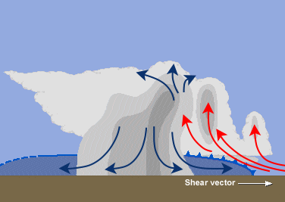

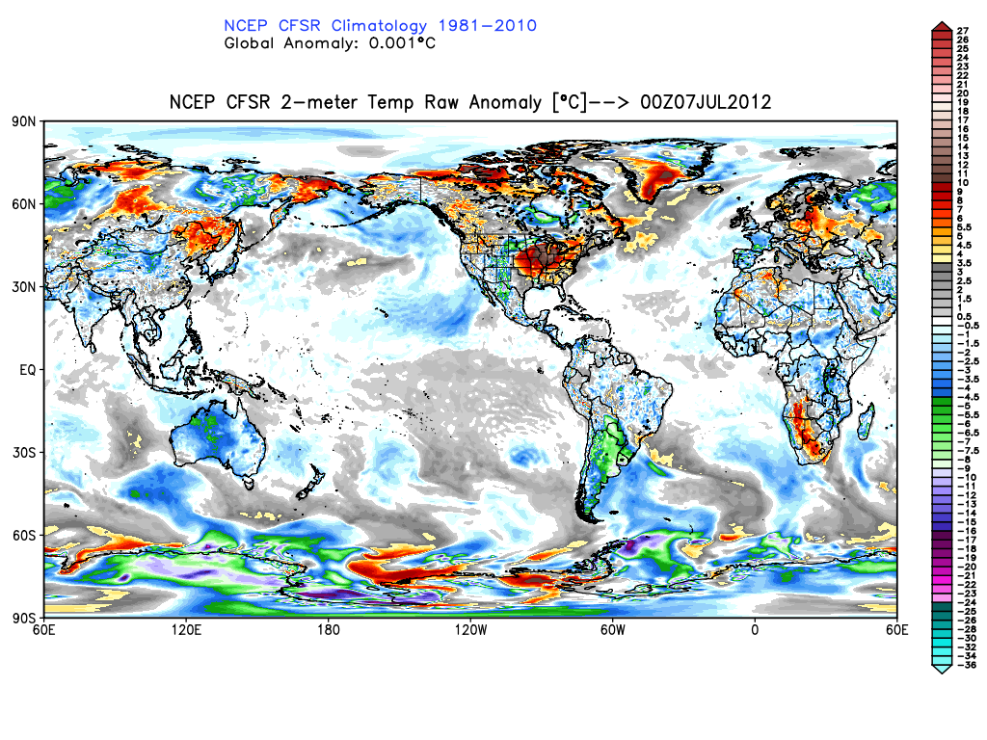
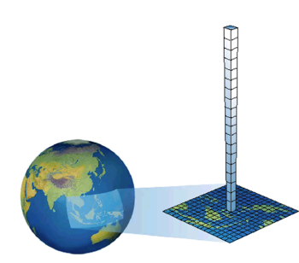
Hierarchy of Model Physics Parameterization Development
From Individual Component “Simulators” to Fully-Coupled Global
Simulators
Simulators: test submodel parameterizations at process level, e.g. radiation-only, land-only, etc.
Radiation
Testbed data sets to develop, drive & validate submodels: observations, models, idealized, with “benchmarks” before adopting changes.
Clouds & convection
Microphysics
Submodel interactions, with benchmarks.
Boundary-Layer
Full columns, with benchmarks.
Surface-layer
Limited-area/3-D (convection) with benchmarks.
GEWEX
GLASS
Regional & global NWP & seasonal climate, with benchmarks.
Land
SURFACE
Sea-ice
More efficient model research-to-operations, community engagement, computational usage.
Ocean, Waves
Interaction
tests
Column
tests
Limited-area
Regional & Global
DICE
LoCo
WGNE, other WMO programs

Slide 13
Basic Approach: Coupling
    Creates a better integrated test environment for holistic evaluation of model upgrades, with less implementations.
    Creates environment for investigating benefits of two-way coupling. Enables two-way coupling if science proves benefit.
Negative: More complex implementations
Many potentially coupled model components already in the production suite:
  Where no products exists, science suggests benefit of coupling.
  For the hourly forecast range, all still TBD.
  DA is also moving (internationally) to coupling.
  Space weather making its way into operations.
  Ecosystems (marine, terrestrial) being considered (not in table).
Subsystem | Year | Month | Week | Day | Hour
Land / hydrology | Y | Y | Y | S | ?
Ocean / coast | Y | Y | Y | S/R | ?
Ice | Y | Y | S | ? | ?
Waves | S | Y | Y | Y | ?
Aerosols | S | S | Y | Y | ?
Space weather | ? | ? | Y | ? | ?
Y: present product
S: science benefit
R: unmet requirement
?: TBD

Slide 14
Basic Approach: Coupling “Now”
 | Influencing
 | Atmos. | Land / hydro | Ocean / coast | ice | waves | Aerosols | Space W.
Atmos. |  | yes | yes | yes | yes | yes | yes
Land/hydro | yes |  | inflow | yes | inundation
Ocean/coast | yes | inundation |  | yes | WCI | climate
Ice | yes |  | yes |  | yes
Waves | fluxes |  | WCI | yes
Aerosols | climate |  |  |  |  |  | yes
Space W. | yes |  |  |  |  | yes
Green boxes: light: tradition 1-wy downstream coupling
dark: two-way coupling in selected operations.
Grey boxes: fixed data, not dynamic coupling
Black text: presently in place.
Red text: science has shown impact

Slide 15
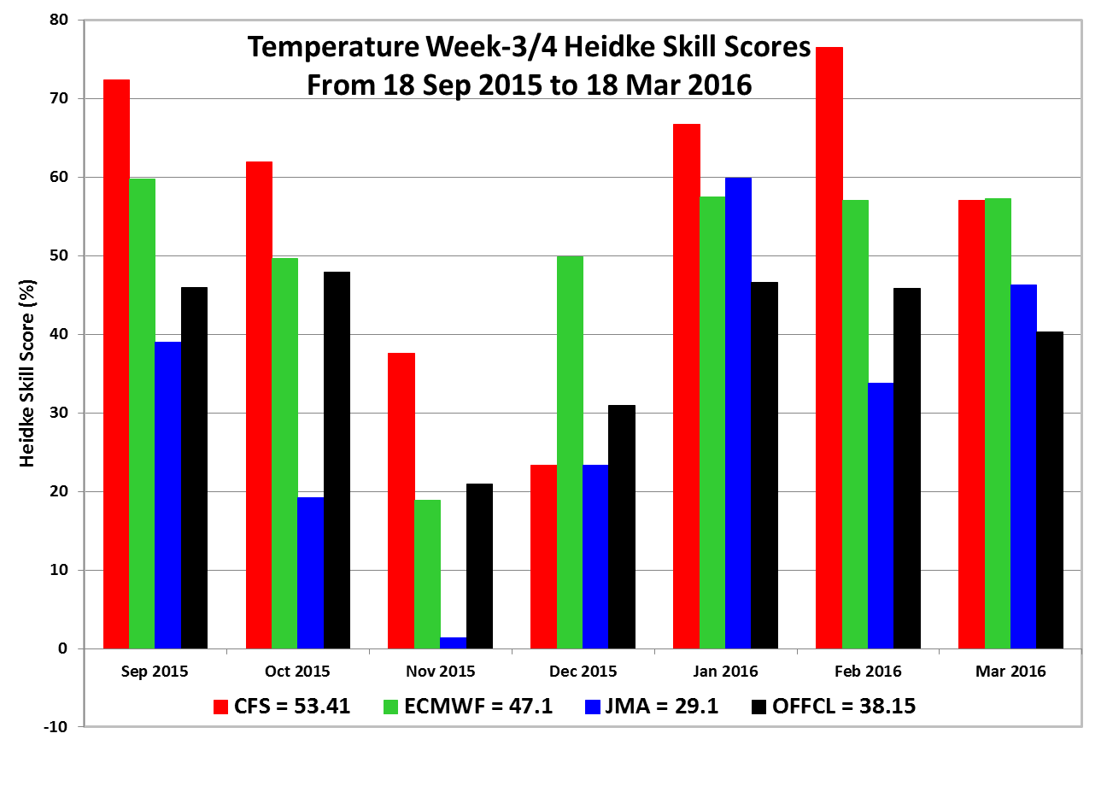
Example of the Benefit of Coupled Modeling:
US Temperature Week 3&4 Heidke Skill Scores (CFSv2)
18 September 2015 – 18 March 2016

Slide 16
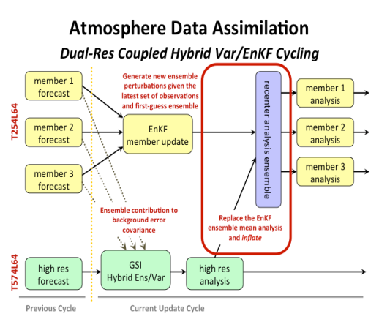
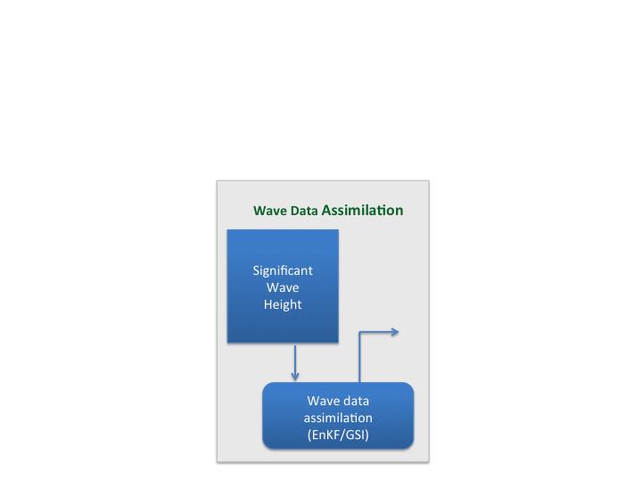
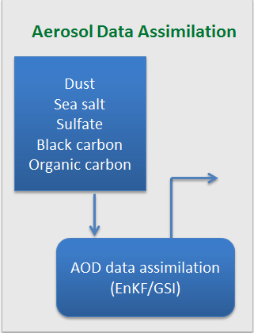
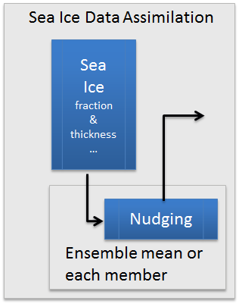
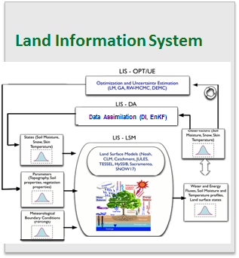
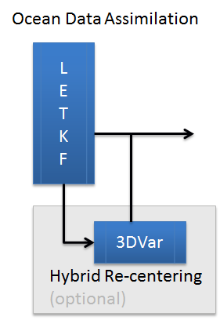
NCEP Coupled Data Assimilation and Forecast System
NEMS
NEMS
ATMOS
AERO
LAND
WAVE
SEA-ICE
ATMOS
AERO
LAND
WAVE
OCEAN
SEA-ICE
OCEAN
Coupled Model Ensemble Forecast
Coupled Model Ensemble Forecast
Coupled Ensemble Forecast (N members)
Ensemble Analysis (N Members)
INPUT
OUTPUT

Slide 17
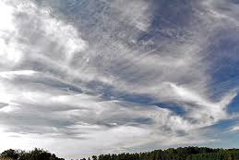



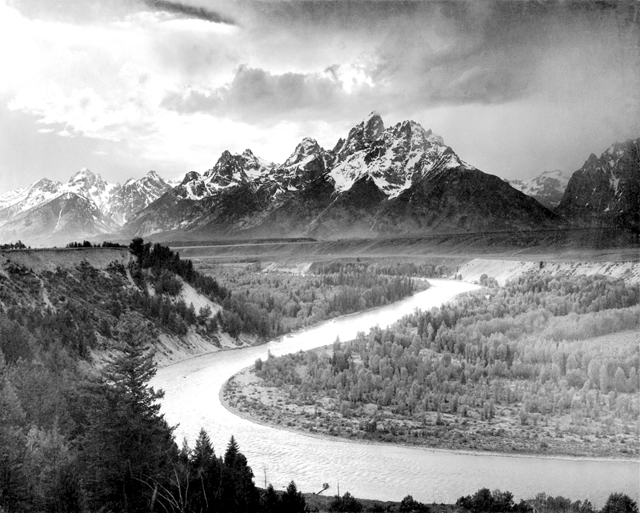
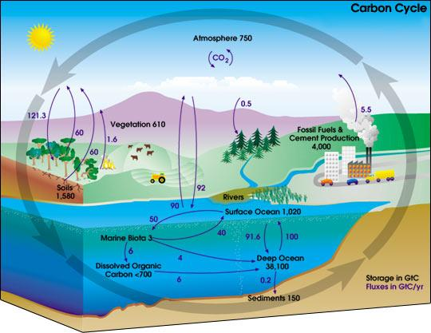



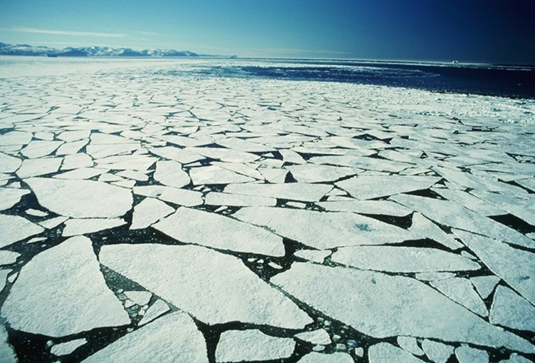
Unified Global Coupled System (UGCS) for Weather and Climate Prediction
  UGCS will include fully-coupled Earth System components, namely Atmosphere, Land-Hydrology, Ocean, Sea-Ice, Waves & Aerosol, both for data assimilation & model forecasts.
  Use NEMS/ESMF software.
  Atmosphere will comprise of a new dynamic core, new physics, higher resolution in the horizontal and vertical, accompanied by an advanced 4D EnVAR data assimilation system.
  Ocean component will be MOM6 and HYCOM model systems with updated physics and bio-geochemistry and an ensemble based coupled data assimilation system.
  Land-Hydrology component is Noah land model with upgrades to land surface physics and an upgraded ensemble based Land Information System that assimilates new data sources.
  Sea-Ice component will be CICE and SIS2 model systems with an ensemble-based coupled sea-ice data assimilation system for sea-ice cover and thickness.
  Wave component will be Wavewatch III that will be fully coupled to the atmosphere and ocean, with a new ensemble-based coupled data assimilation for assimilating significant wave height observations, etc.
  Aerosol component will be GOCART and will also have a ensemble-based coupled data assimilation to incorporate AOD and other sources of data.
  Unify GFS, GEFS and CFS models under a single unified modeling system for:
  Weather (GFS): ~10 days, 10 km, 128 levels, 3 year reanalysis & hindcasts, implement every year.
  Sub-seasonal (GEFS): ~45 days, 30km, 128 levels, 20-yr reanalysis & hindcasts, implement every 2 yr.
  Seasonal (CFS): ~12 months, 50km, 128 levels, 40-yr reanalysis & hindcasts, implement every 4 years.

Slide 18
Unified Design (High-Level Goal)
NGGPS (+ UDA)
Unified Global Coupled System (UGCS)
NGGPS (+UDA)
Regional apps
Whole Atmosphere Model
Year or CGS
(climate)
Month or OGS
(outlook)
Week or WGS
(weather)
Day or RRGS
(rapid refresh)
Hour or WoFGS
(WoF)
hurricane moving nests
Application =
Coupled Ensemble
+ Reanalysis + Reforecast
UDA: Unified Data assimilation
CGS: Climate Guidance System
OGS: Outlook Guidance System
WGS: Weather Guidance System
RRGS: Rapid Refresh Guidance System
WoFGS; WoF Guidance System

Slide 19
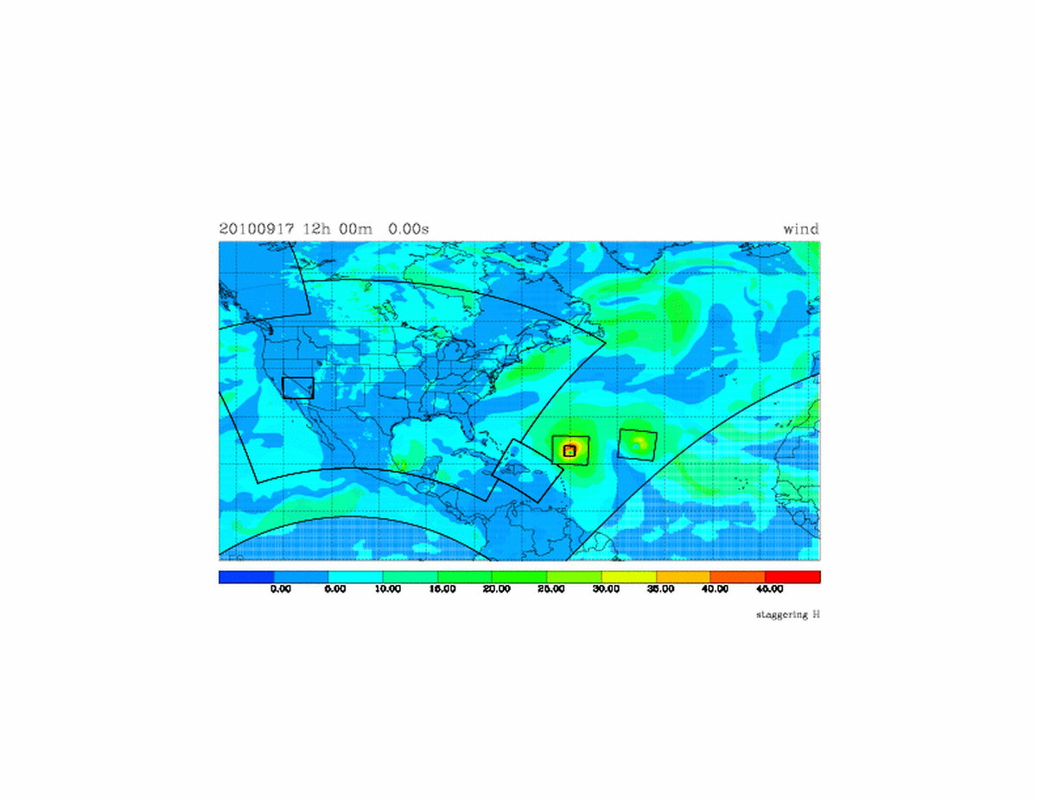
Basic Approach: Unified Example
Simulation of Global NMM-B (NAM) with multiple static and moving nests running under NOAA Environment Modeling System (NEMS).
6 km Alaska Nest
12 km NAM NMM-B
4 km CONUS Nest
9 km Moving Nests
w/3 km Inner Moving Nest
1.33 km fire
weather Nest
3 km Puerto Rico Nest
27 km Global NMM-B
2-m wind (m/s)
Nests: 1-way, with boundaries from parent every time-step, and “grid-associated” with parent (same orientation w.r.t. earth).
Moving nests and 2-way interaction under development.
Tom Black, NCEP/EMC

Slide 20
Resulting Compute Needs (Operations)
 | year | month | week | day | hour | total
low | 0.32 | 0.30 | 6.6 | 12.7 | 141 | 161
med | 0.49 | 0.81 | 12.5 | 22.9 | 223 | 259
high | 1.38 | 1.95 | 20.0 | 40.4 | 422 | 486
high-2 | 4.01 | 7.36 | 43.5 | 136.4 | 3378 | 3569
Overall costs per element uncertain, but clearly different with respect to NCEP Production Suite element:
  Hourly / WoF very expensive
  Other elements feasible in next 5-10 years at “med” level
Moving from equal split between global (year-week) and meso (day-hour) modeling to compute focus on meso.
Cost in PFlop
 | year | month | week | day
low | 1.6% | 1.5% | 33.2% | 63.7%
med | 1.3% | 2.2% | 34.0% | 62.5%
high | 2.2% | 3.1% | 31.4% | 63.4%
high-2 | 2.1% | 3.8% | 22.7% | 71.3%
Percentage of NPS without hour element
➔ Research Compute: 3x to 5x+ Operations

Slide 21
Thank you!

