Slide 1
Update on GODAE OceanView and its Coupled Prediction Task Team
Hal Ritchie
Environment and Climate Change Canada

Slide 2
Outline
GODAE Ocean View (GOV) Introduction
GOV Coupled Prediction Task Team (CP-TT) Overview
High priority research areas
Current CP-TT activities
Recent developments
Examples of results from CP-TT members
Summary

Slide 3
GOV Science Team (GOVST)
“Core Goal”: GODAE OceanView continues the legacy of GODAE in providing leadership in consolidating and improving R&D for global & regional ocean analysis and forecasting systems.
GODAE Ocean View (GOV) is represented by the GOV Science Team or GOVST:
Representatives from national, international and intergovernmental organisations with an expertise in operational ocean monitoring and forecasting
GOVST
Task Teams
(co-chairs)
GOVST (co-chairs)
Patron’s Group
Forecasting- and observing system representatives
Program Office
GOVST co-Chairs: Andreas Schiller (CSIRO, Australia) and Fraser Davidson (DFO, Canada)
The GOVST is guided by a group of Patrons providing advice and advocacy to the members of the GOVST with regard to science activities, collaborations and resources.
The GOV is supported by the programme office.

Slide 4
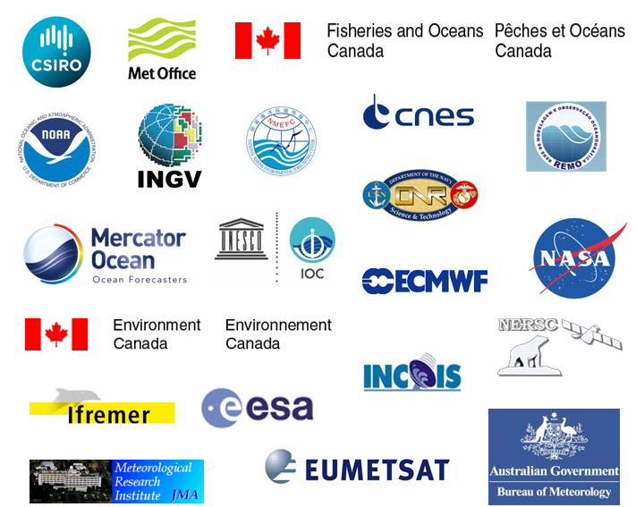
GOV an International Programme
“ GOV is inherently an international endeavour”: GOV provides a platform for international collaboration which is being integrated with parent bodies, international research programs and research initiatives related to ocean analysis and prediction including those within WCRP and IOC/WMO.
JCOMM/ ET-OOFS
WGNE
IMBER
OOPC
GOVST
GSOP/
CLIVAR
TT
(co-chairs)
GOVST (co-chairs)
Patron’s Group
GEOSS
GOVST (nat, international, representatives)
Program Office
GOOS
European R&D projects
Copernicus

Slide 5
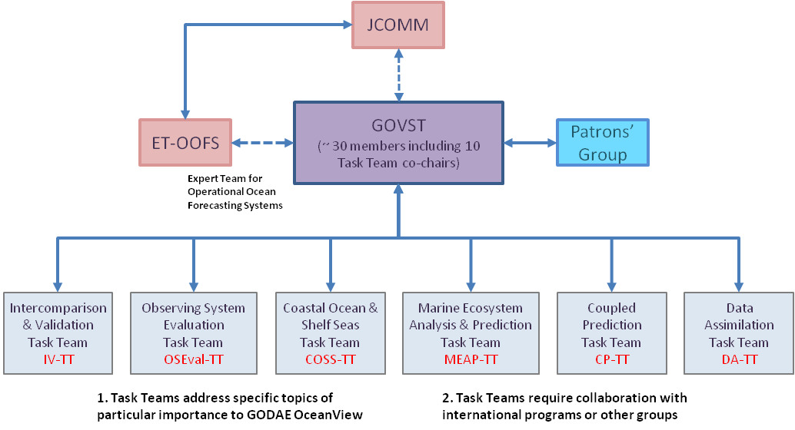
GOV structure & task teams
Task Teams: “GODAE OceanView aims to coordinate the development of new capabilities through a number of Task Teams (or TTs) which focus on specific topics of particular importance to GODAE OceanView.”
All task team chairs are members of the GOVST.
The current GODAE OceanView task teams are:
COSS-TT: Coastal Ocean and Shelf Seas Task Team
CP-TT: Coupled Prediction (renamed Oct 2014)
IV-TT: Intercomparisons and Validation Task Team
MEAP-TT: Marine Ecosystem Analysis and Prediction Task Team
OSEval-TT: Observing System Evaluation Task Team
DA-TT: Data Assimilation (formed Oct 2014)
TT address specific topics of particular
interest to GOV
TT work in collaboration with
international programmes and
research groups
Notes:
COSS-TT: The mission goal of the Coastal Ocean and Shelf Seas Task Team (COSS-TT) is to work in coordination with GOVST and GOOS towards the provision of a sound scientific basis for sustainable multidisciplinary downscaling and forecasting activities in the world coastal oceans. The Task Team fosters international collaboration will work with other GOV Task Teams under specific activities of common interest in the coastal and shelf seas. These include: the development of best practices for prediction assessments (with the IV-TT); quantifying the impact of observations to guide array design (with the OSEval-TT), coastal data assimilation (with the DA-TT) and the interface between open ocean and shelf models.
CP-TT: The mission goal of this Task Team is draw together the international scientific and technical expertise in ocean, sea-ice and wave prediction and to seek collaboration with equivalent expert groups in atmospheric-land surface-hydrology prediction to accelerate the scientific and technical development of fully coupled systems for short- to medium-range prediction.
IV-TT: The IV-TT will coordinate and promote the development of scientific methods for validation and intercomparison of operational oceanography systems, including techniques for intercomparing model products and observations.
MEAP-TT: The focus of this Task Team is on developing the underpinning science and tools which will eventually enable full integration of biogeochemistry and, ultimately, ecosystems in existing physical operational systems. Its mission is to contribute to the improvement of the biogeochemical observing systems, assimilation and modelling of Essential Biogeochemical Variables (EBV) and bridging the gap with end-users.
OSEval-TT: Through work undertaken by the OSEval-TT, GOV will provide unbiased, evidence-based assessments of mature observing systems, and will propose new observing systems to observing system agency providers. This will be achieved through system-wide evaluations of observation impact on ocean forecast and reanalysis systems, including routine monitoring of observation impacts, and through the application of a range of different observing system design experiments. The OSEval-TT will work with the assigned Patrons Group champion to effectively engage with observation groups. The Task Team, comprised of representatives of GOV system and GOV TTs, seeks to clearly communicate the scope, limitations of its observation system assessment and design studies.
DA-TT: The DA-TT will foster the development and evaluation of data assimilation systems relevant to GOV. It will coordinate and improve the assimilation of ocean and sea-ice data into ocean, sea-ice and coupled models and provide a focus for diagnosing and understanding model and observation biases through the use of data assimilation techniques, and discussing the results with model developers and observation specialists.

Slide 6
Coupled Prediction Task Team (CP-TT)
The mission goal of the CP-TT is to draw together the international scientific and technical expertise in ocean, sea-ice and wave prediction and to seek collaboration with equivalent expert groups in atmospheric-land surface-hydrology prediction to accelerate the scientific and technical development of fully coupled systems for short- to medium-range prediction.
Co-Chairs: Chris Harris (Met Office) and Hal Ritchie (Environment and Climate Change Canada)
Focus areas for activities and projects
Coupled prediction in an Earth Systems Modeling context but with a focus on the role of and impact on oceans (e.g., ocean-ice-wave interactions)
Coupled data assimilation in coordination with Data Assimilation Task Team

Slide 7
CP-TT (continued)
Main priorities for activities and projects
Facilitate exchange of national and international programs of scientific progress
Collation of quantified impact of earth system coupling for ocean-wave-sea-ice-atmosphere and interfacial flux phenomena
Foster targeted research on particular topics of interest to GOV members (e.g., SST/diurnal cycle, sea ice impacts on boundary layer fluxes, wave coupling)

Slide 8
Updated CP-TT Membership
Santha Akella, GSFC/NASA, USA
Magdalena Balmaseda, ECMWF, UK
Gary Brassington, BoM, Australia
Eric Chassignet, Florida State University, USA
Jim Cummings, NRL, USA
Yann Drillet, Mercator-Océan, France
Chris Harris, Met Office, UK, Co-chair
Patrick Hogan, NRL, USA
Patrick Laloyaux, ECMWF, UK
Tiejun Ling, NMEFC, China
Avichal Mehra, NOAA, USA
Hal Ritchie, Environment and Climate Change Canada, Co-Chair
Paul Sandery, BoM, Australia
Gregory Smith, Environment and Climate Change Canada
Yuhei Takaya, JMA, Japan
Ricardo Todling, NASA/GSFC, USA
Akiyoshi Wada, MRI-JMA, Japan
Patron champions: Hendrik Tolman (NOAA, USA), Hui Wang (NMEFC, China)

Slide 9
High Priority Research Areas
JMA plans to develop a relatively high-resolution model (55km for atmosphere, 0.25 degrees for ocean) for the next seasonal prediction system, which would provide some scientific basis for subseasonal coupled prediction. Ocean coupling is important for subseasonal to seasonal (S2S) prediction and CP-TT should link with the WWRP/WCRP S2S project.
At NOAA plans are afoot for CFS v3 which will include a fully coupled 7 component system with Atmosphere-Ocean-SeaIce- Waves- Land-Aerosols - Ionosphere components for both data assimilation and forecasts. For Medium Range, test skill of MJO amplitudes and phases. For long term, ENSO variability is a stated goal for coupled systems. Seasonal variability of oceanic water mass transformations. Skill in first month US surface 2m Temperature and precipitation which would include getting skill in coupled data assimilation and forecasts.

Slide 10
High Priority Research Areas (cont’d)
At ECMWF increase of atmospheric resolution to TCo639 (15 km) to day 10 and TCo319 to day 15/45. Increase of ocean resolution to ORCA025. Introduction of dynamic sea-ice model. This is a coupled ensemble prediction system, with 50 members, up to 15 days twice a day, and up to 42 days twice weekly. The physical coupling includes atmosphere-ocean-land-ice-waves. The waves interact with the atmosphere and ocean, and work is ongoing for the ice-wave interaction. Research areas include coupled data assimilation for reanalyses (producing a XX-century coupled reanalysis with conventional data and a high-resolution coupled reanalysis for the satellite era), and for initialization of coupled forecasts (improve the use of surface observations in different media, thus improving surface analysis and reducing initialization shock).

Slide 11
High Priority Research Areas (cont’d)
NRL has examined bias estimates from ocean analyses and forecasts using dynamically based calibrations to characterize resulting ocean forecast errors. HYCOM is 2-way coupled with CICE. The plan is to extend forecasts to 14 days, including ice, by Fall 2018.
FSU is examining the impact of horizontal resolution (1/12 to 1/50 degree) on Gulf Stream Separation and penetration. Other factors being held constant, it all seems to come together with the emergence of sub-mesoscale eddies at 1/50 degree.
NMEFC is examining the importance of resolving the diurnal cycle of SST and sea skin temperature in coupled models. They developed a new mixed layer model that improves both the amplitude and phase, and find that it has important impacts on regional weather and climate in a coupled model.

Slide 12
High Priority Research Areas (cont’d)
ECCC continues the research, development and implementation of coupled prediction systems within the context of the Canadian Operational Network of Coupled Environmental PredicTion Systems (CONCEPTS). Upgrades have been recently made to the GEM-NEMO-CICE coupled Gulf of St. Lawrence (GSL) system that is now running at higher resolution over the Laurentian Great Lakes where it is improving forecasts both for the atmosphere and the water bodies. The ¼ degree Global Ice-Ocean Prediction System (GIOPS) is now in full operational status, and a 1/12 degree regional version (RIOPS) is running experimentally. Coupled GEM-NEMO-CICE systems are in development for deterministic medium-range forecasts and ensemble seasonal prediction.

Slide 13
Test cases / periods for evaluation
Coupled DA for polar regions, where coupling between components is very strong. It can help to assimilate ice thickness and ice concentration better, and to produce a snow analysis
Coupled forecasting for tropical cyclones
Coupled forecasting in strong frontal regions
Many of these are illustrated in slides submitted by some CP-TT members related to the following activities

Slide 14
Current CP-TT Activities
Clarify and refine the CP-TT workplan and plan some items in more detail
Agree suitable test cases / periods for comparison of coupled / uncoupled GOV systems
Prepare an inventory of GOV coupled systems and related plans (coupling methods including sequencing of component models, relative resolutions of components, interpolations between components, details of where flux calculations are performed, initialization, treatment of rivers, etc.)
Build on links started with participating in WGNE-30, planning for Joint GOV-WGNE Workshop on Coupled Modelling and Data Assimilation in 2017
Interact with the Coupled Global Modelling (CGM) Committee in the US
Participated in DA-TT Workshop 20-22 May 2015 at Met Office, Exeter UK
Work on specific research areas (including SST/diurnal cycle)

Slide 15
Recent Developments
CP-TT helped shape and support the international workshop on “High-resolution ocean modelling for coupled seamless prediction” (HRCP) held at the Met Office in Exeter UK, 13-15 April 2016. Members Magdalena Balmaseda, Eric Chasignet, Chris Harris, Pat Hogan, Tiejun Ling and Hal Ritchie participated.
CP-TT is co-convening a special session on “Coupled Modelling and the Year of Polar Prediction at the Canadian Meteorological and Oceanographic Society Congress in Fredericton NB Canada 29 May – 2 June 2016. Member Avichal Mehra will give a lead-off invited presentation on coupled modelling at NCEP and Hal Ritchie will give an overview of coupled modelling in CONCEPTS.
Members Magdalena Balmaseda, Chris Harris and Hal Ritchie are participating in the organizing committee for the WMO Working Group on Data Assimilation and Observing Systems (DAOS) international workshop on coupled data assimilation announced for 18-21 October 2016 at Météo-France in Toulouse FR.

Slide 16
Recent Developments (continued)
Considering the presentations at the HRCP workshop and for the upcoming CMOS Congress and the DAOS workshop, we question whether another large workshop in 2017 is necessary.
Would a more focused CP-TT meeting be more beneficial, perhaps in conjunction with another meeting in which many of us will participate?
One suggestion is a comparison of coupled system configurations and performance. In preparation we would accelerate our inventory of GOV coupled systems and related plans, agree and initiate suitable test cases and periods for comparison of coupled and uncoupled systems. Motivated by the HRCP workshop discussions, this should include developing appropriate metrics in collaboration with the GOV IV-TT. Eric Chasignet indicated willingness to host such a meeting in Fall 2017, although there may be an earlier opportunity.
We would appreciate continuing consultation and interaction with WGNE on these options.

Slide 17
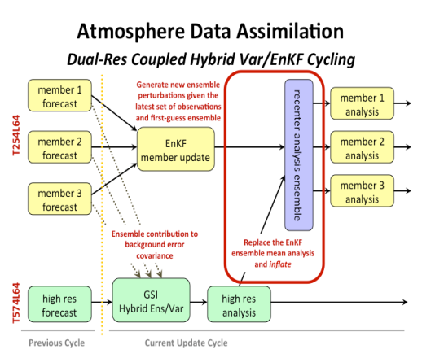
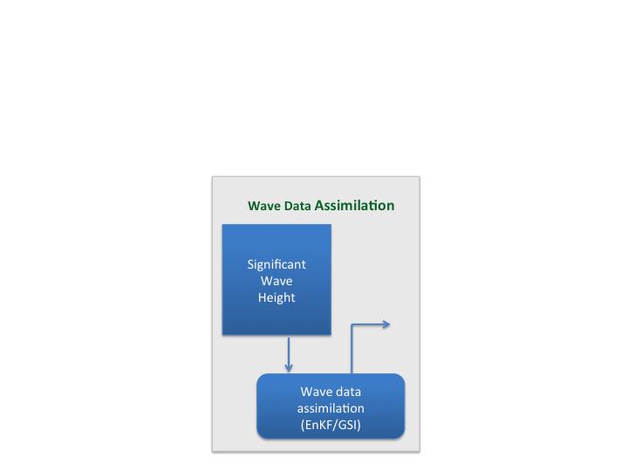
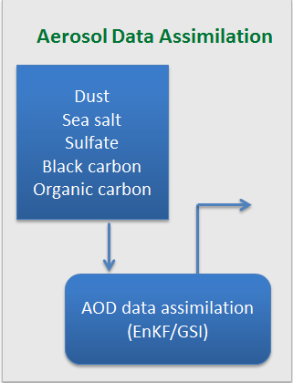
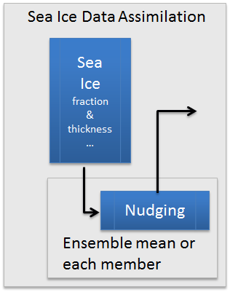
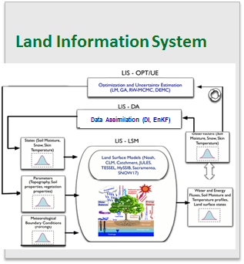
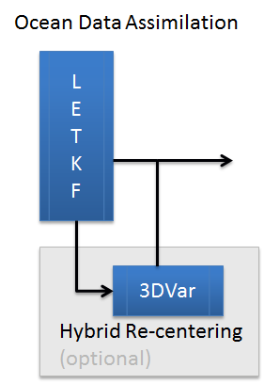
NCEP Coupled Hybrid Data Assimilation and Forecast System
CFS v3
NEMS
NEMS
ATMOS
AERO
LAND
WAVE
SEA-ICE
OCEAN
ATMOS
AERO
LAND
WAVE
SEA-ICE
OCEAN
Coupled Model Ensemble Forecast
Coupled Model Ensemble Forecast
Coupled Ensemble Forecast (N members)
Ensemble Analysis (N Members)
INPUT
OUTPUT

Slide 18
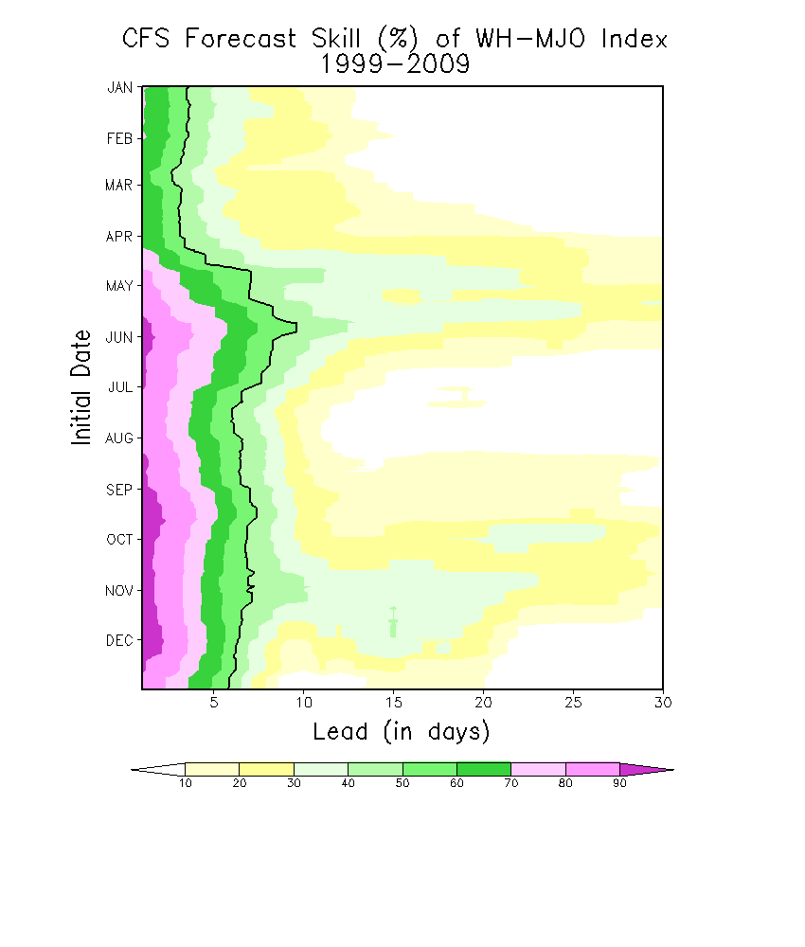
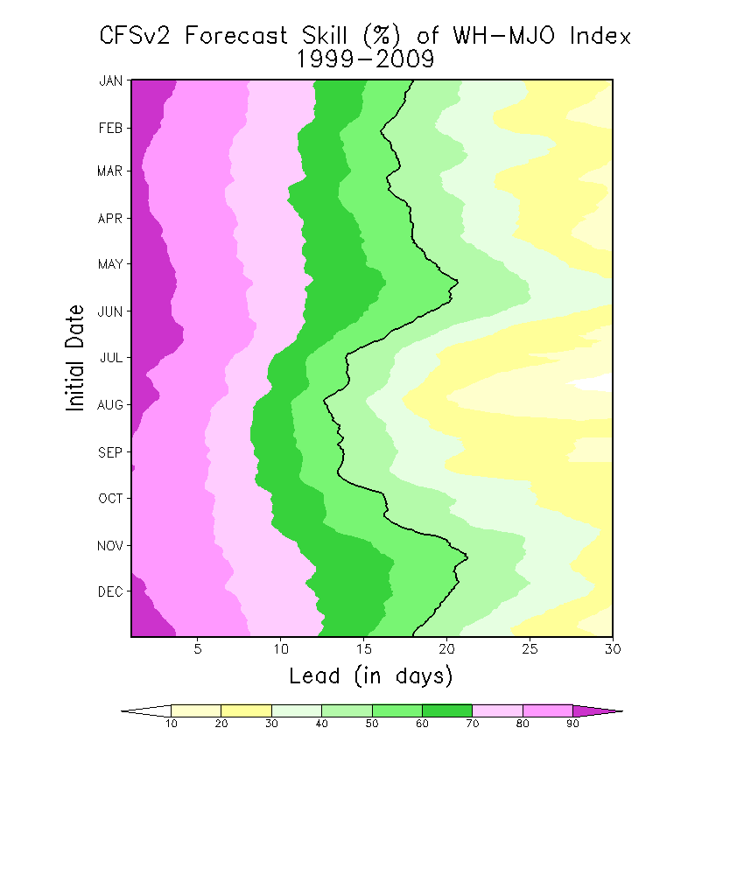
Forecast Skill of WH-MJO index
Qin Zhang and Huug van den Dool, CPC

Slide 19
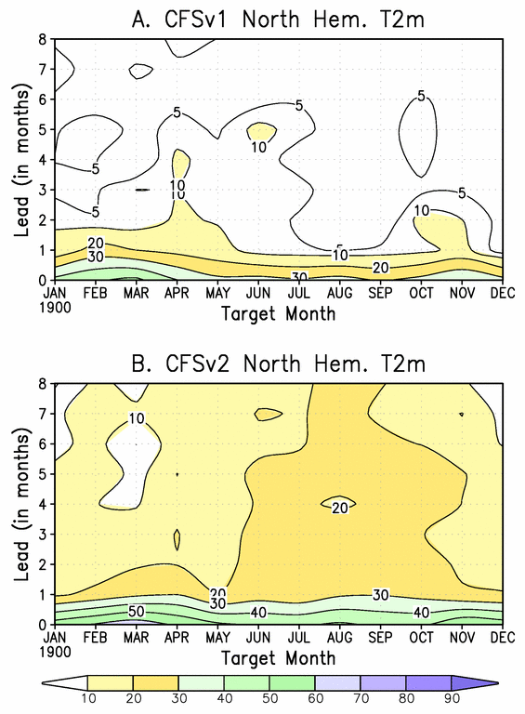
2-meter Temperature Ensemble skill of Northern Hemisphere (all land north of 20°N)
CFSv2 clearly has more skill
Huug van den Dool & Emily Becker, CPC

Slide 20
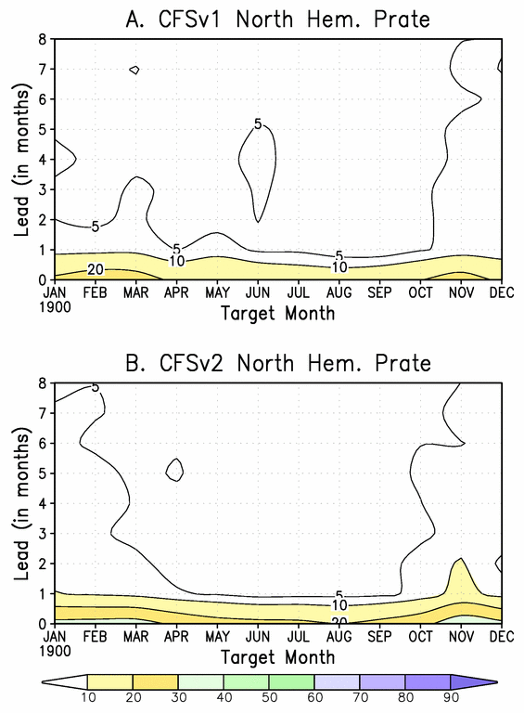
Precipitation Ensemble skill of Northern Hemisphere (all land north of 20°N)
Both systems have very little skill for precipitation
Huug van den Dool & Emily Becker, CPC

Slide 21

CONCEPTS Examples
Several new coupled systems under development as part of CONCEPTS
  Canadian Operational Network of Coupled Environmental Prediction Systems
Tri-departmental collaboration
  To develop coupled atmosphere-ice-ocean forecasting systems
Model development
  Coupling GEM (Global Environmental Multi-scale) atmospheric model to NEMO (Nucleus for European Modelling of the Ocean)
Collaboration with Mercator
  French operational oceanographic group
CONCEPTS
Notes:
21

Slide 22

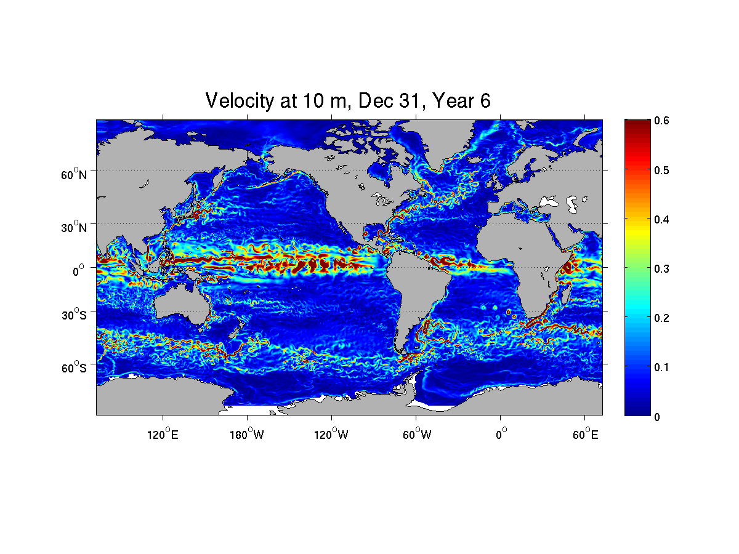
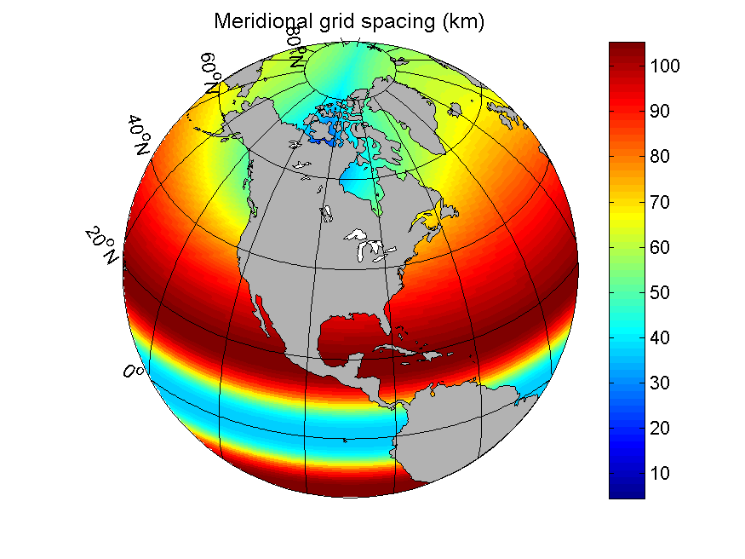
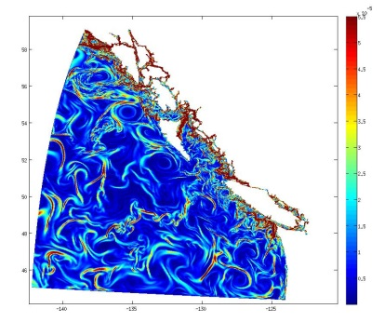
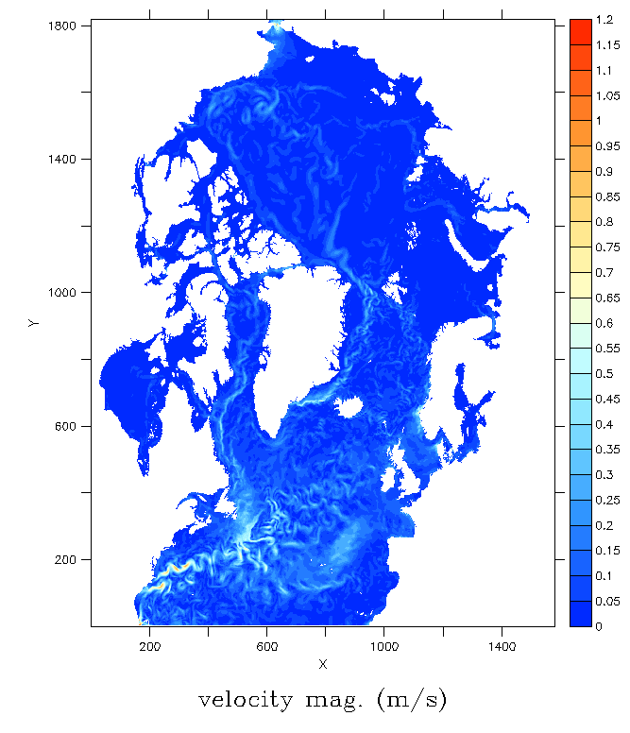
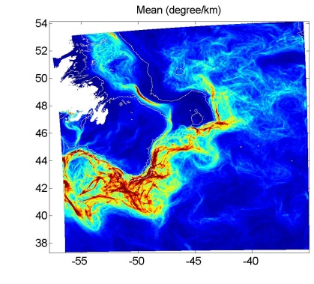
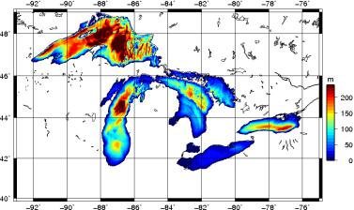
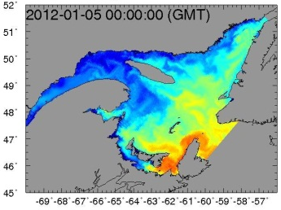
Ice-ocean modelling with
Operational
Experimental
(fall 2015)
In development
Applications and domains
1/4° Global
1° Global
Global 1/4° resolution (GIOPS)
  Medium-monthly forecasting
Global 1° resolution (CanSIPS)
  Seasonal forecasting
N. Atlantic and Arctic 1/12° (RIOPS)
  Short-to-medium range forecasting
East and West Coastal 1/36° (CIOPS)
Great Lakes 2km (RMPS-GL)
Gulf of St. Lawrence 5km (RMPS-GSL)
  Short-term forecasting
Surface currents
Resolution
1/36° Northeast Pac.
Grad SST
1/12° N. Atlantic and Arctic
Surface currents
1/36° Grand Banks
Surface temperature
Bathymetry
Surface currents
Notes:
- Coming back to Canada: Several configurations under development using NEMO

Slide 23
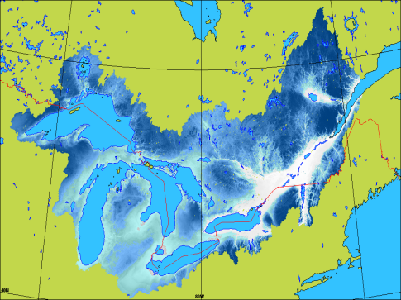
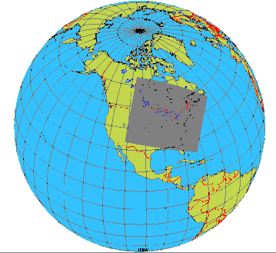
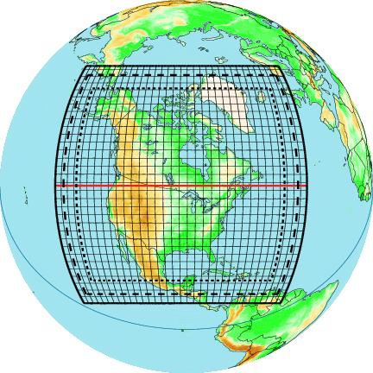
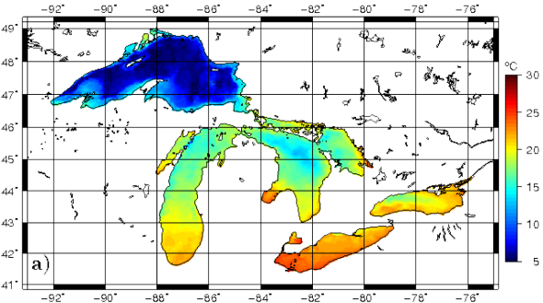
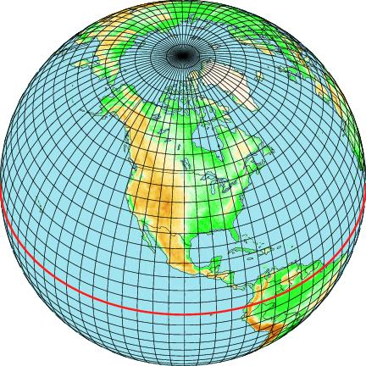
Great Lakes and St. Lawrence Water Cycle
Prediction System (Fortin, Dyck et al.)
WATROUTE
routing model (1km)
GEM LAM (10 km)
atmospheric model
(ISBA land-surface scheme)
GEM RDPS (10 km)
atmospheric model
Runoff
Streamflow
Turbulent fluxes
2 forecasts/day
(00Z and 12Z)
48-h forecasts
Assimilation cycle: direct insertion of RADARSAT ice cover and WSC streamflow
NEMO+CICE (2 km) ocean-ice model
GEM GDPS (25 km)
atmospheric model
Notes:
- Based on operational system running over Gulf of St. Lawrence (GEM+NEMO)
- Necessary to add routing component over the Great Lakes to simulate changes in Great Lakes water level
- Makes it possible to also issue streamflow forecasts

Slide 24
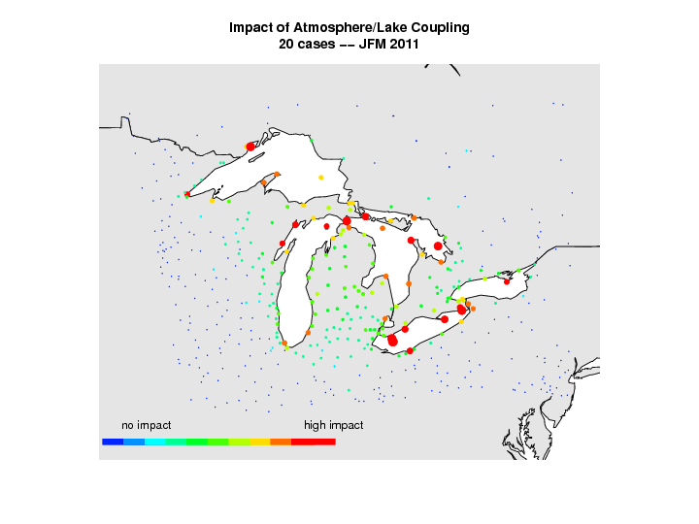

Slide 25
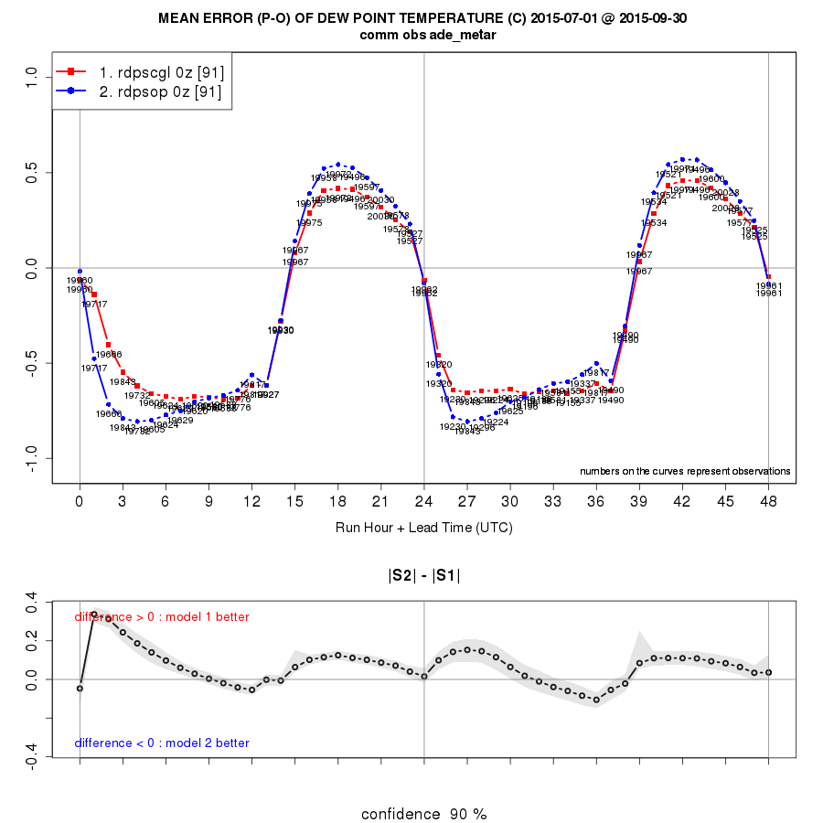
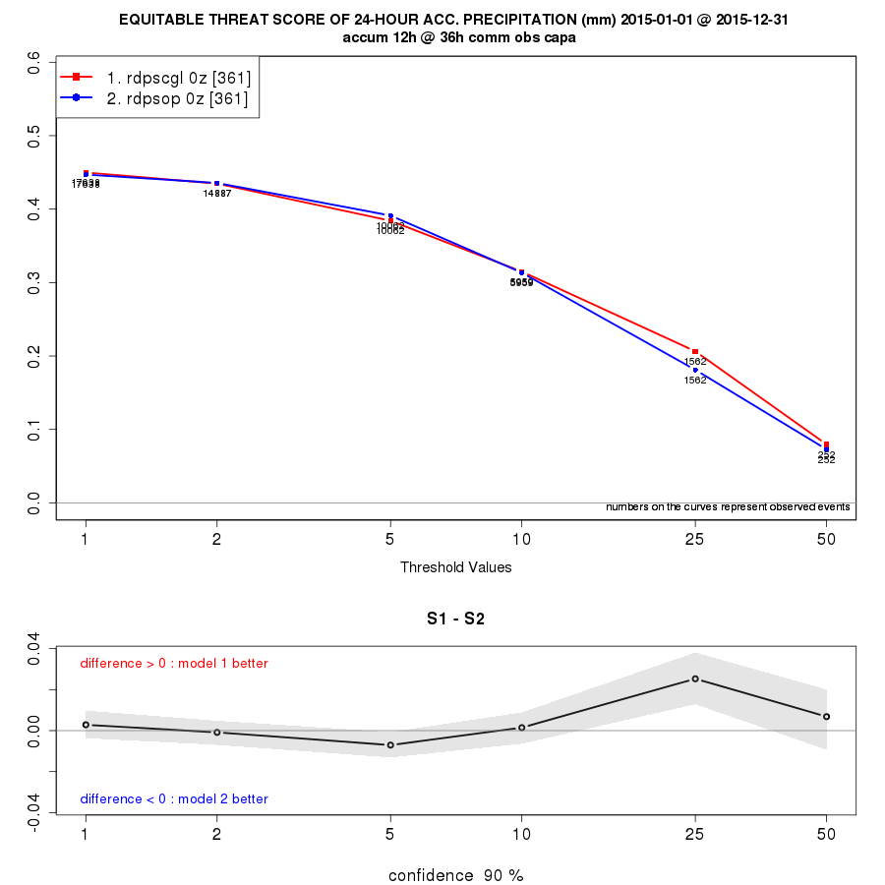
Better weather forecasts
Summer 2015
RDPS
GL-WCPS
Year 2015
RDPS
GL-WCPS

Slide 26
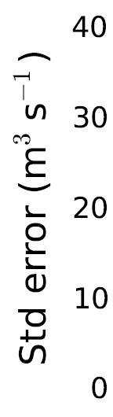
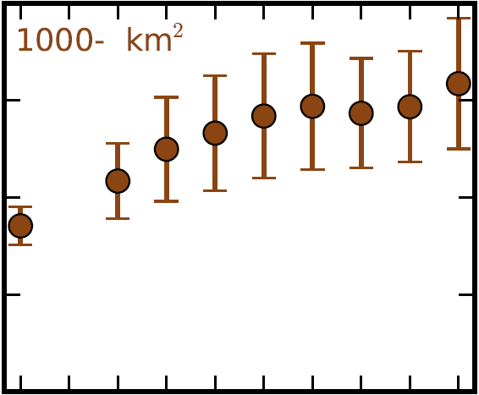
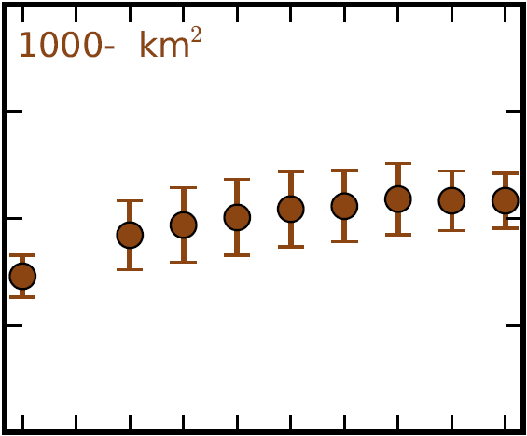
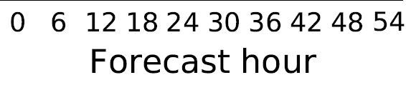
Better streamflow forecasts
Winter 2015-16 (2015-11-04 - 2016-01-31)
RDPS GL-WCPS

Slide 27
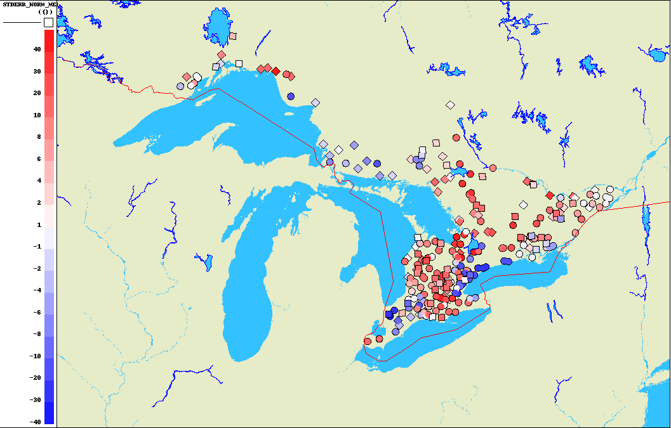
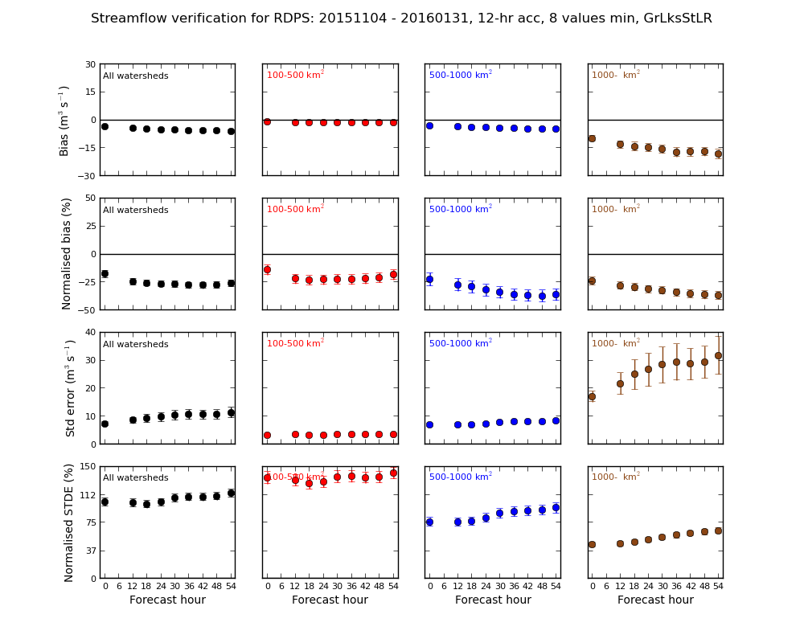
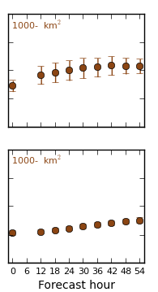
Better streamflow forecasts
Winter 2015-16 (2015-11-04 - 2016-01-31):
Difference between STDE of RDPS and GL-WCPS
Winter 2015-16 (2015-11-04 - 2016-01-31)
RDPS GL-WCPS
100-500 km²
500-1000 km²
>1000 km²

Slide 28
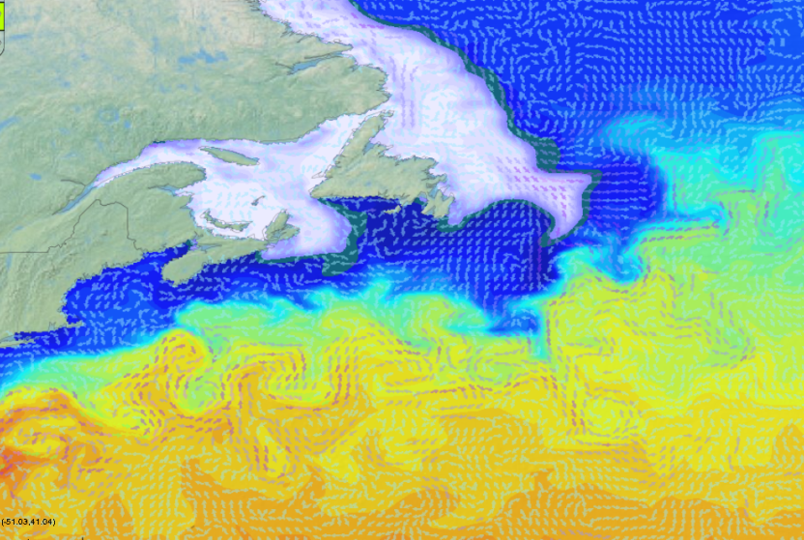
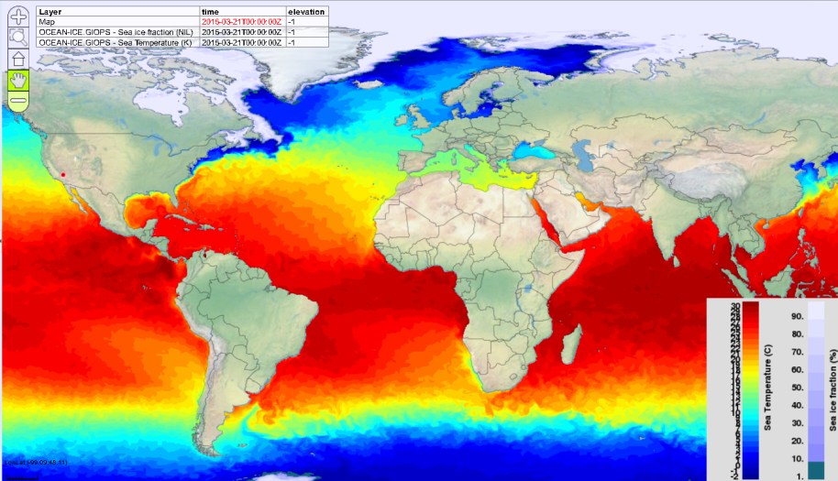
Global Ice-Ocean Prediction System
Dorina Surcel Colan, Matt Reszka, Francois Roy, Daniel Deacu, Yimin Liu, …
Produces daily ice-ocean analyses and 10day forecasts
  NEMO-CICE (~1/4°), < 15km in Arctic
Mercator Ocean Assimilation System (SAM2):
  Sea surface temperature
  Temperature and salinity profiles
  Sea level anomaly from satellite altimeters
3DVar Ice analysis:
  SSM/I, SSM/IS, CIS charts, Radarsat image analyses
Experimental implementation (March 2014)
Operational since August 20, 2015
Dissemination
  External cluster (pegasus)
  Available on MSC Datamart (Netcdf4)
    http://dd.weather.gc.ca/
  WMS using GeoMet or RPNWMS
    E.g., www.meteocentre.com/plus
Smith et al., QJRMS, 2015
Notes:
Develop full NWP style prediction system

Slide 29
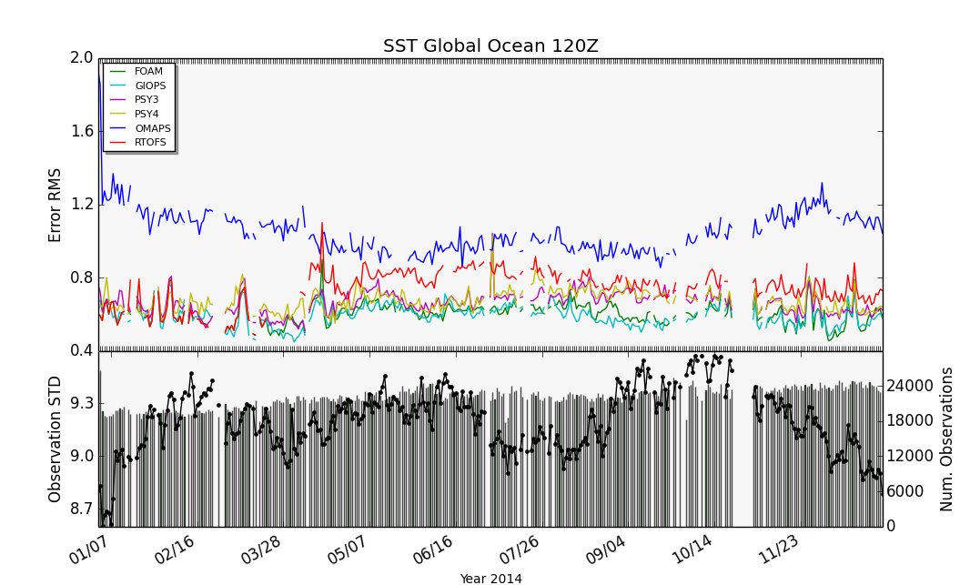
GODAE Oceanview Intercomparison
International near real-time evaluation of global ocean forecasting systems
2014 in review
Sea surface temperature (SST)
Systems:
  UK Metoffice (FOAM)
  Env. Canada (GIOPS)
  Mercator (PSY3, PSY4)
  US Navy (RTOFS)
  Australian BofM (OMAPS)
High quality SST critical for coupled forecasting
Jinshan Xu and Fraser Davidson

Slide 30
New GEM-NEMO Configuration and Experiments
GEM configuration
- As in Global Deterministic Prediction System GDPS 4.0 (25 km)
- incremental analysis update (IAU) and recycling
NEMO configuration identical to that of GIOPS (ORCA025) except for the
surface flux parameterization (RPN PHY instead of CORE – Francois Roy)
Ice-ocean analysis: CMC or GIOPS v182
Series of 10-day hindcasts initialized at 36-hour intervals performed with
three GEM-NEMO configurations
- 42 (40) cases for Jul-Aug (Feb-Mar) 2011
GEM-NEMO configurations | GEM | Sea ice and ocean analyses | Surface flux calculation | Remarks
U03 | uncoupled | CMC | implicit | ice fixed in time
U04 | uncoupled | GIOPS | explicit | ice fixed in time
C04 | coupled w/ NEMO | GIOPS | explicit | Surface fluxes calc. in NEMO

Slide 31
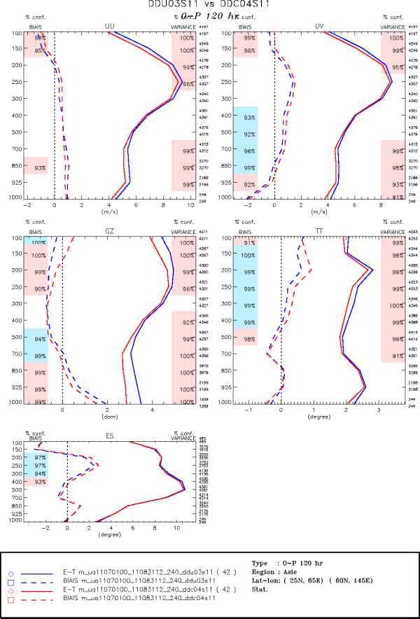
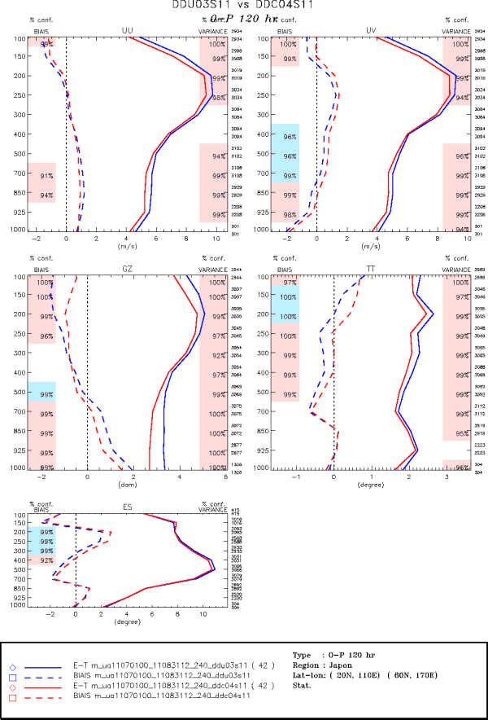
U03 vs C04
120-h Asia
Jul-Aug 2011
U03 vs C04
120-h Japan
Jul-Aug 2011

Slide 32
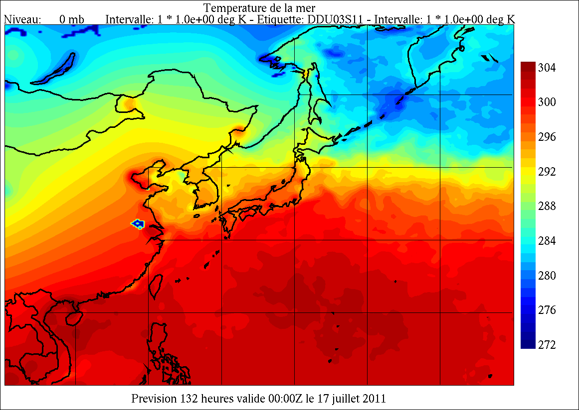
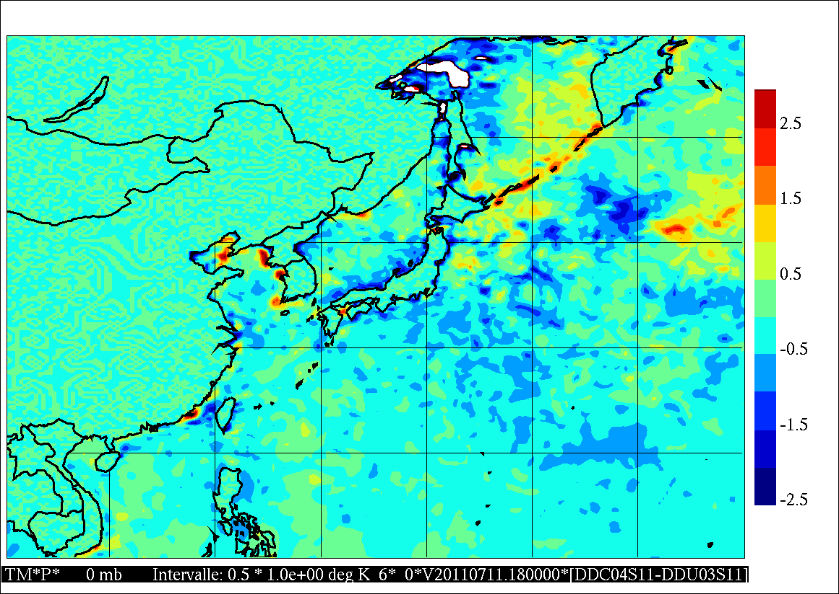
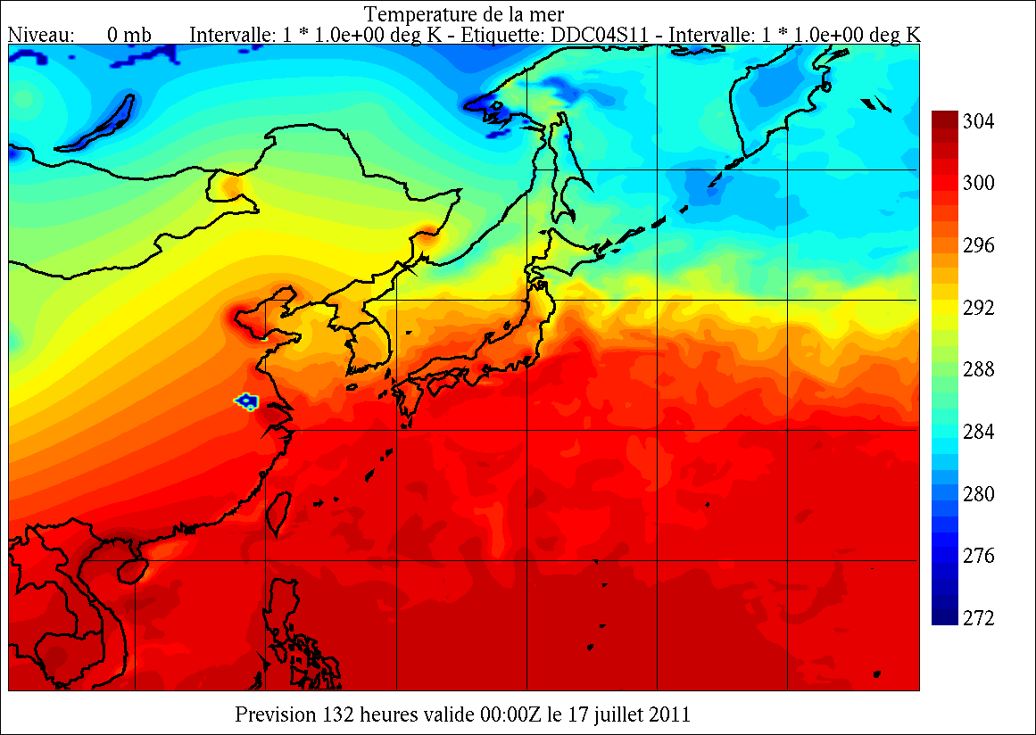
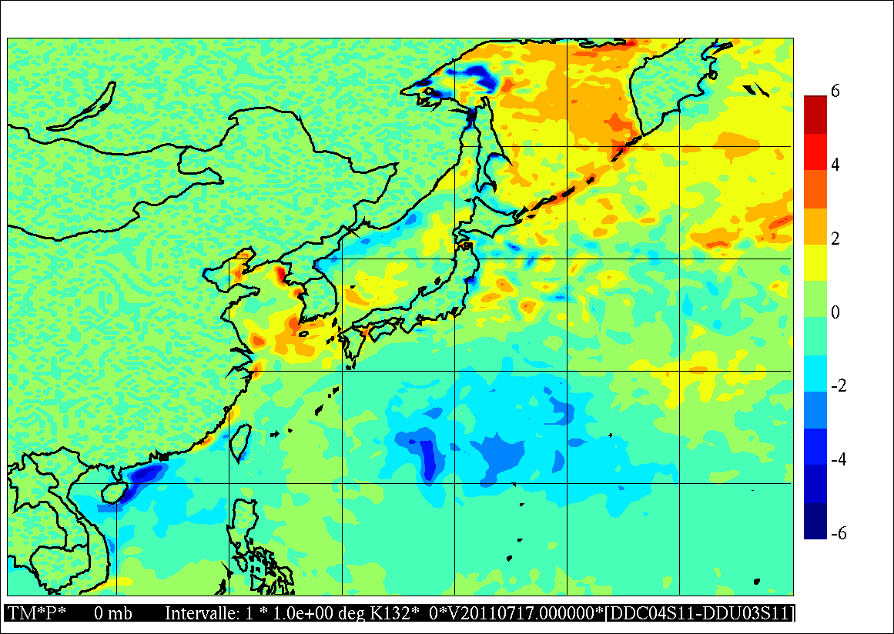
Typhoon-4 MA-ON: 132-h forecast valid at 00Z 17 July 2011
U03
(uncpl.)
6-h
SST held
constant
in time
C04
(coupled)
132-h
Sea surface temperature (K)
SST(C04) - SST(U03)
Cold wake

Slide 33
Summary
GOV is coordinating an international effort of providing leadership in consolidating and improving global & regional ocean analysis and forecasting systems through its task teams.
In particular, the Coupled Prediction Task Team (CP-TT) is drawing together international scientific and technical expertise in ocean, sea-ice and wave prediction and is fostering collaboration with expert groups in atmospheric – land surface – hydrology prediction to accelerate the development of fully coupled systems for short- to medium-range prediction.
Research and development is in progress by CP-TT members to quantify the impacts of coupling for ocean-wave-sea ice – atmosphere phenomena and interfacial flux phenomena, which will be further pursued in the coming years.
One particular CP-TT objective is to continue the links with WGNE related to coupled prediction as a follow up to our joint GOV-WGNE workshop that was held at NCWCP in March 2013.

Slide 34
Thank you!

