Slide 1

Working Group on Nowcasting and Mesoscale Research
Paul Joe & Jeanette Onvlee
Estelle deConing & Peter Steinle

Slide 2
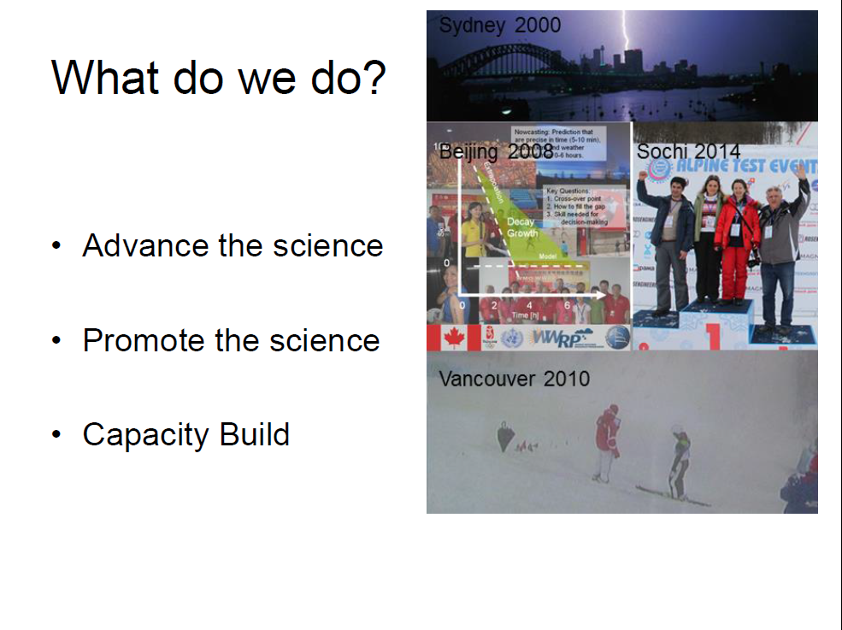
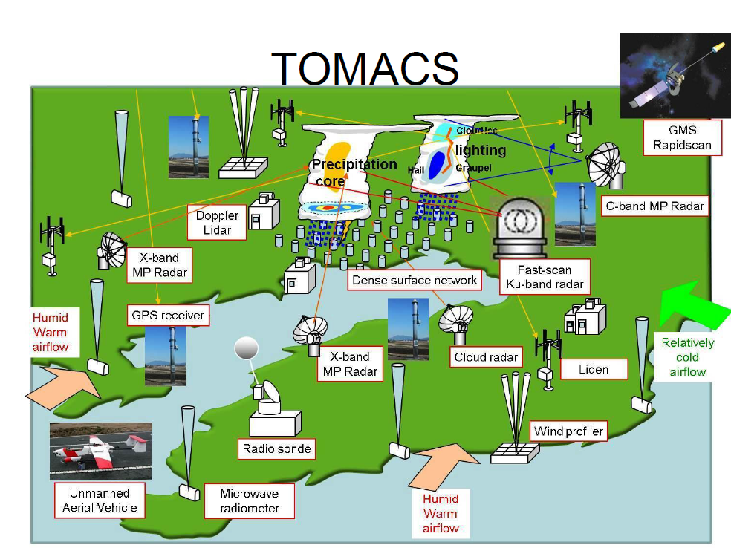
Role of WGNMR
Advance & Promote Nowcasting & Mesoscale Science
Build Capacity
…. Often via FDP & RDPs
Goal:
High Impact, Seamless, Multi-scale, Multi-Hazard, Semi-Automated Forecast Systems
One of the challenges:
0-6 hour nowcasts/forecasts suitable for issuing warnings
Merger
reflects merging of Nowcast/VSR NWP science & technology

Slide 3
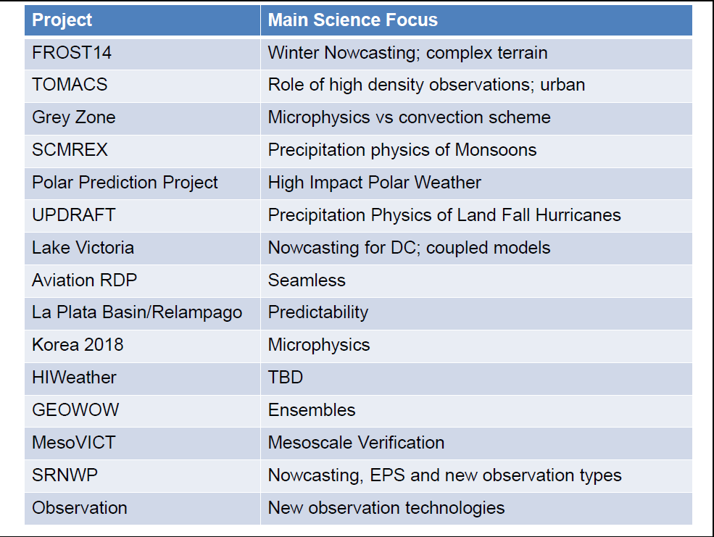
Involvement with major initiatives
Aviation RDP (now its own Program)
Lake Victoria Basin- Hydroclimate to Nowcasting Early Warning System
ICE-POP 2018 (Pyeongchang, Korea Olympics Demsontration Project)
Tokyo Metropolitan Area Convection Study (TOMACS)
Notes:
Highlighted the Projects that have/are under WGNMR remit, as opposed to larger projects we are involved in.
Acknowledging of course that AvRDP is now its own project

Slide 4
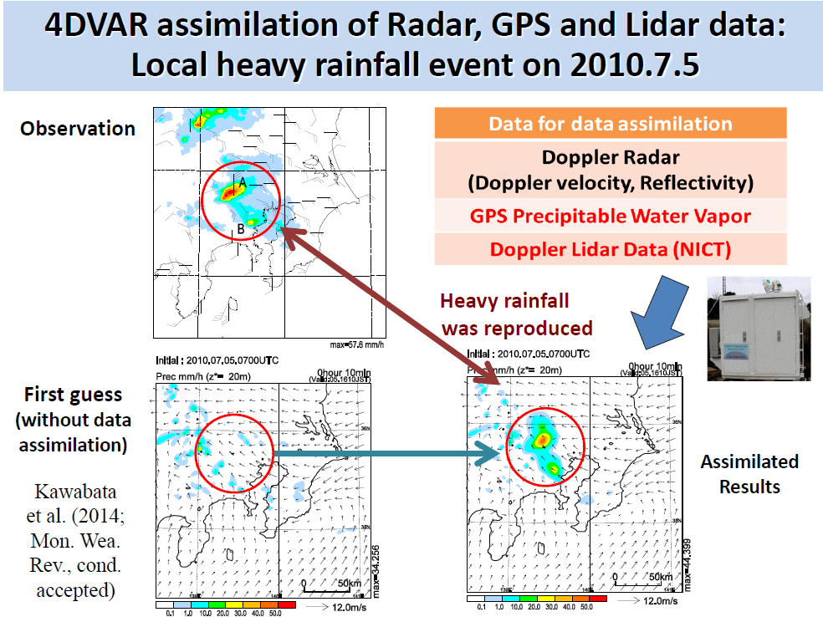
Major data sources for model evaluation convection: TOMACS
Very high density observing network of convective environment, convective cloud structure. Includes modeling & DA studies

Slide 5
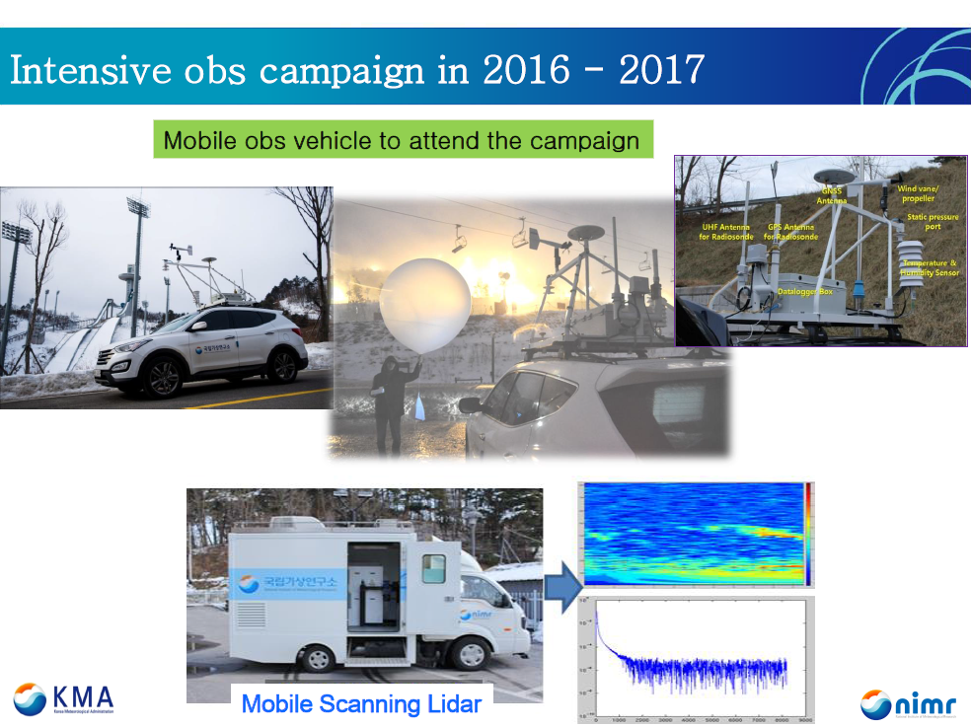
Major data sources for model evaluation -cold season clouds: ICE-POP, Korea 2018
Augment existing obs network
AWS, balloons etc.
Research vessel
Observe adjacent ocean
Research aircraft
Cloud radar
Microphysics sensors
Mobile balloons & lidars
Cloud Physics Laboratory
More microphysical obs

Slide 6
Convective scale NWP
Rolling out operationally by most national NWP centres
Increasingly with ensemble prediction and advanced (4D-Var, ensemble) data assimilation
Increasing sources of high resolution observations
Land Surface assimilation increasingly important
Regional Reanalyses
From downscalers to full nested reanalysis
Towards city scale (10-50m)
downscaling of model with LES or model only
Required enhanced urban surface schemes
Notes:
Subjective assessment of over larger scale models generally strong
- clearer story of how the mesoscale effects will play out, and of course the lifecycle/interactions of mesoscale features
Objective verification less clear beyond 6'ish hours – will discuss later

Slide 7
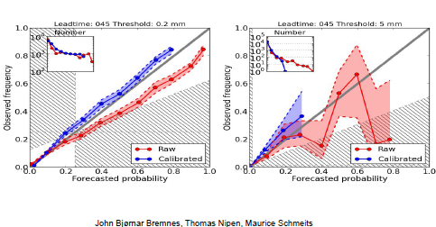
Mesoscale ensemble forecasting
Models moving to scales which inherently are more stochastic → probabilistic forecasting systems needed
Mesoscale ensemble systems becoming of age
Initial and boundary conditions, physics, surface perturbations
Generally still underdispersive
Research on ensemble calibration: beyond Bayesian model averaging
Example of impact of calibration on reliability of 3h accumulated precipitation for the GLAMEPS ensemble

Slide 8
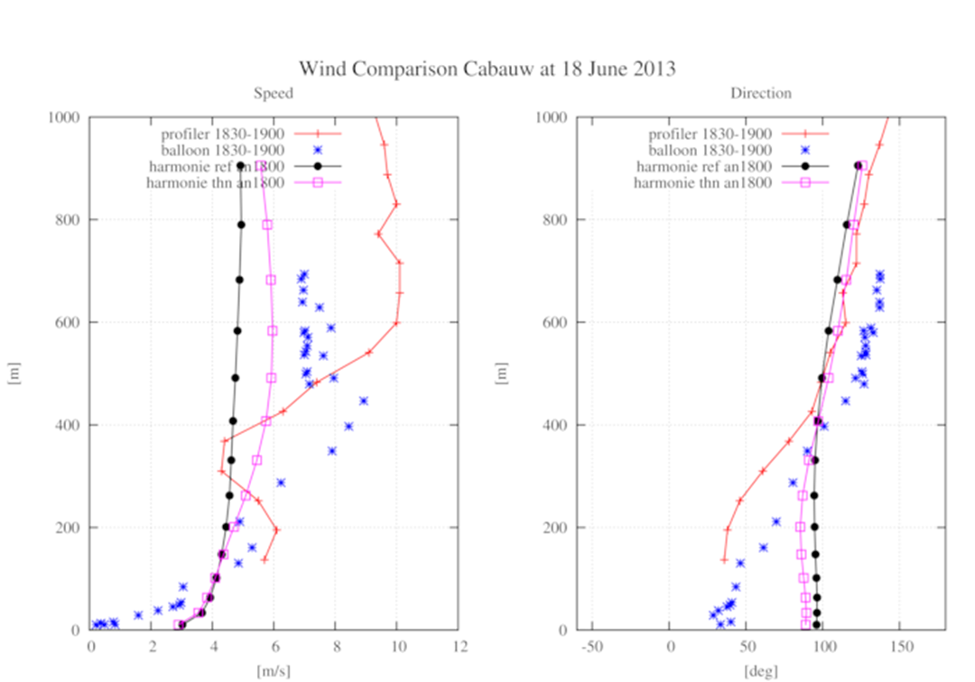
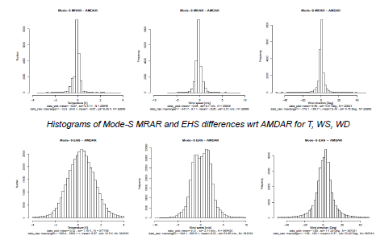
New observations
Increasingly making use of data from non-meteorological networks (GNSS, Mode-S, road observation networks, …)
Crowd-sourced data
How to get reliable urban observation networks???
Case study: Impact of assimilation of hot air balloon wind observations on boundary layer profile
Notes:
Figures: left: Aircraft Mode-S observations can consist of a variety of bulletins, some of which are not produced by all aircraft. The relative strengths and weaknesses of the information in these bulletins is being assessed. The figure shows a comparison of two types of Mode-S aircraft bulletins, MRAR and EHS. MRAR bulletins are provided by far fewer aircraft than EHS but they provide more accurate wind and temperature observations.
Right: the motion of hot air balloons is a good proxy for the wind speed in the summer convective boundary layer, and can provide valuable information when assimilated in km-scale models. The figure shows a case study of the impact of assimilation of a balloon-derived wind speed and direction information on a boundary layer profile in the Harmonie mesoscale model.

Slide 9
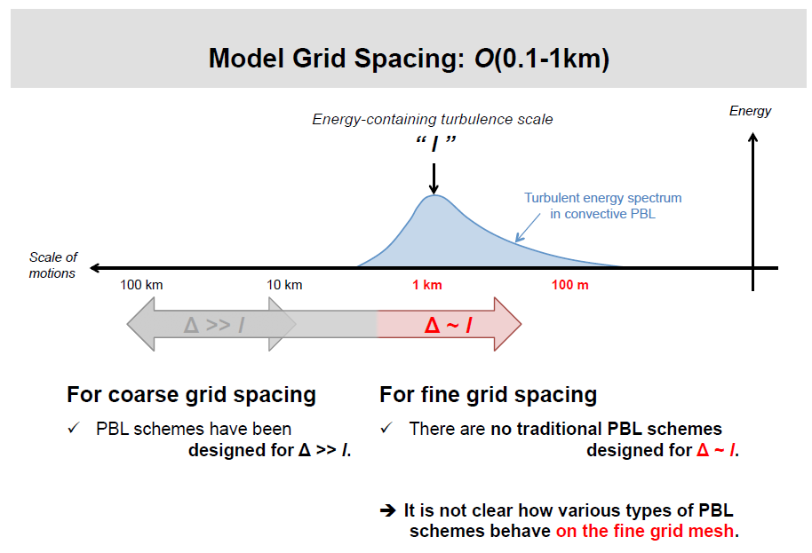
Issues – PBL Start to resolve thermals (c.f. convective grey zone)
c/o J. Dudhia
Local (TKE) schemes →eddies at scales where they should not exist (~3+ km)
Non local schemes generally suppress resolved eddies more than local schemes
Scheme should transition from 1-d PBL to 3-d turbulence as grid → LES
Similar problems with transition from shallow to deep convection? -
Notes:
With km scale models, we now move on to the next "grey-zone" - turbulence
- Actually its grey-zones for different all the way down from now on as various sub-grid scale processes become grid scale
- Once below 100m, start to get the urban grey zone (partially resolved urban structures – buildings, canyons) and so on.

Slide 10
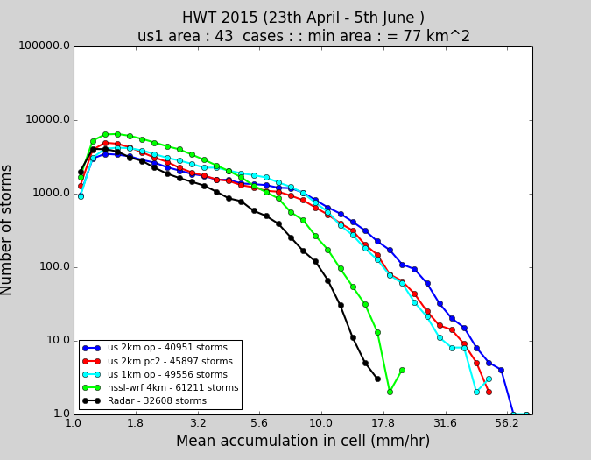
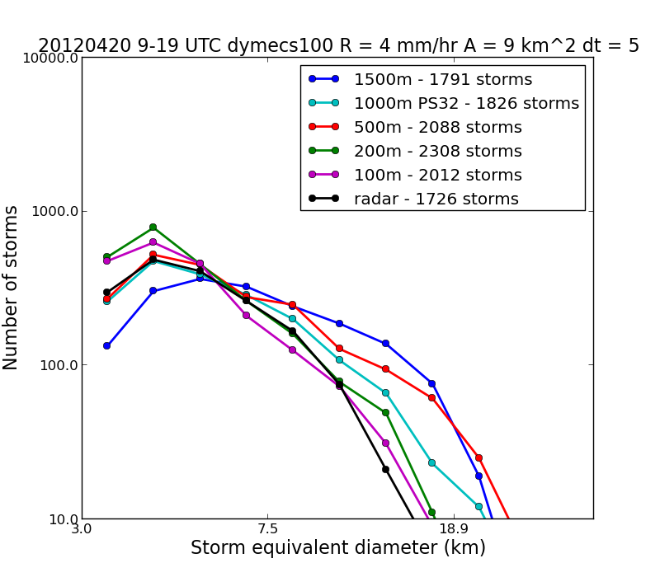
Issues – Convective cloud
Too many large cells, not enough small cells
Explicit cells act as implicit parametrization of smaller cells (Skamarock)
Detrainment and entrainment problems
Cell size distribution can be too resolution dependent
i.e. does not vary enough day-to-day
c/o Humphrey Lean & Kirstey Hanley
Notes:
Large cells doing the work of a smaller cells with a spectrum of sizes and depths
Showing figure on cell size stats from different areas (US & UK, US case includes WRF – which has the same problem as UM)

Slide 11
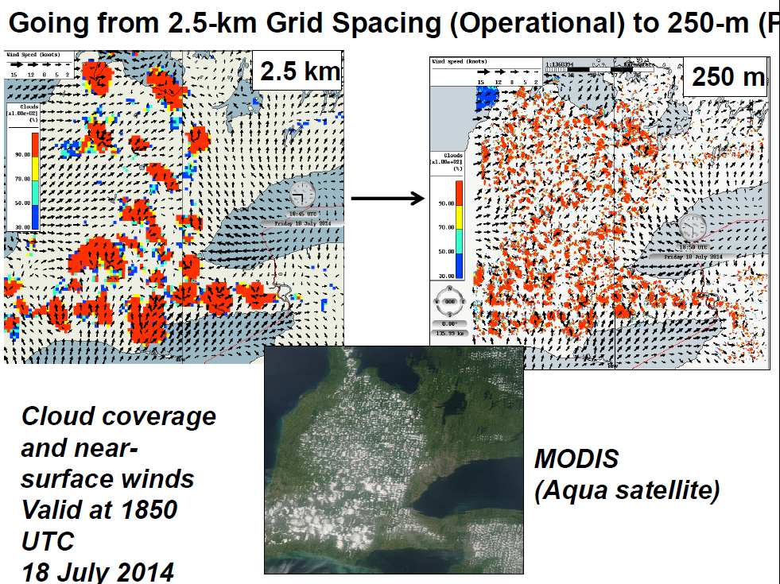
O(100m) models: clouds & local winds Urban Effects, Fire modelling, fog, hydrology, …

Slide 12
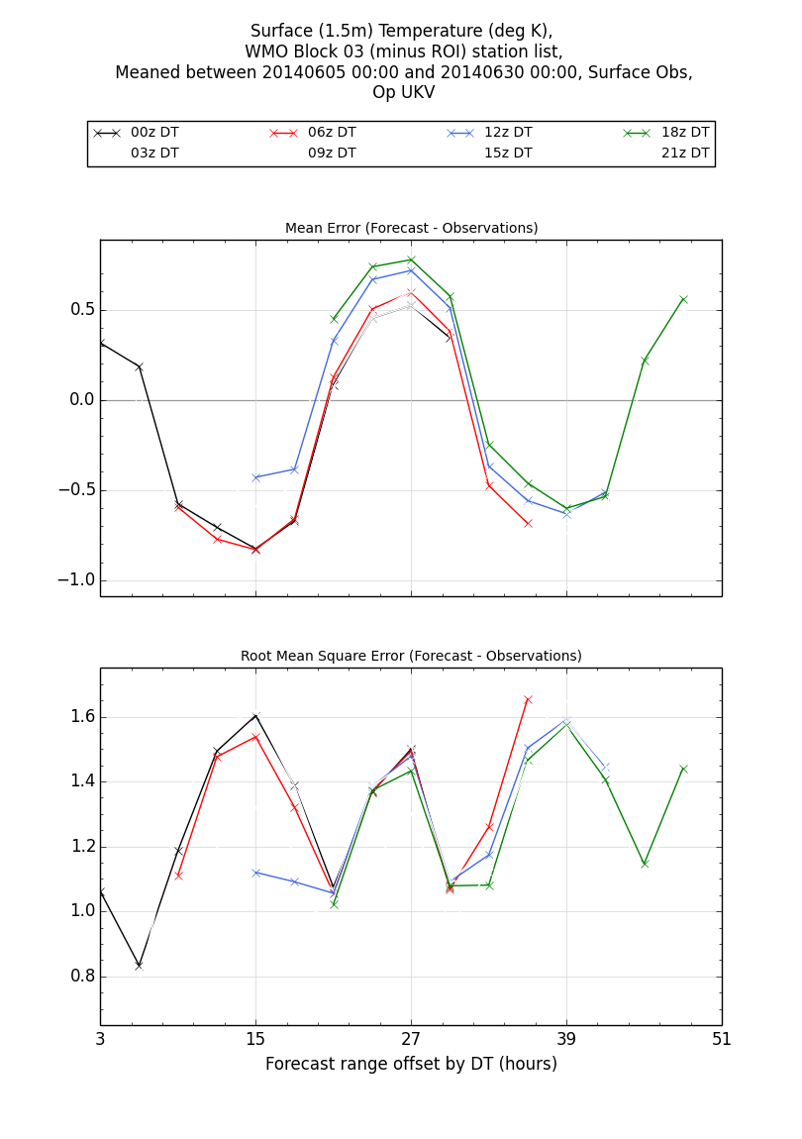
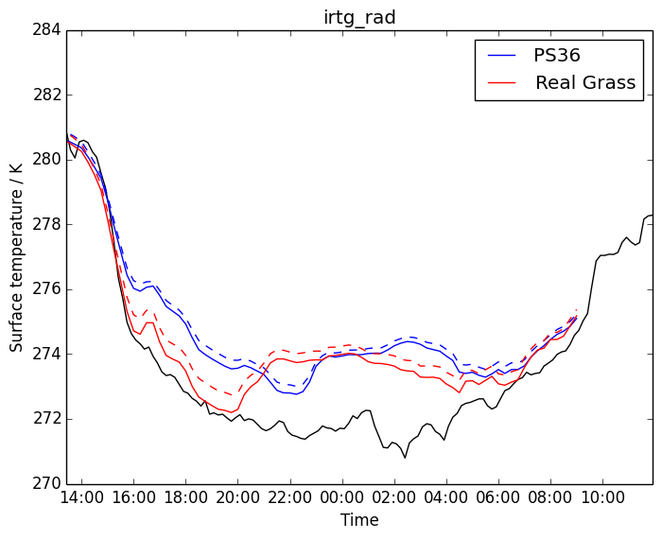



Issues – Land Surface
Characterization of land surface a major issue
Vegetation height & type, Urban characteristics, soil properties etc.
Major international data sets of highly variable quality
Some very outdated, or just poor quality in some areas
June 2014
Early evening
problem worse on clear nights
3 15 27 39 51
Forecast range offset by DT (h)
Time (UTC)
"Real Grass"- more realistic grass surface & sfc. boundary layer mixing
(c/o Adrian Lock, Simon Osborne, Graham Weedon, Ian Boutle et al)
Notes:
Biases in Tmin and Tmax reduce diurnal cycle.
- These really show up when just Lookat clear nights – so not cloud problems etc.
Have found major errors in tree & grass heights, urban fractions, you name it, when start investigating the detailed structure of land cover/land use
….and then there are all the problems with soil properties leading to difficulties with analyzing and modelling soil moisture
If thermal capacity of land surface wrong, then mis-timings on the morning temp rise. Consequences for convective initiation, sea breezes (sea breezes important? Many large urban areas are coastal, many major airports also!)

Slide 13
Other Issues
Lateral Boundary Conditions
Takes time to spin up explicitly resolved processes from parametrized processes in driving model
Data Assimilation
Errors due to large scale forcing vs those from local effects
Large scale model errors
Lateral boundary conditions
Balance between the two impacts of responsiveness of systems
Cloud structure

Slide 14
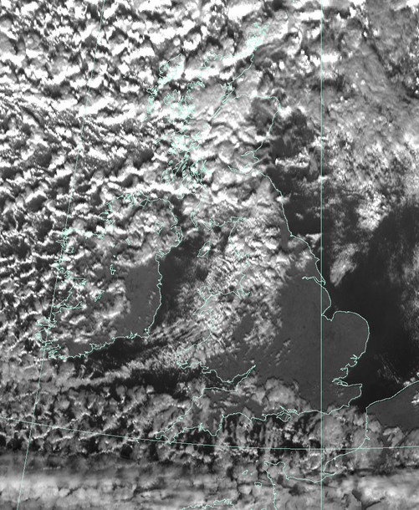
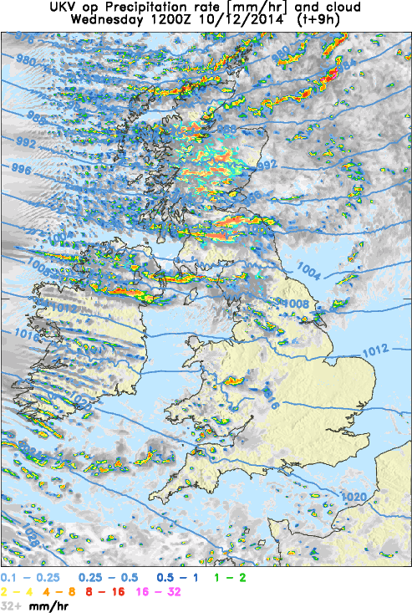
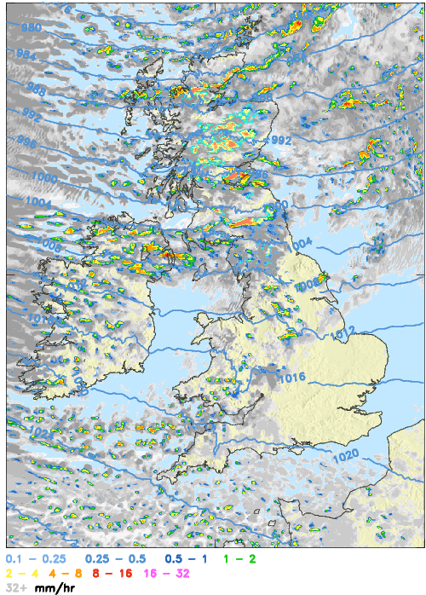
Lateral Boundary conditions
Transition from parametrized to explicit process takes time to spin up
With stochastic perts (~0.1K)
c/o Simon Vosper
Notes:
slow spin up of convection. By introducing small (~0.1 K) random temperature T perturbations into the model we have gone some way to improving this.
This is a nice example of stochastic physics which clearly represents missing (unresolved) variability, and has a positive impact of a deterministic forecast.

Slide 15
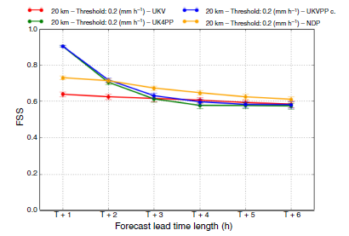
There is a lot of good news!
Despite all of the issues…..
Convective scale models provide valued information to users
Intiation, evolution/organization of cell clusters
Topographic forcing
Rainfall comparable to radar based nowcasts at 2 hours lead time
STEPS – radar based nowcast blends
1.5 km NWP
4km NWP
Ballard et al. 2015
Notes:
1.5km rapid update brings useful information one hour earlier (i.e. NWP now comparable to nowcasts by two hours into the forecast)
Also highlights that need to work on analysis error if want to use NWP at 1 hour

Slide 16
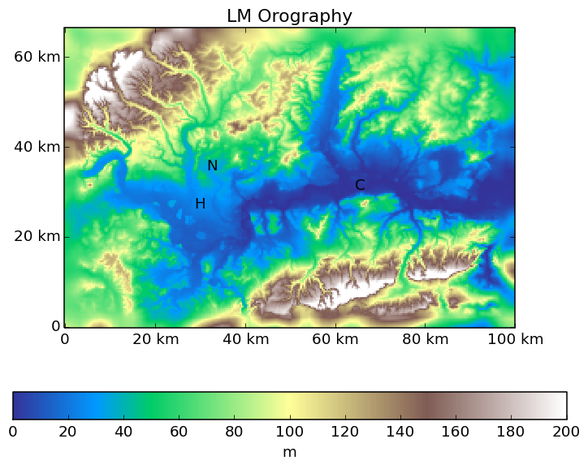
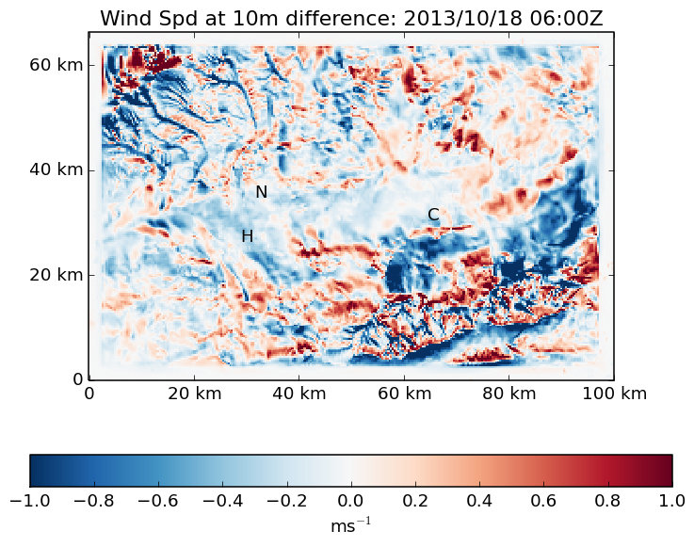
Considerable activity at O(100m) grid spacing Urban Effects, Fire modelling, fog, hydrology, …
10m wind difference due to high res orography
Lots of additional variability in the near surface windspeed
Closely tied to variability in the orography, but not exclusively implying remote effects
Direct impact on fog formation
Notes:
Comparisons between 10m winds from 330m and 1.5km models.
- differences in wind speed occur remotely from differences in topography (i.e. drainage flows etc.)
Also looked at cases of fog formation – direct improvement due to topography (effect of differences sub grid scale RelHumidity/cloud variability was shown to be minor)

Slide 17
Verification
Major effort by JWGVR on meso-verification.
Traditional verification stats of limited value
Large area-averages limited sensitivity to local, topographic enhancements.
Critical to verify against observations
Allow for uncertainty in observations, and sub grid scale variability when dealing with extreme values/high impact events
Use Cloud (satellite images) and rain (radar) as reference data

Slide 18
Summary
WGNMR focus on 0-6 hour time frame and developments at convective scale (or higher)
Science merging the two areas – so WG’s merged
FDPs and RDPs are major tools for realizing the goals
Value of convective scale models well-established
Move beyond standard verification scores
Stochastic modeling and verification
Major developments in modeling, data assimilation, verification and observation networks
Many challenges remain
Major progress in bridging the gap to nowcasting
Still need blended nowcasting for the first 1-2 hours
High quality, high density observation sets for model development available
Summer (TOMACS) and winter (ICE-POP)

