Slide 1
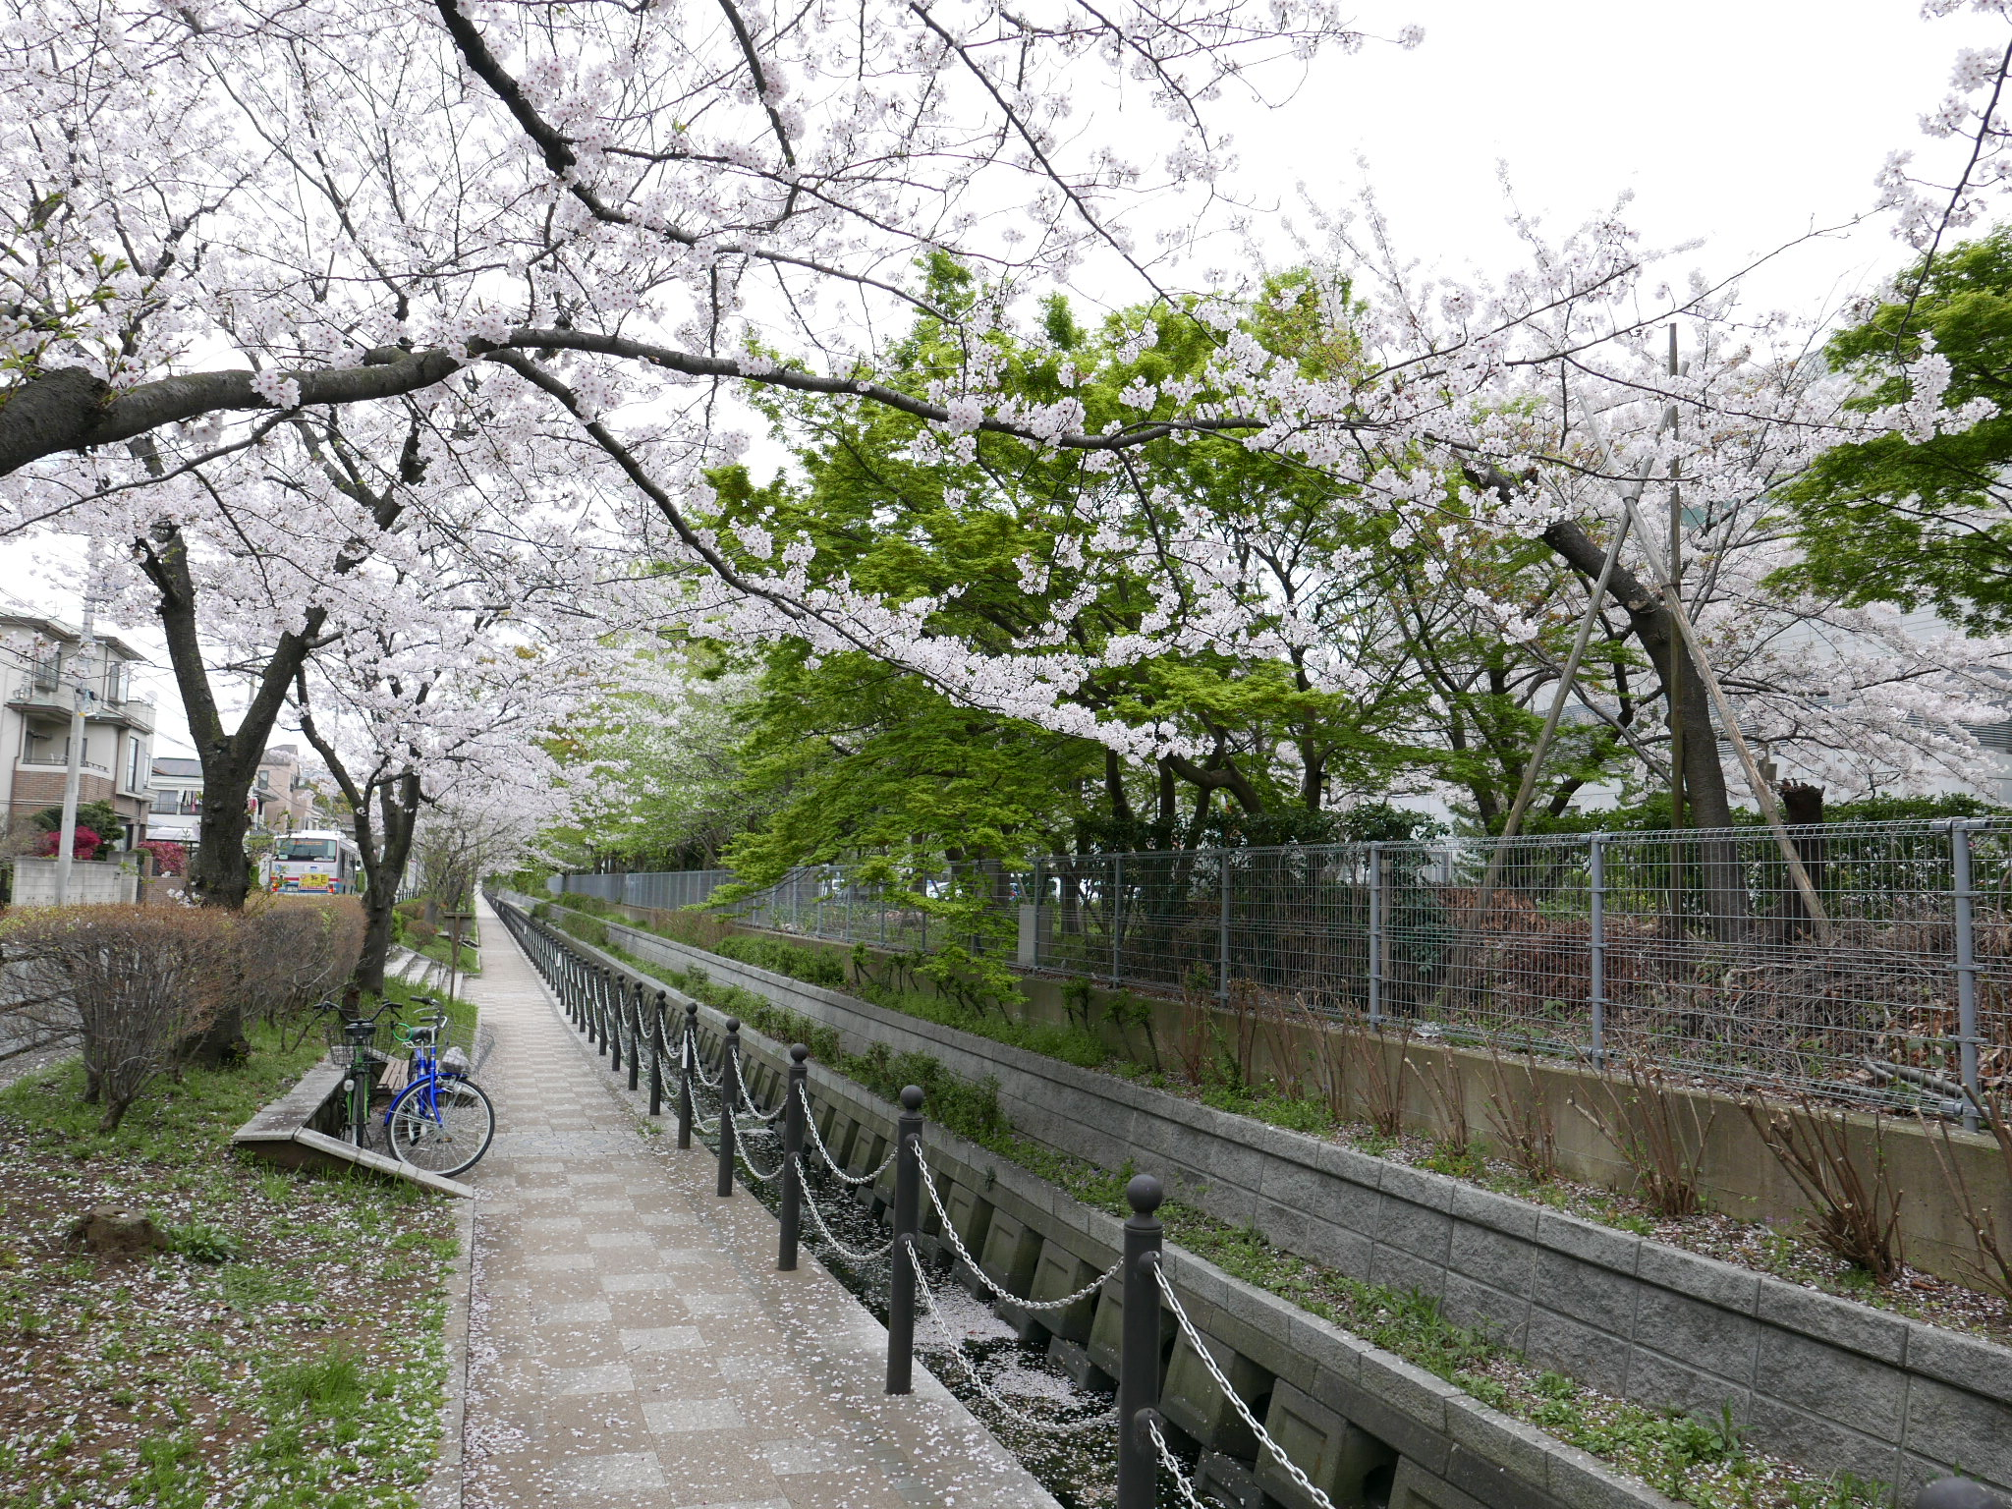
The role of mid and high latitude air-sea interactions
in interannual to multiyear climate variations
over southern Africa
Yushi Morioka (JAMSTEC)
F. Engelbrecht (CSIR), S. K. Behera (JAMSTEC)

Slide 2
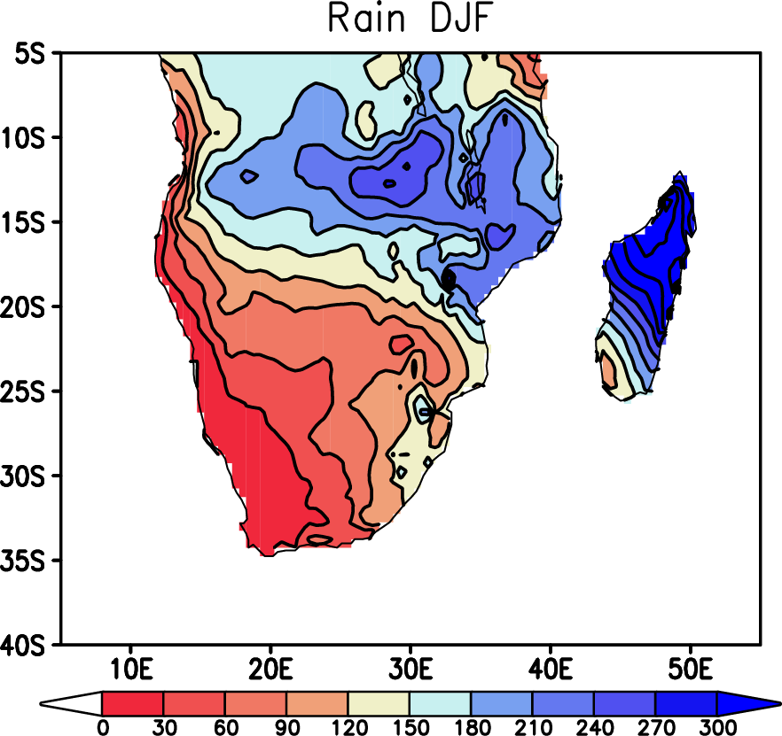
Background (I) Interannual SA climate variability
Summer rainfall (Dec-Feb)
Potential climate drivers:
ENSO
Benguela Niño
Subtropical Dipole
Southern Annular Mode
e.g. Reason et al. (2006)
Role of Antarctic sea-ice variability is not well studied.

Slide 3
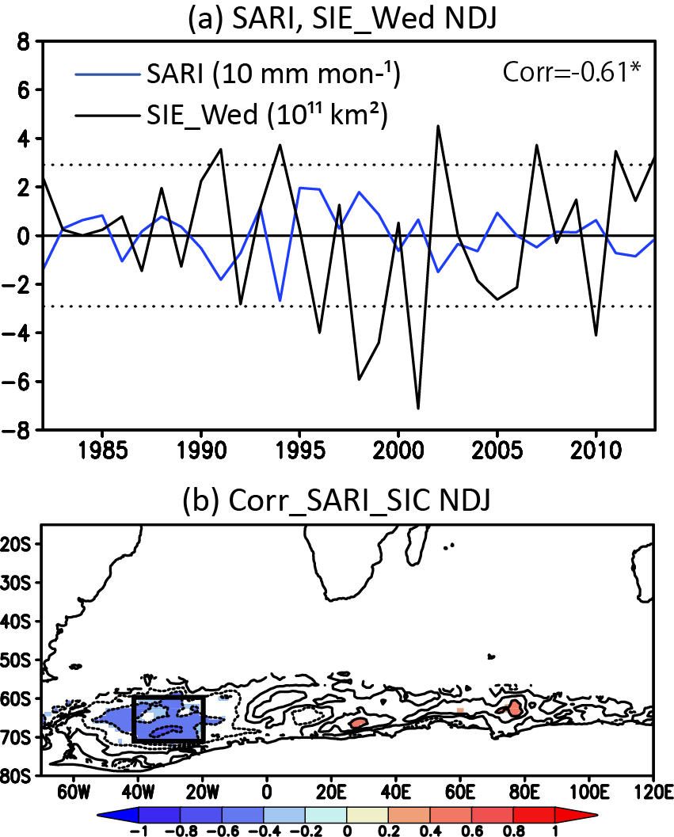
Link between Southern African Rainfall Index (SARI)
and Weddell Sea Ice Extent
Morioka et al.
(2016, submitted)

Slide 4
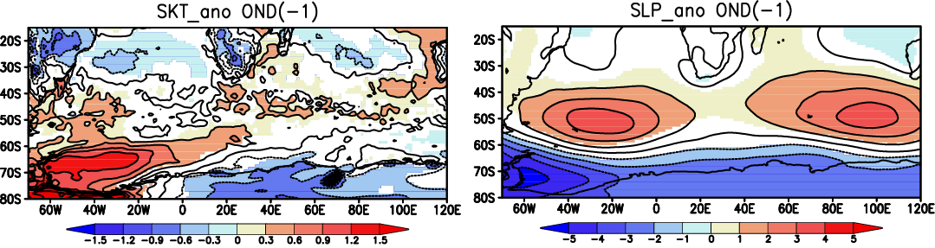
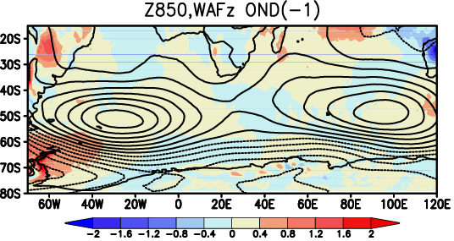
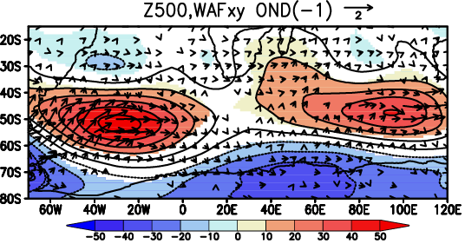
Composite anomalies (Obs)
Low Weddell Sea ice years (Oct-Dec)
Morioka et al.
(2016, submitted)

Slide 5
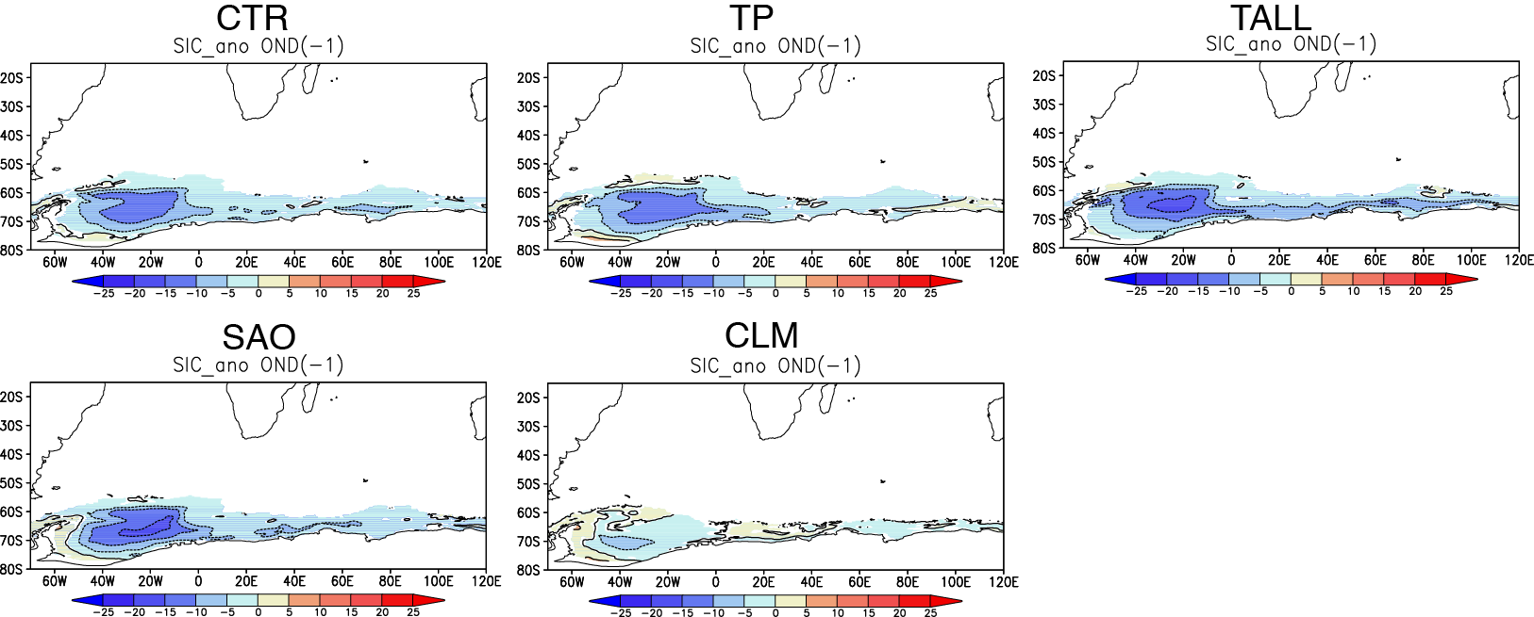
Composite SIC anomalies
(SINTEX-F2 150 yr)
SST-nudging exp
TP: Tropical Pacific
TALL: All Tropics
SAO: South Atlantic CLM: Global
Morioka et al.
(2016, submitted)

Slide 6
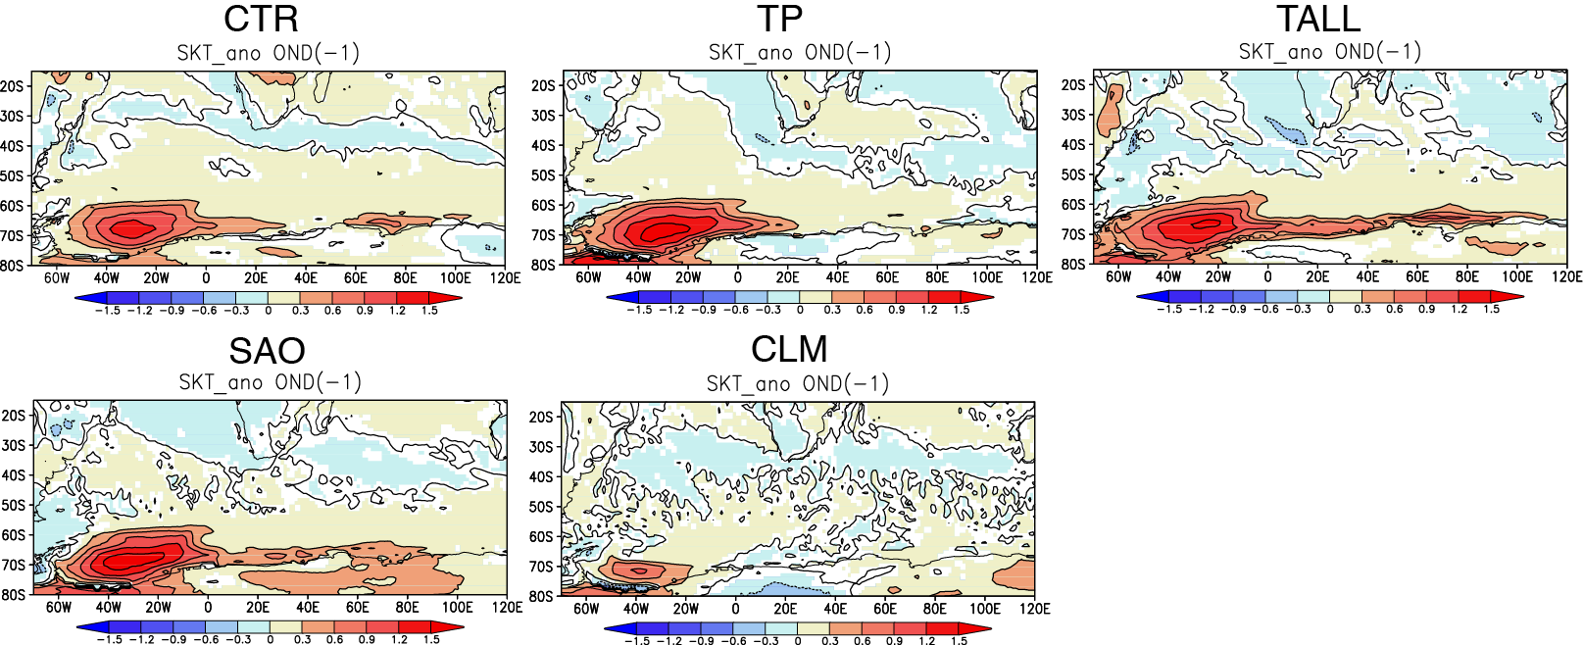
Composite SKT anomalies
(SINTEX-F2 150 yr)
SST-nudging exp
TP: Tropical Pacific
TALL: All Tropics
SAO: South Atlantic CLM: Global
Morioka et al.
(2016, submitted)

Slide 7
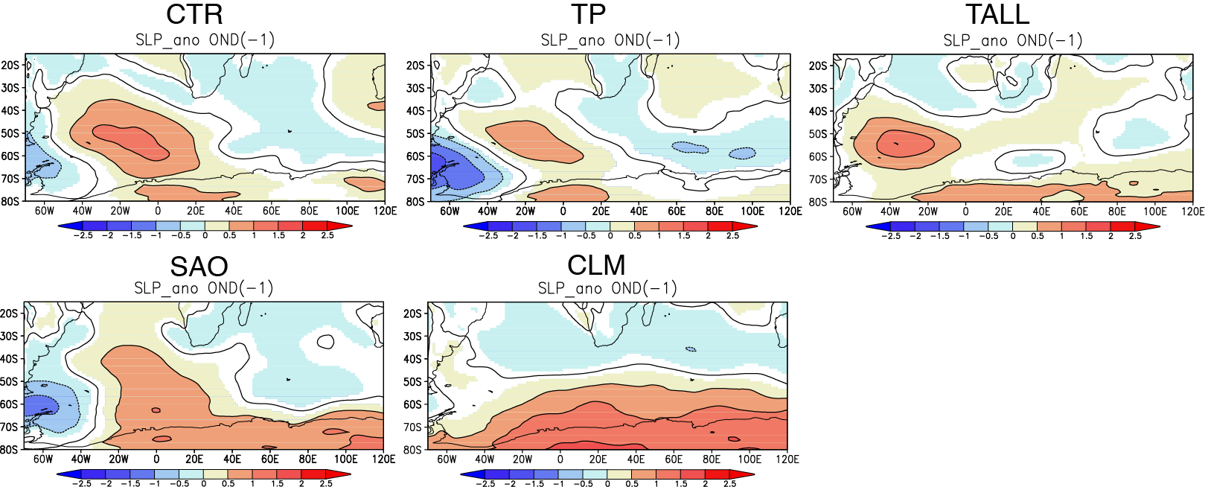
Composite SLP anomalies
(SINTEX-F2 150 yr)
SST-nudging exp
TP: Tropical Pacific
TALL: All Tropics
SAO: South Atlantic CLM: Global
Morioka et al.
(2016, submitted)

Slide 8
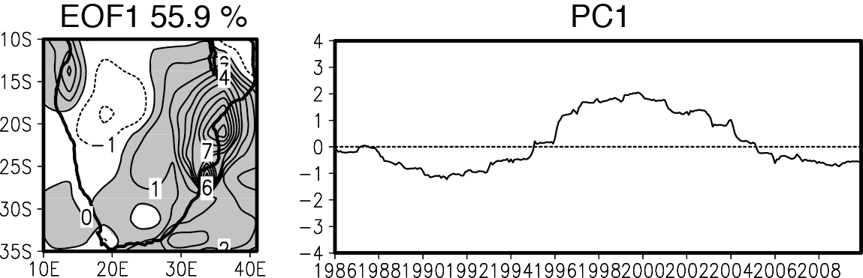
Background (II) Decadal SA climate variability
Potential climate drivers:
- Decadal ENSO
Indonesian Through Flow
Southern Annular Mode
e.g. Allan et al. (1995)
Role of local air-sea interaction in the South Atlantic
and southern Indian Oceans is not identified.

Slide 9
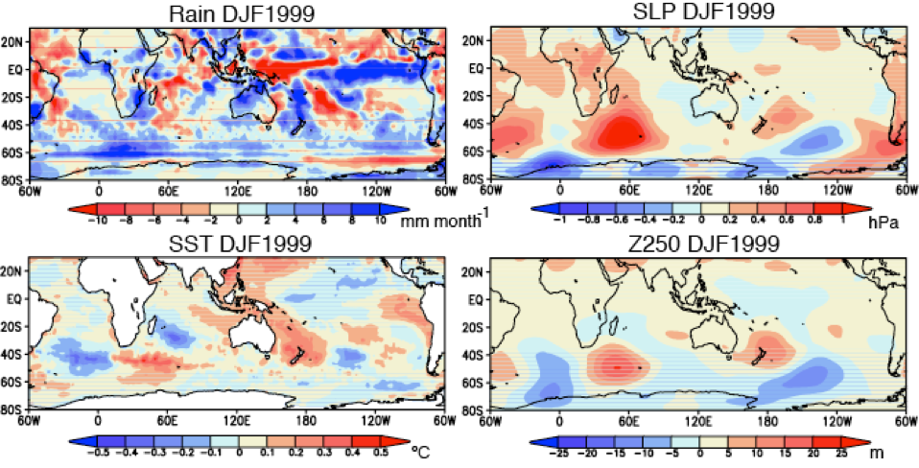
Decadal climate anomalies (Obs)
during Dec1999-Feb2000
Morioka et al.
(2015, JC)

Slide 10
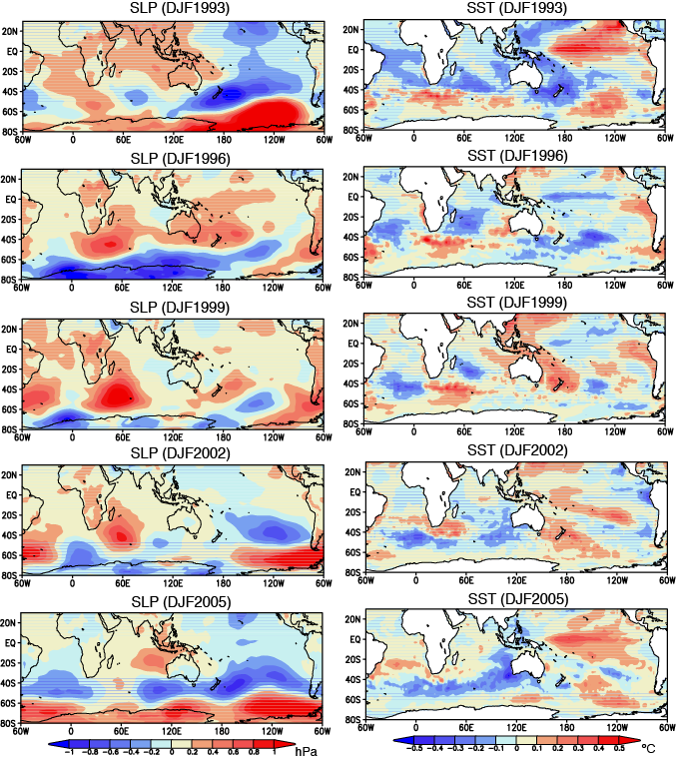
Decadal SLP/SST anomalies from 1993 to 2006
Morioka et al.
(2015, JC)

Slide 11
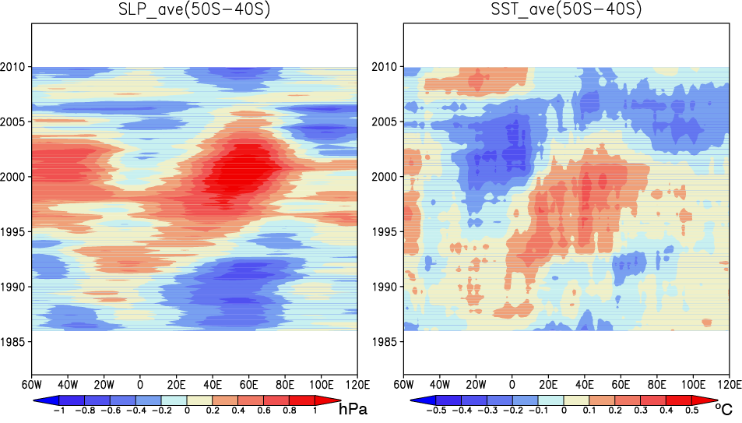
Decadal SLP/SST anomalies (Obs)
at 40-50ºS
1.5 cm/s
Morioka et al.
(2015, JC)

Slide 12
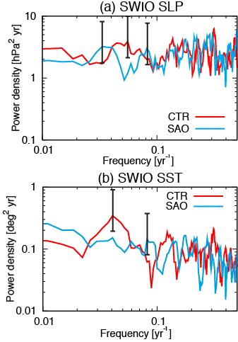
Fourier spectrum of SLP/SST in SWIO region
SINTEX-F2
(300-yr)
20 yr
25 yr
Morioka et al.
(2015, JC)

Slide 13
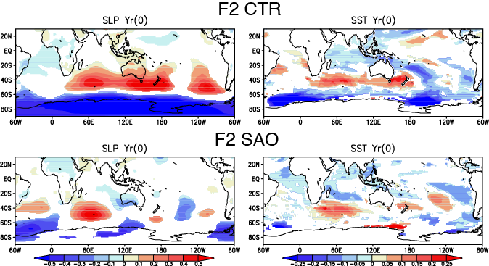
Composite SLP/SST anomalies
(SINTEX-F2 300-yr)
Morioka et al.
(2015, JC)

Slide 14
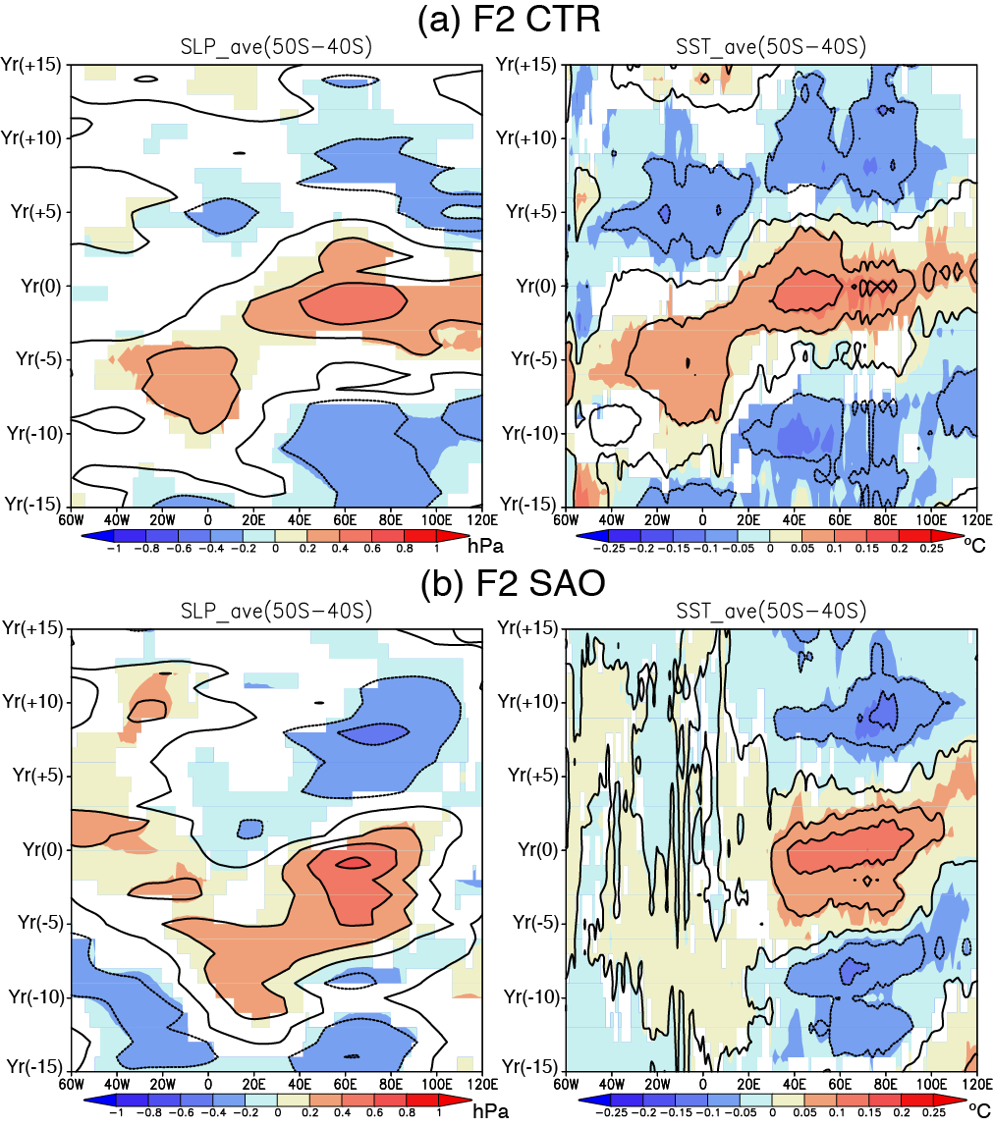
Composite SLP/SST anomalies at 40-50ºS
SINTEX-F2
(300-yr)
2.4 cm/s
Morioka et al.
(2015, JC)

Slide 15
Summary
Data analysis and SINTEX-F2 model experiments reveal…
1. Interannual SA climate variability:
Weddell Sea ice variability has potential influence on the subtropical high variability in the SAO and SIO by modulating the near-surface atmospheric stability.
2. Decadal SA climate variability:
Besides remote influence by decadal ENSO and SAM, local air-sea interaction in the SAO and SIO plays key role in the eastward propagating decadal anomalies, which affect the SA rainfall variability.

