Slide 1
Lessons learned from JMA global and regional model development
Junichi Ishida and colleagues at JMA
WGNE-31, 26-29 April 2016
CSIR, Pretoria, South Africa

Slide 2
Introduction
JMA operates a global model (GSM) with a horizontal resolution of 20km and 2 regional models with a horizontal resolution of 5km (MSM) and 2km (LFM).
GSM was upgraded in March 2016 and LFM was upgraded in January 2015. We gained following lessons through the development of both systems. I would like to share them and discuss about them.
Cloud scheme and Cumulus parameterization of GSM
Grey zone of convection at LFM

Slide 3
Cloud scheme and Cumulus parameterization of GSM

Slide 4
Motivation
JMA global model (GSM) with a horizontal resolution of 20km employs convection scheme and cloud scheme.
For convection; Prognostic Arakawa-Shubert type parameterization
For cloud; PDF (a top hat function)-based scheme (Smith 1990)
Both schemes have been modified and they are implemented in GSM in March 2016.
The new global model with another modifications (radiation, land surface model etc.) shows significant improvement in the TC track and precipitation forecast skill and reducing dry and cold bias in the tropical mid-troposphere.
During the development, we recognized the necessity to modify cloud scheme in order to adjust to the change of characteristic of new convection scheme.

Slide 5
Improved convection and cloud scheme
List of major changes
Convection (Prognostic Arakawa-Schubert type)
Improving of melting process
Inclusion of the auto-conversion process in the updraft
Modification to the static energy at the cloud base
Cloud (PDF-based scheme (Smith 1990))
Excluding time-step dependency from the icefall process
Removing the cumulus effect on the PDF width
Modified global model with changed convection scheme showed significant increase of grid point storm…
Removing the cumulus effect on the PDF width was also developed based on the research to clarify the new characteristic of grid point storm.

Slide 6
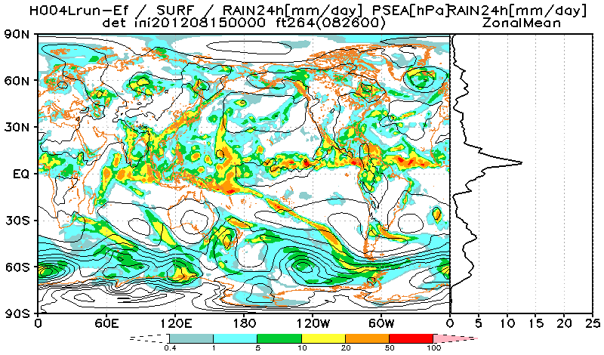
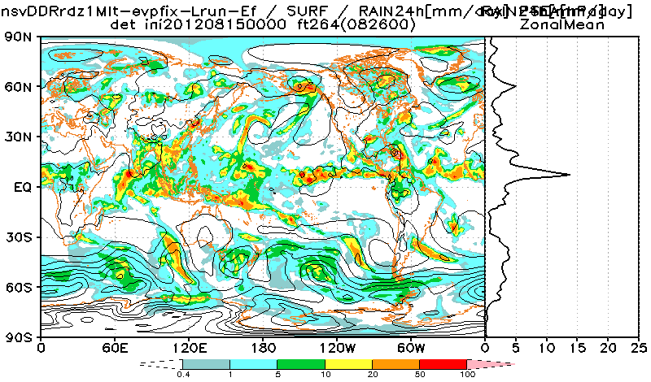
Grid Point storm with new convection scheme
Old model
Modified convection scheme
GSM with a modified convection scheme showed significant increase of unrealistic grid point storm in the tropics in the development…

Slide 7
Cloud scheme in GSM
PDF scheme based on Smith 1990
Total water is divided into water vapour and cloud water using PDF
A top hat function is employed as PDF
The convection scheme does not count the cloud amount and water in convection explicitly because of the assumption that the convection area is too small and negligible.
To count the cloud amount and water, the PDF width was stretched to increase the amount of cloud.
Historically, the treatment was introduced to modify the low bias of mid level cloud in the tropics.
The treatment reproduces too much cloud water which results in too much precipitation.
PDF
Water vapour
Width σ_{s}
Cloud water
Total water q_{T}
Mean total water q_{T}
Saturated relative humidity q*

Slide 8
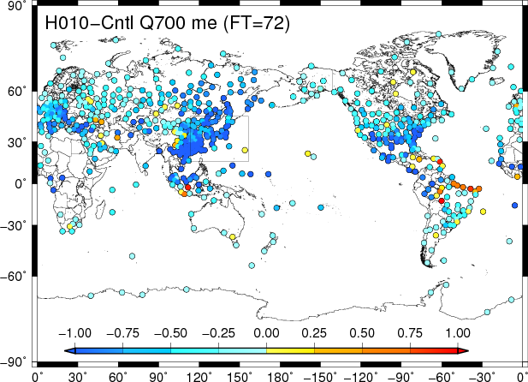
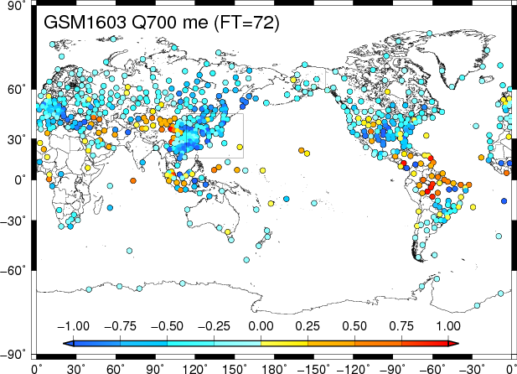
Bias of specific humidity
Reducing the effect of convection in PDF width shows significant improvement of dry bias in midlevel in the tropics, because…
Too much conversion from water vapour to precipitation via cloud water was improved.
More activated convection brought more mid level humidity by detrainment.
Q700
Old
New
Verification against sonde; mean error at T+72, from July to September in 2015

Slide 9
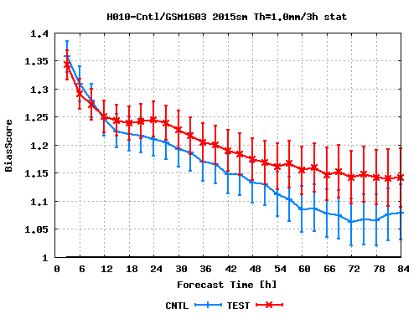
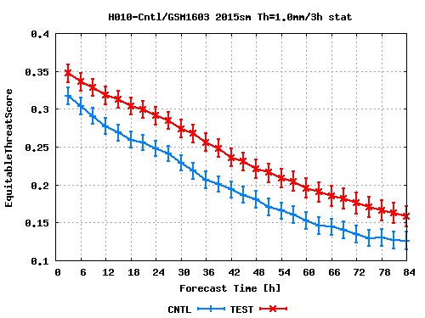
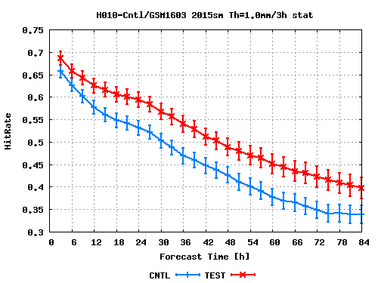
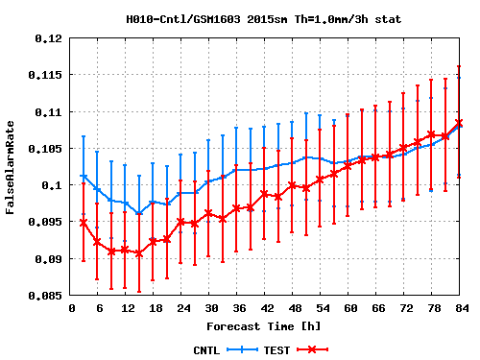
Improvement of precipitation skill
New
Old
Bias Score
Equitable Threat Score
Hit Rate
False Alarm Rate
Verification against surface obs. in Japan from T+3 to T+84, from July to September in 2015
Threshold of 1mm / 3hour, red and blue line indicates new and old model respectively
Up to T+12; Bias Score becomes close to 1, Equitable Threat Score, Hit Rate and False Alarm Rate increase significantly.
From T+12 to T+57; Though Bias Score increases over 1, Equitable Threat Score and Hit Rate increase significantly and False Alarm Rate reduces significantly.
From T+60; False Alarm Rate is almost neutral and Hit Rate increases significantly.

Slide 10
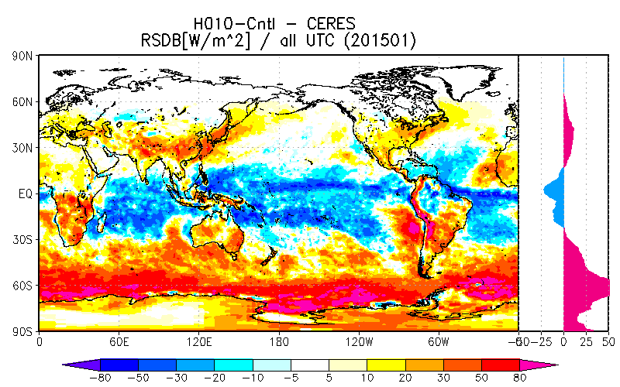
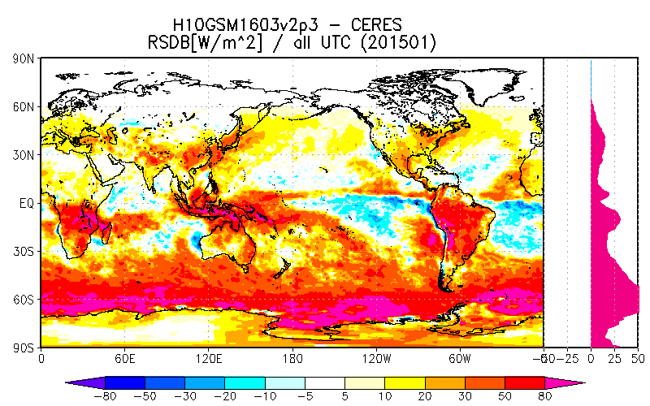
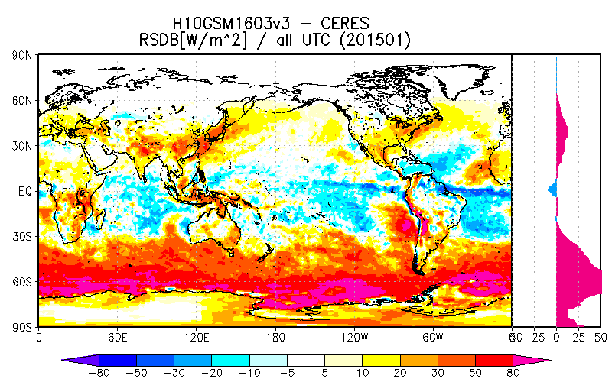
Future issues
Midlevel cloud amount decreases especially in the tropics and the accuracy of short wave radiation flux at surface is deteriorated.
It might cause unfavorable effect to global circulation.
Representation of the effect of cloud amount and water of convection is next issue for JMA global model…
New radiation scheme which considers the effects is under development.
Old
New
New with developing scheme
Verification of downward short wave radiation at surface against CERES;
mean error at T+72, from July to September in 2015
Note: the results is not only by the change of convection but also by the change of radiation scheme…

Slide 11
Lessons Learned
Midlevel humidity in the tropics is quite sensitive to PDF width with a top hat type function.
Precipitation forecast accuracy might be also sensitive to it.
Though consideration of the effect of convection in the PDF is not unnatural, the uncertainty of the PDF width is too large and difficult to determine it.
To consider the effect we are developing to modify not cloud scheme but radiation scheme.
When the effect of convection scheme is considered in the cloud scheme, impact to the cloud scheme should be investigated during the development of convection scheme.

Slide 12
Grey zone of convection at LFM

Slide 13
Motivation
JMA operates 2km model (LFM) with following objectives
Providing information for aviation weather forecast
Disaster prevention especially caused by heavy precipitation
Verifications show that LFM is able to predict smaller scale heavy precipitation, but also reveal serious problems that
Start of convective heavy rain is often delayed.
The convective precipitation intensity is too high.
The less accurate of forecast of timing and intensity of convective precipitation is serious not only for forecasters to issue warnings or advisories, but also for computational stability.
Some operational NWP centres or consortia (ex. Met Office, COSMO) also face similar problems.
Information from European Working Group on Limited Area Modeling (EWGLAM) meeting in 2015.
We have tried to solve the shortcomings and I would like to introduce the lessons learned from the development.

Slide 14



Grey Zone problem Ex: convection
Not represented by grid-mean vertical velocities at all
Partially resolved by grid-mean vertical velocities
Grid-mean vertical velocities can represent all vertical transport
(m)
?
All transport should be parameterized
No parameterizations are necessary
In the Gray Zone, resolved and unresolved phenomena are mixed.
Vertical transport
Convective initiation
Entrainment/Detrainment

Slide 15
Processes in convection
vertical transport
entrainment detrainment
initiation / trigger
(forced lifting by convergence, topography, growing PBL)
Vertical transport: Significant part is explicitly resolved in the LFM
Entrainment / detrainment: Not resolved in the LFM
They are caused by very small vortexes.
Initiation / trigger: Partly resolved in the LFM
Large scale divergence is resolved while small scale divergence or trigger caused by small scale (ex. dispersion of topography) is not resolved.
a Different approach from traditional cumulus parameterization is required!

Slide 16
Horizontal Diffusion; not worked well… As a parameterization of entrainment / detrainment
Smagorinsky type horizontal diffusion scheme was tested to parameterize the effect of entrainment / detrainment but was not worked well…
Test of diffusion for momentum, PT and QV
Test of diffusion for PT and QV
It worked not only on unstable columns but also on stable columns and the smoothed field suppresses the trigger of convection…
Test of diffusion from LFC to LNB
It worked mainly on top of convection which strengthen the unstableness and not the boundary but top of convection cell…
Therefore the diffusion was not employed in the LFM.
Problems
Is the down gradient type diffusion is adequate to parameterize entrainment / detrainment?
How to distinguish the boundary of convection cell?

Slide 17
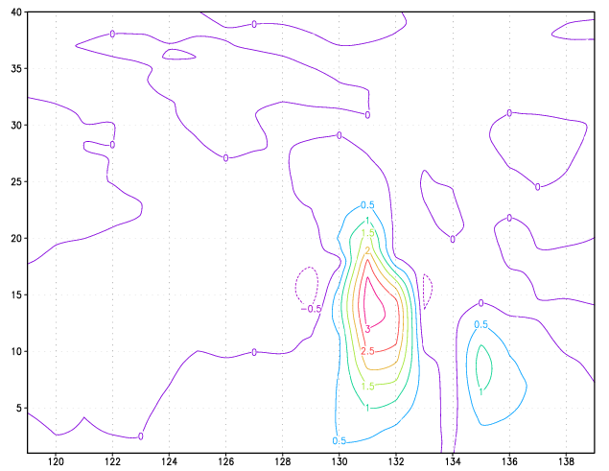
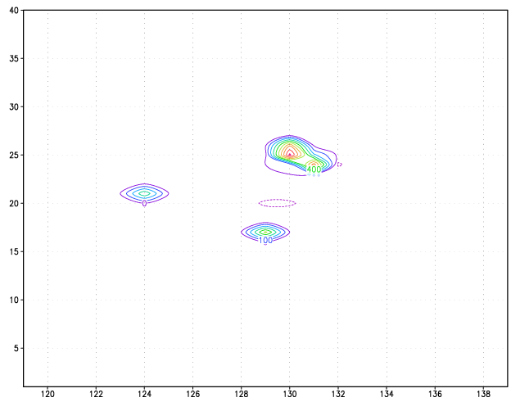
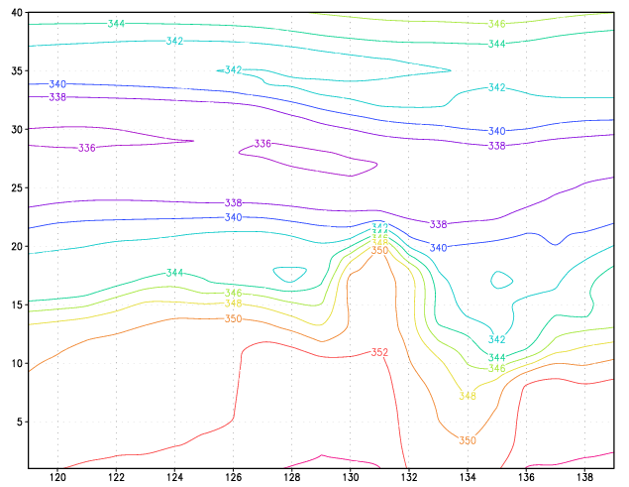
Horizontal Diffusion
W
Tendency of ρQv
EPT
Vertical cross section of W, EPT and time tendency of ρQv by the new horizontal diffusion scheme which works from LFC to LNB.
The scheme mainly works on the top of convection cell and not at the boundary of convection cell.

Slide 18
Introducing a parameterization for convective initiation(PI)
Based on the existing convective parameterization (Kain-Fritcsh, employed by JMA’s 5-km operational mesoscale model), but tendency from convective process is much smaller than the original one (assuming slower convective stabilization)
At the initiation stage, if the dynamics does not produce updraft due to convection even with unstably stratified layer realized, the parameterization is activated and modifies layer stratification by weakly transporting heat and moisture vertically and releasing latent heat through phase transition of water, resulting in producing local low pressure area.
Once such local low pressure area is generated, the dynamics of the model calculates convergence into the low pressure area and promotes development of convection.
Because it acts very weakly, the parameterization just helps dynamics foster convective system.

Slide 19
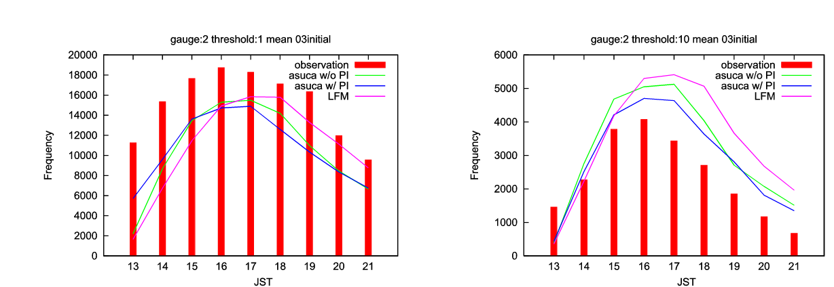
Time series of precipitation frequency
Red bars: observation
Pink lines : LFM
Green Lines: asuca without PI, Blue Lines: asuca with PI
over 1mm/h
over 10mm/h
Even without PI, asuca improves peaks of frequency compared with LFM.
By employing PI, peaks of frequency almost coincide with observed ones, though frequency of prep >= 1mm/h is still too low and that of prep >=10mm/h is still too large

Slide 20
Lessons Learned
LFM had serious problems that the start of convective heavy rain was often delayed and the convective precipitation intensity was too high.
A 2km model can not resolve all processes in convection, especially entrainment / detrainment can not be resolved at all.
Smagorinsky horizontal diffusion scheme was tested but not worked well.
It mainly worked on the top of convection and not the “boundary” of convection.
Is down-gradient type diffusion adequate?
How to distinguish the “boundary” of convection?
Modified existing convection parameterization to parametrize the effect of trigger / initiation was tested and improves the timing of convection.
Too strong convection cells still remain in the model due to the lack of entrainment / detrainment.
For more sophisticated treatment of convection in 2km model…
How to parameterize the entrainment / detrainment?
How to develop more sophisticated initiation parameterization?
Small scale orographic effect such as dispersion or other trigger?

