Slide 1


The SINTEX-F seasonal predictability and its applicability for southern Africa
Swadhin Behera, Takeshi Doi and Yushi Morioka
Application Laboratory, JAMSTEC, Yokohama, Japan
Notes:
Yosoku oyo riikogaku program

Slide 2
Three new WGSIP projects on seasonal prediction
Drift
Co-lead: Bill Merryfield (EC), Mikhail Tolstykh (RAS)
Focus on transient drift after initialisation with observations
Snowcover
Co-lead: Jee-Hoon Jeong(Ch.Uni.), Yvan Orsolini (NILU)
Focus on effects of snow cover initialisation
Teleconnections
Co-lead: Laura Ferranti(ECMWF) and Adam Scaife (UKMO)
Focus on tropical rainfall and connections to extratropics

Slide 3
The SINTEX-F1 seasonal prediction system (developed at JAMSTEC under the EU-Japan collaboration)
 | AGCM | OGCM | Coupling | Sea Ice
SINTEX-F1 | ECHAM4.6 T106L19 | OPA8.2 2×(0.5-2) L31 | Every 2 hour No flux correction | No
Initialization: SST-nudging system
9 ensemble members (3 nudging strength × 3 coupling physics)
Hindcast experiments (every month initialization in 1982—present, 2yr-lead time)
Real-time seasonal forecast & outlook
(Luo et al. 2003)
Current system (e.g. Prediction from May. 1st 2015 )
SST-nudging run
(initialization)
Forecast run
(free run)
~1982
2015.4.1
2015.4.30
2015.5.1
2017.4.30
AGCM restart files
OGCM restart files
Notes:
At the initialization period, the OGCM SST is strongly nudged toward the observed SST in a coupled mode. (The AGCM forced by such generated OGCM SSTs. Then, the OGCM forced by the AGCM simulated fluxes with nudging to observed SST.)
As a first , I would like to explain our seasonal forecast system.
The JAMSTEC climate prediction system was built on the basis of the Scale Interaction Experiment-Frontier (SINTEX-F) fully coupled global ocean–atmosphere GCM. The coupled model was developed at JAMSTEC under the European Union–Japan collaboration. The atmospheric component (ECHAM4.6) has a resolution of 1.18 (T106) with 19 vertical levels. The oceanic component (OPA8) has a relatively coarse resolution of a 28 Mercator horizontal mesh (about 2×2 degree) but with an equatorial intensification up to 0.58 in the meridional direction. It has 31 levels in the vertical with a resolution of 10 m from the sea surface to 110-m depth. Heat, water, and momentum fluxes across the air–sea interface are exchanged every two hours without any corrections using a standardized coupler [Valcke et al. 2000]. No sea ice model is incorporated into the current system; sea ice cover is relaxed toward observed monthly climatology in the ocean GCM. For model details and performance, readers are referred to Luo et al. [2005a].
After 11-years spin-up, SST-nudging initialization scheme is adopted [see Luo et al., 2005b, 2010]. Model SSTs since 1 January 1982 are strongly nudged toward daily observations, which are interpolated from weekly SST from three datasets by three restoring time (1-, 2-, and 3-day) respectively. [Luo et al., 2007, 2008b]. Concerning large uncertainties in surface wind stress estimations, model-coupling physics is further perturbed in three different ways by considering or neglecting ocean surface current contributions [Luo et al., 2005a]. Therefore, our ensemble prediction system has 27 ensemble members and attempts to measure uncertainties of both initial conditions and model errors for forecasts. When calculating model forecast anomalies, we have removed model climate drifts at each lead time in a posteriori manner during 1983-2006 [Luo et al., 2005b]. In APL, the real-time seasonal prediction is updated on our website every month like this page,
Since 2005, we update
the JAMSTEC prediction system has been used for real-time forecast experiment (available at http://www.jamstec.go.jp/frcgc/research/d1/iod/index.html). In this paper, we discussed 27 ensemble members mean.

Slide 4
9-member mean (1982-2004)
based on a semi-multimodel ensemble prediction system
>0.9
Luo et al., J. Climate, 2005b.

Slide 5
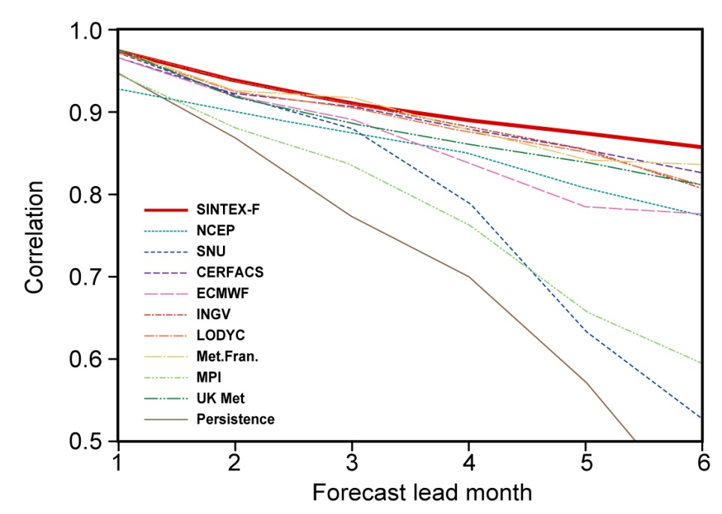
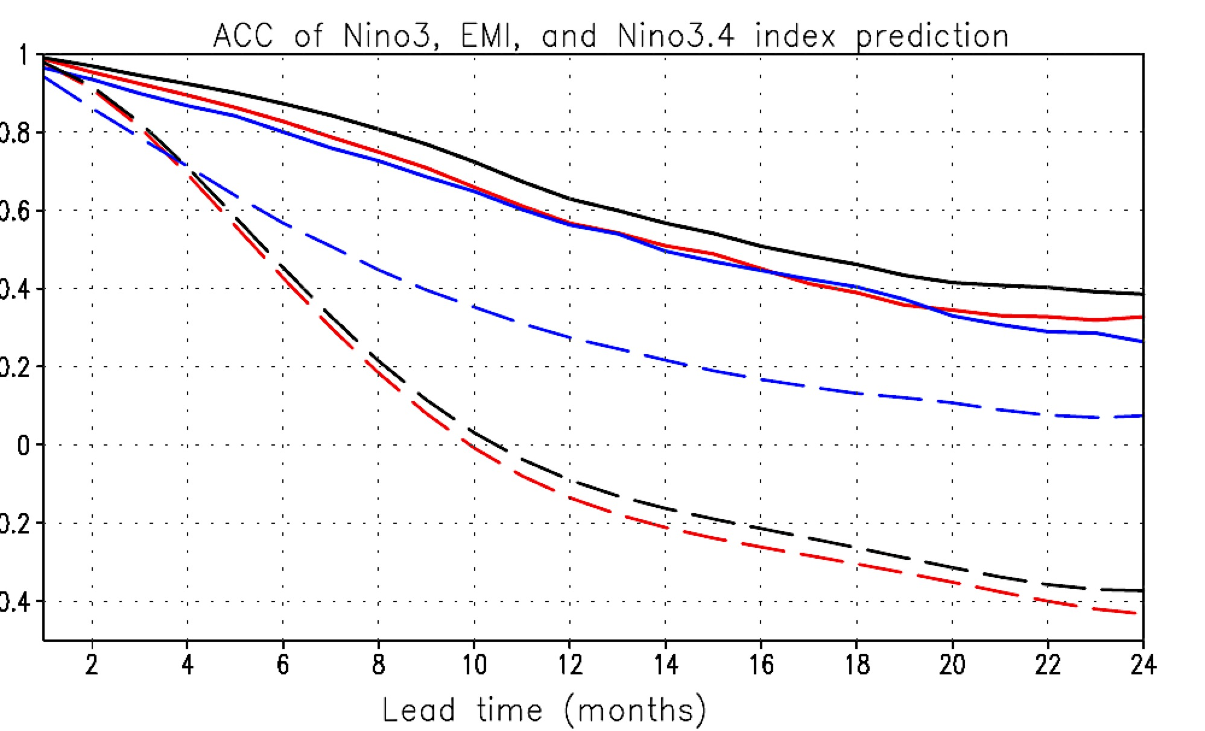
SINTEX-F IOD and ENSO Predictions
ENSO prediction skill of 10 coupled GCMs
Nino3.4 index
(1982-2001)
Nino3.4
EMI
Nino3
---persistence
Jin et al. 2008
Luo et al. 2016
Indian Ocean Dipole
9-member ensemble
hindcasts (1982-2004)
Both winter and spring barriers exist
Luo et al. 2007

Slide 6
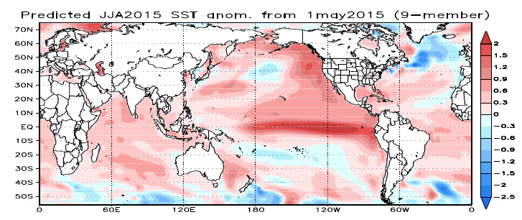
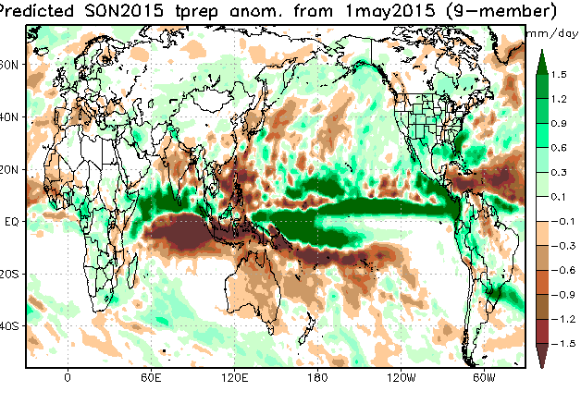
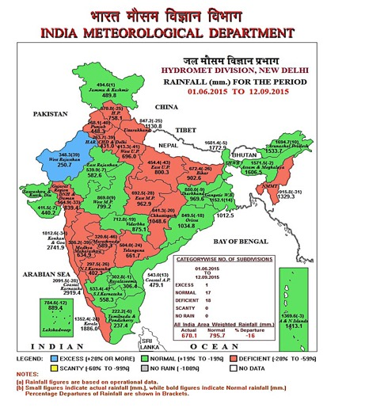
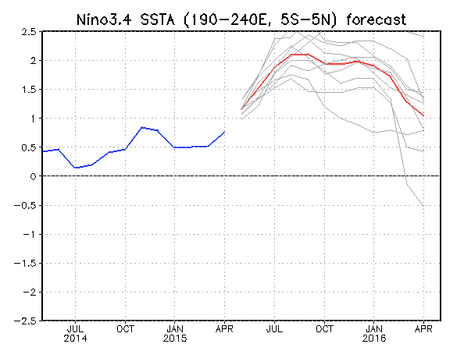
SINTEX-F 2015 boreal summer climate predictions initiated on 1 May
http://www.jamstec.go.jp/frcgc/research/d1/iod/index.html
Observed later

Slide 7
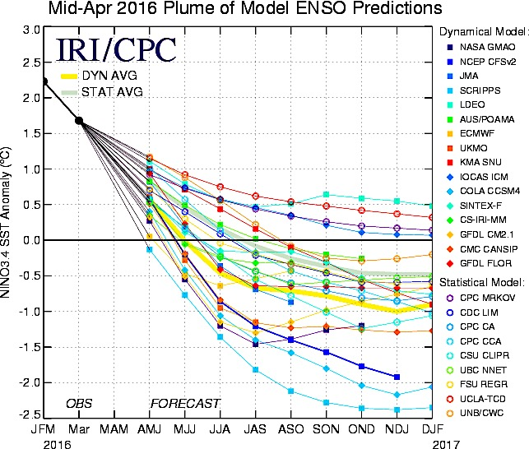
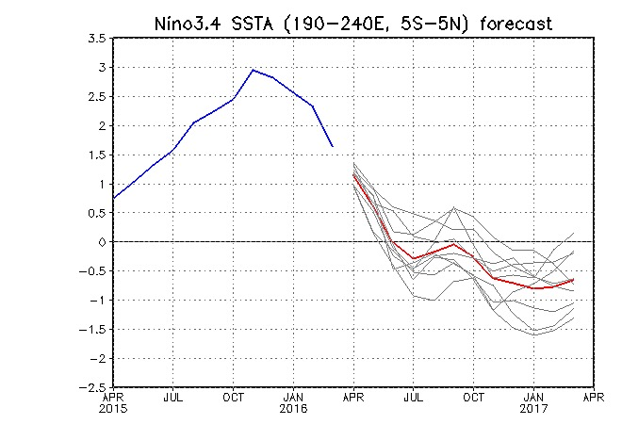
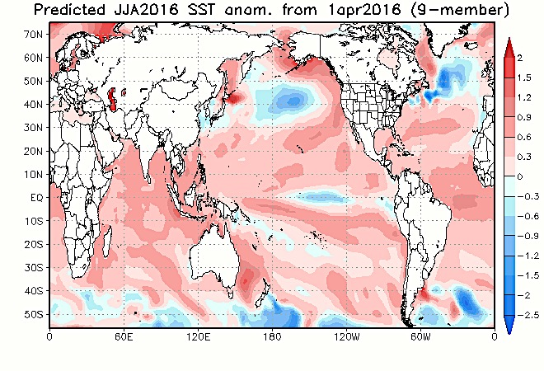
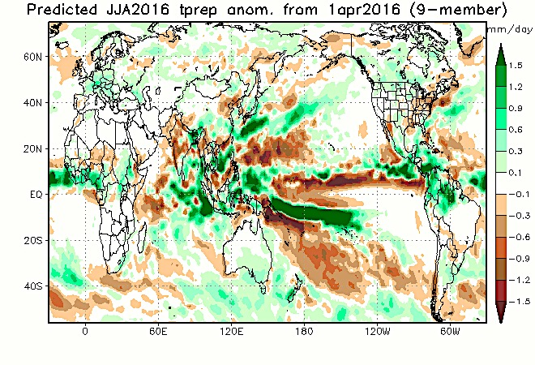
SINTEX-F 2016 predictions initiated on 1 Apr
SINTEX-F
http://www.jamstec.go.jp/frcgc/research/d1/iod/index.html

Slide 8






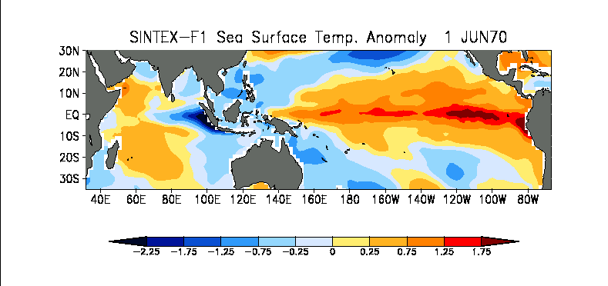
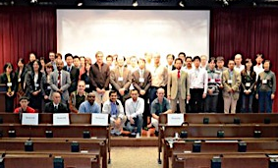
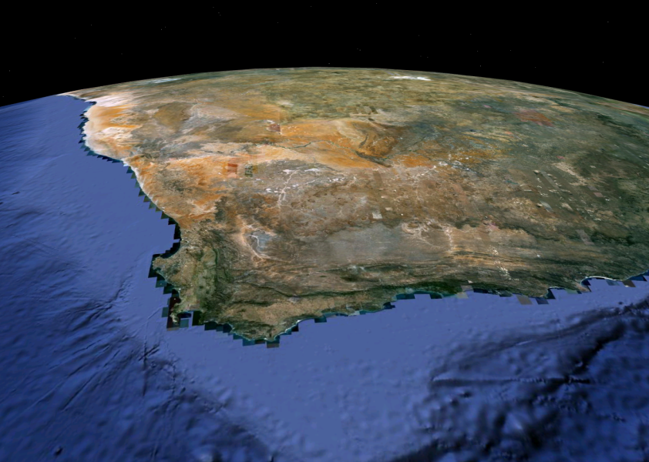
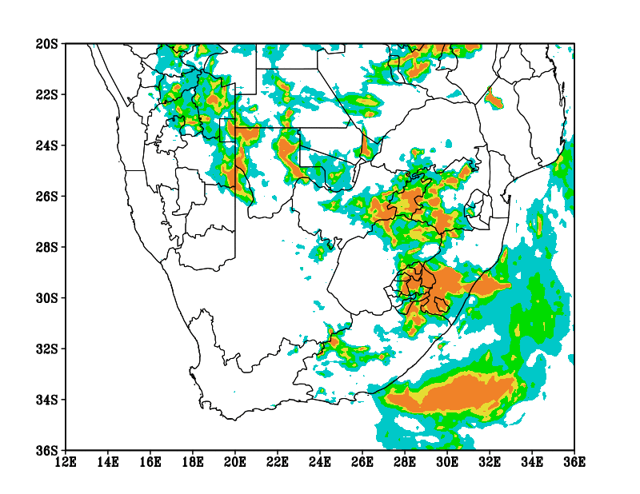
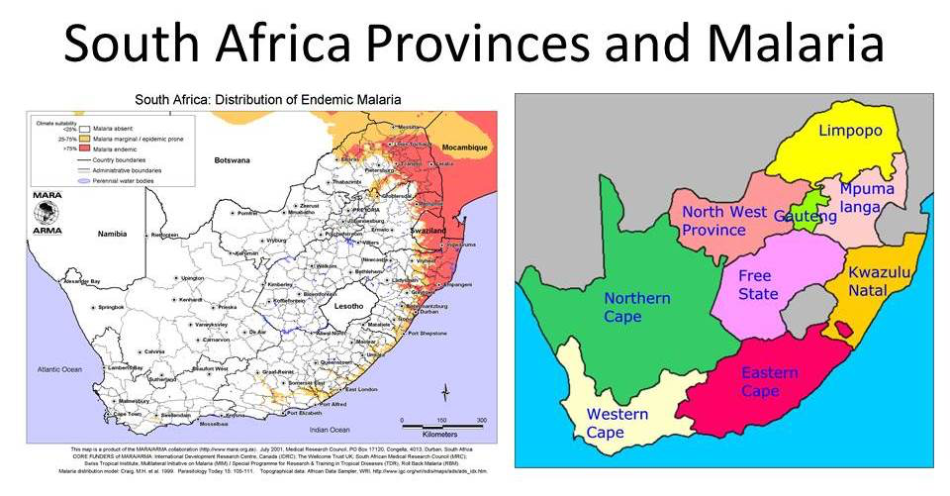
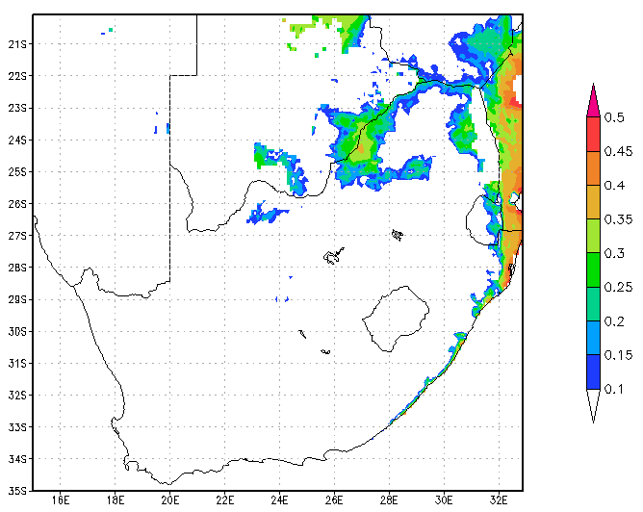
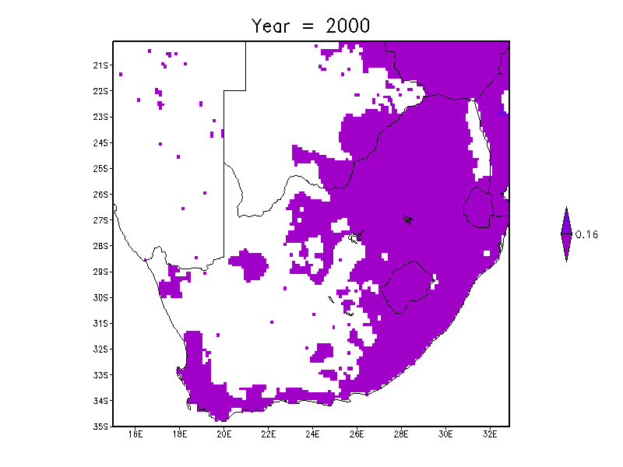
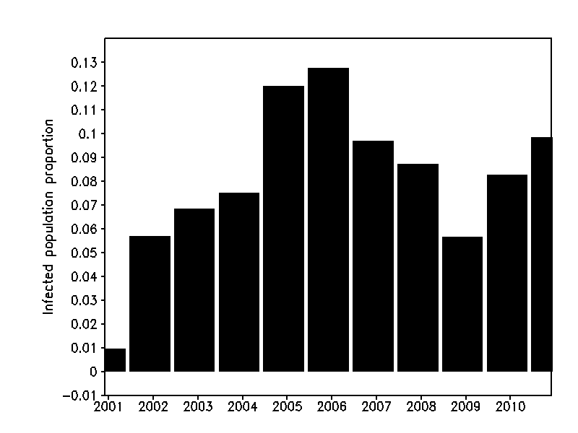
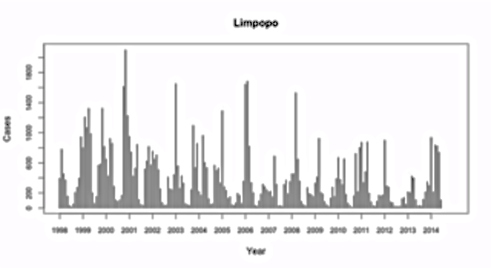
SATREPS South Africa: 2010-13
JAMSTEC, U. Tokyo, ACCESS, U. Cape Town, U. Pretoria, ARC, CSIR
Application projects
SATREPS infectious Diseases Early Warning System (iDEWS) for southern Africa: 20014-19
U. of Nagasaki, JAMSTEC, U. Tokyo, ACCESS, MRC, CSIR, U. Cape Town, U. Limpopo, DOH…
Observed malaria incidences
Model
malaria incidences

Slide 9
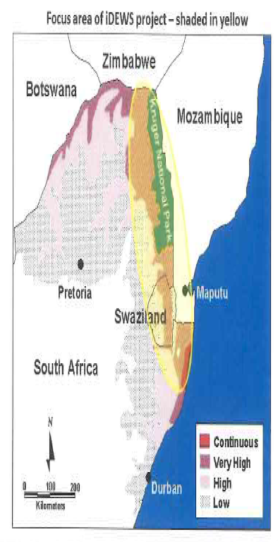
A new SATREPS project to establish a climate-based early warning system for the infectious diseases in southern Africa (iDEWS)
ACCESS & JAMSTEC
JAMSTEC-CSIR-SAWS
Regional climate model
(southern Africa)
Weather and climate information
JAMSTEC-CSIR-SAWS
Downscaling
NEKKEN-MRC & UWC
MRC
Refinement
Weather data
District level climate model
Disease transmission model
Disease surveillance systems
Refinement
ALL
Disease prediction model
ACCESS: Applied Center for
Climate & Earth System Science
CSIR, SAWS, UP, UV, UL,UWC
JAMSTEC: Japan Agency for Marine-
Earth Science and Technology
MRC: South African Medical
Research Council
NEKKEN: Institute of Tropical
Medicine, Nagasaki University
Early Warning systems

Slide 10
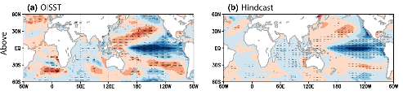
Seasonal predictability of SA summer rainfall is linked to ENSO, SASD, and SIOD.
Obs.
SINTEX-F1 hindcast from Oct. 1
La Niña-Modoki
La Niña-Modoki
[Yuan et al. 2013]
Indian Ocean Subtropical Dipole
South Atlantic Subtropical Dipole
The SINTEX-F1 system has difficulty with prediction of SASD and SIOD.

Slide 11
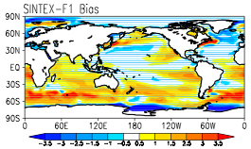
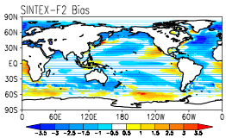

New SINTEX-F2 seasonal prediction system
 | AGCM | OGCM | Coupling | Sea Ice
SINTEX-F1 | ECHAM4.6 T106L19 | OPA8.2 2×(0.5~2) L31 | Every 2 hour No flux correction | No
SINTEX-F2 | ECHAM5 T106L31 | NEMO(OPA9) 0.5×0.5 L31 | Same as F1 | Yes
Annual mean SST bias from NOAA OISSTv2
(*cloud, radiation, advection scheme, ocean mixing)
Better!
==> the mid-latitude climate simulation skill is improved (e.g. Morioka et al. 2015)
 | Initialization | Ensemble | Lead time | Period
SINTEX-F1 | SST-nudging, every month | 9 (27) | 1-2yr | 1982~
SINTEX-F2 | SST-nudging, every month | 12 | 6mo | 2000~
Notes:
We are now developing the new seasonla prediction systemo on a basis of new SINTEX-F2 GC>
We can see significangt improvement in Mid-latitude, in particluar the tram trac and frontal redion around antarcitic region.
So, we believe this new system on SINTEX-F2 becaume great helps to prediction southe arfican climate.
Vertical resolution SINTEX-F1 sea ice cover is relaxed toward observed monthly climatologies in the OGCM.
Climate drift: each lead time in a posteriori manner using hindcast outputs
Real-time seasonal forecast (http://www.jamstec.go.jp/frcgc/research/d1/iod/seasonal/outlook.html)
2. F1 と F2の違い
解像度、海氷以外の大きな違いについてまとめます。
参考資料も添付しておきます。
•大気(ECHAM4 v.s ECHAM5)：雲微物理、雲カバー、対流スキーム、放射スキーム、陸面モデル、地形ドラッグ等
•海洋(OPA8.2 v.s. OPA9)：移流スキーム、細かい海底地形を考慮したスキーム(Partial Steps),

Slide 12

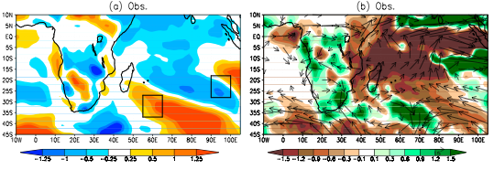
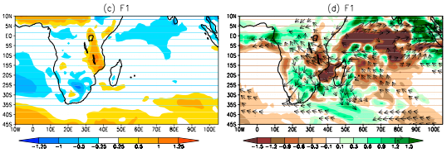
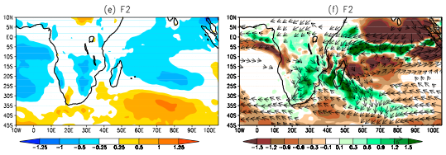

Slide 13
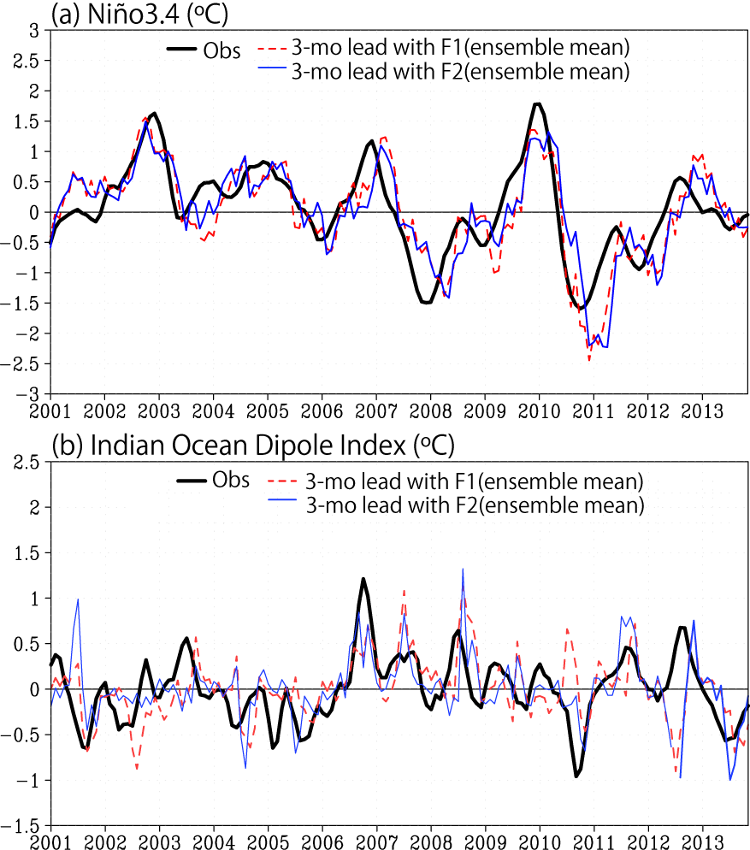


Nino3.4 & DMI predictions

Slide 14
SST-nudging initializatio v.s.
SST-nudging with 3DVAR correction
Current system (e.g. Prediction from May 1st, 2012 )
Forecast run
(free run)
SST-nudging run
(initialization)
1982.1.1
2012.4.30
2012.5.1
AGCM restart files
OGCM restart files
New system (e.g. Prediction from May 1st, 2012 )
SST-nudging run with 3DVAR correction
(initialization)
Forecast run
(free run)
1982.1.1
1982.1.31
1982.2.1
3.1
4.1
2012.4.1
2012.5.1
AGCM restart files
SST-
nudging
SST-
nudging
SST-
nudging
OGCM restart files
EN4 T/S
3D profile data
New OGCM restart files
3DVAR
3DVAR correction
every 1st date
of each month
FGAT window size: 10days
3DVAR correction

Slide 15
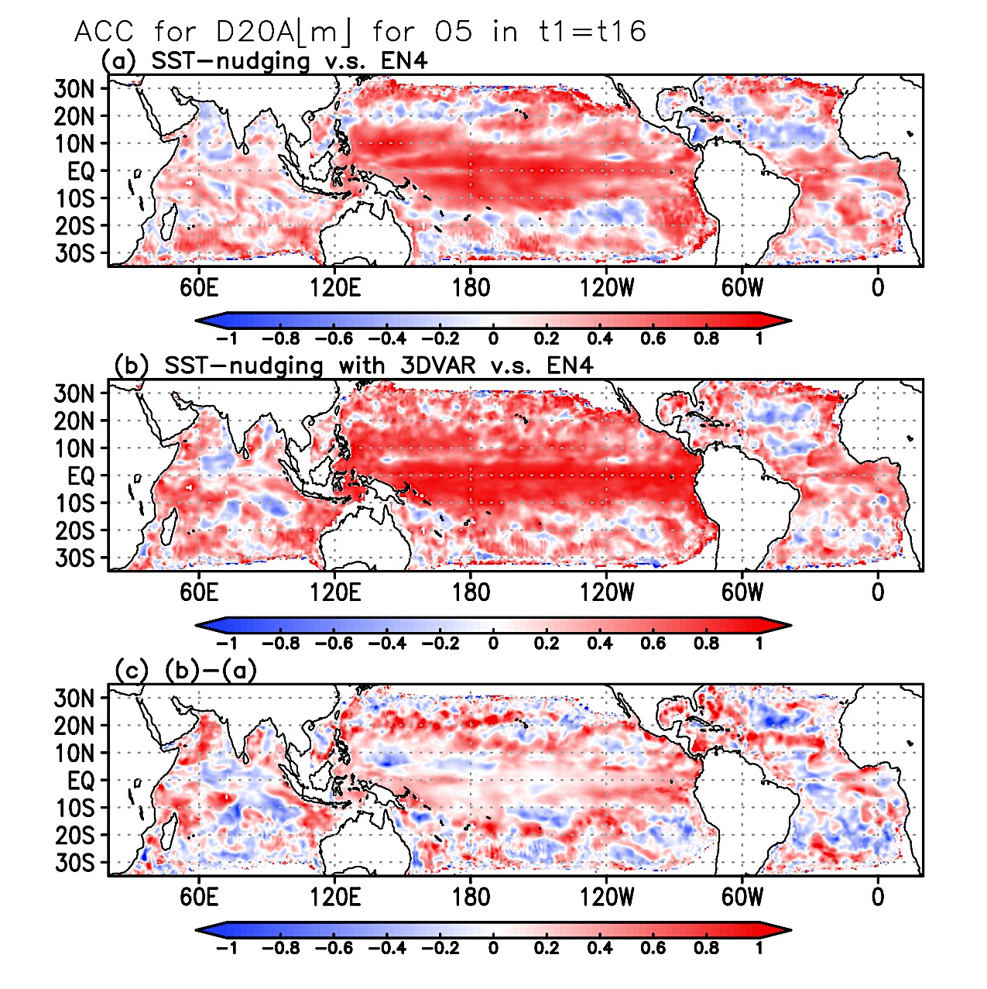
ACC for D20A in 1983-1997 (May)
May: the preconditioning season for IOD

