Slide 1
Current Issues and Challenges in Ensemble Forecasting
Junichi Ishida (JMA) and Carolyn Reynolds (NRL)
With contributions from WGNE members
31th WGNE
Pretoria, South Africa, 26-29 April 2016
Recent trends in ensemble-related research
Continued improvements in global EPS
High-resolution ensembles (issues, improvements)
Impact-driven products
Tropical cyclone ensembles
Overview of plans

Slide 2
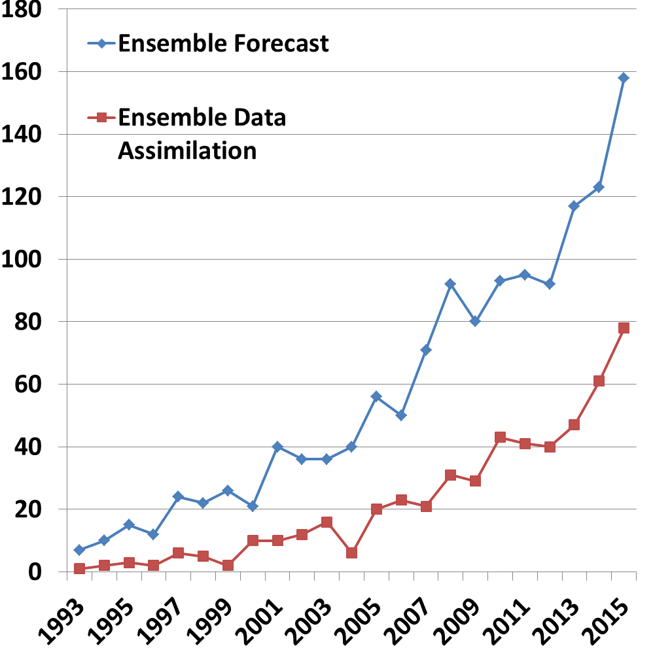
Number of Article/Year with These Words in the Abstract*
Research in ensemble forecasting and ensemble data assimilation continues its steady climb.
*AMS journals only

Slide 3
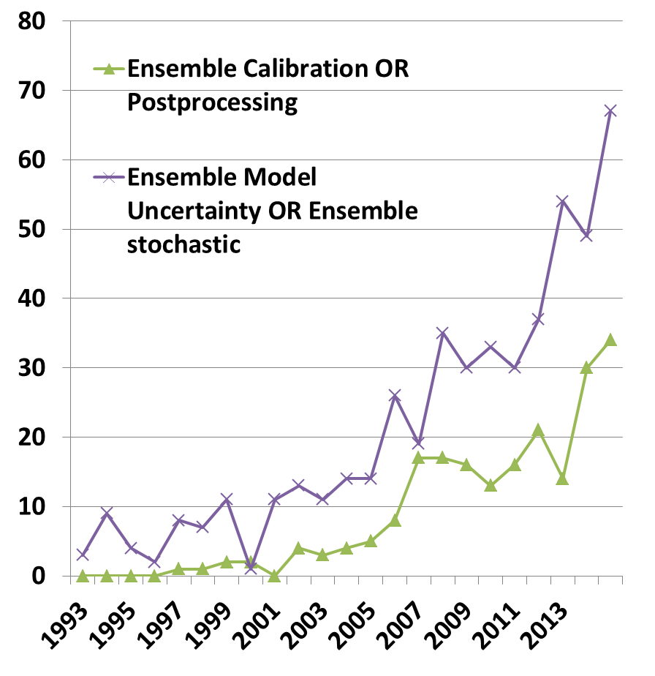
Number of Article/Year with These Words in the Abstract*
Research in model uncertainty continues to grow rapidly.
Interest in calibration and post-processing also substantially larger than in the early 2000s.
*AMS journals only

Slide 4
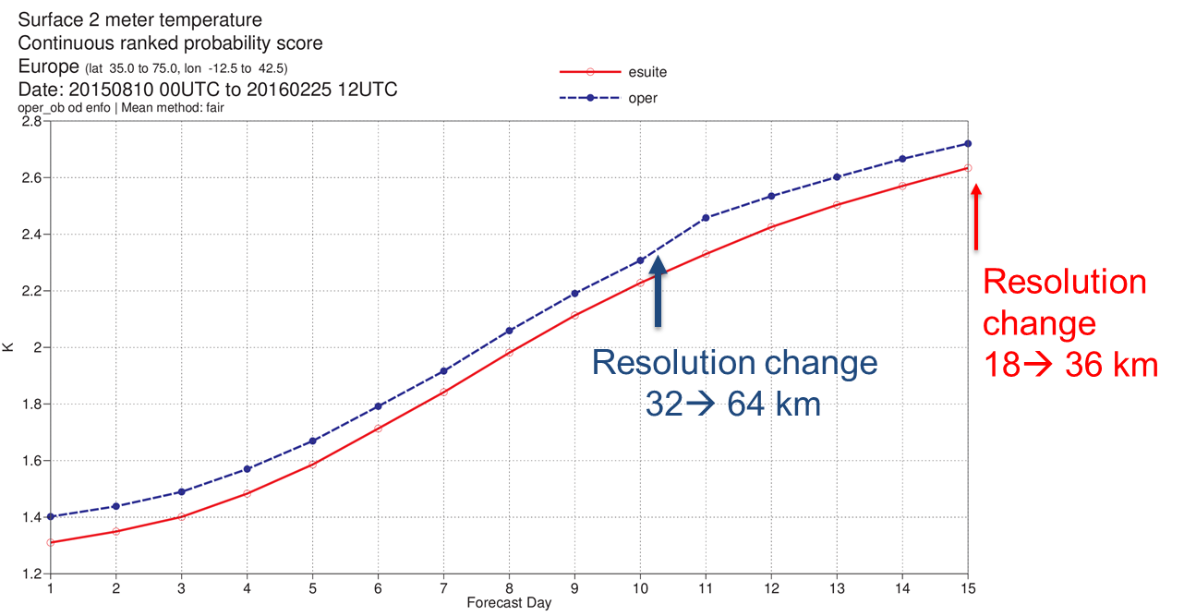
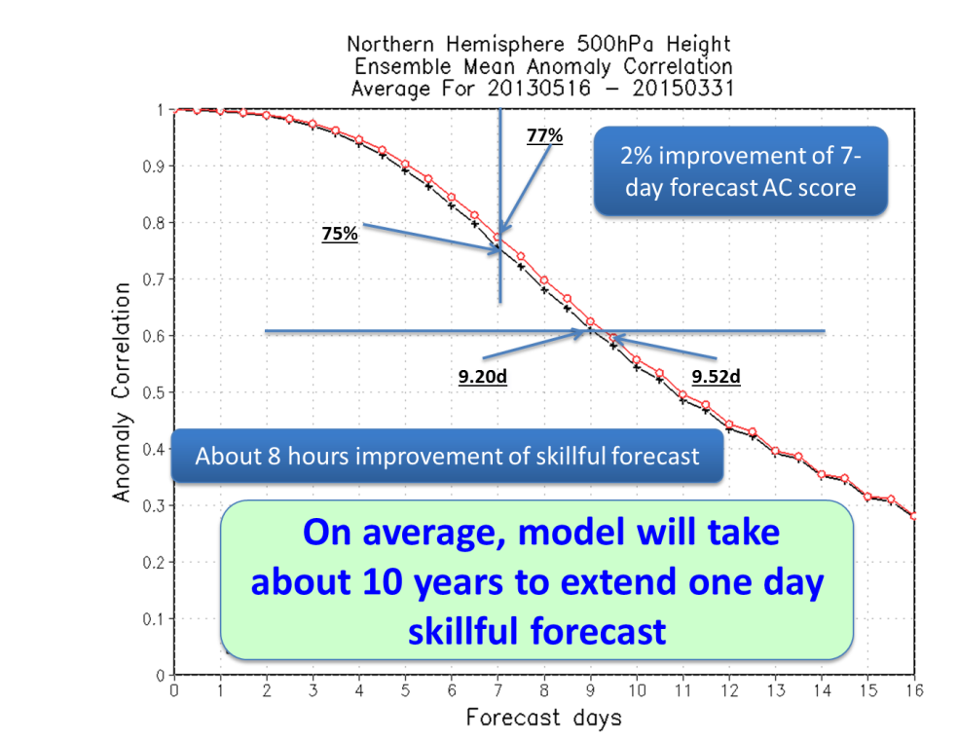
Continued Improvement in Global EPS
ECMWF: 2-m T over Europe: Impact of resolution upgrade
NCEP: 500-hPa AC impact from latest model and resolution upgrades, shift from ETR to EnKF based initial perturbations.

Slide 5
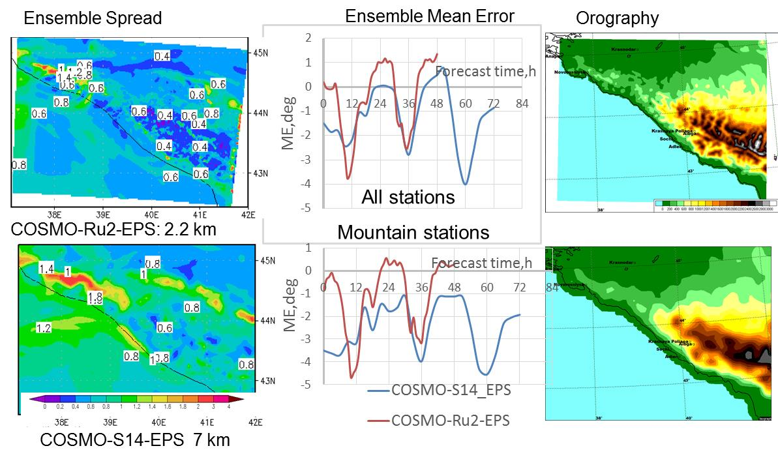

High Resolution Ensembles
ROSHYDROMET: Sensitivity of 2-m T to resolution
Understanding why spread is so small in regions of higher topography may help in reducing under-dispersion problem.
Notes:
Case-study. The spread for COSMO-Ru2-EPS is clearly smaller than for COSMO-S14-EPS.
It’s also so if averaged over a month. The spread pattern reflects the orography pattern with more details for higher-resolution EPS.
It’s suggested that finding the reason for this behavior can help to increase the spread in the convection-resolving system
(The majority of convection-resolving systems are underdispersive, especially for T2m)

Slide 6
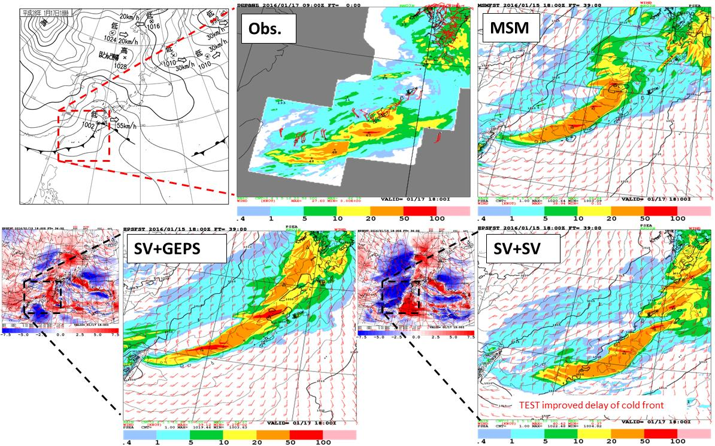
High Resolution Ensembles
JMA: More consistency between initial and lateral boundary conditions improves performance (including timing of front, below).
Notes:
・MSMは寒冷前線の進行が遅い
・2実験間では側面境界摂動が異なり、摂動の構造がかなり異なる。
SV+SVでは寒冷前線の後面の寒気移流を強める摂動だが（右図）
SV+GEPSでは側面境界摂動によって、寒気移流が強まっていない
【補足】
・摂動の図は前スライドのFT=39と同じです（ともにメンバー06）。
･低気圧中心から朝鮮半島にのびる気圧の谷は、両実験とも予報では低気圧を作ってしまっているため、南西諸島にしぼりました。

Slide 7

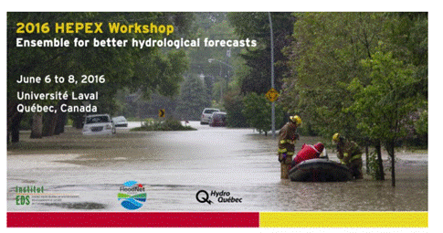
Impact-driven Products
calibration of ensemble output, focus on severe weather event forecast;
deterministic and probabilistic methods for prediction of fog and thunderstorm;
predictability of severe weather events in an ensemble forecast framework;
evaluation of the impact of the different components of an ensemble system on the prediction of the severe weather phenomena, focusing on the representation of the model errors and surface uncertainties﻿.
Focus on post-processing approaches and downscaling of atmospheric ensemble forecasts, community multimodel endeavors, hydrologic DA (what and how), ensemble verification and value of predictions, post-processing of hydrological predictive distributions, uncertainty quantification and user acceptance, communication of forecast services and products, risk-based decision-making….

Slide 8
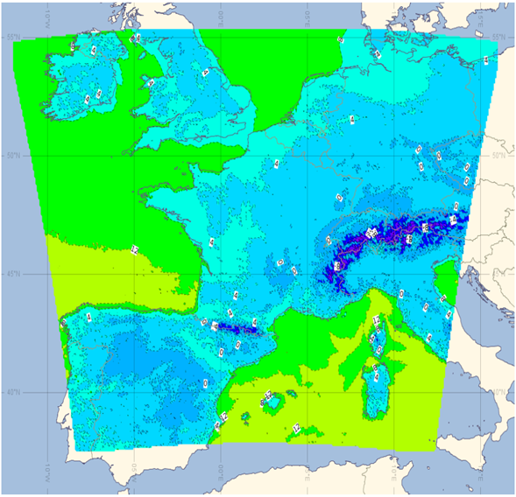
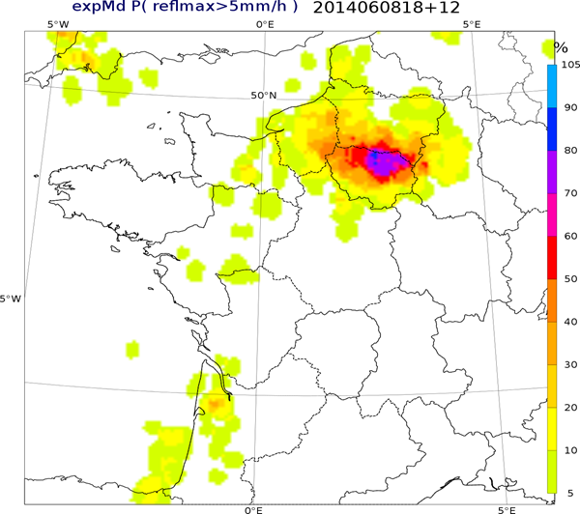
MetoFrance: Probability of Thunderstorm Occurrence (12-h range) from Arome-EPS (2.5 km)
New Products and Severe Weather
Probabilities of a convection severity index derived from the 3D hydrometeor fields in ensemble members
Arome-France EPS domain

Slide 9
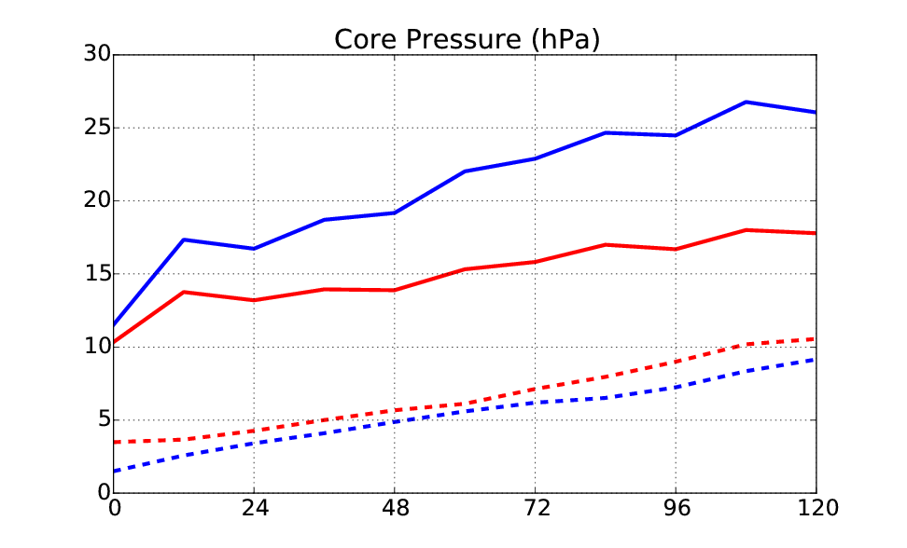
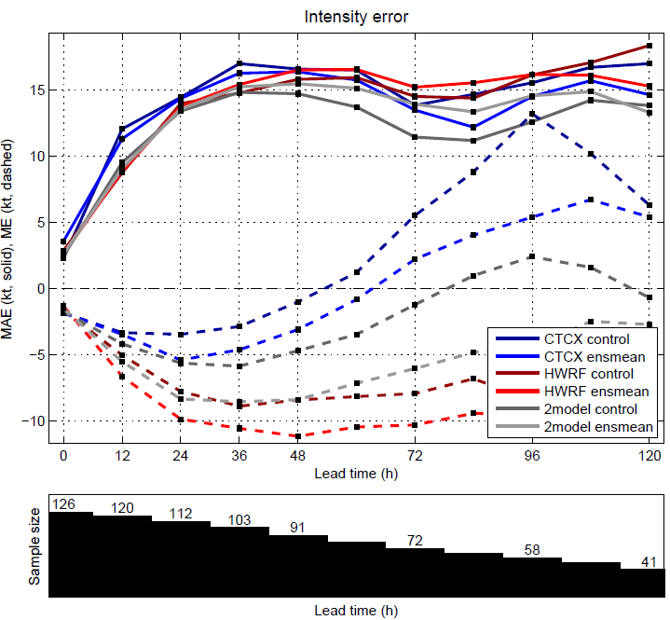
Tropical Cyclone Ensemble Forecasting
Blue : TL639
Red : TCo639
ECMWF increase in resolution substantial decreases intensity error (solid red line) and increases spread (dashed red line).
h
Intensity error (solid) & bias (dashed)
NOAA Hurricane Forecast Improvement Project 2015 Real-time Multi-model Ensemble: COAMPS-TC & HWRF combination outperforms the two individual models. Multi-models show promise, but more cases needed to better assess performance.
COAMPS-TC
HWRF
Combo COAMPS-TC & HWRF

Slide 10
PLANS (beyond increased resolution and # of members)
Improved initial conditions:
ROSHYDROMET: LETKF and 3d-VAR Hybrid
NCEP: EnKF replaced ETR
CPTEC: EnKF
ECMWF: Use ensemble of 4dVARs directly (no recentering)
Met Office: replace ETKF with En-4dENVar, convective scale ens. DA
NRL: Perturbed obs scheme in atmosphere and ocean
CMC: Validation package to test for expected statistical relationships, incremental updates replacing digital filter
Improved Model Uncertainty
NCEP: (SKEB, SPPT, SHUM)
MeteoFrance: extend stochastic physics
ECMWF: Revision of SPPT scheme, physically consistent tendency perturbations, consistent at all time ranges.
Met Office: Upgrades to random parameters

Slide 11
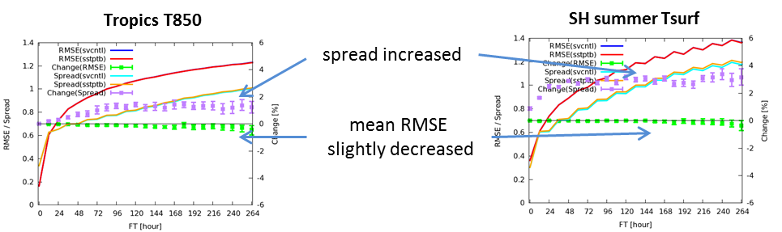
PLANS (beyond increased resolution and # of members)
Improved lateral/lower boundary uncertainty
NCEP: Stochastic perturbed land surface
NRL: SST perturbations, SST diurnal cycle
MeteoFrance: Surface perturbations, new surface model (SURFEX)
JMA: consistent initial and lateral boundary perturbations
CPTEC: Use coupled Brazilian Earth System Model
ECMWF: resolution upgrade to NEO ocean model
Met Office: Coupled atmo. in all global configurations, parameter perturbations in JULES land surface model
JMA Representation of SST Uncertainty: Impact on atmospheric forecast

Slide 12
PLANS (beyond increased resolution and # of members)
Subseasonal to seasonal forecasting
NCEP extending GEFS to 45 days, coupling TBD
NRL testing global ensembles (NAVGEM-HYCOM-CICE)
ECMWF: Extending forecast range from 32 to 46 days
Met Office: increase hindcast members (also running decadal ensembles)
Workshop on Subseasonal Predictability: ECMWF 2-4 NOV 2015
Recommendations concerning representation of model uncertainty:
•Closer integration between development of model components and the stochastic parameterization;
•Need to explore the representation of uncertainty in ocean/sea-ice/land-surface
•Improved understanding of impact of stochastic parametrization on the model climate and modes of variability
•Exploit S2S to explore model uncertainty issues

Slide 13
Extra slides

Slide 14
(Paraphrased) Comments from Pieter Houtekamer (CMC)
1) Validation of the initial ensemble: Ideally, an ensemble prediction system would use a fully coherent simulation of the sources of error in the data assimilation and prediction system. A test suite will be developed for the EnKF system to confirm that expected statistical relations are respected. Will be developed using Python, may serve in system intercomparisons.
2) Length of the assimilation window: With increasing spatial resolution it may be necessary to reduce the length of the assimilation window. Issues are how to maintain balance and reduce model spin-up when a model run has been interrupted by data assimilation. Current R&D work in global and regional EnKF. Systems migrating to the use of incremental analysis update replacing digital filter. Compute analysis increments directly on the model grid.
3) Coupling with other forecasting systems: Parameters in a component system may be tuned to partly compensate for an error of unknown origin. Therefore improvement in one system can actually degrade the performance of a system coupled to it. R&D has to be performed in a big-science mode where various groups work tightly together to improve systems.

Slide 15
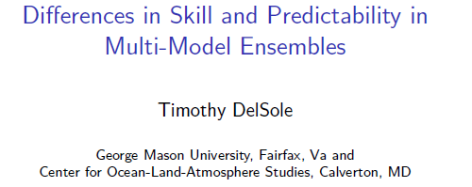
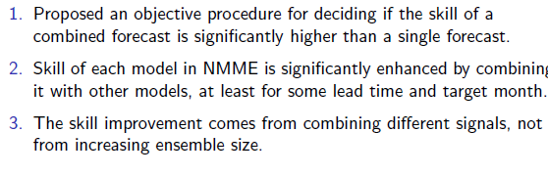
Number of multi-model ensembles are growing
Mesoscale: TIGGE-LAM, NOAA SREF, AEMET-SREPS, SESAR, CAPS, HFIP
Global 1-2 weeks: NAEFS, NUOPC, TIGGE, HIWPP, ICAP
Subseasonal to seasonal: NMME, DEMETER, S2S
Why do multi-model ensemble often outperform single model ensembles? Is the improvement in skill due to larger ensemble size or to combining signals? (extra slide)
International Conference on S2S prediction, 10-13 Feb 2014
How does one combine multi-model forecasts of unequal skill? Equal weights competitive with more complex schemes (DelSole et al. 2012, Sansom et al. 2013, …)
Tradeoffs between independence from multi-models vs. focusing resources on one system.
Issues of latency, data transfer reliability, etc.

