Slide 1
WGNE-31, 26th-29th April 2016, Pretoria
Deterministic (HRES) and ensemble (ENS) verification scores
by Nils Wedi, Martin Janousek, Linus Magnusson, Thomas Haiden, Sinead Duffy
wedi@ecmwf.int
European Centre for Medium Range Weather Forecasts

Slide 2
Outline
Global HRES( deterministic) and ENS (ensemble) scores evolution between 1998 – 2016
YOPP 2017 preparations – Arctic and Antarctic scores evolution
Reminder on ECMWF WMO Lead Centre activities for Deterministic Forecast NWP Verification (WMO-LCDNV)

Slide 3
HRES - Headline score Z500 Europe, time series of acc=0.8
12-month running mean
monthly
Europe
NHem

Slide 4
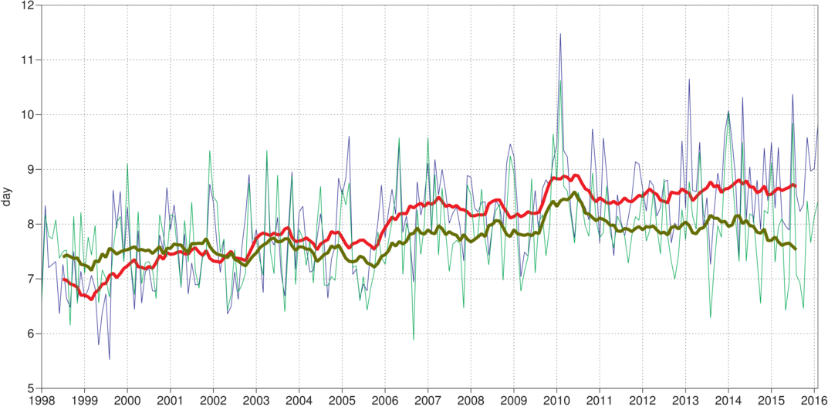
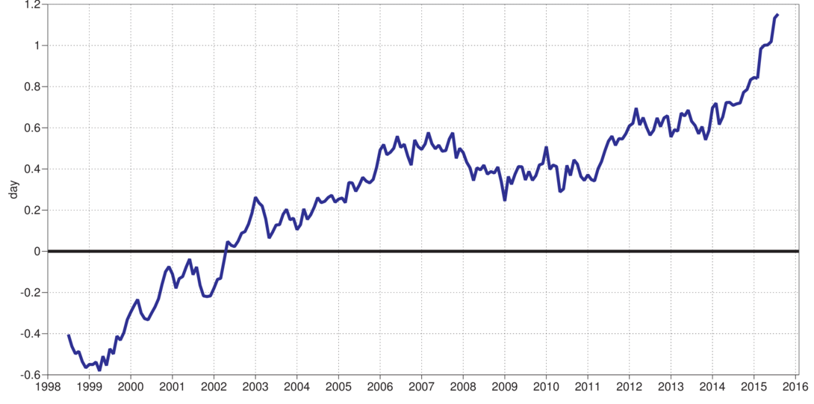
HRES verification against ERA-I Z500 time series of acc=0.8
HRES
ERA-I
difference

Slide 5
ENS - Headline probabilistic score, CRPSS, T850 Europe
Europe
Day at which skill
score reaches 25%
NHem

Slide 6
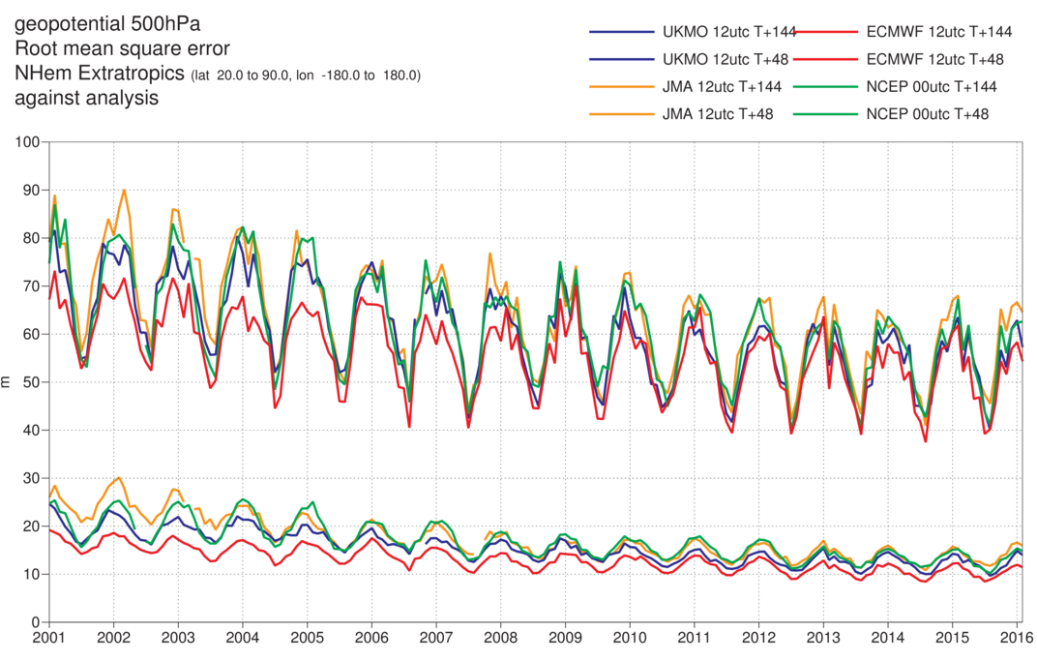
HRES - WMO scores Z500 NHem

Slide 7
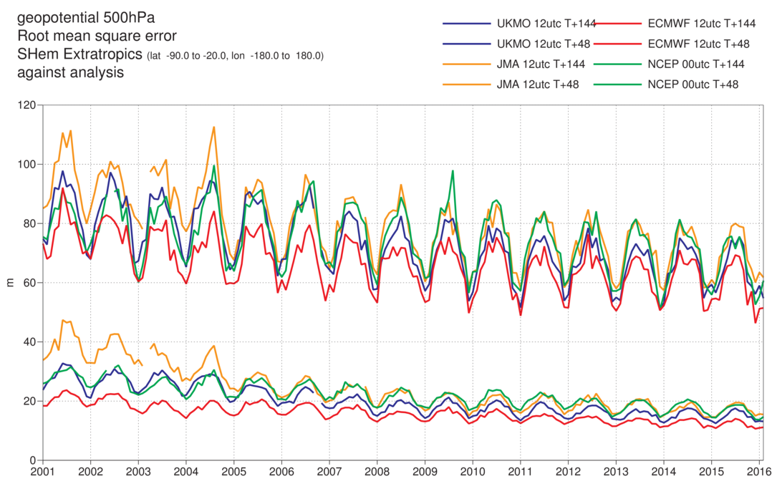
HRES - WMO scores Z500 SHem

Slide 8
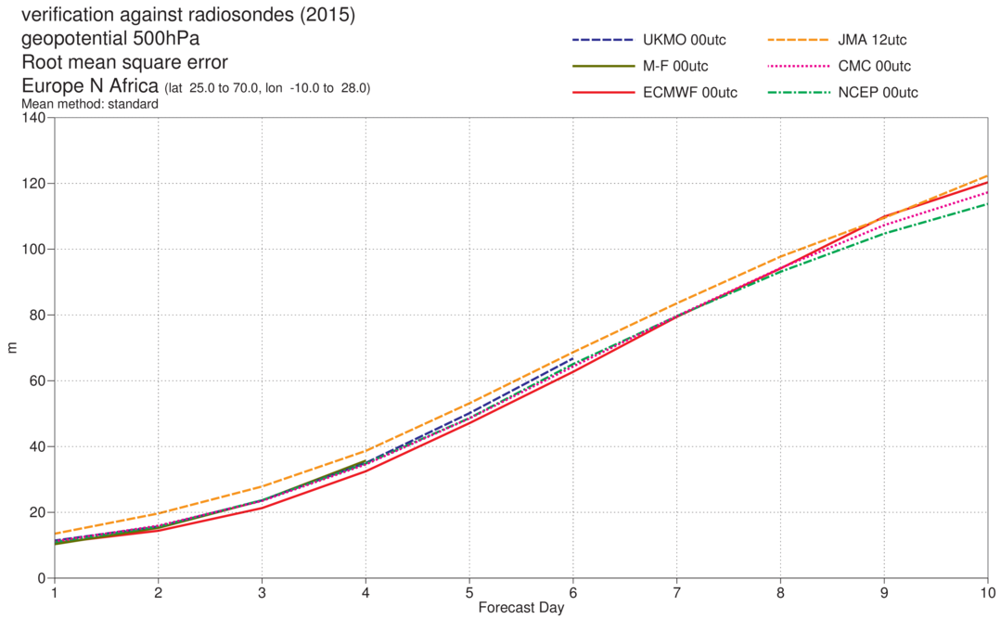
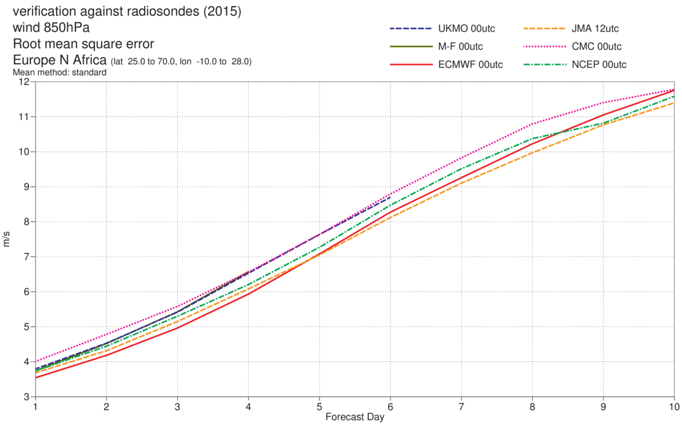
HRES - WMO scores against radiosondes, Z500 and wind850 over Europe, 2015
Z500
T850

Slide 9
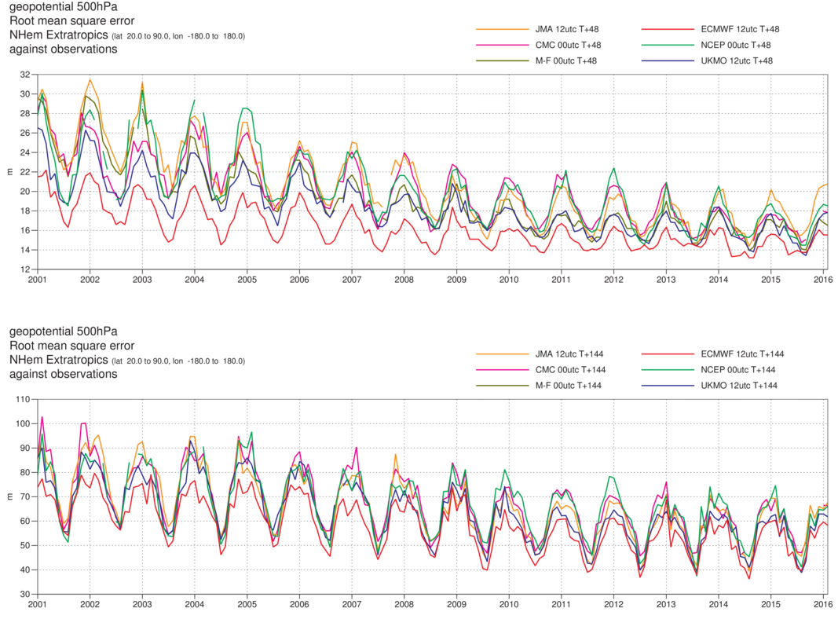
HRES - verification against observations, Z500, NHem
Day 2
Day 6

Slide 10
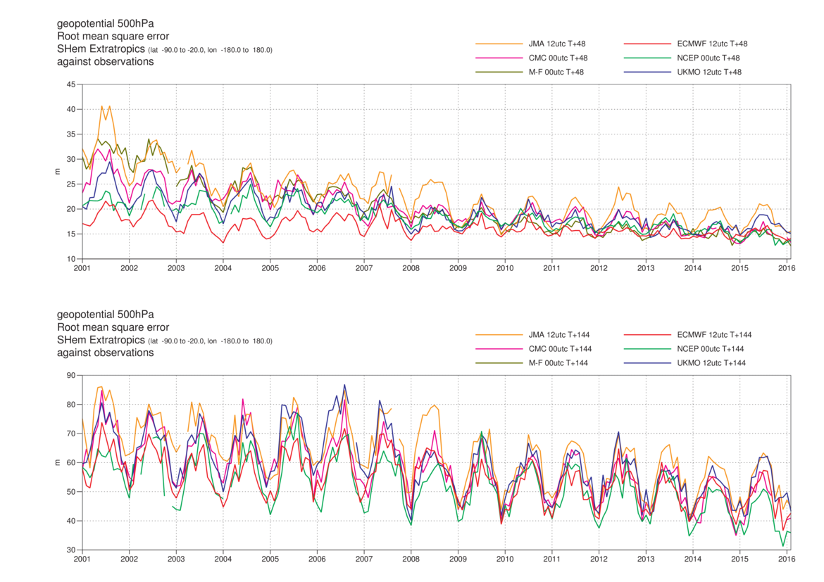
HRES - verification against observations, Z500, SHem
Day 2
Day 6

Slide 11
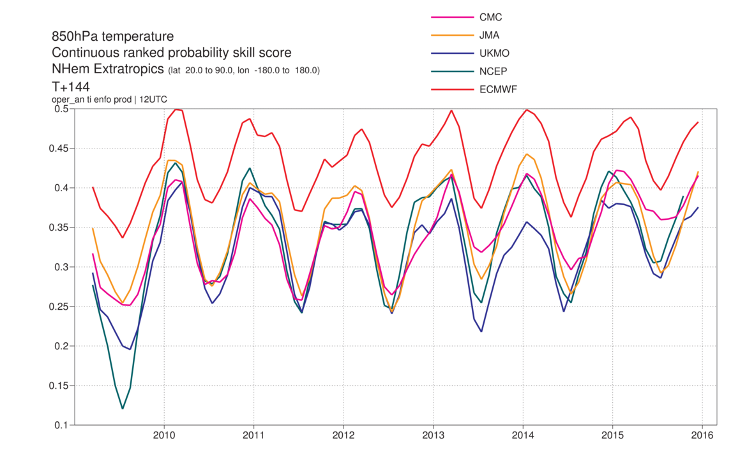
ENS - CRPSS, T850, NHem, day 6

Slide 12
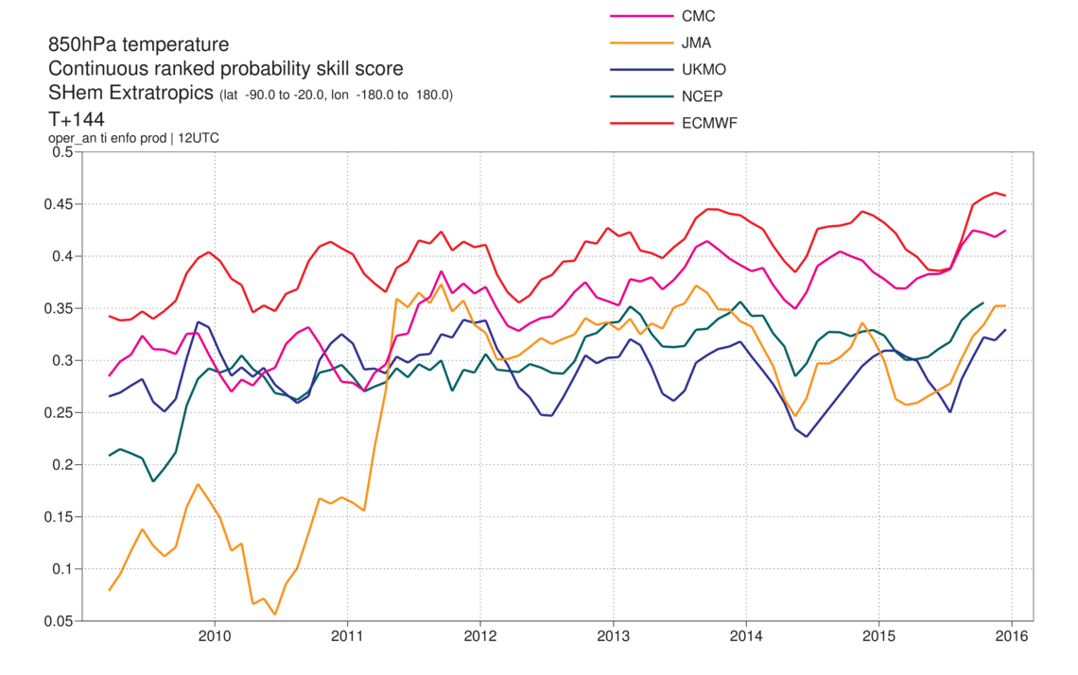
ENS - CRPSS, T850, SHem, day 6

Slide 13
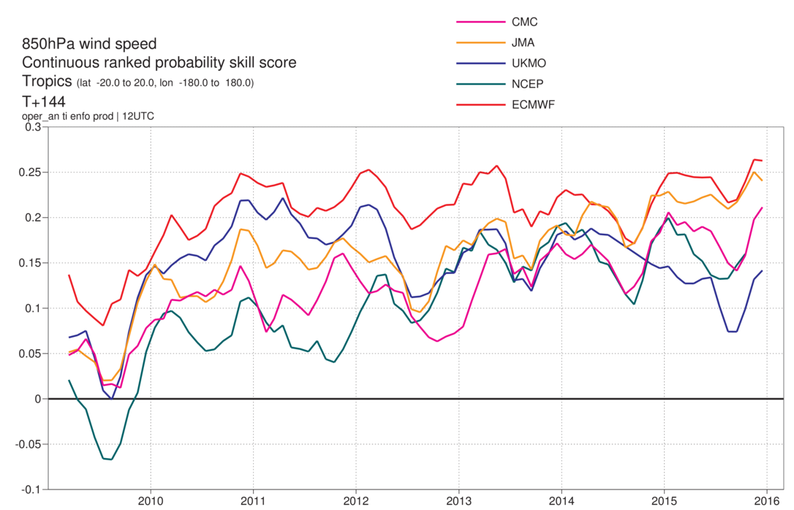
ENS - CRPSS, T850, Tropics, day 6

Slide 14
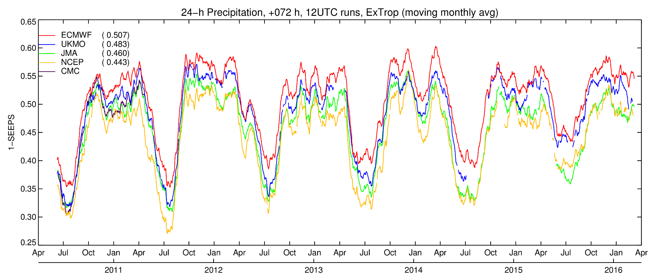
HRES – 24h precipitation forecasts, day 3, SEEPS
Symmetric Equitable Error in Probability Space (SEEPS)
14
Notes:
Model intercomparison for T+72 in the extra-tropics using SEEPS. ECMWF leading, with UKMO second. Temporal evolution dominated by strong seasonal cycle in skill.

Slide 15
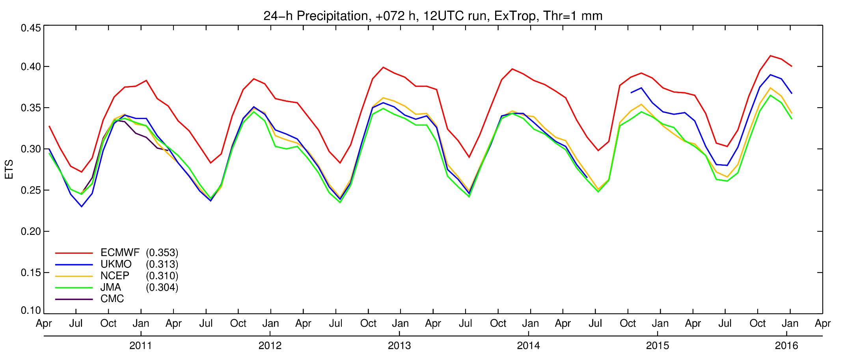
HRES - 24h precipitation forecasts, day 3, ETS
Equitable Threat Score (ETS)
15
Notes:
Model intercomparison for T+72 in the extra-tropics using ETS for a low threshold of 1 mm. Recent increases in skill partly due to improved light precipitation forecast due to microphysics changes.

Slide 16
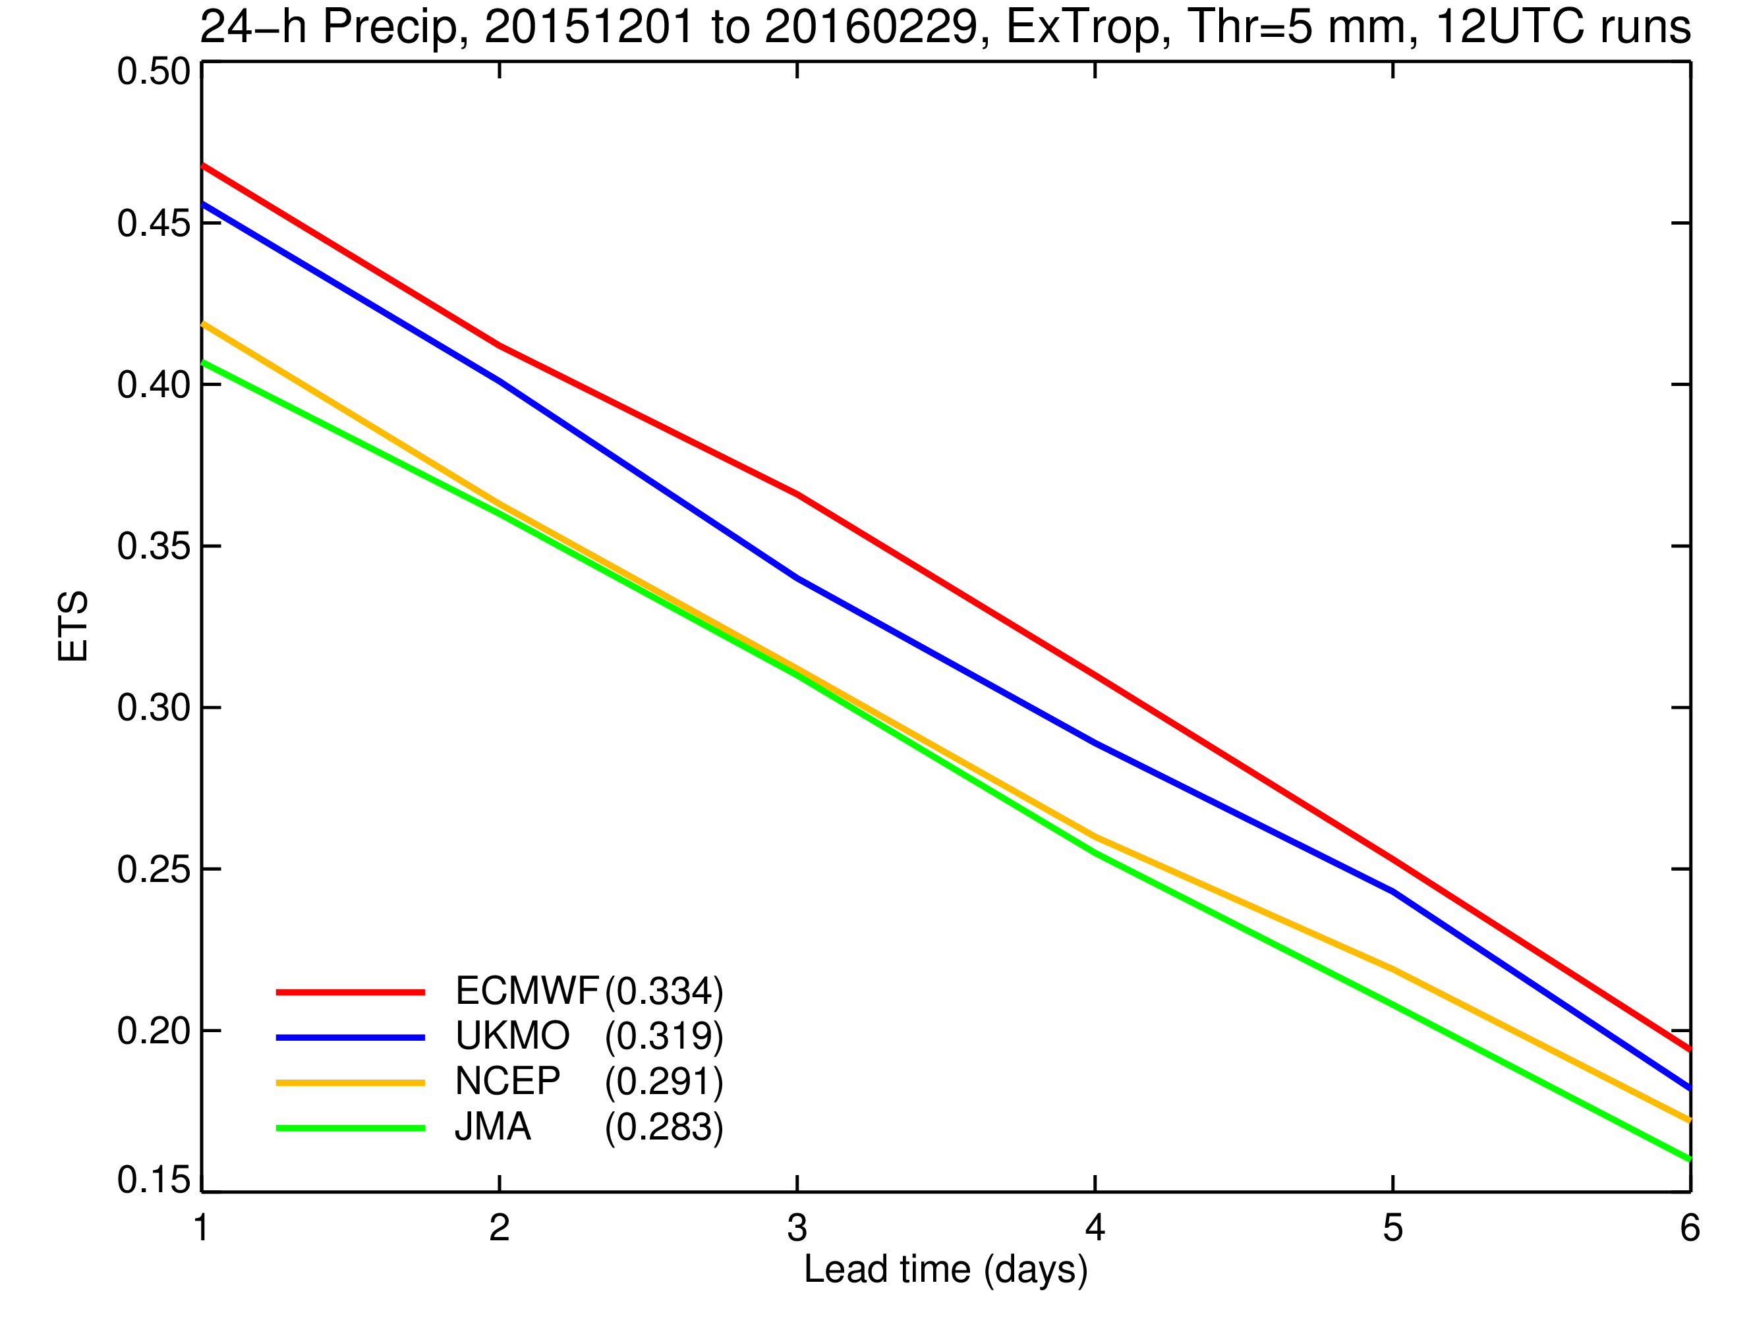
HRES - 24 precipitation forecasts, ETS against lead-time
Equitable Threat Score (ETS)
16
Notes:
The ETS for a higher threshold of 5 mm in the extra-tropics, showing dependence on lead time.

Slide 17
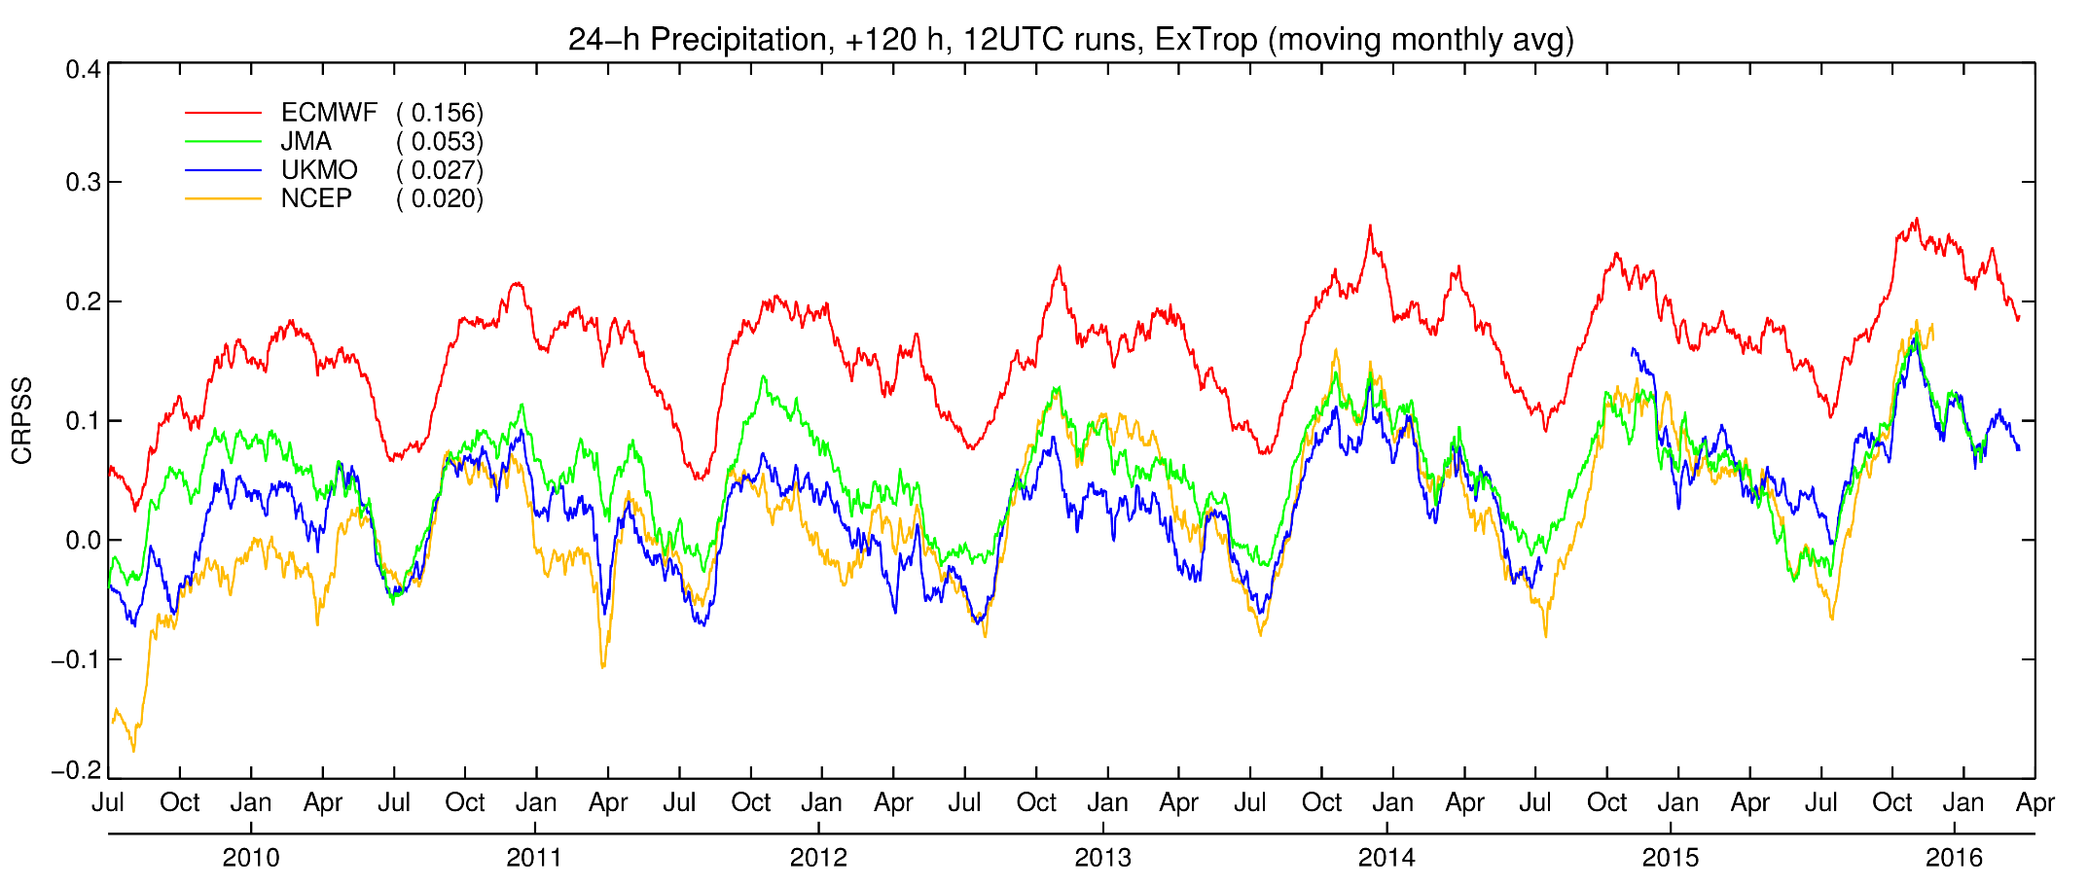
ENS – 24h precipitation forecasts, CRPSS, day 5
Continuous Rank Probability Skill Score (CRPSS)
17
Notes:
CRPSS evolution at T+120 in the extra-tropics for different centres. Overall improvement for all, with ECMWF leading by a good margin.

Slide 18
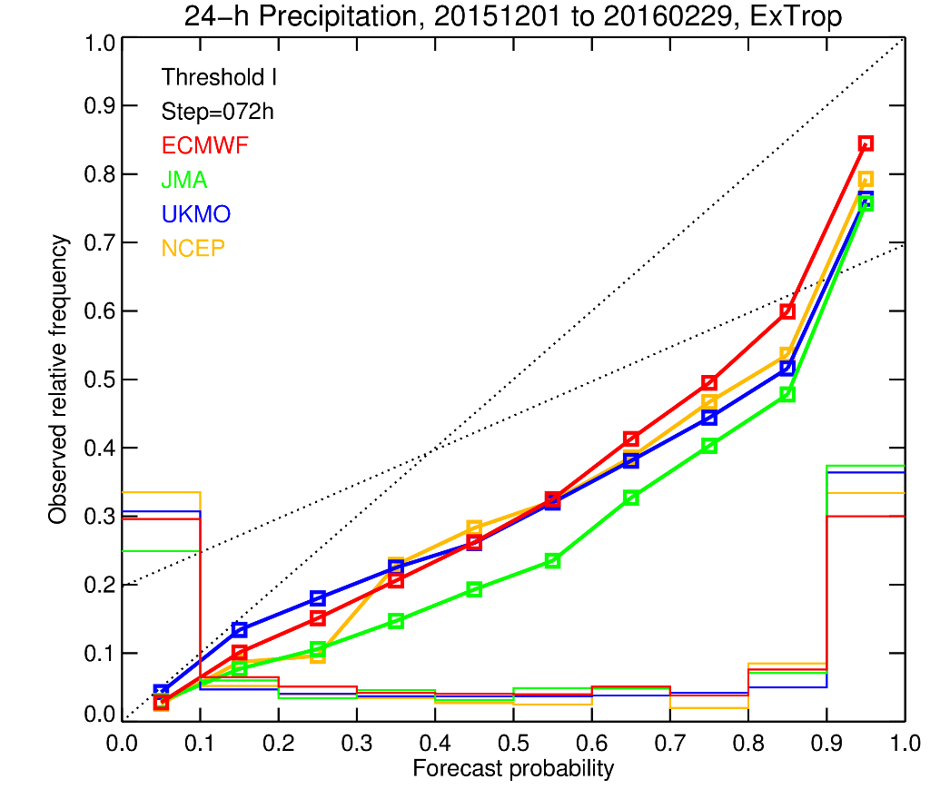
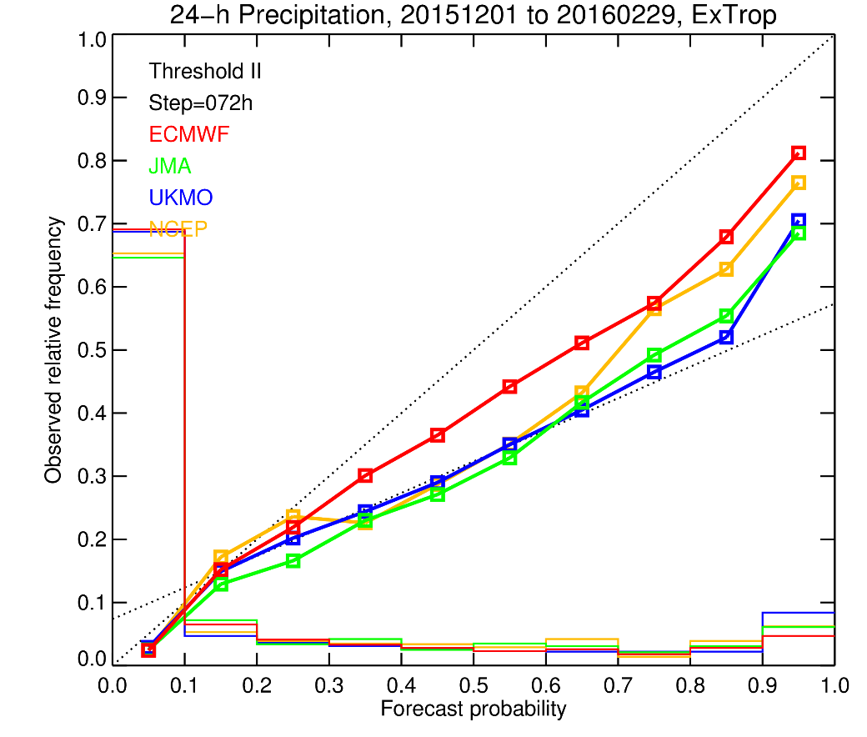
ENS – 24h precipitation forecasts, BSS, day 3, DJF 2016
Brier Skill Score (BSS)
perfect reliability
no skill
Light precipitation little skill
Moderate-to-heavy precipitation over-confident
18
Notes:
Shows that the reliability of moderate to heavy precip is generally higher than the one for light precipitation. For light precipitation (>0.2 mm/24 h), ECMWF is similar to other centres, for heavier precip it is leading.
Thresholds used in the rhs plot are different at each station, depending on the station climate, typically 5-10 mm.

Slide 19
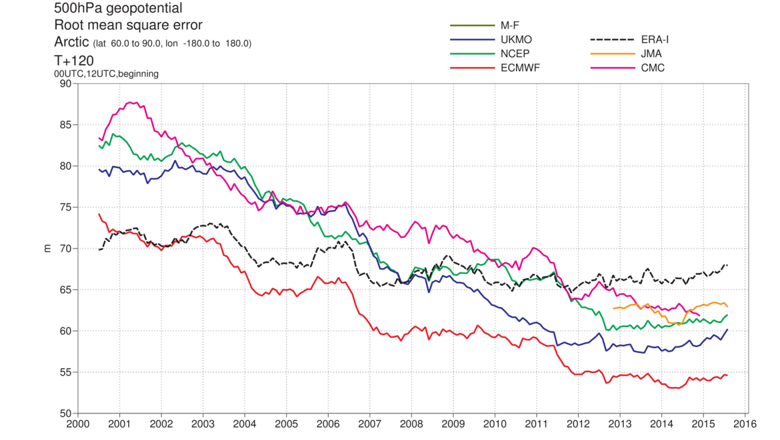
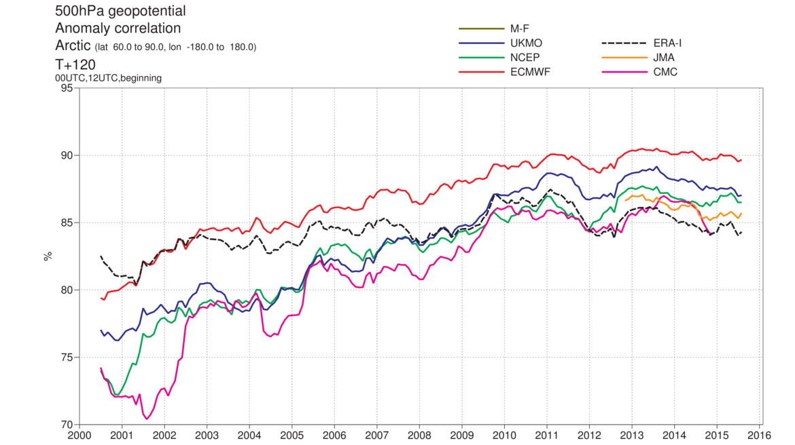
Preparing for the
Year Of Polar Prediction
Arctic scores
Day 5

Slide 20
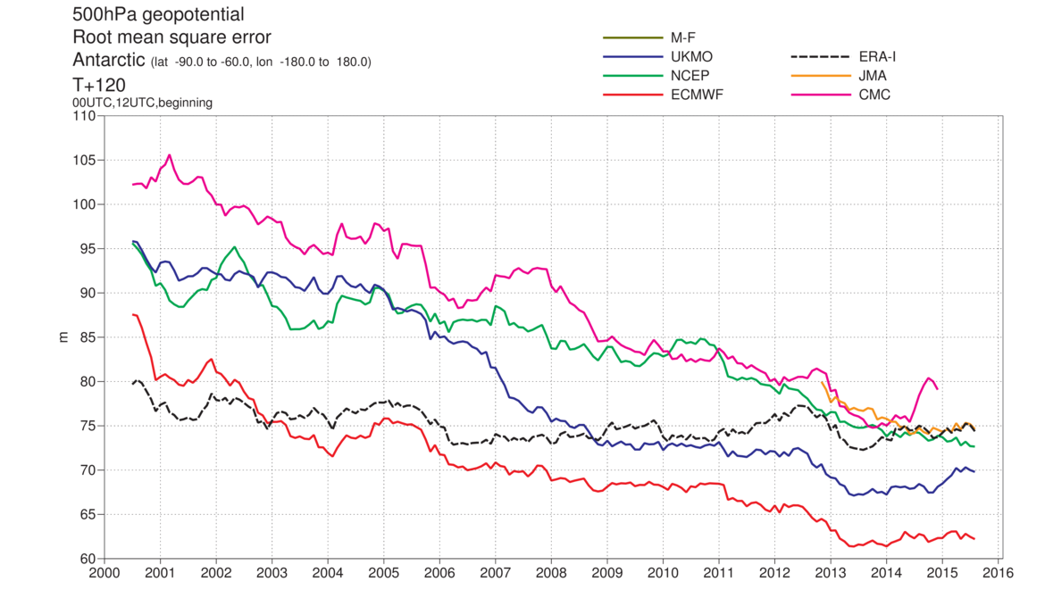
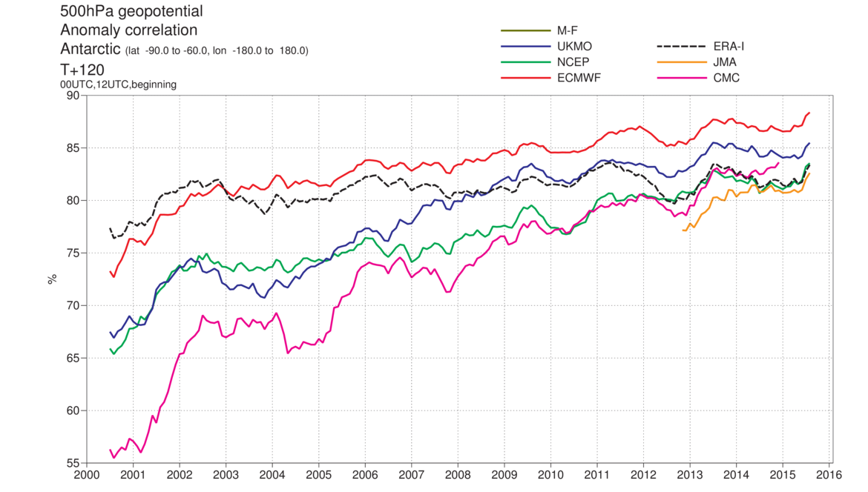
Preparing for the
Year Of Polar Prediction
Antarctic scores
Day 5

Slide 21
Preparing for the
Year Of Polar Prediction
DJF 2016
Arctic
Antarctic

Slide 22
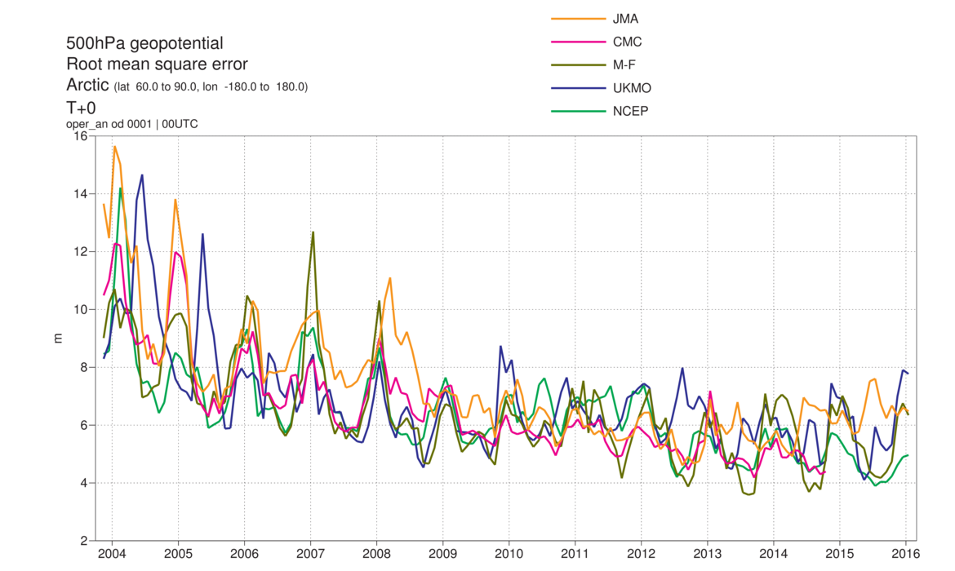
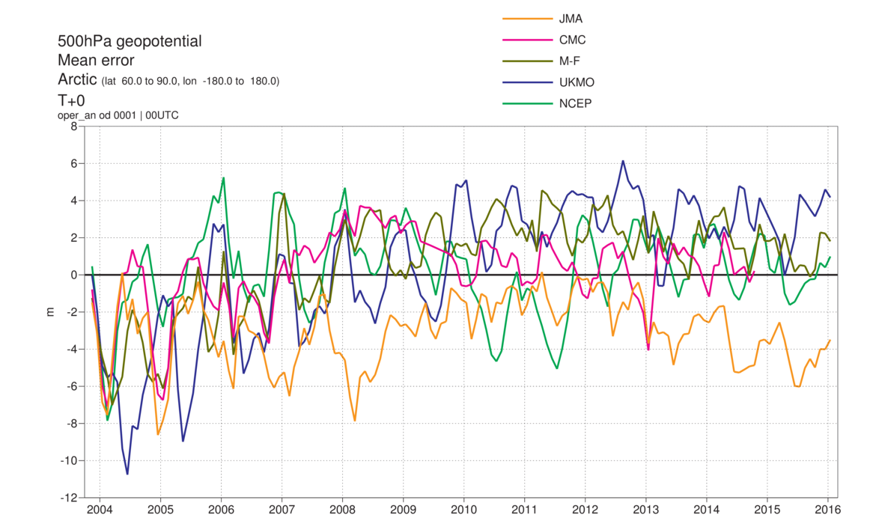
Arctic, Z500 analysis difference compared to ECMWF analysis
rms
mean error

Slide 23
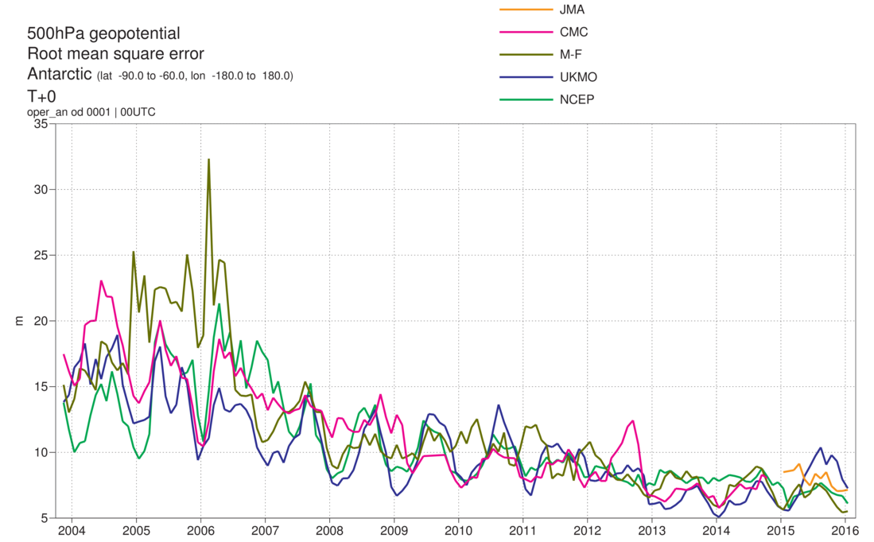
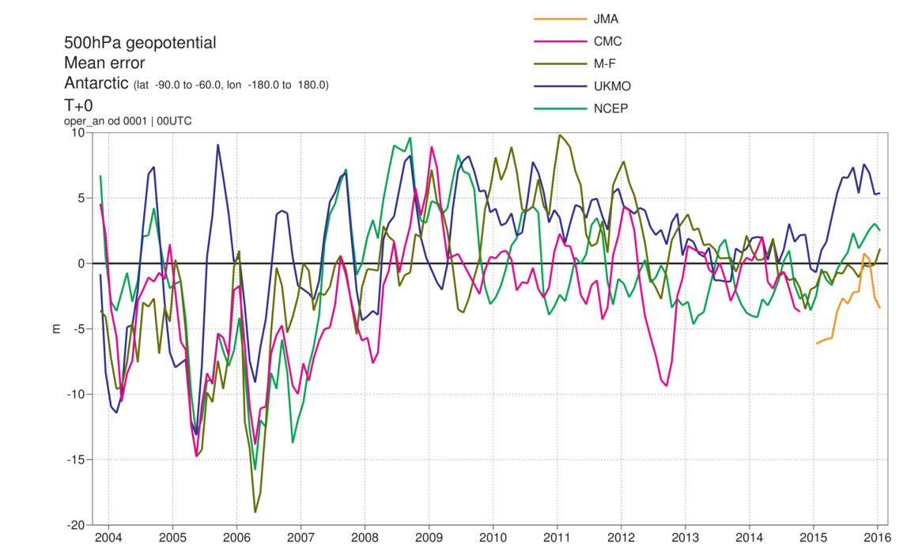
Antarctic, Z500 analysis difference compared to ECMWF analysis
rms
mean error

Slide 24
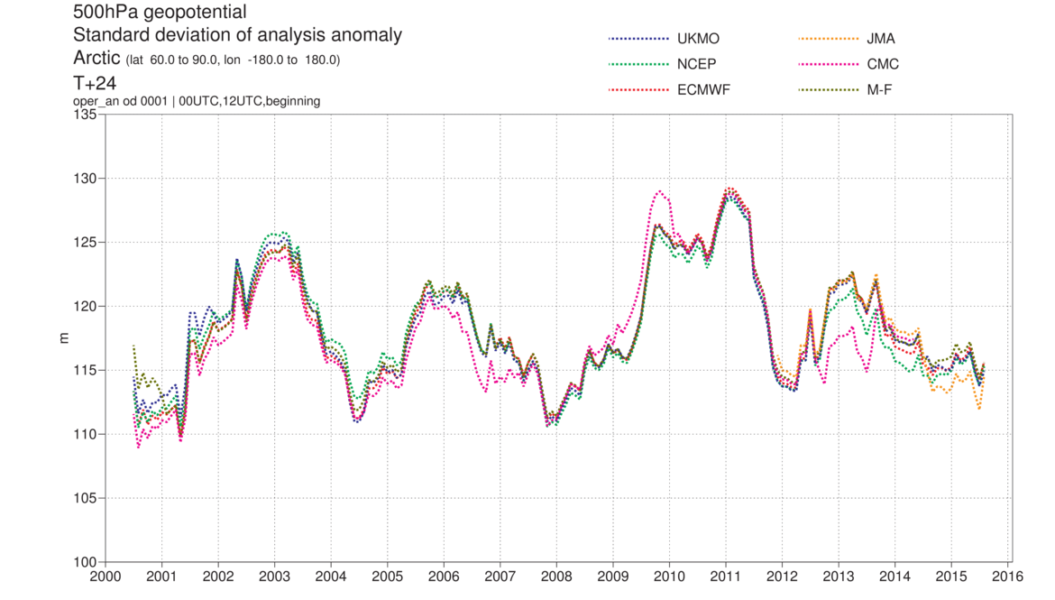
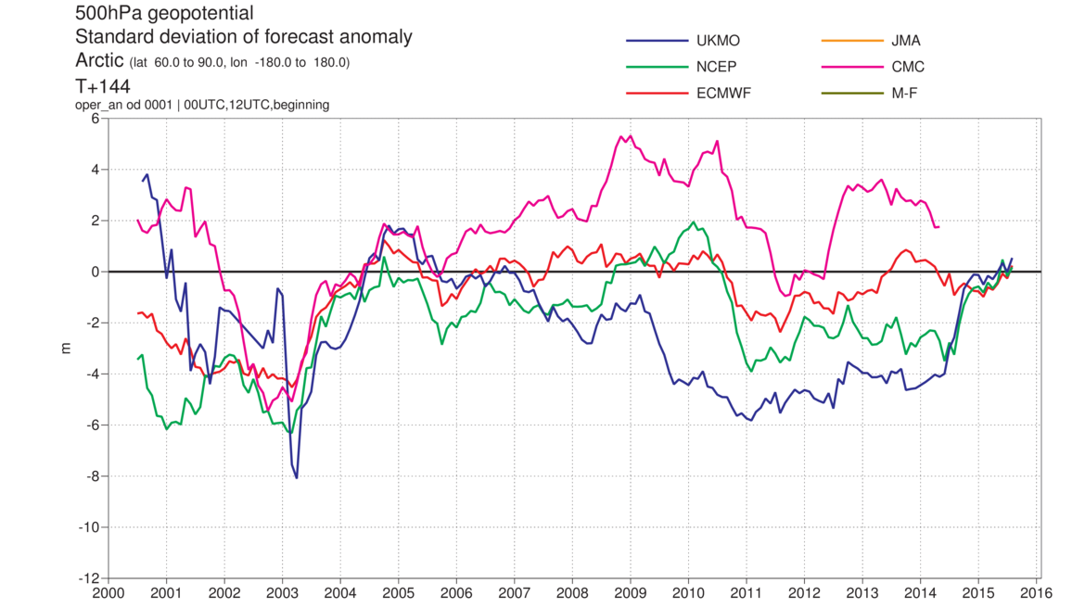
Arctic, analysis and model activity
gain
Difference of stdev of
forecast and analysis
anomalies
loss

Slide 25
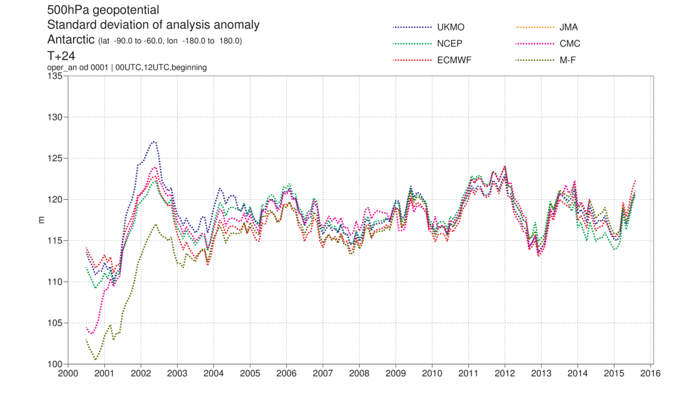
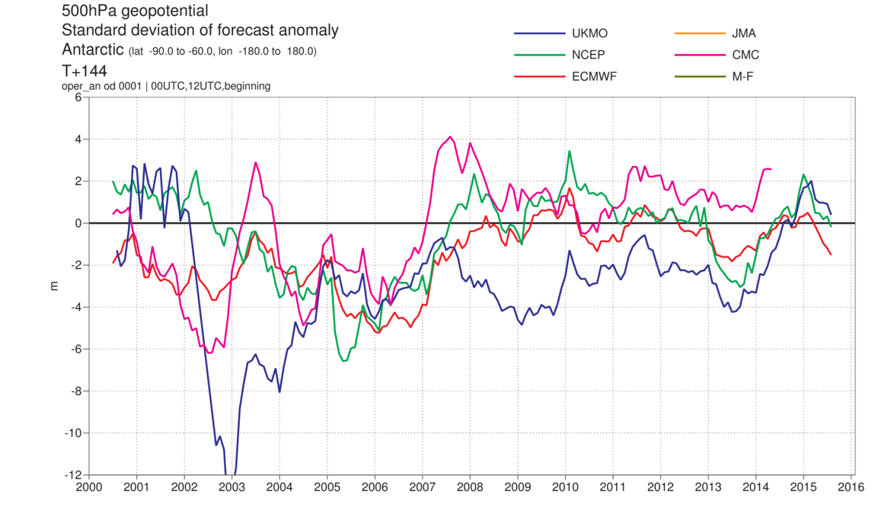
Antarctic, analysis and model activity
gain
Difference of stdev of
forecast and analysis
anomalies
loss

Slide 26
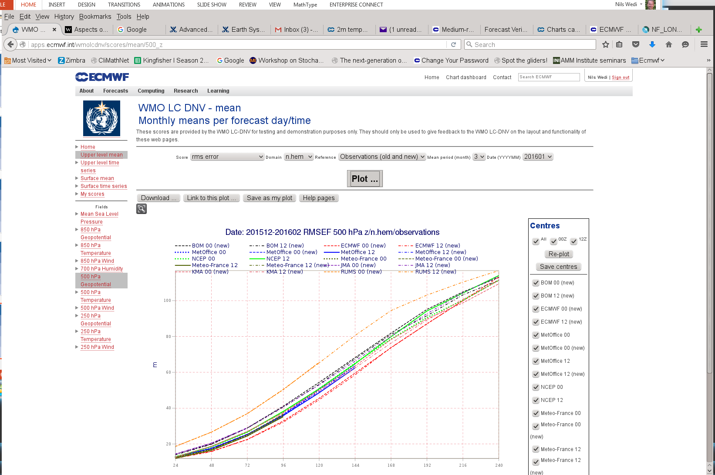
WMO Lead Centre for Deterministic Forecast NWP
Verification (WMO-LCDNV)
Please see http://apps.ecmwf.int/wmolcdnv/

Slide 27
Conclusions
Europe Era-Interim performance noted, not present for northern hemisphere.
CRPSS T850 positive (improvement) trend for several models in SHem, NHem constant, Europe big improvement at ECMWF in 2015
NCEP SHem lowest day 6 rms errors against observations in 2015, procedure, sampling or systematic ?
Moderate to heavy precipitation forecasts improved but over-confident precipitation forecasts common.
Notable differences in Arctic and Antarctic analyses.

Slide 28
Additional slides

Slide 29
Verification against SYNOP
Characteristics
- 24-h precipitation
- Forecast days 1 to 10
- Aggregation over large domains (extra-tropics, tropics, Europe)
Verification of HRES Forecasts
- Symmetric Equitable Error in Probability Space (SEEPS)
- Equitable Threat Score (ETS)
{ - Frequency bias (FB)
- Symmetric Extremal Dependence Index (SEDI) }(not shown)
Verification of ENS Forecasts
- Continuous Rank Probability Skill Score (CRPSS)
- Brier Skill Score (BSS)

Slide 30
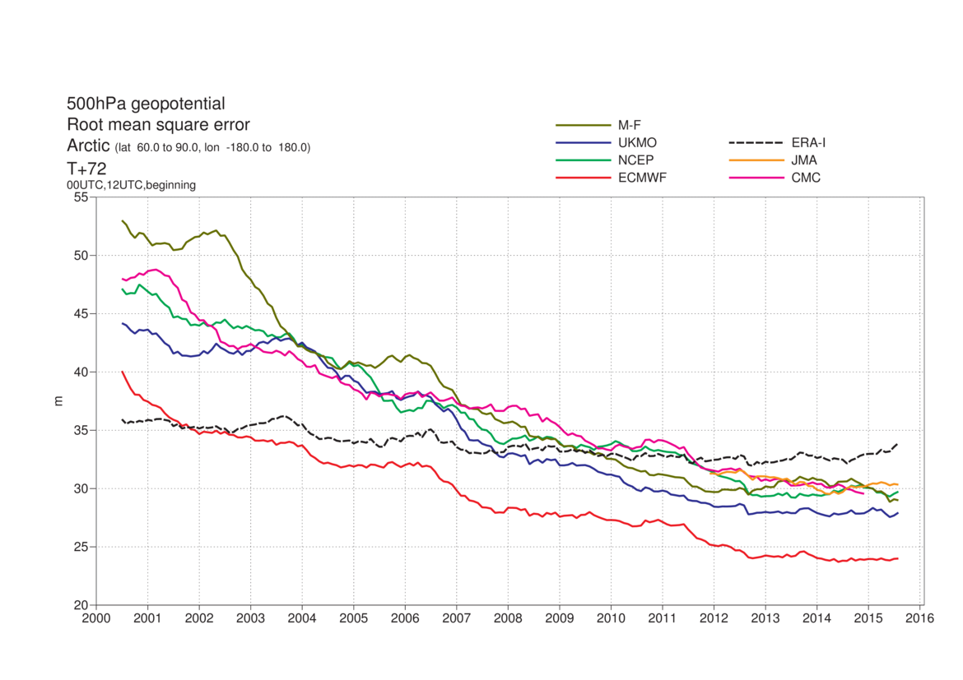
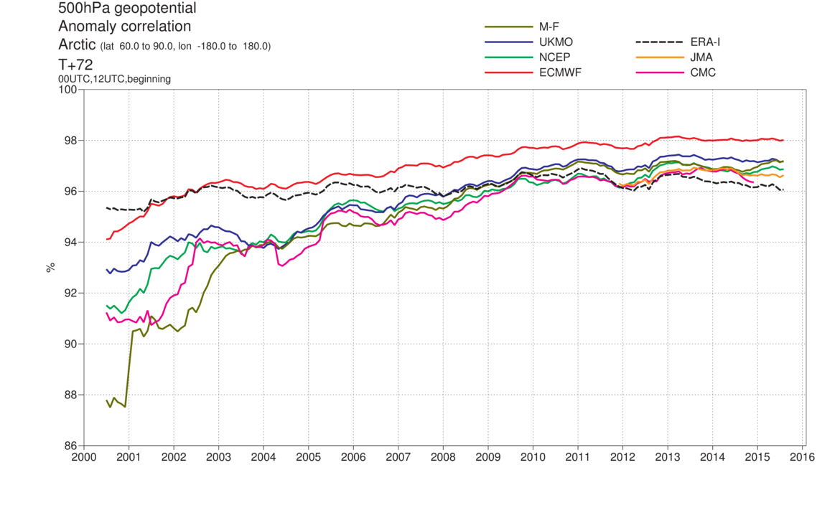
Preparing for the
Year Of Polar Prediction
Arctic scores
Day 3

Slide 31
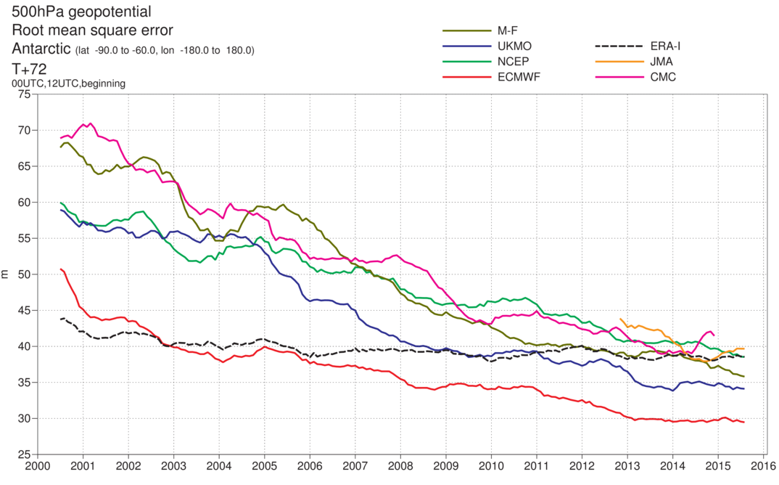
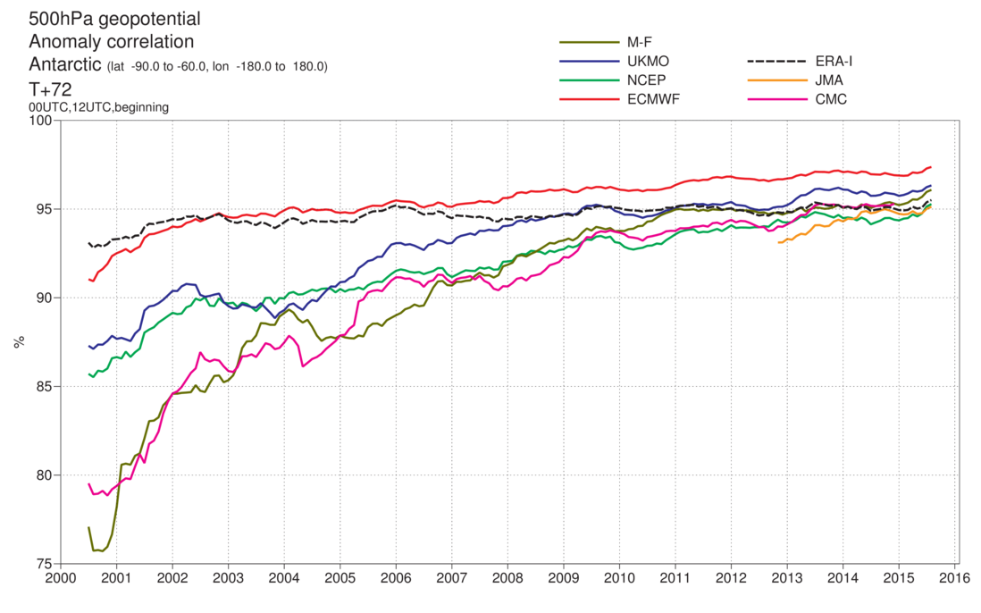
Preparing for the
Year Of Polar Prediction
Antarctic scores
Day 3

